Slide 1
Hypothesis Testing
Notes:
Hypothesis Test:
1.先猜后证：小概率事件发生的概率很低！
假设检验： 检验总体！

Slide 2
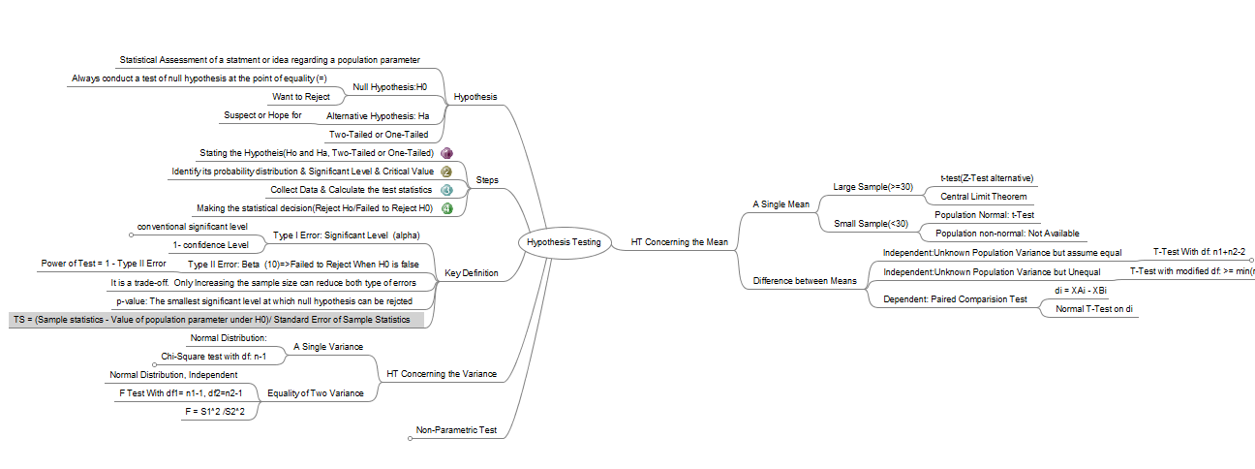
MindMap

Slide 3
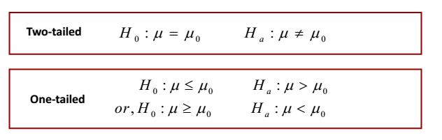
Hypothesis
Define Hypothesis
Statistical assessment of a statement or idea regarding a population parameter
Null Hypothesis: (Want to Reject, include “=“)
Alternative Hypothesis(Hope For)

Slide 4
Hypothesis-Example
1. Austin Roberts believes that the mean price of houses in the area is
greater the $145,000. the appropriate alternative hypothesis is:
A. Ha: μ< $145,000
B. Ha: μ ≥$145,000
C. Ha: μ> $145,000
➢ Answer: C
2. An analyst is conducting a hypothesis test to determine if the mean time
spent on investment research is different from three hours per day. The
appropriate null hypothesis for the described test is:
A. H0: μ= 3 hours, two-tailed test.
B. H0: μ= 3 hours, one-tailed test.
C. H0: μ ≥3 hours, two-tailed test.
➢ Answer: A

Slide 5
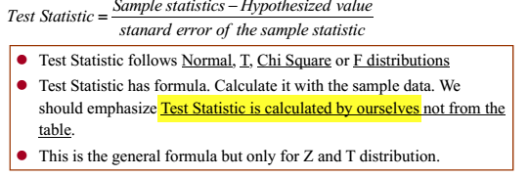



Key Concept(1)
Test Statistics:
Examples:

Slide 6
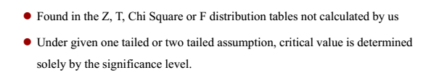
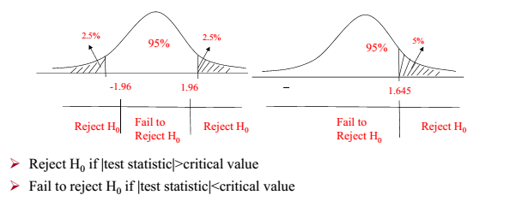
Key Concept(2)
Critical Value
Decision Rule: Critical Value Method

Slide 7
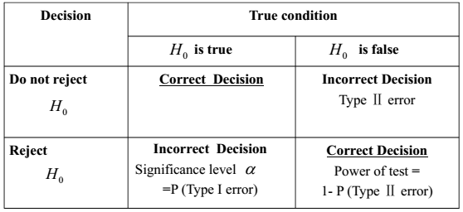
Key Concept(3)
Significant Level: α = Pr(Type I Error) = Pr( Ho=0 | Ho=1) = Pr(01)
Type II Error: β = Pr(Ho=1|Ho=0) = Pr(10)
Power of Test= 1- β = 1- P(Type II Error) = Pr(Ho=0 | Ho=0)
How to Reduce Both Error: Increase Sample Size
Type I Error ++, Type II Error --, Vice Versa

Slide 8

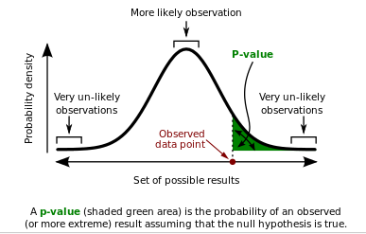
Key Concept(4)
P-Value:
It is the smallest level of significance at which Ho can be rejected
P < α , reject, otherwise failed to reject
P Smaller, Easier to Reject

Slide 9
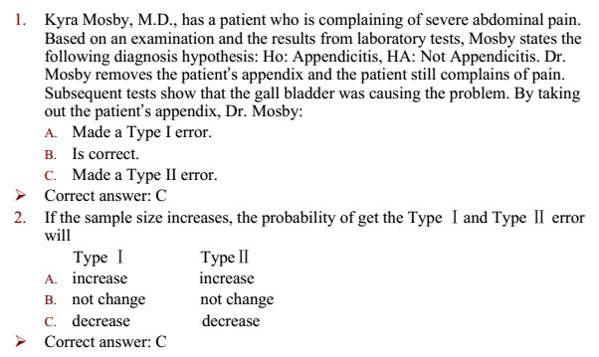
Key Concept- Example

Slide 10
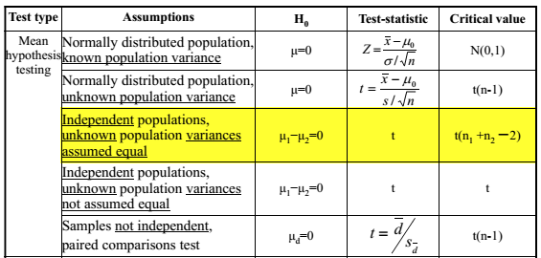
Mean Hypothesis Test(1)

Slide 11
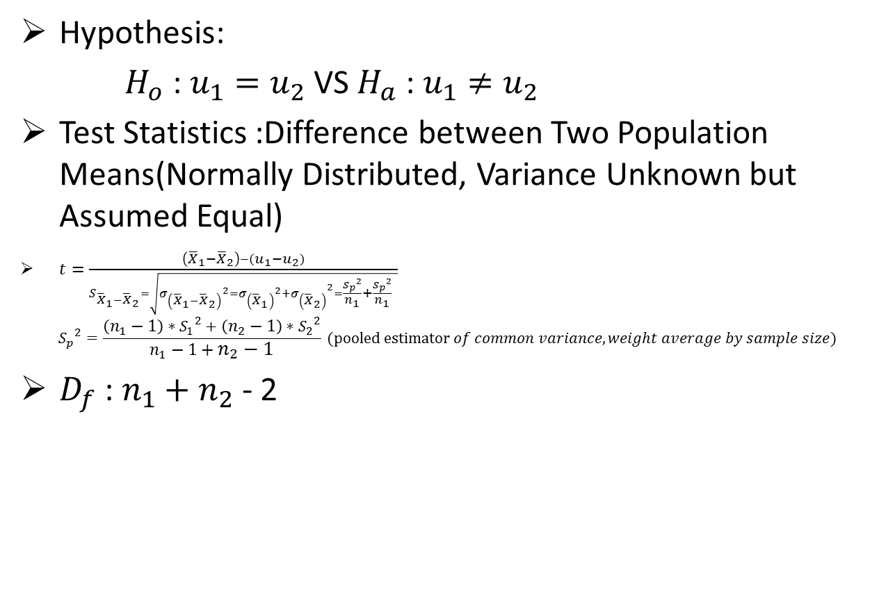
Mean Hypothesis Test(2)
Hypothesis:
$H_{o}$ : $u_{1}=u_{2}$ VS $H_{a}$ : $u_{1}≠u_{2}$
Test Statistics :Difference between Two Population Means(Normally Distributed, Variance Unknown but Assumed Equal)
$t=\frac{\left({\overline{X}}_{1}−{\overline{X}}_{2}\right)−\left(u_{1}−u_{2}\right)}{S_{{\overline{X}}_{1}−{\overline{X}}_{2}}=\sqrt{{σ_{\left({\overline{X}}_{1}−{\overline{X}}_{2}\right)}}^{2}={{{σ_{\left({\overline{X}}_{1}\right)}}^{2}+σ}_{\left({\overline{X}}_{2}\right)}}^{2}=\frac{{S_{p}}^{2}}{n_{1}}+\frac{{S_{p}}^{2}}{n_{1}} }}$
$${S_{p}}^{2}=\frac{\left(n_{1}−1\right)∗{S_{1}}^{2}+\left(n_{2}−1\right)∗{S_{2}}^{2}}{n_{1}−1+n_{2}−1} (pooled estimator of common variance, weight average by sample size)$$
$D_{f}$ : $n_{1}+n_{2}$ - 2

Slide 12

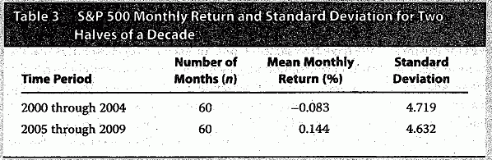
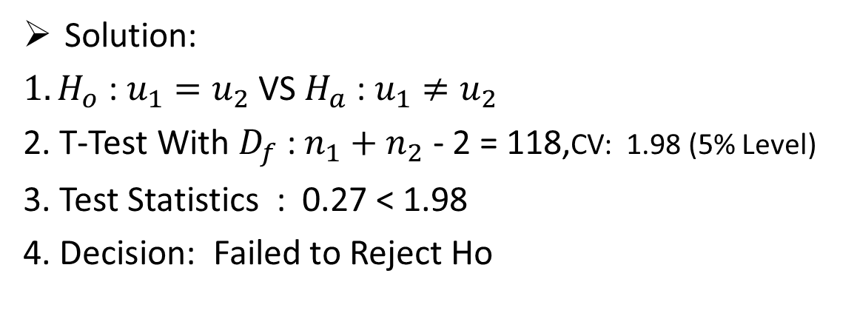
Mean Hypothesis Test Example
Solution:
$1.H_{o}$ : $u_{1}=u_{2}$ VS $H_{a}$ : $u_{1}≠u_{2}$
2. T-Test With $D_{f}$ : $n_{1}+n_{2}$ - 2 = 118,CV: 1.98 (5% Level)
3. Test Statistics : 0.27 < 1.98
4. Decision: Failed to Reject Ho

