Slide 1
Basics of Options Pricing & Valuation
Notes:
Hypothesis Test:
1.先猜后证：小概率事件发生的概率很低！
假设检验： 检验总体！

Slide 2
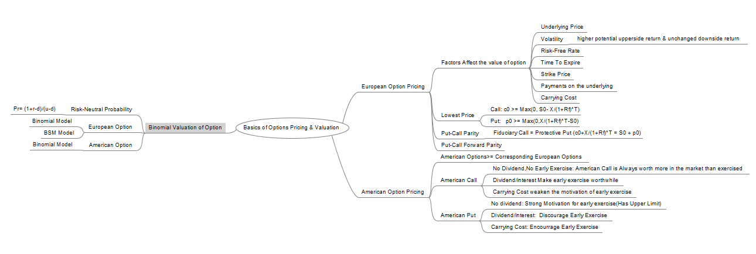
MindMap

Slide 3


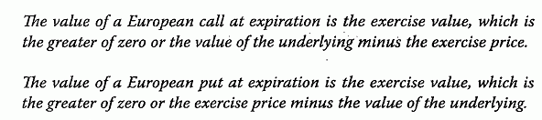
Value of European Option at Exp
Value(call option at expiration) = Exercise Value/Intrinsic Value
Value (put option at expiration) = Exercise Value/Intrinsic Value

Slide 4
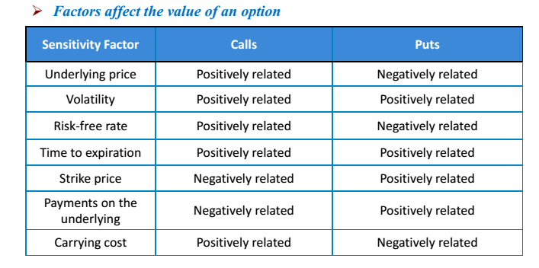
Factors Affect Option Price

Slide 5
Factors - Volatility
Higher Volatility => More Extreme Value of the Underlying
Case 1: Higher Value of Underlying at Expiration, Higher Payoff of call option at Expiration
Expiring more in the money is better than less in the money. (>)
Case 2: Lower Value of Underlying at Expiration, Remain 0 payoff of call option at Expiration
Expiring more out of money is not worse than less out of money.(=) => Higher Volatility => Better Payoff at expiration

Slide 6


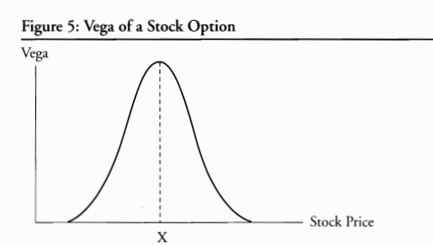
Factors – Volatility(2)
Greek Letters Of Option (FRM)

Slide 7
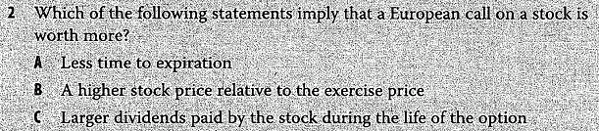
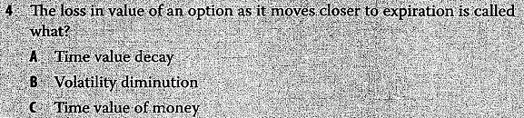
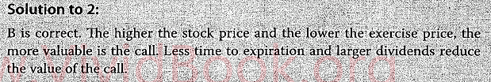
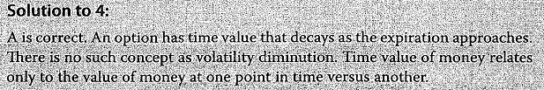
Example

Slide 8
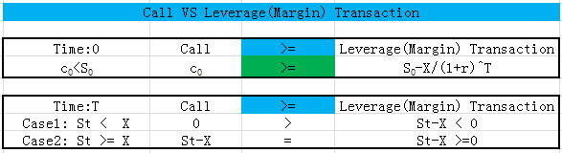
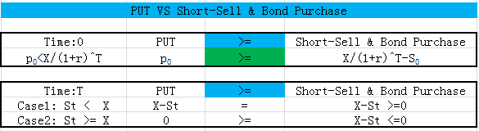
Lower & Upper Bound of Option(1)
Lower & Upper Bound of Call Option
Lower Bound of European Put Option

Slide 9
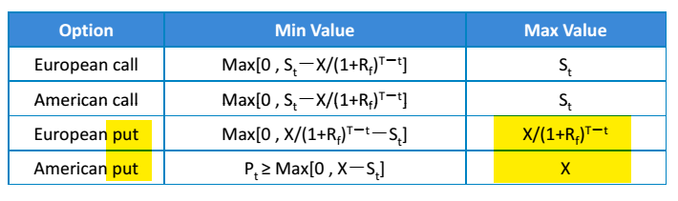
Lower & Upper Bound of Option(2)
Lower & Upper Bound of Option Value

Slide 10
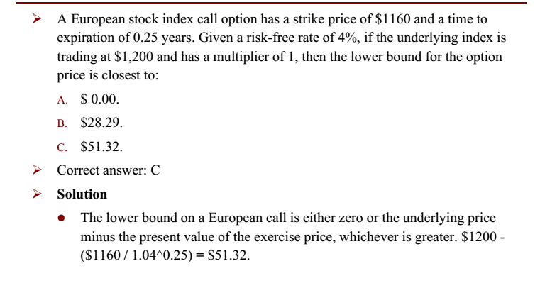
Example

Slide 11
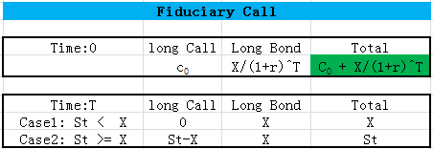
Put-Call Parity-Fiduciary Call
Fiduciary Call is a portfolio consisting of:
A long position in a European call option with an exercise price of X that maturities in T years on a stock.
A long position in a pure‐discount risk less bond that pays X in T years

Slide 12
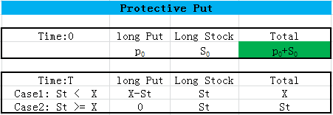
Put-Call Parity- Protective Put
Protective Put is a portfolio consisting of:
A long position in a European put option with an exercise price of X that maturities in T years on a stock.
A long position in the underlying stock

Slide 13
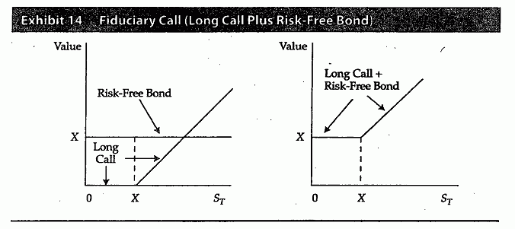
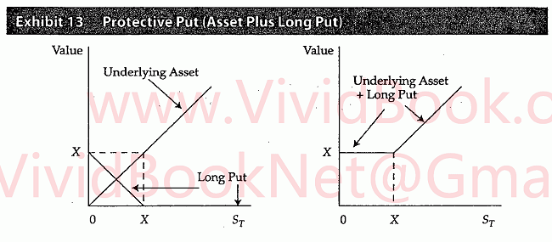
Put-Call Parity- Graph

Slide 14
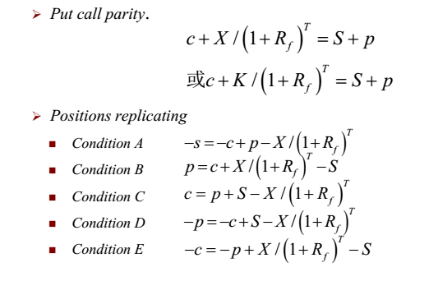
Put-Call Parity Formula
Put-Call Parity : Not Applicable to American Options (unless they are held to expiration)
American Options allow early exercise, Early exercise will result in a departure in the present values of the two portfolios.)

Slide 15
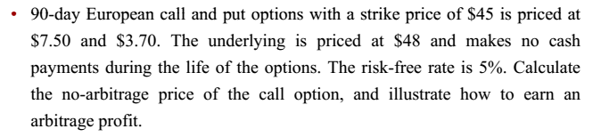
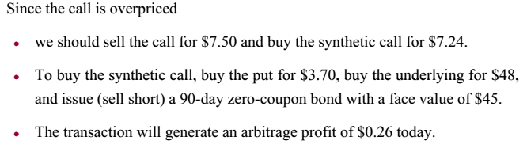
Example: Exploit violations of parity
Example: Exploit violations of put-call parity
Answer:

Slide 16
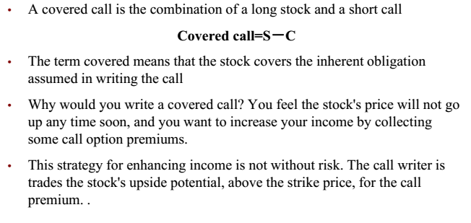
Fiduciary Call VS Covered Call
Covered Call

Slide 17
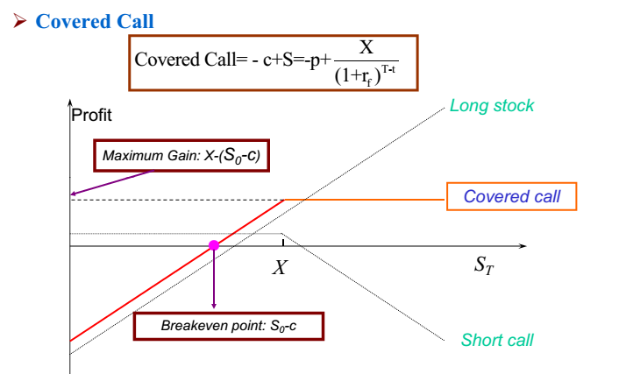
Fiduciary Call VS Covered Call(2)

Slide 18
Warrant Buffet’s Exlample
Coca-Cola: Lower Purchase Price
April 1993, Sold 5 million shares out-of-the-money Coca-Cola put options(X=$35)
Received Premium: 1.5 * 5M => 7.5M$
Berkshire's 2008 Letter to shareholders
Our put contracts total $37.1 billion: S&P 500, FTSE 100, Euro Stoxx 50, and Nikkei 225. Our first contract comes due on September 9, 2019 and our last on January 24, 2028. We have received premiums of $4.9 billion, money we have invested.
Notes:
http://www.nasdaq.com/article/warren-buffett-converts-crisisera-warrants-for-28-of-goldman-sachs-cm285398

Slide 19
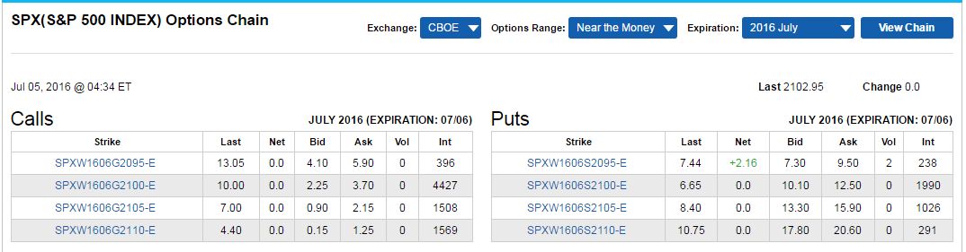
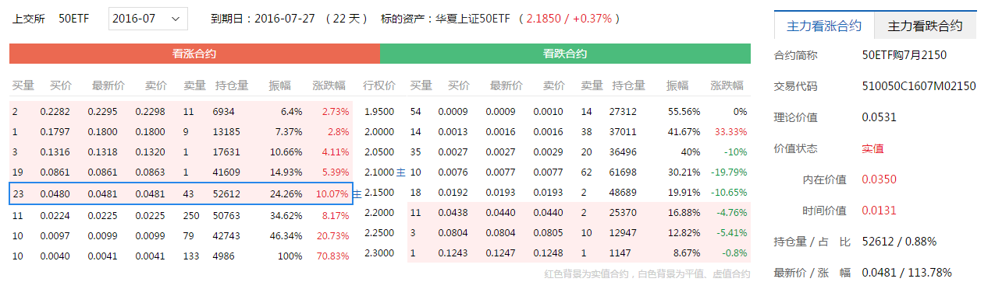
Quotes
CBOE: https://www.cboe.com/delayedquote/quotetable.aspx?ticker=SPX
SSE: http://stock.finance.sina.com.cn/option/quotes.html
Notes:
CBOE: https://www.cboe.com/DelayedQuote/quotetable.aspx
http://stock.finance.sina.com.cn/option/quotes.html
SSE: http://edu.sse.com.cn/col/option/home/

