Slide 1
Knowl-EDge
Serverless Learning Backend Service with Knowledge Base, Lambda and API Gateway
University of Toronto
School of Continuing Studies
SCS 3547 – Intelligent Agents
Student: Arjie Cristobal
Instructor: Larry Simon
March 2024

Slide 2
Objective
The primary objective of this study is to develop Knowl-EDge, a Serverless Backend Learning Service tailored for developers and technical support.
The study aims to take advantage of Generative AI with Large Language Models (LLMs), including RAG (Retrieve-Augmented Generation) and integrate Agents for Amazon Bedrock Knowledge Base to enhance the overall functionality and effectiveness of the service.
Consumers of this new API will be able to efficiently inquire about and access information related to the applications within our organizations.

Slide 3
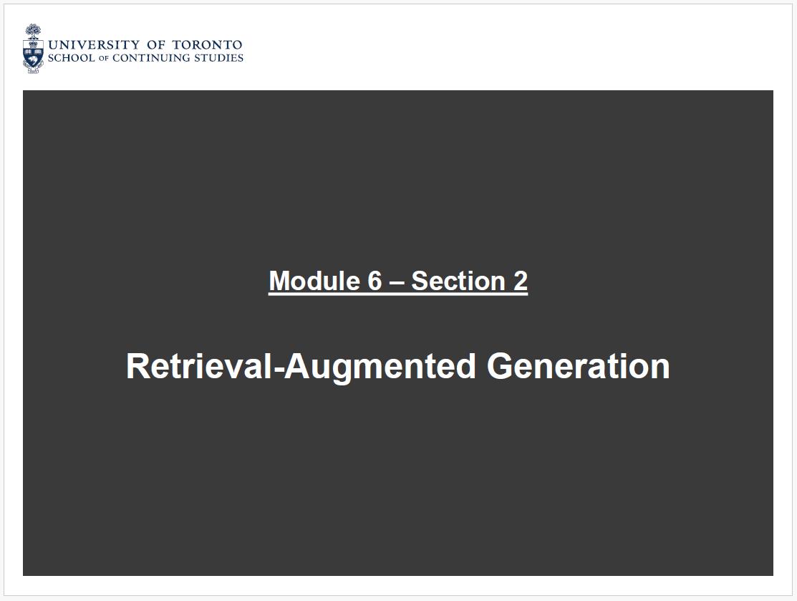
Concepts and Architecture
RAG:
Allows to create a more customize version of LLM prompt that have an appearance of a fine-tuned document, but in reality we simply inserting text context into the prompt.
The RAG Process can be a substitute for fine tuning a model, since it is far cheaper.

Slide 4




Data Ingestion Workflow
Data Source
Transform Data
Create Vector Embeddings
Vector Store
Amazon S3
Chunking
Amazon Titan
Amazon OpenSearch
Business Analyst, Product Owner, Training Manager
www.quickheaven.ca

Slide 5

RAG Process
Generate
Prompt
Prompt
+
Context
Augmented
Amazon Bedrock - Foundation Model (Claude)
Titan Text Embedding
Context
Retrieval
Amazon OpenSearch
Create Vector Embeddings
Transform Data
Data Source
Data Ingestion Workflow
Vector Store
Text Embedding
Chunking
Amazon S3
www.quickheaven.ca

Slide 6

Data Ingestion Workflow
Data Source
Transform Data
Create Vector Embeddings
Vector Store
Knowledge Base for
Amazon Bedrock
Amazon S3
Chunking
Amazon Titan
Amazon OpenSearch
AWS Free Tier, OpenSearch Service provides free usage of up to 750 hours per month of a t2.small.search or t3.small.search instance ($0.036 Price per hour)
Business Analyst, Product Owner, Training Manager
www.quickheaven.ca

Slide 7




Knowl-EDge – Serverless Knowledge Base App Architecture
Knowledge Base
(2) Event
(3) RetrieveAndGenerate API
(9) Response
(8) Response
(4) Context
Amazon OpenSearch
Amazon API Gateway
AWS Lambda
R
A
G
(5) Context
Amazon Titan
(1)
(10)
(7) Response
Chunking
Client
(6)
Amazon Bedrock
(Claude Foundation Model)
Documents
www.quickheaven.ca
Amazon S3

Slide 8
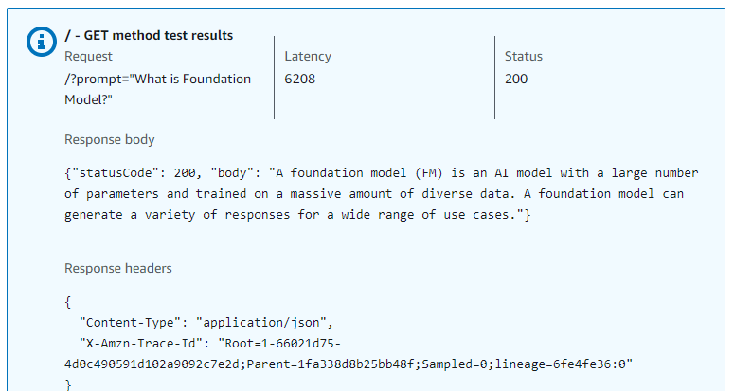
Agents for Amazon Bedrock
Agents for Amazon Bedrock offers the ability to build and configure autonomous agents in the application. An agent helps end-users complete actions based on organization data and user input. Agents orchestrate interactions between foundation models (FMs), data sources, software applications, and user conversations.
AWS Lambda
boto3.client(‘bedrock-runtime’)
boto3.client(‘bedrock-agent-runtime’)

Slide 9
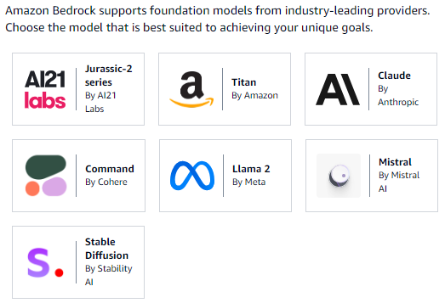
Conclusion
In summary, our study successfully achieved its primary objective:the development of Knowl-EDge, a Serverless Backend Learning Service designed for developers and technical support. By using the power of Generative AI with LLM including RAG, we are able to improve the functionality and effectiveness of the service. The integration of Agents for Amazon Bedrock Knowledge Base ensures that consumers of this API can efficiently inquire about and access crucial information about our applications.
Recommendation
Foundation Model Selection
Prompt Engineering techniques
Evaluate other Vector Databases

Slide 10
Thank you
www.quickheaven.ca

