Slide 1

QUICKSERVE
LOCALIZED SERVICE PROVIDER APP

Slide 2

INTRODUCTION
THE MAIN AIM OF THIS APPLICATION IS TO HELP THE PEOPLE IN NEEDS OF THEIR REPAIRS WITHOUT ANY CONTACT OF THE SECOND MEN.

Slide 3

USER FRIENDLY
QUICKSERVE PROVIDES THE BEST USER FRIENDLY ECONOMY TO THE USER SO THAT IT MAKES THE NEEDS EASY TO SOLVE
THERE WILL BE ALL IN A SYSTEMATIC ORDER
IT PROVIDES THE BASIC SERVICE NEEDS TO THE USER INDIRECTLY BY CONNECTING HIM TO THE SERVICE PROVIDER
IT PROVIDES THE SERVICE AS EARLY AS POSSIBLE THE USER APPROACH THE SERVICE SO, NO WORRIES.

Slide 4

DATABASE AND SECURITY
THE DATABASE IN OUR APP WILL BE STORED IN MYSQL WHICH IS THE BEST FOR STORING DATABSE AND IT IS VERY TRUST WORTHY WITH THE SECURITY
IT PROVIDEES SECURITY TO THE DATA OF THE USER AND THE SERVICE PROVIDER SO THAT IT MAKES OUR APPLICATION TRUSTFUL BY BOTH THE USER AND THE SERVICE PROVIDER

Slide 5

ADMIN
IN OUR APPLICATION ADMIN PLAYS A KEY ROLE
HE LOOKS AFTER ALL THE FUNCTION DONE IN THE QUICK SERVE
HE ALSO MANAGES REQUESTS FROM THE CLIENT
HE WILLRESPOND TO THE REPORT GIVEN BY THE USER AND TAKES THE SEVERAL ACTION ON THINGS

Slide 6
SIGNUP PAGE
FIRSTLY TO USE OUR APP THE USER NEED TO SIGNUP WITH HIS EMAIL
OR IF HE IS ALERADY SIGNED UP THEN HE WILL GO TO THE LOGIN PAGE

Slide 7

DASHBOARD
HERE USER CAN SEE THE SERVICES PROVIDED BY THE EACH SERVICE PROVIDR
AND HE CAN EVEN SEARCH THE SERVICE PROVIDER HE NEEDS
AND THE COST OF SERVICE WILL ALSO BE DISPLAYED NEAR THE SERVICE NAME SO IT WILL BE EASY TO THE USER TO FIND THE COST

Slide 8

PAYMENT
HER WE USE A SECURED GATEWAY FOR PAY
WHICH ENSURES SAFE PAYMENTS
PROVIDERS PAYMENT HISTORY

Slide 9

FEEDBACK SYSTEM
WE TAKE FEEDBACK FROM USER AFTER EVERY SERVICE
TO IMPROVE OUR SERVICE
AND FOR BEST SERVICE PROVIDER GETS SUGGESTED FIRST

Slide 10
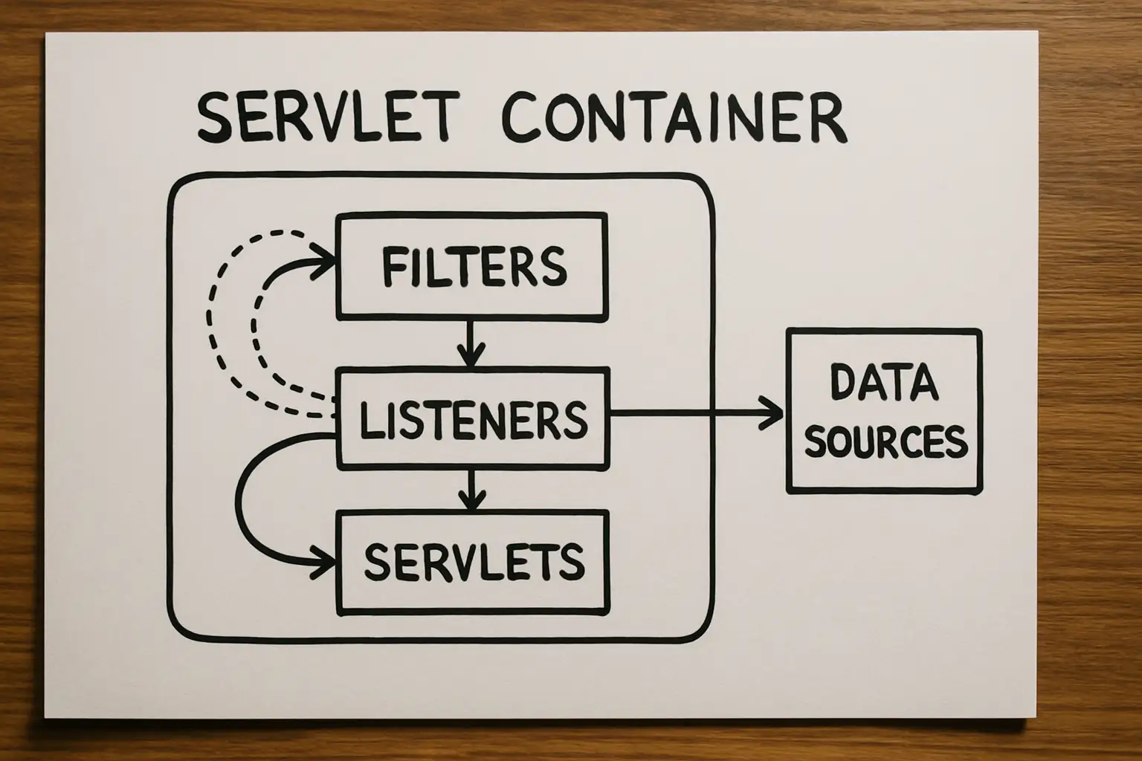
SERVLANT
HERE TO BUILD THIS APPLICATION WE USED JAVA SERVLANT FOR FRONTEND AND DATABASE CONNECTION
IT PLAYS A KEY ROLE IS SHARING DATA FROM DATA TO DATABSAE TO APPLICATION VISEVERSA

Slide 11
USER EXPERIENCE FLOW
Easy onboarding (Sign up/Login)
Location-based service discovery
Simple booking interface
Transparent pricing
Real-time notifications
Hassle-free payments

Slide 12
SERVICE WORKFLOW
User searches for service
Views provider details
Books service
Provider accepts request
Service is delivered
Payment completed
Rating & feedback

Slide 13
FUTURE ENHANCEMENT
AI-based service recommendations
Subscription-based services
Live tracking of service providers
In-app chat support
Voice-based booking system

Slide 14

CONCLUSION
QuickServe simplifies local service booking
Efficient workflow improves user experience
Secure payment system ensures trust
Scalable and user-friendly platform
Strong potential for future growth

Slide 15


