Slide 1
clock
neighbours[0...n-1]
Cell
Electron head

Slide 2
clock
neighbours[0]
...
...
Cell
Electron head
neighbours[n-1]

Slide 3
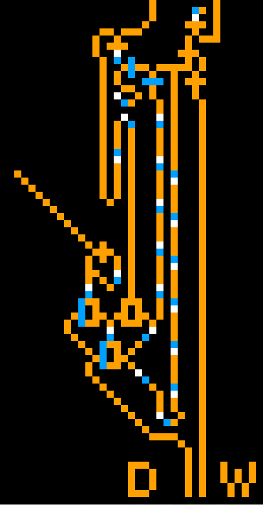
data_out
T1
set_cmd
T3
C1
T2
Tf
C3
C2
display_reset
Data Latch
header
path
XOR Gates
data_in
write_cmd

Slide 4

Frequency doubler

Slide 5
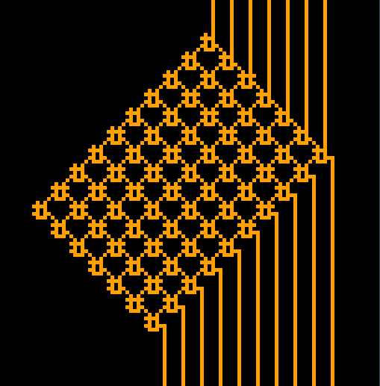
outputs
inputs

Slide 6
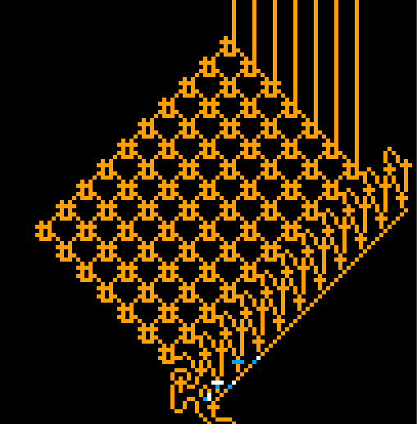
ROM
ROM controller

Slide 7
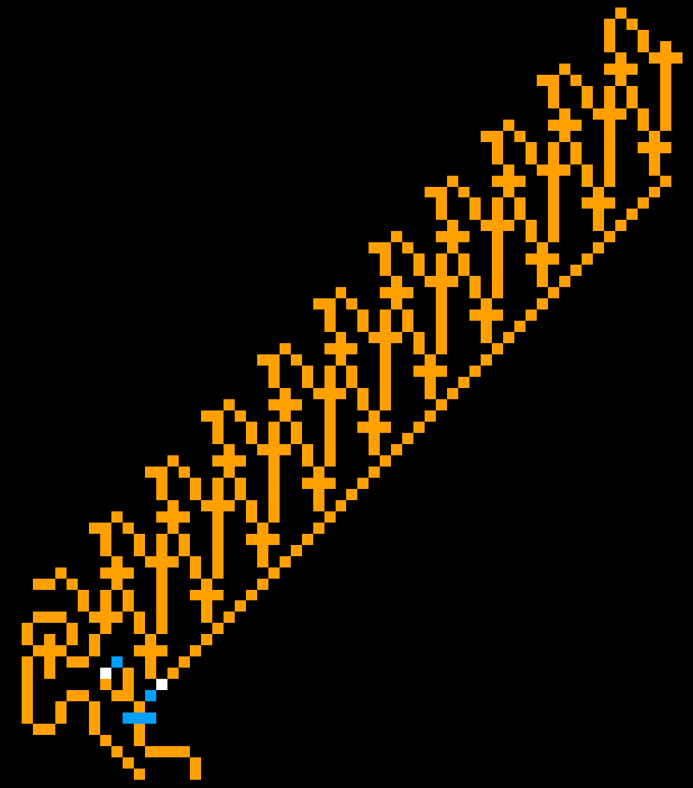
output[9]
loop clear gate
loop load gate
loop
output[0]
header
electron generator
clear_cmd
next_cmd
loop transfer transistor

Slide 8
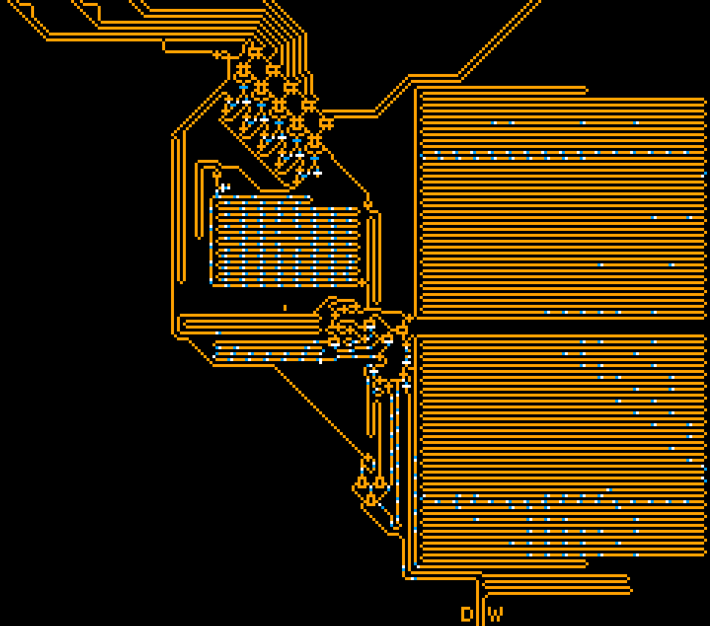
digit[4]
digit[3]
digit[2]
digit[1]
digit[0]
digit selecter
pulse controler
overflow detector
mega loops
binary adder
data latch

Slide 9
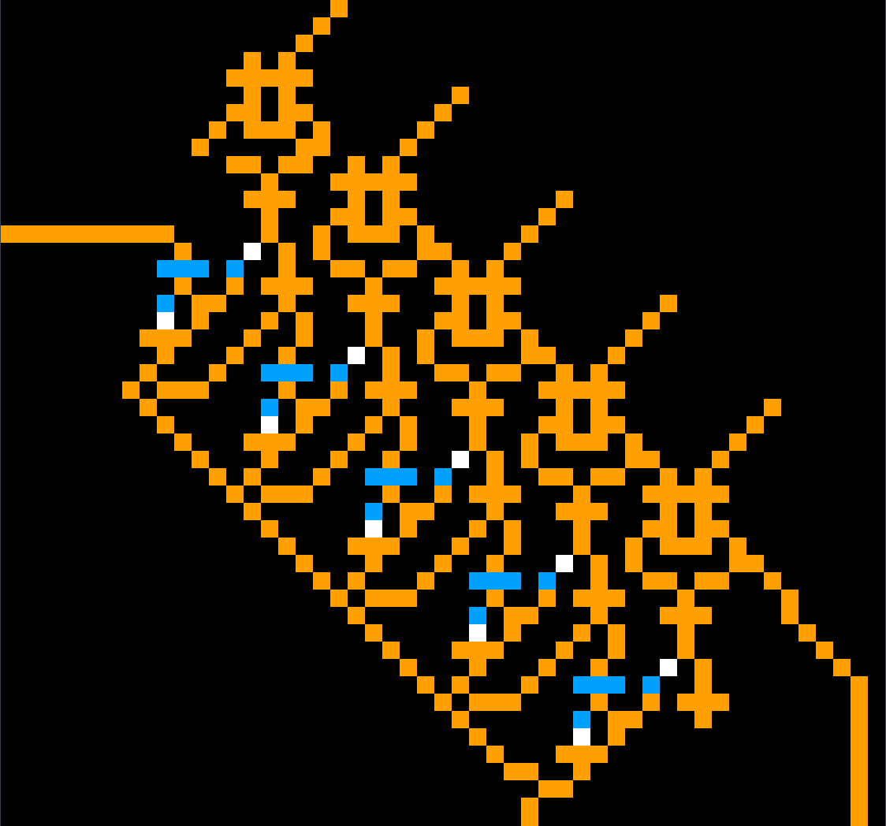
A input
digit[4]
digit[3]
digit[2]
digit[1]
digit[0]
B input
reset
AND NOT
S1 output
loop[3]
S2 output
reset loop[2]
set loop[1]
transistor[0]
change_digit
data_in

Slide 10

clock injector
XOR gate
A && /B Gate
frequency divider

Slide 11

pulse output
transistor
reset
set
overflow detection loop
adder overflow
gen loop

Slide 12
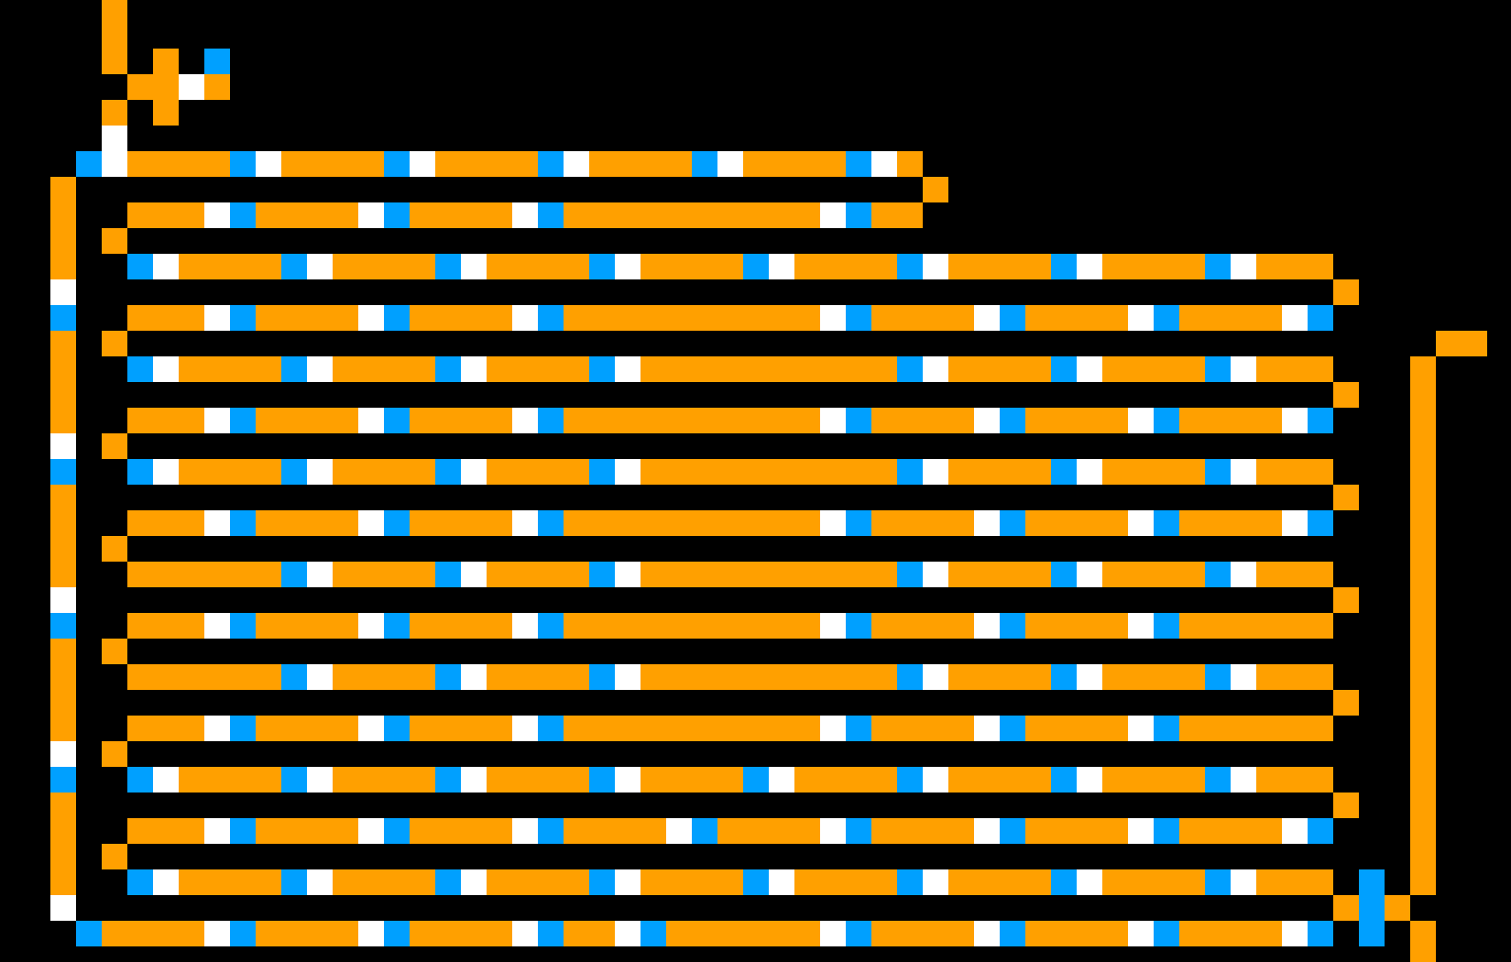
change digit
Tn
C3
pulse output
out of phase electron
Tc
pulse input

Slide 13
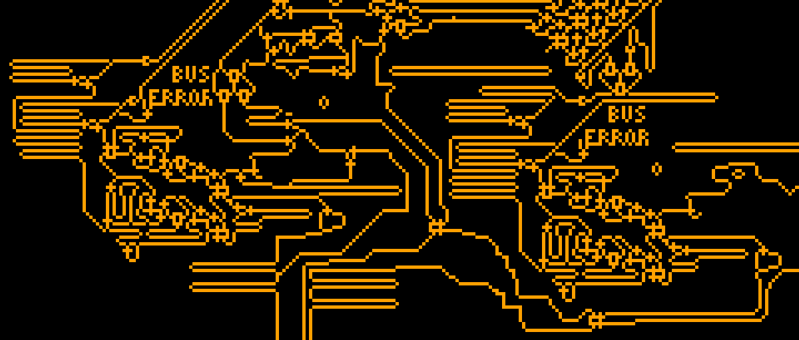
read pulses
read data
register Id
write pulses
read controller
read cmd
write cmd
write controller
write data

Slide 14
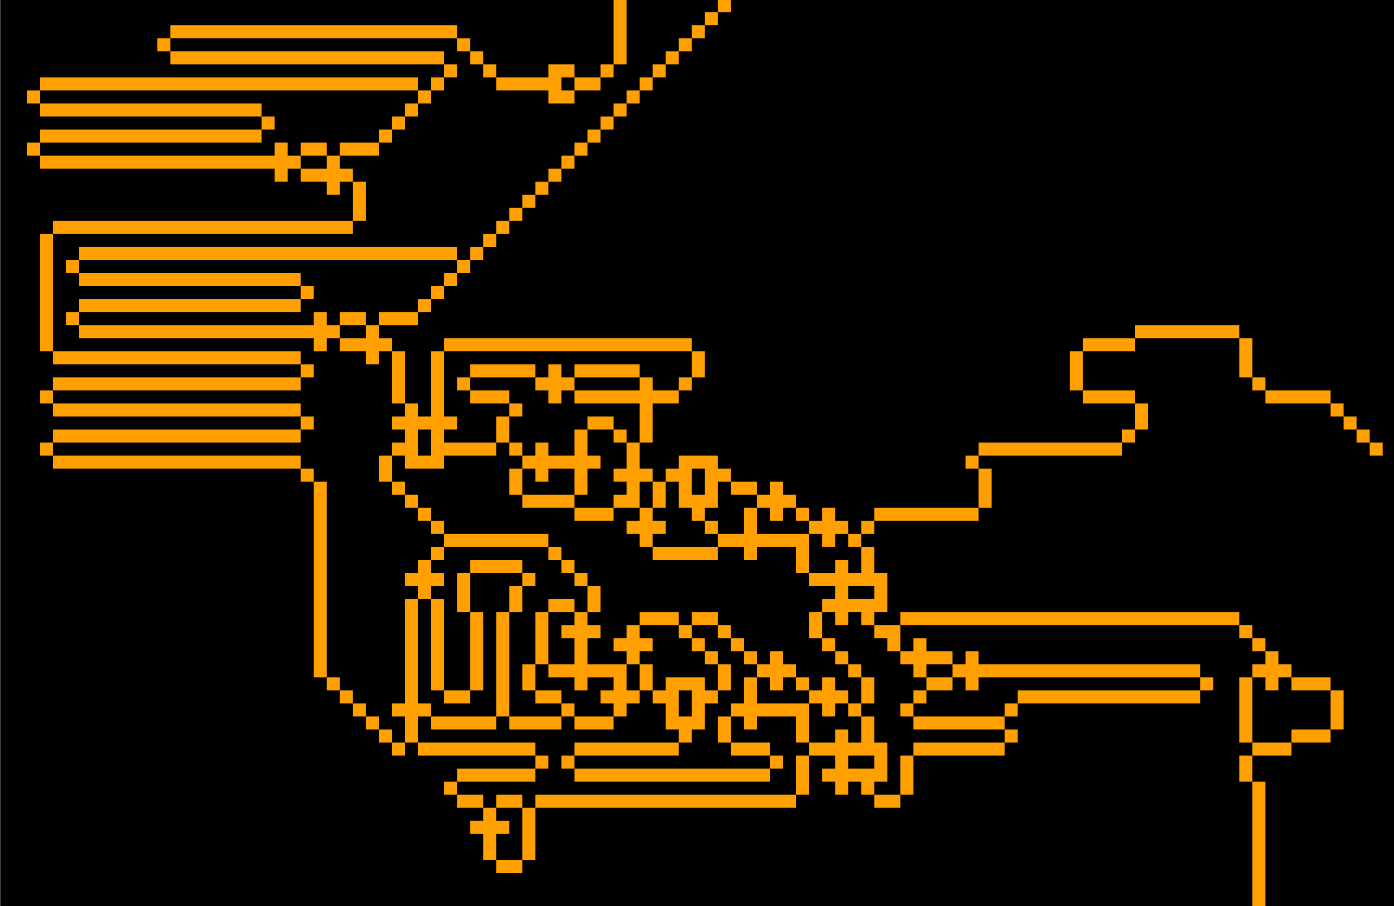
ref burst
delayed burst
burst generators 16
register
Id
delay generators
header
burst generator 8
electron doubler
write cmd

Slide 15

ref electron
delayed electron
T1
B
Bc
register Id
burst
T2
Ba
header
XOR gate
(Burst & register Id) logic

Slide 16

feedback path
burst
generation loop
electron

Slide 17
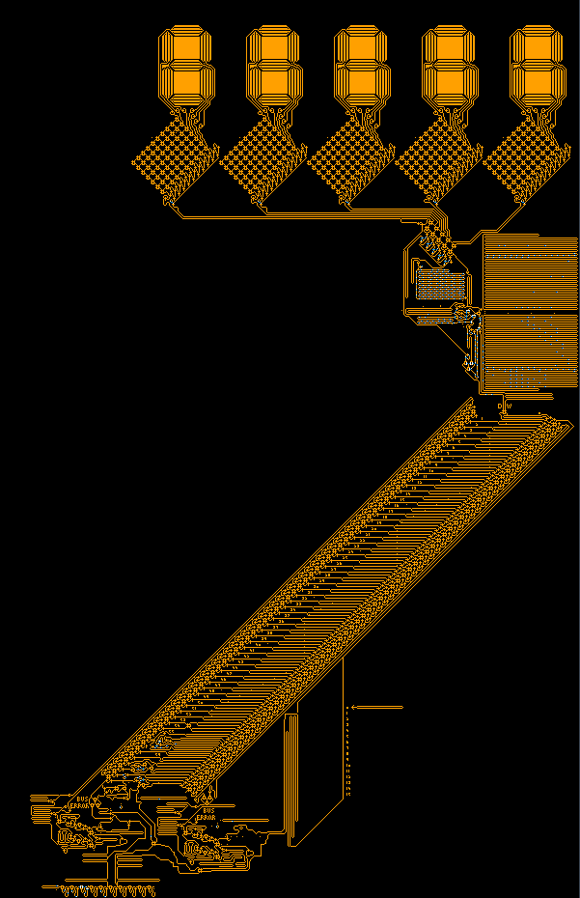
digital display
BCD converter
registers
ALU
control unit
clock

Slide 18
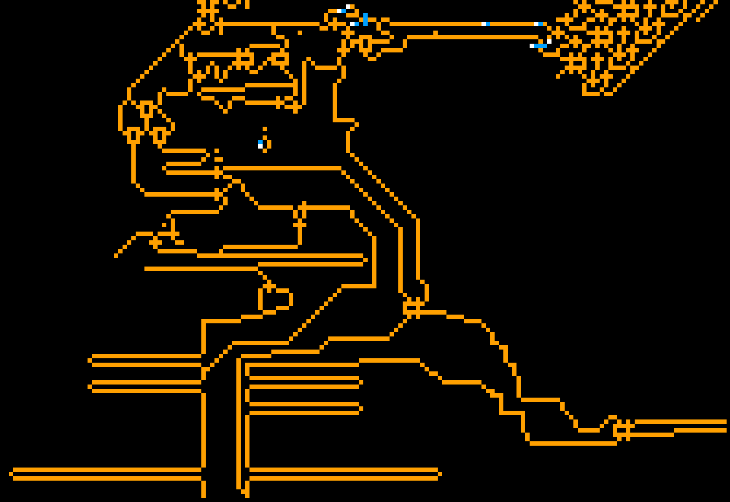
read data
fetched PC
PC increment
read
register id
read_cmd
write_cmd
Data/PC selector
write
register id

Slide 19
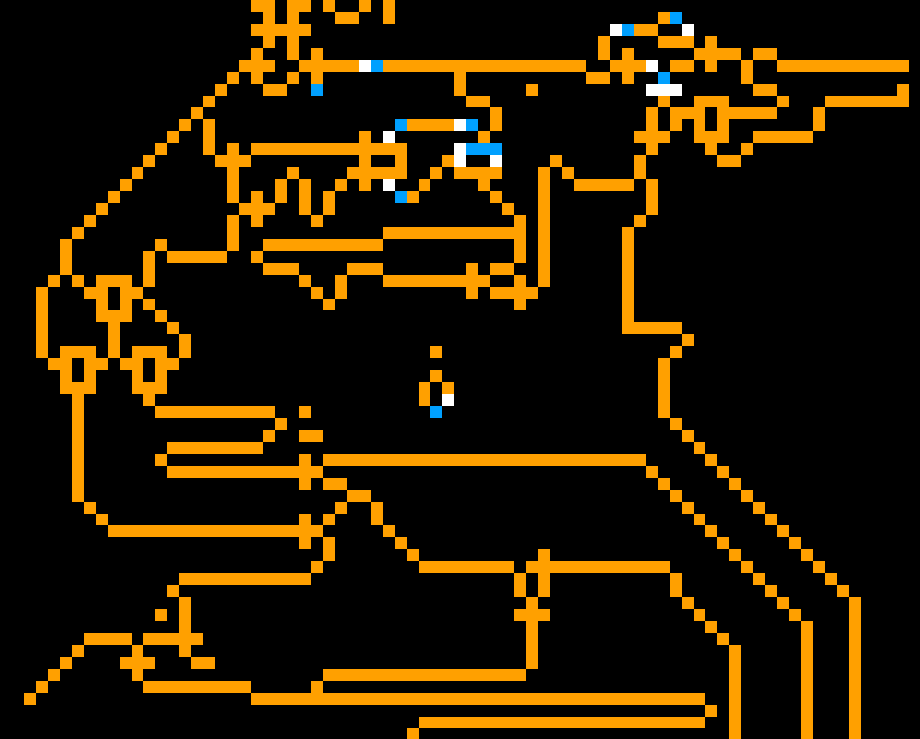
Tpc
OR
data
L1
PC
XOR
burst generator
XOR
Tw
Tr
read register id
double electron
read_cmd
data
write_cmd

Slide 20

L
Tr
To
register
out
PC in
PC out
Linc
inc_cmd
XOR

Slide 21

register
value
OR
Lndata2
Lndata1
X
old
value
Lsel1 / Lsel2
data
rising burst
falling burst

Slide 22

Lsel1 / Lsel2
X
register
value
rising burst
data
Tr
falling burst

Slide 23
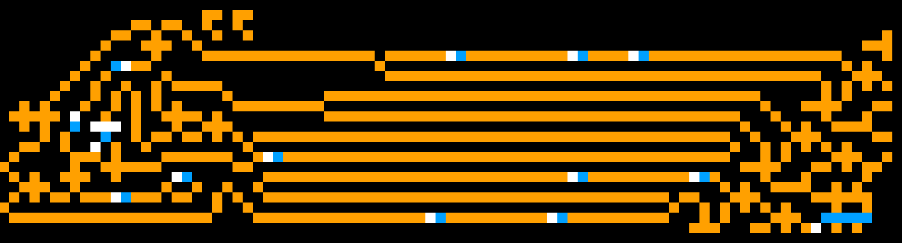
FF2
T1
FF1
R55
OR
result
R56
T2
T3
generator
R57
reset loop

