Slide 1
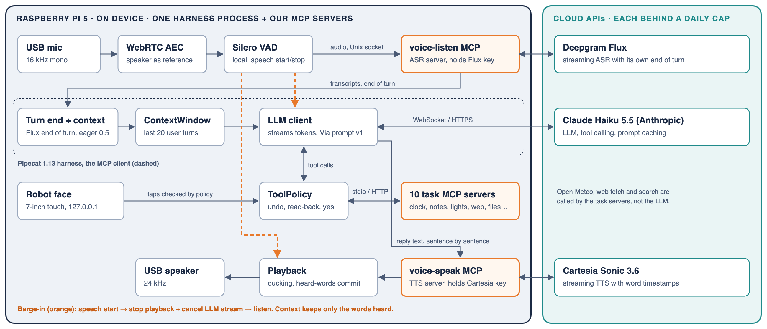
MACHINE EXERCISE · AI222 · VIA (ME3)
Full-Duplex Voice Agent on a Raspberry Pi
Via ("voice input agent") · Nov 6, 2026
1
SYSTEM DIAGRAM the one diagram that explains the build
USB mic → WebRTC AEC → Silero VAD on the Pi → voice-listen MCP (ASR) → Pipecat agent → voice-speak MCP (TTS) → USB speaker
Harness with MCP client: Pipecat 1.13, one process on the Pi
LLM is a commercial API (Claude Haiku 5.5); every tool comes from our own MCP servers
All 12 MCP servers are ours and run on the Pi: voice-listen, voice-speak and 10 task servers
Barge-in stops playback and cancels the LLM stream; Cartesia word timestamps keep only the words heard
On-Pi left, cloud right: Deepgram Flux, Anthropic, Cartesia, each behind a hard daily cap
voice in → VAD → voice-listen → LLM (+MCP tools) → voice-speak → voice out
barge-in: speech detected → stop playback + cancel LLM stream → listen
2
PROMPT in the repo, versioned: harness/bot.py PROMPT_VERSION
3
CONTEXT ENGINEERING
SYSTEM PROMPT (Via v1) - excerpt
You are Via, short for voice input agent, a hands-free voice assistant, and every reply is spoken aloud. Start with a short sentence of a few words, and keep the whole reply under about 30 words: no lists, formatting or parentheses. Call a tool straight away, with no words before it. If a tool result says waiting_for_undo or needs_confirmation, it has not happened yet: say so briefly and do not call the tool again. Speech recognition may mishear: act on the likely meaning, but if a short fragment could mean different things, ask in a few words and do not act.
Stopping on barge-in and confirming risky actions are enforced by the harness (ToolPolicy), not left to the model.
GOES IN:
MANAGED:
System prompt (Via v1) + agent persona
Flux final transcripts (partials only drive the face)
Flux end-of-turn events, eager at 0.5
MCP tool results + notes of screen taps
Document agents: docs read tools (no vector store)
Last 20 user turns kept: 26 trims in 41 turns
Cached stable prefix: ~87% less LLM cost
idle → listen → think → speak, on the face
Barge-in: queued audio dropped, heard words kept
Logged: prompt tokens median 6.8K, max 8.5K
Via, full-duplex voice agent on a Raspberry Pi 5 · github.com/quielq/quielq-full-duplex-voice-agent
2-page template · 1/2

Slide 2
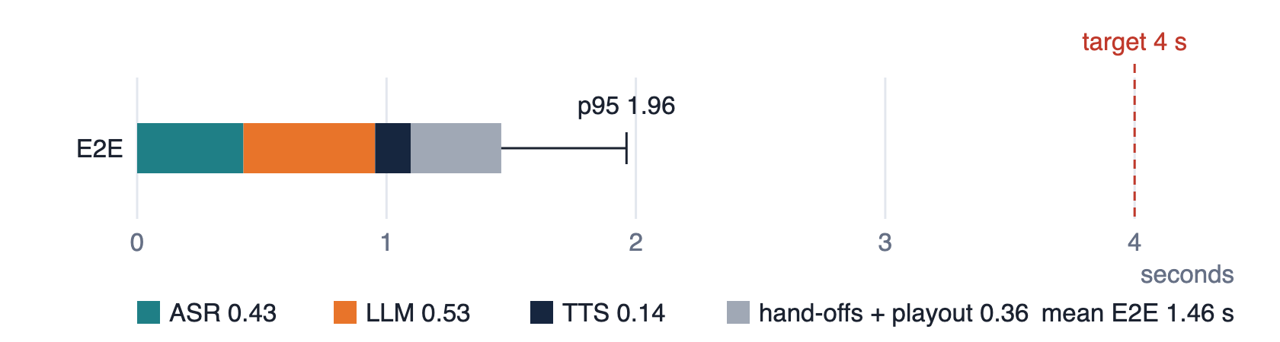
MACHINE EXERCISE · AI222 · VIA (ME3)
MCP Services, Evaluation & Model Serving
all servers built by us, running on the Pi
4
MCP SERVICES + section 6: model serving (one table, one truth)
Component | MCP server / transport | Tools | Model | Served where / notes
ASR | voice-listen / stdio, HTTP | listen, stop_listening, status | Deepgram flux-general-en | Pi; holds the key; Flux ends the turn
TTS | voice-speak / stdio, HTTP | speak, stop, status | Cartesia sonic-3.6 | Pi; word timestamps; cut on barge-in
LLM | harness MCP client (Pipecat 1.13) | function calling over all task tools | claude-haiku-5-5 | Anthropic API; streaming, prompt caching
VAD | in-process | speech start / stop | Silero VAD | Pi on-device, 16 kHz mono
Task | clock, notes, lights, thermostat | set_timer, add_note, delete_note, set_light, set_thermostat | none | Pi; lights, thermostat are mocks
Task | music, comms, delegate | play_music, next_track, send_message, call_contact, start_task | Spotify; Haiku 5.5 worker | Pi; comms is a mock by default
Task | knowledge, docs, workspace | get_weather, fetch_content, search, read_file, write_file, bash | Open-Meteo, web | Pi; workspace only; bash sandboxed
5
EVALUATION & BENCHMARK fd-benchmark stage test, the class's standard method
One clock: the Pi's monotonic clock; fdbench's Pipecat observer stamps every stage
VAD end → ASR final → LLM 1st token → TTS 1st audio → speaker
E2E = speaker − VAD end; barge-in = stop − speech start
10 phrases × 2 runs (20 turns); mean + p95; JSON log per run
Metric | Definition | Target | Mean | p95
E2E latency | end of speech → audio out | < 4.0 s | 1.46 s | 1.96 s
ASR final | end of speech → transcript | < 0.8 s | 0.43 s | 1.18 s
LLM TTFT | transcript → first token | < 1.5 s | 0.53 s | 0.70 s
TTS TTFB | text → first audio chunk | < 0.6 s | 0.14 s | 0.18 s
Barge-in | speech → playback stopped | < 0.8 s | 0.70 s | 0.79 s (n=2)
WER | ASR accuracy on test set | < 15% | 5.5% | -
latency_chart.svg, fdbench run 2026-11-06_21-22-21
DEMO (2.5 min, docs/live-demo.md)
RESULTS
CHALLENGES (problem, cause, fix, proof) & REFERENCES
Real tasks, no push-to-talk: kitchen light, a 2-minute timer
Barge-in: "wait, stop" cuts a story mid-sentence
Slow API: weather call covered by the waiting phrase
Screen tap + voice share one policy; a delete held, then cancelled
Raspberry Pi 5 Model B, 8 GB; active cooler, fan; peak 62.8 C, never throttled
Wi-Fi to the cloud (IPv6 off); Nov 6, 2026
Pipecat 1.13.0, Flux flux-general-en, Haiku 5.5, Cartesia sonic-3.6, Silero, prompt Via v1
Every target met except ASR final p95
Problem
Cause
Fix
Proof
Slow replies: 2.35 s
EOT wait 0.85 s, LLM 1.0 s, long 1st line
Eager EOT 0.5; short 1st sentence
1.46 s: EOT 0.43, LLM 0.53, TTS 0.14
Gaps mid-reply
Aura-2 slower than real time
Cartesia TTS (ADR-015)
Median gap 354 → 45 ms
No speech on the Pi
Wi-Fi IPv6 route did not reach Cartesia
IPv6 off on wlan0
0.39 s handshake; 30/30 trials spoke
Pi at risk of throttling
Under-voltage from a weak supply
Proper 5 V supply
throttled=0x0, peak 62.8 C
Bot cut itself off
Heard its own voice; no AEC in Pipecat
AEC + echo filter (ADR-042)
27 speaker turns, no self-cut
modelcontextprotocol.io · docs.pipecat.ai · github.com/trueshotjames/ai231-me3-full-duplex-benchmarking · run logs in logs/
Via, full-duplex voice agent on a Raspberry Pi 5 · github.com/quielq/quielq-full-duplex-voice-agent
2-page template · 2/2

