Slide 1


An In-depth Study of LTE: Effect of Network Protocol and Application Behavior on Performance
Junxian Huang¹ Feng Qian²
Yihua Guo¹ Yuanyuan Zhou¹ Qiang Xu¹
Z. Morley Mao¹ Subhabrata Sen² Oliver Spatscheck²
¹University of Michigan ²AT&T Labs - Research
August 15, 2013
Notes:
OK, let’s start
Today I am very happy to present my work on *title*

Slide 2

LTE is New, Requires Exploration
4G LTE (Long Term Evolution) is future trend
Initiated by 3GPP in 2004
Entered commercial markets in 2009
Now available in more than 10 countries
LTE uses unique backhaul and radio network technologies
Much higher available bandwidth and lower RTT, compared with 3G
Notes:
First, a little background for LTE.
LTE stands for Long Term Evolution. Back in 2004, 4G LTE is initiated by 3GPP.
The design goal for LTE is quite promising, with 100Mbps downlink, 50Mbps uplink and <5ms user-plane latency.
Since 2009, LTE has entered commercial markets and now available in more than 10 countries, with more countries ongoing or planned.
It is anticipated to become the first truly global mobile phone standard and is a future trend

Slide 3
LTE not extensively studied in commercial networks
How network resources are utilized across different protocol layers for real users?
Are increased bandwidth efficiently utilized by mobile apps and network protocols?
Are inefficiencies in 3G networks still prevalent in LTE?
Notes:
Given that LTE has only entered commercial markets a few years ago, it has not been extensively studied empirically in a deployed commercial network setting.
We wish to study how network resources are utilized across different protocol layers for real users
And evaluate the benefits of bandwidth improvement for mobile applications and essential network protocols to identify their limitations.

Slide 4
Data collection and data set
Abnormal TCP behavior
Bandwidth estimation
Inefficient Resource Usage of Applications
Conclusion

Slide 5
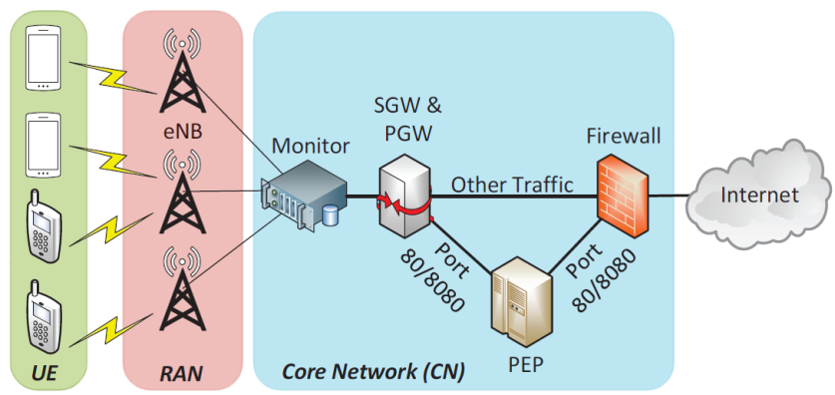
LTE Network Topology of the Studied Carrier
Notes:
We start by introducing the LTE network topology.
UE or user equipment is connected with the eNB in the Radio Access Network via wireless signals.
The traffic then goes through the monitor, gateways, proxy and firewalls in the core network, before entering Internet.

Slide 6
LTE Network Topology of the Studied Carrier
Notes:
And our data set is collected at the monitor side

Slide 7
Data Set
Data set statistics
From 22 eNodeB at a U.S. metropolitan area
Over 300,000 users
3.8 billion packets, 3 TB of LTE traffic
Collected over 10 consecutive days
Data contents: packet header trace
IP and transport-layer headers
64-bit timestamp
No payload data is captured except for HTTP headers
Notes:
The data set covers a fixed set of 22 eNBs at a large metropolitan area in the U.S. with over 300,000 subscribers.
There are 3.8 billion packets corresponding to 3TB of LTE traffic and the data set is collected over 10 consecutive days.
The data includes IP and TCP/UDP packet header and HTTP header, etc.

Slide 8
Data collection and data set
Abnormal TCP behavior
Bandwidth estimation
Inefficient Resource Usage of Applications
Conclusion

Slide 9
Queueing Delay
Large buffers in the LTE networks may cause high queuing delays
Bytes in flight – unacknowledged TCP bytes
Notes:
We notice one problem for LTE networks when transferring large-size objects.
TCP uses a window to allow sending bytes without requiring acknowledgements of all previous bytes.
Such unacknowledged TCP bytes can be called bytes in flight.
In LTE networks, there are large buffers that can hold bytes in flight and in this figure, we can observe that when the bytes in flight grows, the RTT significantly increases.

Slide 10
Similar Observations in Controlled Experiments
LTE Carrier A
LTE Carrier B

Slide 11
High Queueing Delay Causes Unexpected TCP Behavior
Notes:
Such high queueing delay may cause unexpected TCP behavior.
Here is one example. This figure shows the TCP sequence number vs. time plot of an LTE user downloading a music file.
Each dot in the figure corresponds to either a data packet or an ACK packet.

Slide 12
High Queueing Delay Causes Unexpected TCP Behavior
bytes in flight growing
Notes:
The vertical gap between data and ACK curve indicates the bytes in flight
And we clearly see that the bytes in flight is growing as the downloading proceeds.

Slide 13
High Queueing Delay Causes Unexpected TCP Behavior
Packet loss
Notes:
We observe a packet loss at time 1 second

Slide 14
High Queueing Delay Causes Unexpected TCP Behavior
Fast retransmission allows TCP to directly send the lost segment
to the receiver possibly preventing retransmission timeout
Fast retransmission
Notes:
Then based on TCP, when the sender detects that there is a packet loss,
Fast retransmission would be triggered which allows it to directly send the lost segment to the receiver possibly preventing retransmission timeout.

Slide 15
High Queueing Delay Causes Unexpected TCP Behavior
TCP uses RTT estimate to update retransmission timeout (RTO)
However, TCP does not update RTO based on duplicate ACKs
RTT: 262ms
RTO: 290ms
Duplicate ACKs
Notes:
TCP uses RTT estimate to update retransmission timeout (RTO),
In this example, when the lost segment is retransmitted, RTT is 262ms and RTO is 290ms.
However, TCP does not update RTO based on duplicate ACKs.
Notice that the duplicate ACKs are generated by the reception of the data packets sent AFTER the lost segment.

Slide 16
High Queueing Delay Causes Undesired Slow Start
Retransmission timeout causes slow start
RTT: 356ms
RTO: 290ms
RTT > RTO, timeout!
Slow start
Notes:
However, given that the RTT is growing and by the time the ACK of the retransmitted segment is back,
RTT has increased to 356ms, while RTO is not updated.
Since RTT is larger than RTO now, there is unexpected retransmission timeout.
It is called unexpected because the purpose of fast retransmission is to prevent such timeout to happen.
After timeout, the congestion window would drop to 1 segment size, triggering slow start, which hurt TCP performance

Slide 17
Prevalence of the Undesired Slow-start Problem
For all large TCP flows (>1 MB)
61% have at least one packet loss
Within them, 20% have undesired slow start.
Example: a 3-minute flow
50 undesired slow starts
Average throughput of only 2.8Mbps
The available bandwidth > 10Mbps
TCP SACK can be used to mitigate undesired slow start
SACK enabled in 82.3% of all duplicate ACKs
Notes:
Using our flow analysis techniques, we study the prevalence of such problems in our data set.
For all the large TCP flows with >= 1 packet loss, about 20% of them have such slow start problem,
which is 12.3% of all large TCP flows.
In one case, a 3-minute flow have 50 slow starts, and the resulted throughput is only 2.8Mbps while the actual bandwidth is > 10Mbps.
In the thesis, we talked about different possible methods to mitigate this problem.

Slide 18
Data collection and data set
Abnormal TCP behavior
Bandwidth estimation
Inefficient Resource Usage of Applications
Conclusion

Slide 19
Bandwidth Estimation From Passive Traces
Goal: understanding the network utilization efficiency of mobile applications
Active probing is not representative
High-level approach: identify short periods during which the sending rate exceeds the wireless link capacity and measure the receiving rate to infer the bandwidth
Notes:
In order to understand the network usage efficiency of mobile applications in LTE networks, we first need to know the available bandwidth.
Given our data set, we have to devise a passive bandwidth estimation algorithm based on server-side traces, because the existing active probing methods do not apply as the network condition is highly variable and it is impossible to launch measurement for all users.

Slide 20
Bandwidth Estimation Algorithm
Typical TCP data transfer
Notes:
I will briefly describe our bandwidth estimation algorithm using this figure illustrating a typical TCP data transfer.
P1 to Pn are data packets sent from server to UE
T1 to t7 are packet timestamps in each entity’s local clock.
Notice that we only have access to traces collected at the monitor side, so we don’t know the timestamps such as t1 and t5.

Slide 21
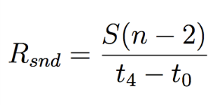
Bandwidth Estimation Algorithm
S: packet size
Sending rate between
t₀ and t₄ is
Notes:
Assume the packet size is S, the sending rate from the monitor to the UE between t0 and t4 is given in this formula,
Since there are n-2 packets.

Slide 22
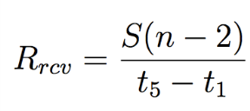
Bandwidth Estimation Algorithm
From UE’s perspective,
the receiving rate for
these n − 2 packets is
Notes:
From the UE’s perspective, the receiving rate for these n-2 packets is S(n-2) devided by t5 – t1, assuming there is not out-of-order transfer and no packet loss.

Slide 23
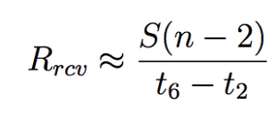
Bandwidth Estimation Algorithm
Typically, t₂ is very close
to t₁ and similarly for
t₅ and t₆
Notes:
Using controlled experiments, we observe that the gap between receiver receiving a data packet and sending an ACK is less than 1ms, which is negligible.
So the receiving rate is close to S(n-2) divided by t6-t2

Slide 24

Bandwidth Estimation Algorithm
Use the TCP Timestamp
option to calculate
t₆ − t₂ (G is a measurable constant)
93% of TCP flows have the TCP Timestamp option enabled
Notes:
From the monitor’s side, we don’t know that t6 and t2 are.
However, we can use TCP timestamps option to calculate t6-t2 with the help of G constant.
Basically, t6-t2 = G(TS2 – TS1) while TS1 and TS2 are the values that can be read from TCP headers at the monitor side.
We also check in our data set and observe that 93% of the TCP flows have TCP Timestamps option enabled making our algorithm applicable.

Slide 25
Bandwidth Estimation Algorithm
Compute a list of {(R_{snd} , R_{rcv} )} by sliding a window along the flow
{R_{rcv}} is the estimated bandwidth
Some restrictions of R_{snd} applies (details in paper)
Estimation error < 8% based on local exprs
Estimated the available bandwidth for over 90% of the large (> 1MB) downlink flows
Notes:
Given the ways to calculate sending rate and receiving rate, we use a sliding window to obtain pairs of Rsnd and Rrcv.
If a list of conditions, such as Rsnd is larger than some threshold, no out-of-order transfers, no packet loss, no delayed-ACK, is met, the receiving rate is the estimated bandwidth.
We use local controlled experiments to validate our algorithm and observe < 8% error rate.
We also analyze the applicability of our algorithm, and we are able to apply the algorithm to predict for over 90% of all large downlink flows.

Slide 26
Bandwidth Utilization by Real Applications in LTE
Overall low bandwidth utilization
Median: 20%
Average: 35%
For 71% of the large flows, the bandwidth utilization ratio is below 50%
Reasons for underutilization
Small object size
Insufficient receiver buffer
Inefficient TCP behaviors
Notes:
To summarize our findings about the network utilization efficiency,
We observe that the median bandwidth utilization ratio is only 20%, with the average ratio 35%.
Also, for 71% of the large flows, the bandwidth utilization ratio is below one half.
We explored the reasons for such underutilization
Some of these underutilization is due to the small object size, while some are due to various application design problems, such as insufficient receiver buffer size, and inefficient TCP behaviors

Slide 27
Bandwidth Estimation Timeline for Two Sample Large TCP Flows
LTE network has highly varying available bandwidth
Notes:
This figure show the time series of estimated available bandwidth of two sample large TCP flows.
The available bandwidth has very high variation.

Slide 28
LTE Bandwidth Variability, RTT and TCP Performance
Under small RTTs, TCP can utilize over 95% of the varying available bandwidth
When RTT exceeds 400∼600ms, the utilization ratio drops to below 50%
For the same RTT, higher variation leads to lower utilization
Long RTTs can degrade TCP performance in the LTE networks
Notes:
We use controlled experiments to study how TCP is capable to utilizing the available bandwidth in such highly varying conditions.
We observe that when RTT is small, TCP is able to use over 95% of the varying available bandwidth.
However, when RTT exceeds 400~600ms, the utilization ratio drops to below 50%.
Also, for the same RTT, higher variation leads to lower utilization.
This indicates that long RTTs, for example resulted by the queueing delay, in LTE network can degrade TCP performance.

Slide 29
Data collection and data set
Abnormal TCP behavior
Bandwidth estimation
Inefficient Resource Usage of Applications
Conclusion

Slide 30
Inefficient Resource Usage – Limited TCP Receive Window
Shazam (iOS app) downloading 1MB audio file
Ideal download time 2.5s v.s. actual 9s
TCP receive
window full

Slide 31
Inefficient Resource Usage – Limited TCP Receive Window
53% of all downlink TCP flows experience full receive window
91% of the receive window bottlenecks happen in the initial 10% of the flow duration
Recommendation: reading downloaded data from TCP’s receiver buffer quickly

Slide 32
Inefficient Resource Usage – Application Design
Netflix (iOS app) periodically requests for video chucks every 10s
Keeping UE radio interface always at the high-power state, incurring high energy overheads
Notes:
Keep this slide or not??

Slide 33
Data collection and data set
Abnormal TCP behavior
Bandwidth estimation
Inefficient Resource Usage of Applications
Conclusion

Slide 34
Conclusions
Performance inefficiencies in LTE
Undesired slow starts observed in 12% of large TCP flows
53% of downlink TCP flows experience full TCP receive window
Cross-layer improvements needed at diff. layers
At TCP (e.g. updating RTT estimations based on dup ACK)
At app design (e.g. maintaining application-layer buffer to prevent TCP receive window becoming full)

Slide 35

Thank you!
Notes:
Thank you and I’m glad to take questions!

