Slide 1

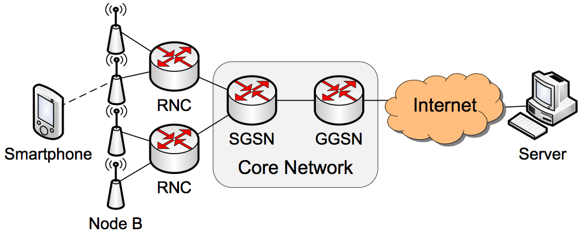
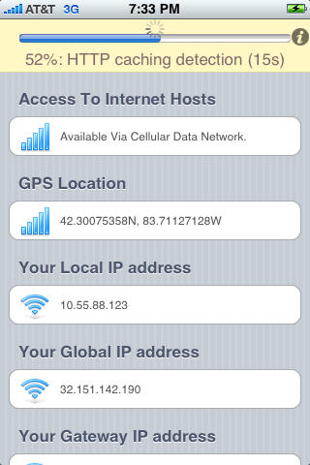
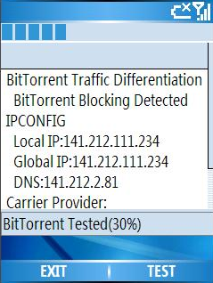
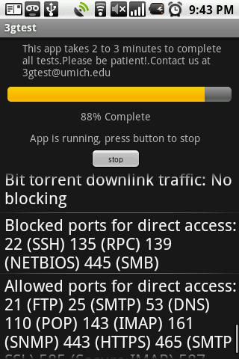
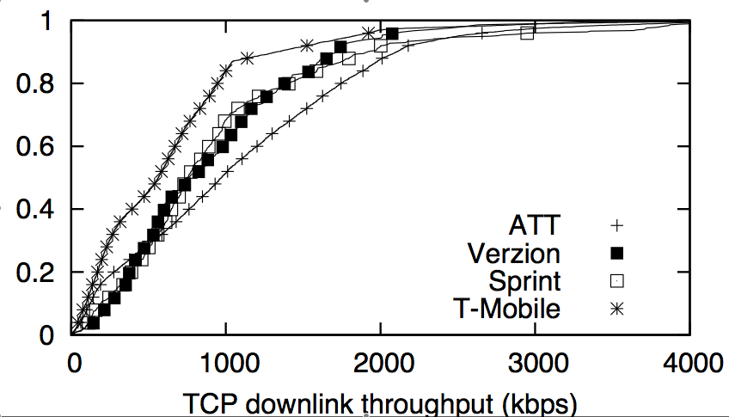
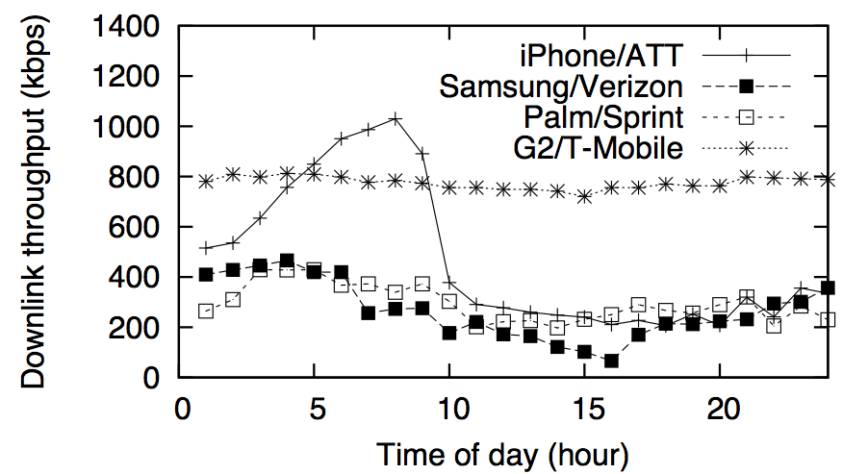
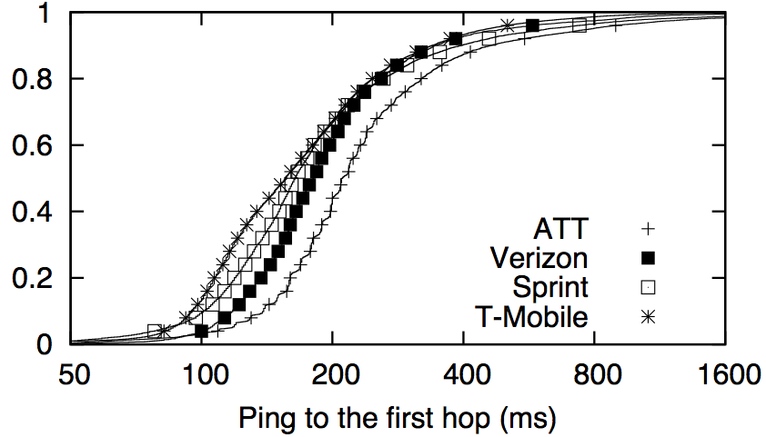
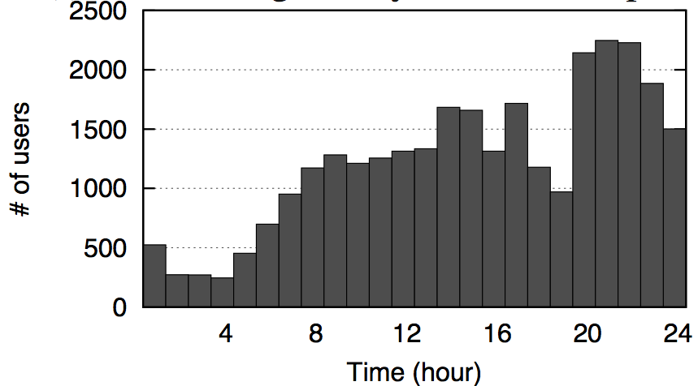
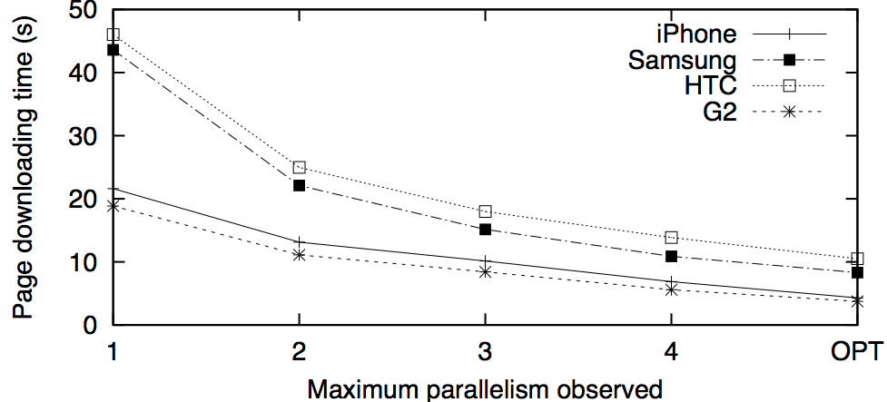
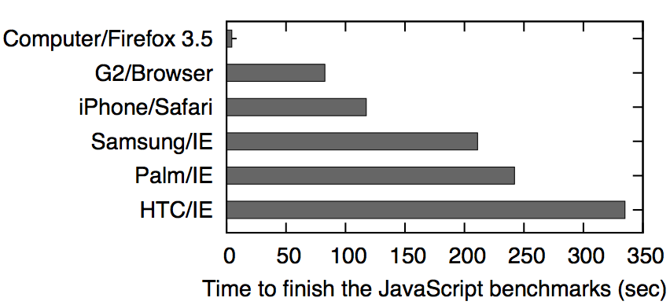
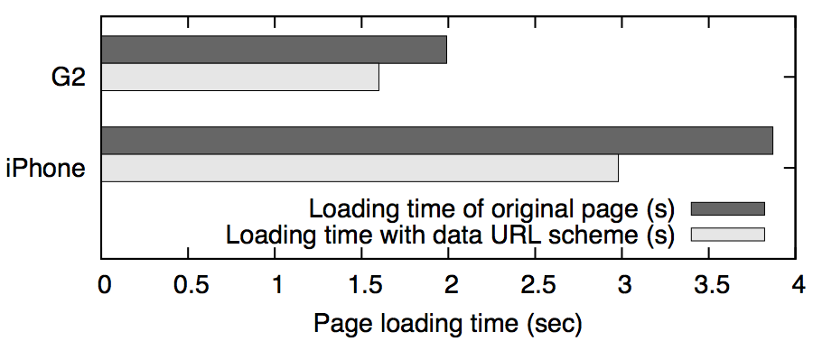
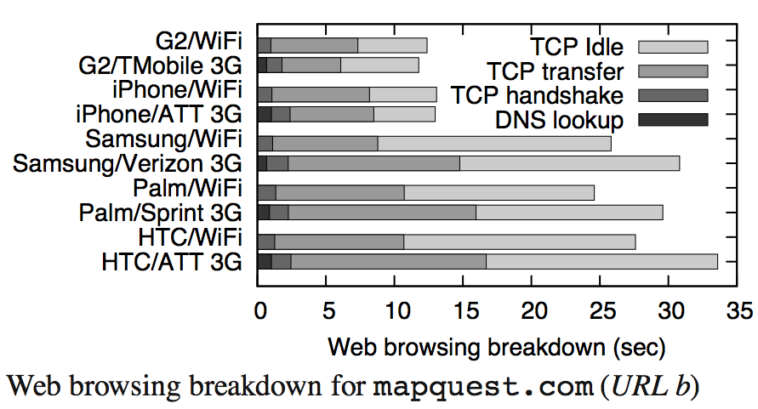

3GTest: Anatomizing Application Performance Differences on Smartphones
Junxian Huang, Qiang Xu, Birjodh Tiwana, Z. Morley Mao (University of Michigan)
Ming Zhang, Paramvir Bahl (Microsoft Research)
Introduction
Platforms and measurement tools
Network performance analysis
Application performance analysis
Smartphones and network-based applications are increasingly popular, such as iPhone, Android phones and Windows Mobile phones.
Application performance is important for user experiences.
All sorts of factors may affect application performance, such as device, OS, carrier, application software, signal strength, time of day, etc.
Understanding the performance bottleneck is the first important step to improve user experiences.
3G Network Topology
We designed a cross-platform tool 3GTest on iPhone, Android and Windows Mobile.
3GTest measures more than 20 different network properties, such as downlink / uplink bandwidth and latency, etc.
Till March 18, 2010, 53,000+ users have run 3GTest for 125,000+ times. We also continuously ran 3GTest for weeks for detailed analysis.
(1) iPhone (2) Windows Mobile (3) Android
3G downlink throughput ranges from 500kbps to1Mbps, and 200kbps to 400kbps for uplink throughput, all 40% - 70% lower than the advertised rate.
Some carriers show clear time of day pattern on weekdays, especially for AT&T’s downlink service.
Sprint and Verizon have higher packet loss rate compared with AT&T and T-Mobile.
Wireless delay dominates total RTT.
Parallel HTTP connections improve performance. Default setting is not optimal, 30% can be improved.
Server-side compression improves Web browsing by 20% on average.
Content optimization is important.
3G network performance and client execution speed are both bottlenecks.
Project website: http://www.eecs.umich.edu/3gtest
RobustNet Research Group, EECS, University of Michigan

