Slide 1
車輛租賃管理系統 Car Rental Management System
111599003 郭振洋、111598034 郭駿頤
Department of Computer Science and Information Engineering National Taipei University of Technology
Taipei, Taiwan

Slide 2
PROBLEM STATEMENT
目前常見的租車系統，並未有提供車輛相關的車況以及保養紀錄，租賃車發生事故的比例也是相當頻繁，主要是因為駕駛者對於車況的不熟悉，以及車輛的保修狀況問題的追蹤。
本APP希望除了有基本的租車系統的功能以外，新增車輛保修的管理系統，進行車輛的保修管理，並提供給承租人做為參考；並於駕駛者在使用車輛後，對於車況進行評分，提供給租賃公司進行車輛的管控，以此讓所有承租人可以安全且舒適的使用體驗。

Slide 3
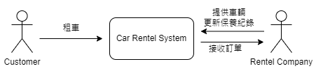
SYSTEM CONTEXT DIAGRAM

Slide 4
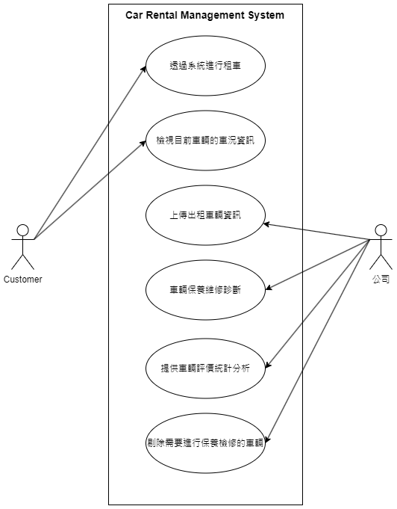
USE CASE DIAGRAM

Slide 5
DEMONSTRATION

Slide 6
SIGNIFICANT USE CASES
Update Car Information

Slide 7
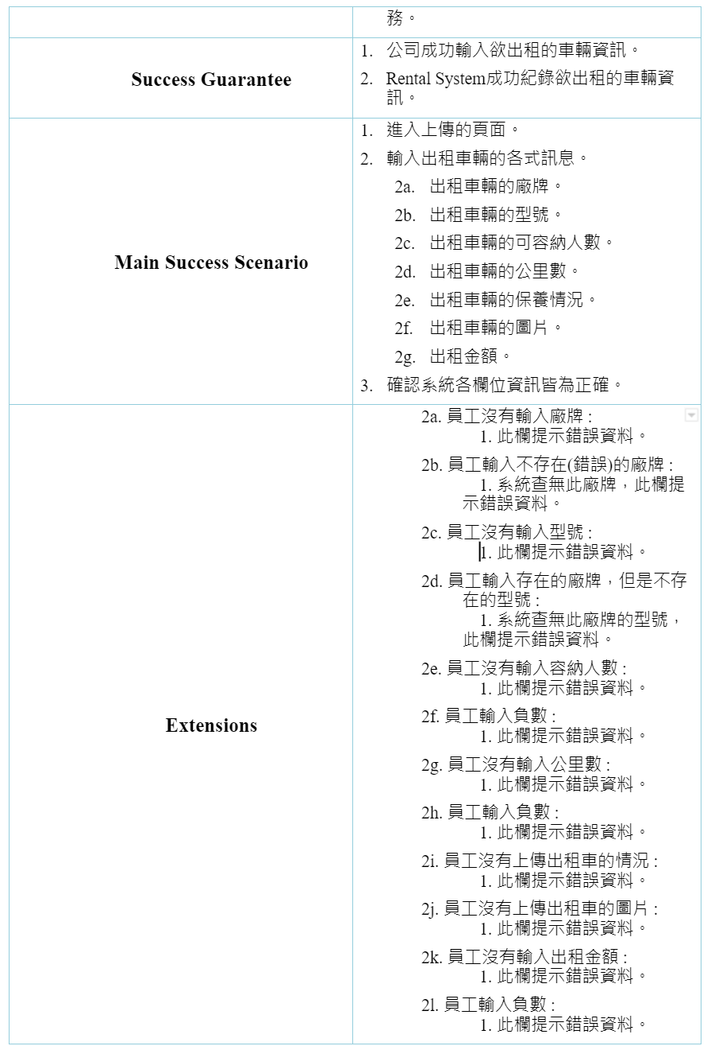
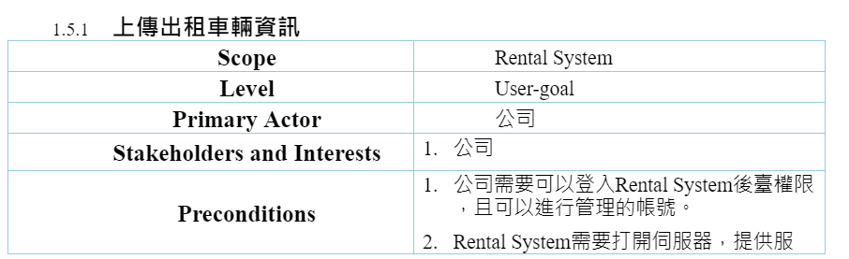
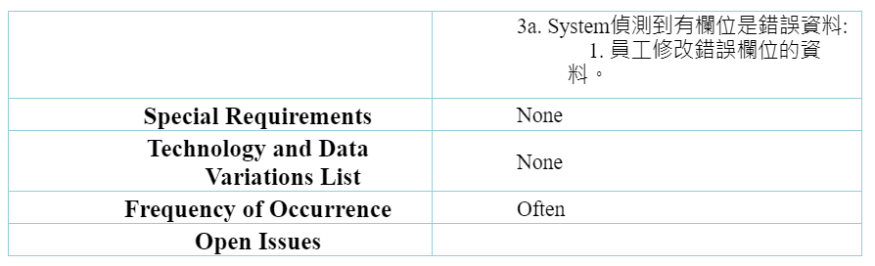
Update Car Information

Slide 8

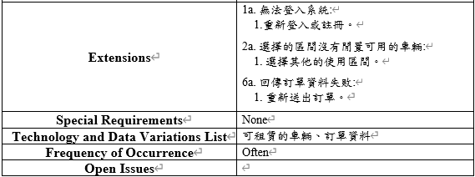
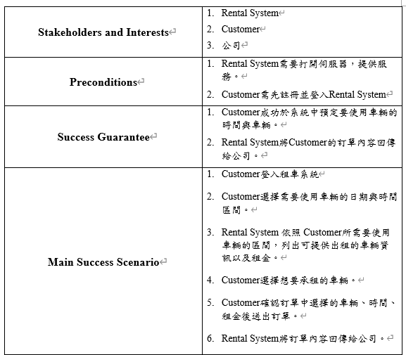
透過系統進行租車

Slide 9
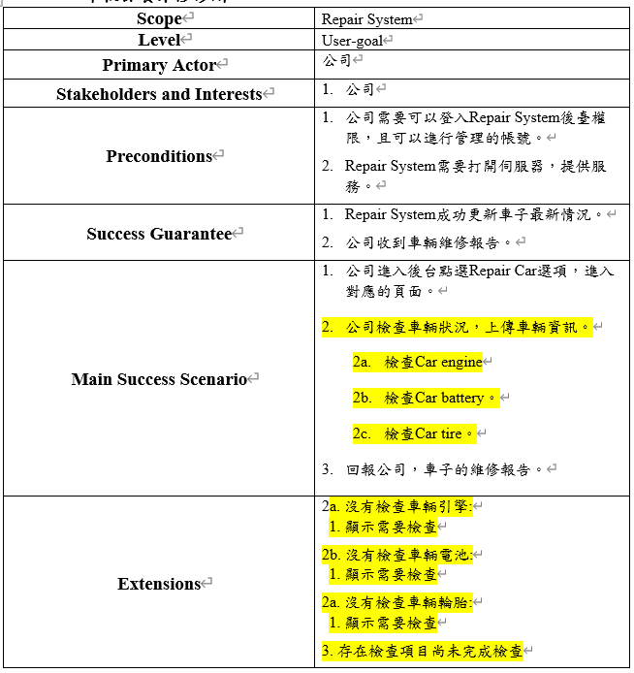
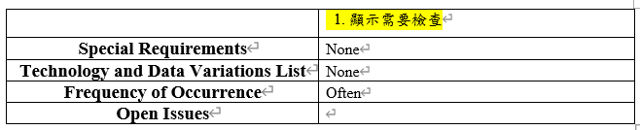
車輛保養維修診斷

Slide 10
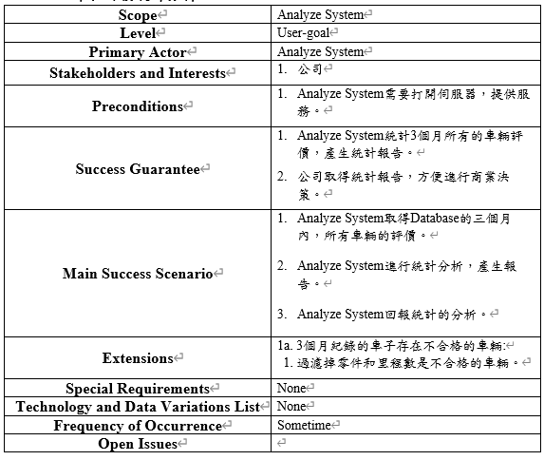
車輛評價統計分析

Slide 11
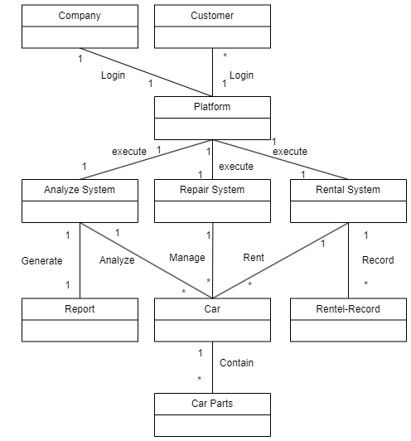
DOMAIN MODEL

Slide 12
USE CASE REALIZATIONS WITH GRASP PATTERNS
System Sequence Diagram
Sequence diagram for each system event

Slide 13
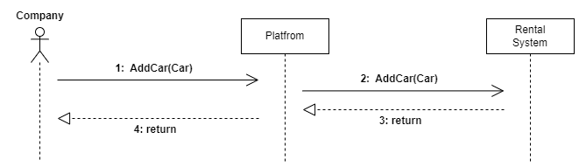
System Sequence Diagram (Update Car Information)

Slide 14
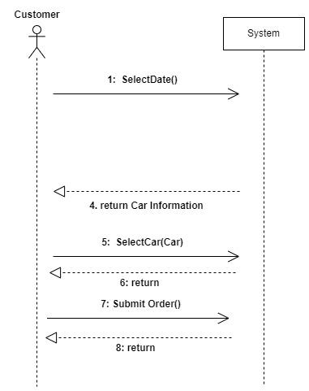
System Sequence Diagram (透過系統進行租車)

Slide 15
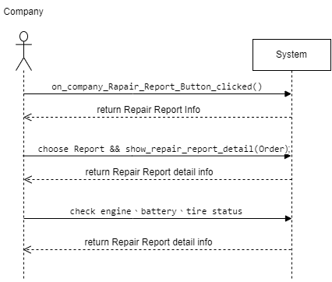
System Sequence Diagram (車輛保養維修診斷)

Slide 16
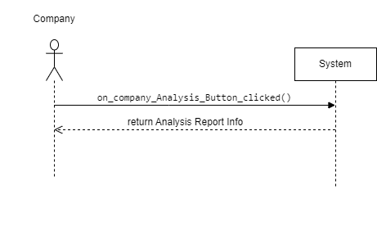
System Sequence Diagram (車輛評價統計分析)

Slide 17
USE CASE REALIZATIONS WITH GRASP PATTERNS
System Sequence Diagram
Sequence diagram for each system event

Slide 18
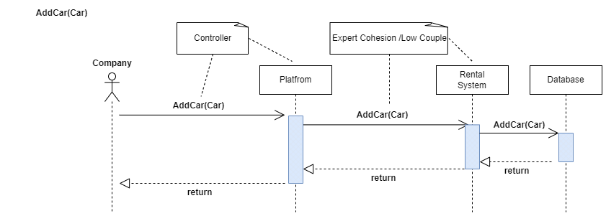
Sequence Diagram (Add Car)

Slide 19
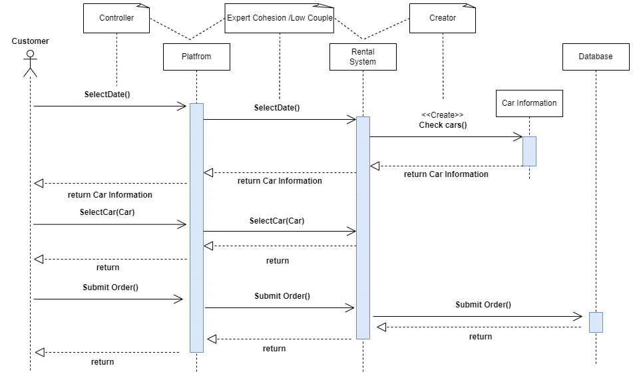
Sequence Diagram (Rental Car)

Slide 20
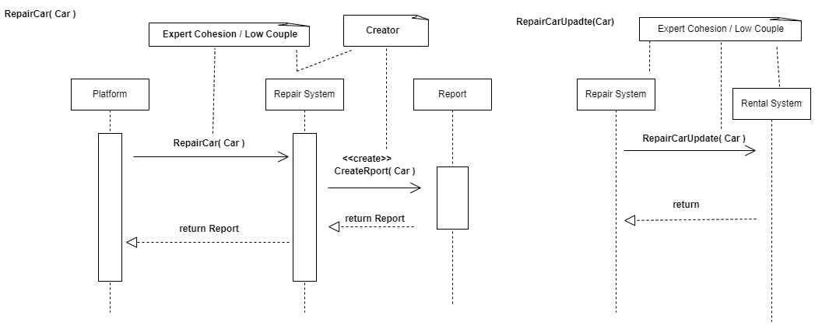
Sequence Diagram (RepairCar)

Slide 21
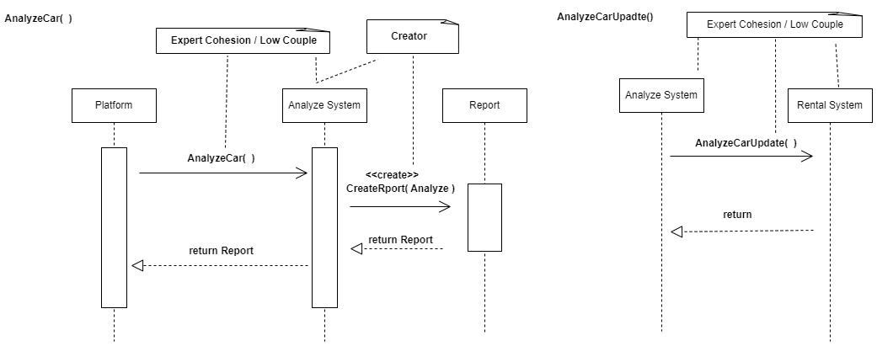
Sequence Diagram (AnalyzeCar)

Slide 22
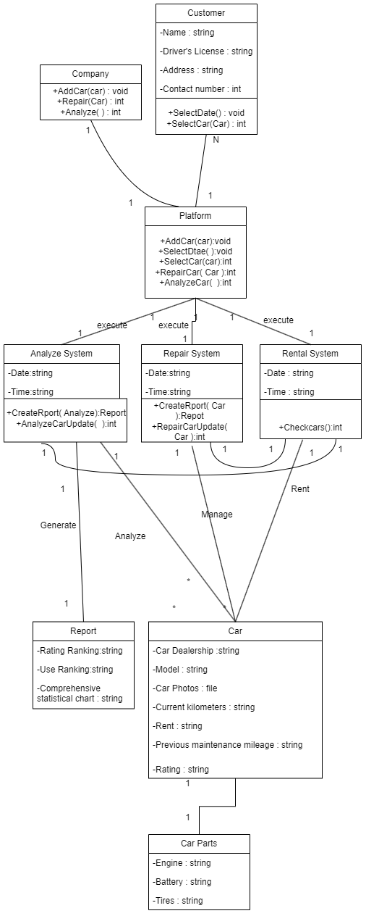
DESIGN CLASS DIAGRAM

Slide 23
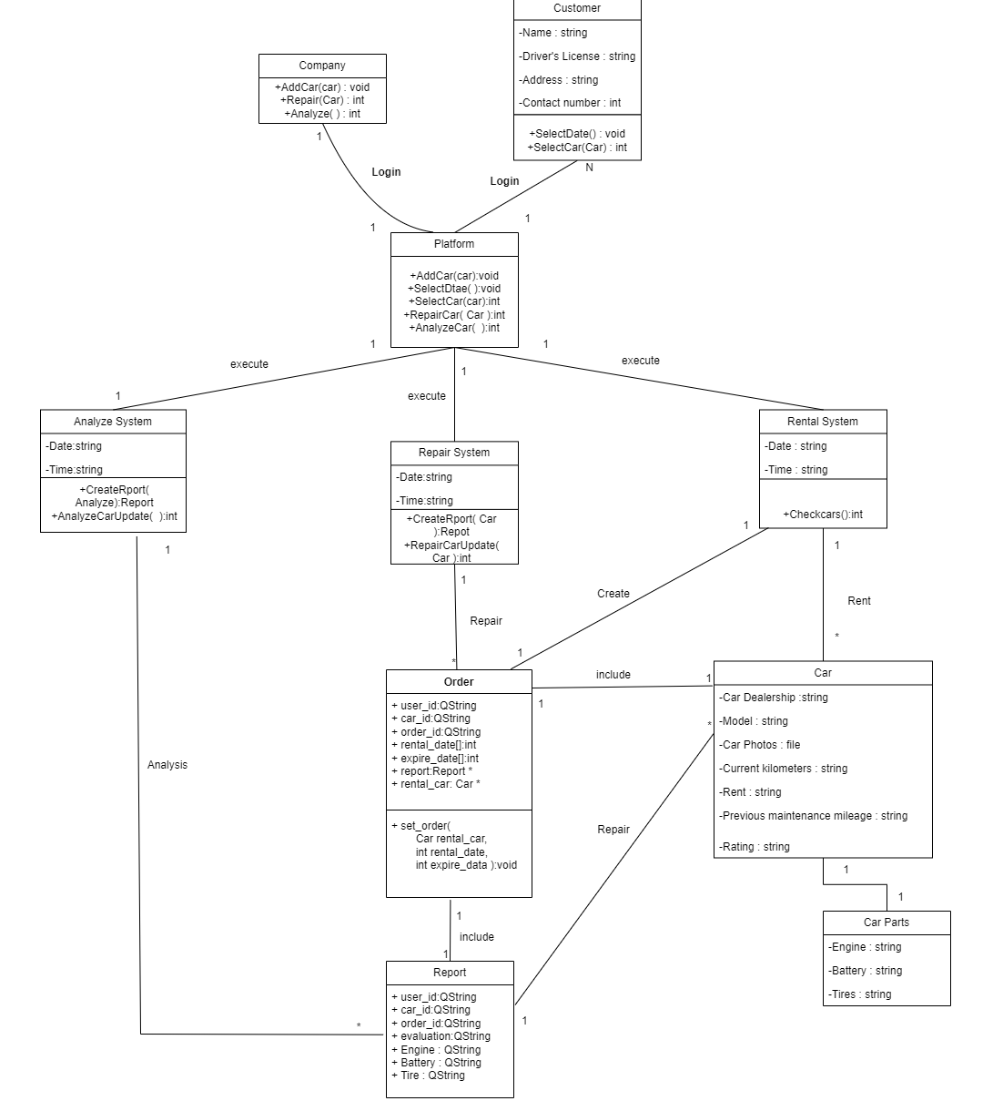
IMPLEMENT CLASS DIAGRAM

Slide 24
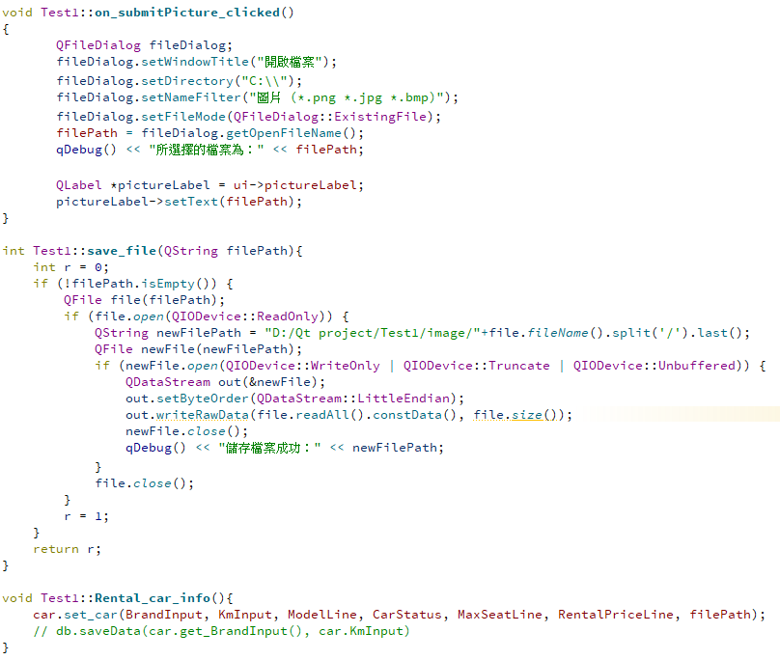
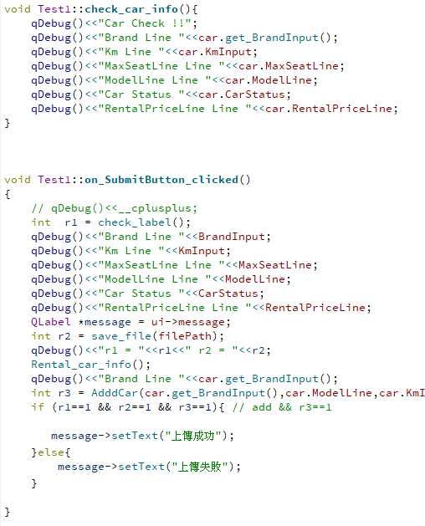
SOURCE CODE(Main)

Slide 25
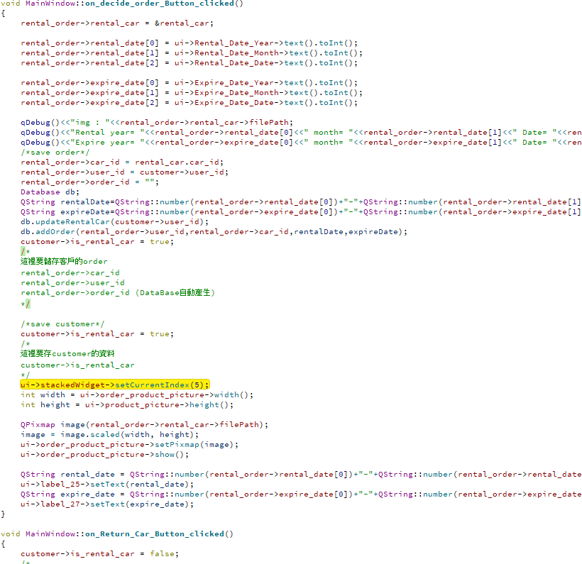
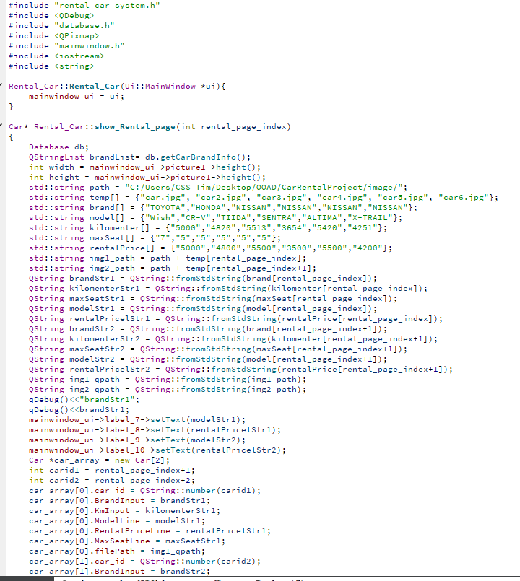
SOURCE CODE(Rental)

Slide 26
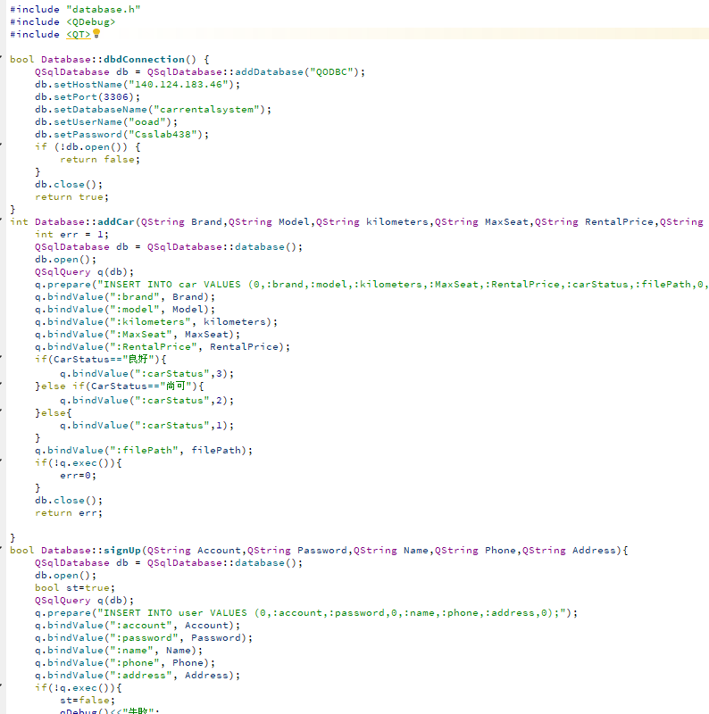
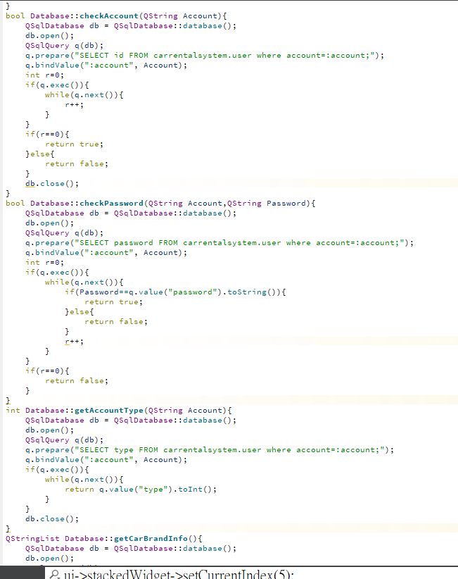
SOURCE CODE(DB)

Slide 27
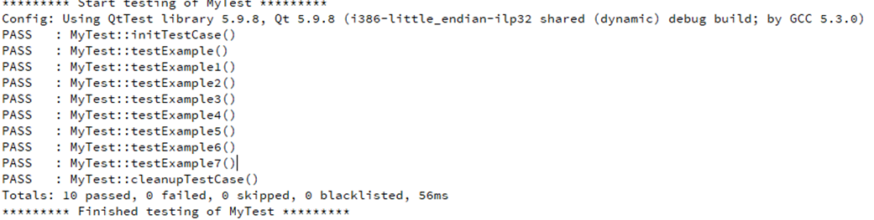
UNIT TESTS RESULT

Slide 28
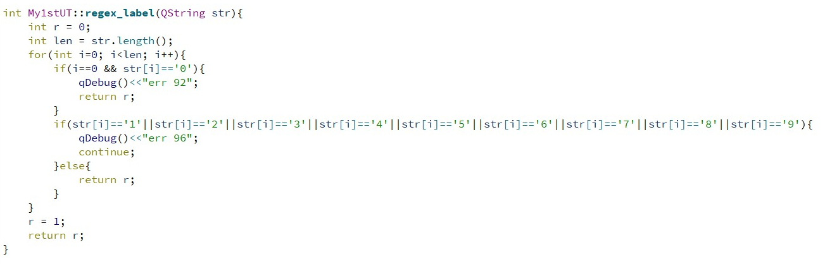
SOURCE CODE OF TEST CASE

Slide 29
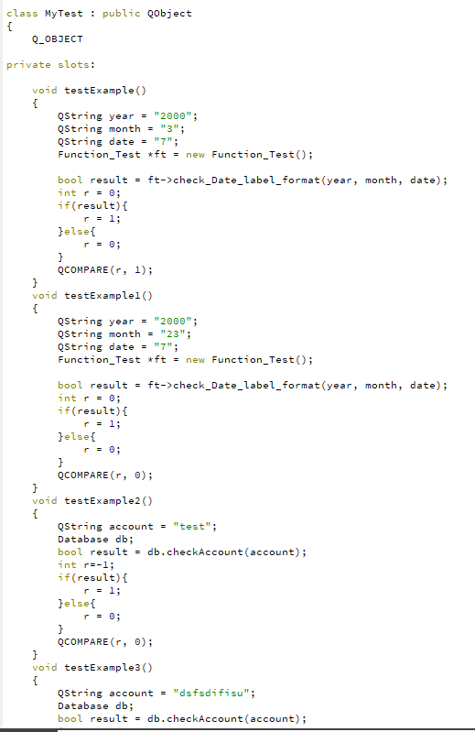
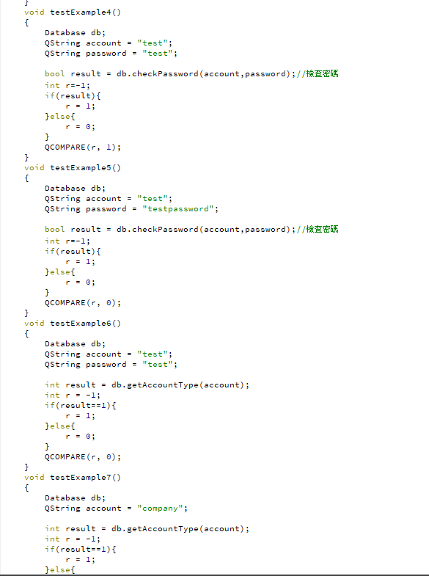
SOURCE CODE OF TEST CASE

Slide 30
PROJECT INFORMATION
Project information
SOURCE CODE | 2725
The number Classes of production code | 101
The number of Methods of production code | 53
The number of unit tests | 65
test code | 50
Team member 郭振洋 time efforts (hours) | 45.5
Team member 郭駿頤 time efforts (hours) | 45.5
Total time efforts (hours) | 91

Slide 31
Thank you for your attention.
Department of Computer Science and Information Engineering National Taipei University of Technology
Taipei, Taiwan
Notes:
This is the end of my presentation. Thank you for listening

