Slide 1
Module 1
M. Q. Michaels – Module 1.2 Assignment
Dr. Toni Farley
CSD-380
Bellevue University

Slide 2
OVERview
Introduction
Technology Value Stream
Lead Time vs. Processing Time
Common Lead Time Concerns
DevOps Ideal

Slide 3
What is technology value stream?
By Definition
Three main requirements
  Start with a business proposition
  Utilize technology to create and support a service
  Provide value to the customer
Once the business objective has been defined, the work moves to development and is added to the backlog to be transformed into a feature.

Slide 4
Lead time vs. processing time
Lead Time
Processing Time
Begins when a request is made
Stops when a request is fulfilled
Includes all aspects: waiting, communication, development, handoffs, and all others
Focus on full experience of a customer waiting for a feature
Starts when work begins
Stops when a request is fulfilled
Doesn’t include idle time (i.e. no work is being done)
Focus on development time

Slide 5
Why does it matter?
Distinction Matters
Lead time reflects customer experience & processing time shows active work effort
Any gaps between lead & processing times lead to delay
Any gaps or focus only on processing time can lead to lost value

Slide 6
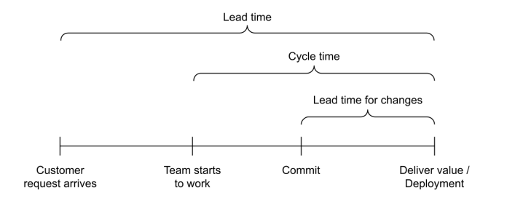
Example lead vs. processing (cycle) time
Visual via: https://blog.codacy.com/how-to-measure-lead-time-for-changes

Slide 7
Long Deployment Lead Times
Unstable value and extended crunch times
Common in large organizations with complex systems
Commonly present in situations with multiple environments and large lead time between implementations in those (e.g., copying from TEST to QUAL to PROD environments)
Usually requires heroic late-stage work
Fixing issues can take an extended amount of time
Value to customer is unpredictable

Slide 8
DevOps Ideal
Lead Time of Minutes: What We Need
Small commits & batch work
Automated testing
Defined deployment pipelines
Modular architecture
Parallel workflows – testing performed while development continues
Frequent deployments to all environments (including PROD)

Slide 9
References
Name | Author | Link | Date Accessed
Cycle Time vs. Lead Time: A Comprehensive Guide | Leah Brown | https://itrevolution.com/articles/cycle-time-vs-lead-time/ | 12/20/2025
How to measure Lead time for changes? | Codacy | https://blog.codacy.com/how-to-measure-lead-time-for-changes | 12/20/2025
The DevOps Handbook | Gene Kim et al | Course Textbook | 12/20/2025

