Slide 1
Module 9 M. Q. Michaels Dr. Toni Farley CSD-380 Bellevue University

Slide 2
OVERview
Just Culture in DevOps
Why it matters
Organizational barriers
Cultural barriers
Technical barriers
Leadership challenges
Key takeaways
References

Slide 3
What Is Just Culture in DevOps?
Promotes blameless feedback and review processes focusing on systems and learning rather than blaming individual contributors
Ties in with emotional safety and continuous improvement
Encourages open reporting of incidents without fear of retaliation, which is vital for org & team resilience

Slide 4
Why Just Culture Matters
DevOps thrives on fast feedback and cross-functional collaboration
Without safety to report errors, teams hide problems
Blame culture leads to defensive stances from the team and slows innovation
Blameless environments allow teams to focus on system weaknesses, not on individual fault

Slide 5
Organizational Barriers
Silos and communication issues
DevOps requires breaking down traditional development & operations departments
Silos prevent shared understanding and teamwork
Lack of leadership support
Without leadership’s support, DevOps initiatives usually fail
Resistance from teams
Legacy roles can resist change due to fears of redundancy with automation

Slide 6
Cultural Barriers
Fear of blame
People avoid reporting problems if past reactions were negative
Not knowing Just Culture vs. having no acountability
Just Culture can be interpreted as no consequences, leading to resistance or misuse of it
Resistance to change
DevOps is a culture shift, not just a change in tools, so it requires change management

Slide 7
Technical & Process Barriers
Focusing on tools instead of collaboration
Teams often adopt DevOps tools but don’t plan to change their collaboration and teamwork so the tools aren’t useful
Lack of feedback
Without visibility, teams cannot learn effectively
Poor incident follow up and review processes
Post-mortems that focus on blame rather than causes discourage Just Culture

Slide 8
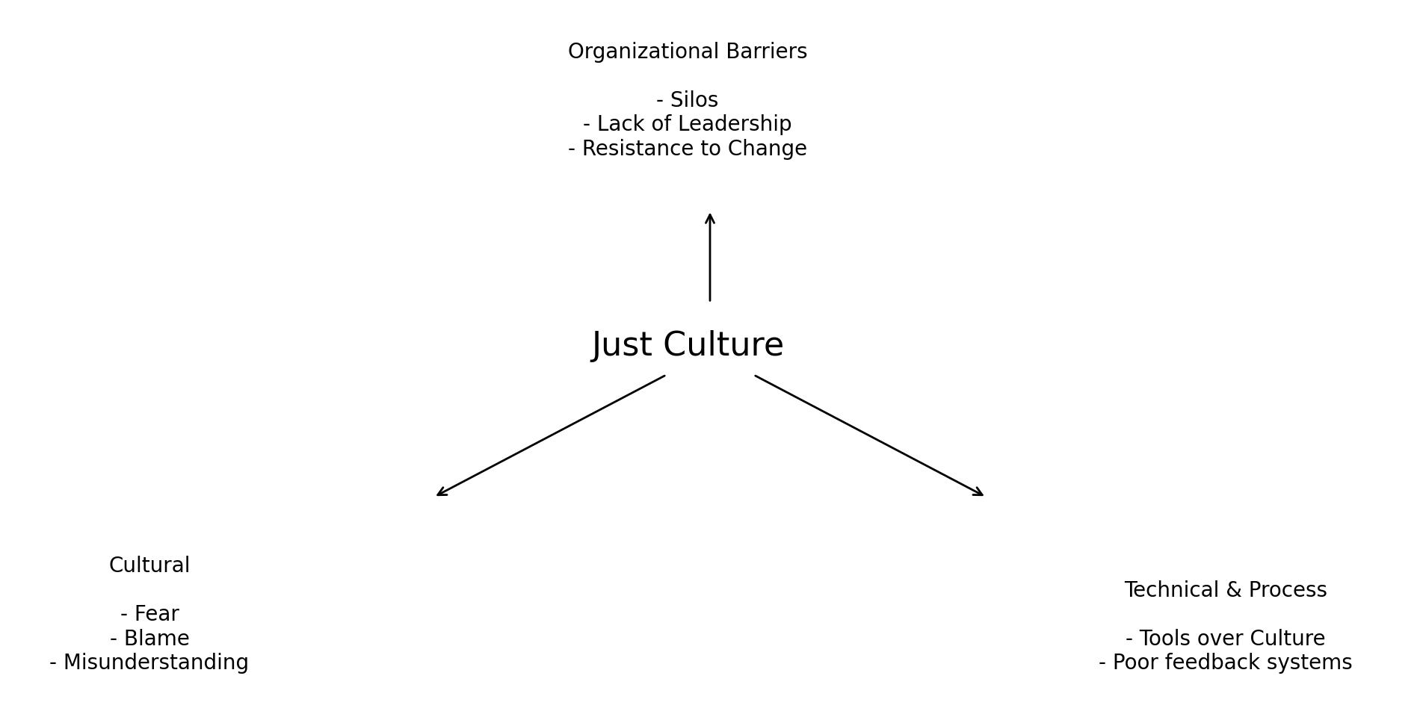
BARRIERS GRAPHIC

Slide 9
references
https://devops.com/how-sre-creates-a-blameless-culture/
https://www.atlassian.com/devops/what-is-devops/devops-culture
https://www.atlassian.com/blog/teamwork/how-to-cultivate-a-blameless-culture

