Slide 1
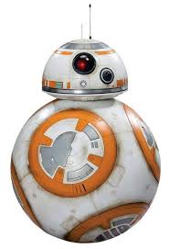


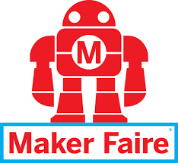
Quincey Daniel
Nova-Labs Intern
BB8 Project

Slide 2
Conventions, Events, and Social Media
Take BB-8 to maker events such as Maker Faire, to show off cool work being done at NOVA Labs to other makers.
Take BB-8 to non-maker events, such SCI-FI conventions, to spark interest for potential new members of NOVA Labs.
Take BB-8 to social media, such as BB-8 Facebook’s BB-8 Builders Club, to document my progress at NOVA Labs, and to give back to the open source community under the name of NOVA Labs.

