Slide 1

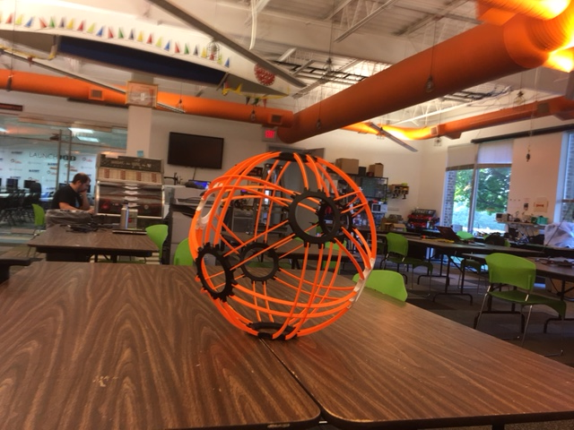


BB8 Builder Project
NOVA-LABS INTERN Quincey

Slide 2
8 cool components for my BB-8
1. using Arduino to control lighting and sound effects
2. wireless communicating with XBees
3. designing and 3d printing parts for the BB-8
For ex: the BB-8’s outer shell and unique remotes
4. using powerful neodymium magnets to keep the head on the top
5. incorporating a pendulum to turn the BB-8
6. using the same aluminum pieces (Tetrix) that are used for FTC robotics to build the chassis
7. writing the software in C for the Arduino controller
8. post my project ideas online for others to use and build
NOVA-LABS INTERN Quincey
BB-8

