Slide 1
Multi-Agent Reinforcemen Learning: Avoiding Tragedy of the Commons
Ariel Kwiatkowski – Ben Greenberg – Quinn Dougherty
Talk by Quinn Dougherty

Slide 2



https:://quinnd.net
: /in/quinn-dougherty
: quinn#9100
quinnd@tutanota.com

Slide 3
Where I’m coming from
Was a musician and producer, did scores, ops/logistics, scripts, etc. for films and theater pieces as well as free improv here in philly (that was at least 5 years ago)
Math major at community college of philadelphia (‘16-’18)
Lambda School’s first data science cohort, later TA (2019)
Python, cloud ops, security at a startup in 2020
Participated in AI Safety Camp 5 in 2021, https://aisafety.camp
Research intern at Stanford Existential Risks Initiative
Logician (auditor, formal verification engineer) at a consultancy implementing a decentralized finance product (Cardano)

Slide 4
Where I’m coming from
Motivation:
Computers ought to be good for civilization
AI advances could be really really bad or at least suboptimal
What leverage does research have in 2021?

Slide 5
Agenda
What is reinforcement learning (RL)
What is multi-agent reinforcement learning (MARL)
What is a common-pool resource problem?
How easy is it to spin up with Ray and RLLib?
Code examples: https://github.com/quinn-dougherty/marl-cpr-talk

Slide 6
Reinforcement learning
Represent environments as states, actions, and rewards.
We “solve” these environments by (selecting actions to) maximize reward.
The study of these “solvers” (maximizers) is called reinforcement learning.

Slide 7
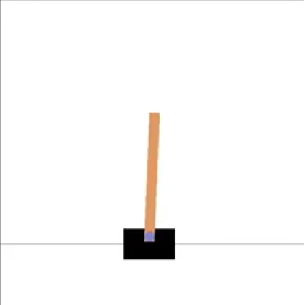
Reinforcement learning

Slide 8
Reinforcement learning
Cartpole:
States: angle, horizontal position
Actions: change in angle, change in horizontal position
State transition function: physics simulator
Reward function: large negative reward for pole dipping beneath “ground” line, 0 or small positive reward for pole staying up

Slide 9
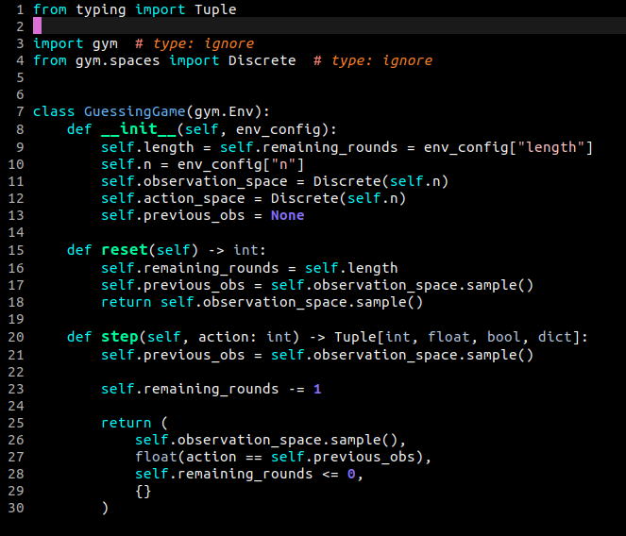
Reinforcement learning

Slide 10
Reinforcement learning
GuessingGame:
states = actions = {0, 1}
State transition function totally_pseudo_random : {0, 1} → {0, 1}
Reward function : states x actions → {0, 1} such that R(s, a) = 1.0 if s == a else 0.0

Slide 11
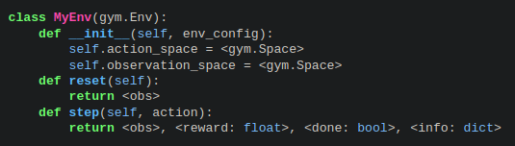
Reinforcement learning – the gym paradigm

Slide 12
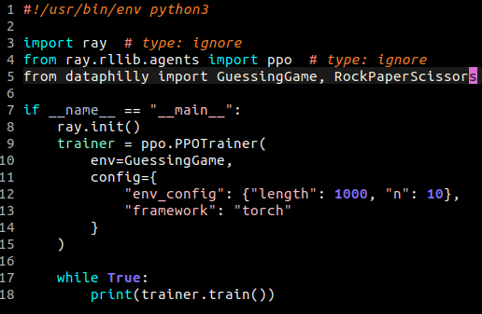
Reinforcement learning – learnit in ray

Slide 13
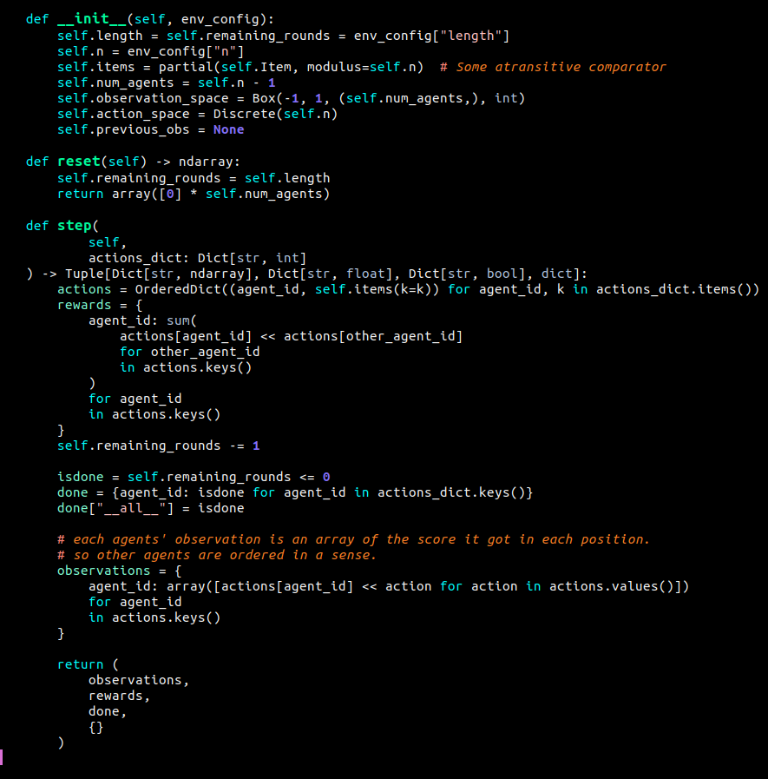
Multi-agent RL

Slide 14
Common pool resource problems

Slide 15
https:://quinnd.net
: /in/quinn-dougherty
: quinn#9100
quinnd@tutanota.com

