Slide 1
Wikipedia android app

Slide 2
group members
22BI13007 – Trần Minh An
22BI13013 – Đỗ Quang Anh
22BI13015 – Hoàng Quỳnh Anh
22BI13071 – Cao Phương Đăng
22BI13094 – Nguyễn Quý Đức
22BI13116 – Phạm Quang Dương

Slide 3
TABLE OF CONTENTS
Introduction
Preview
Future development
Demo (with emulator)
Developed product

Slide 4
INtroduction

Slide 5

Wikipedia

Slide 6
1. Main activity ii. Setting activity

Slide 7
Preview on previous status

Slide 8
i. Main activity
EXPLORE
BOOKMARK
HISTORY
SEARCH

Slide 9
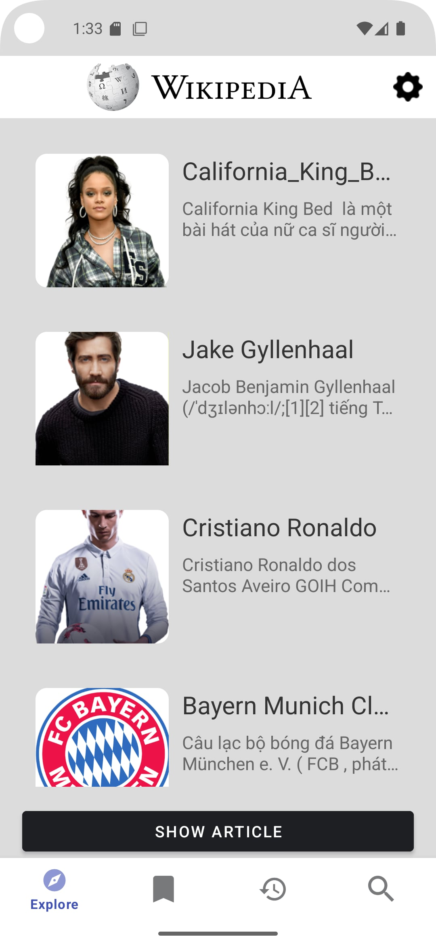

Explore

Slide 10
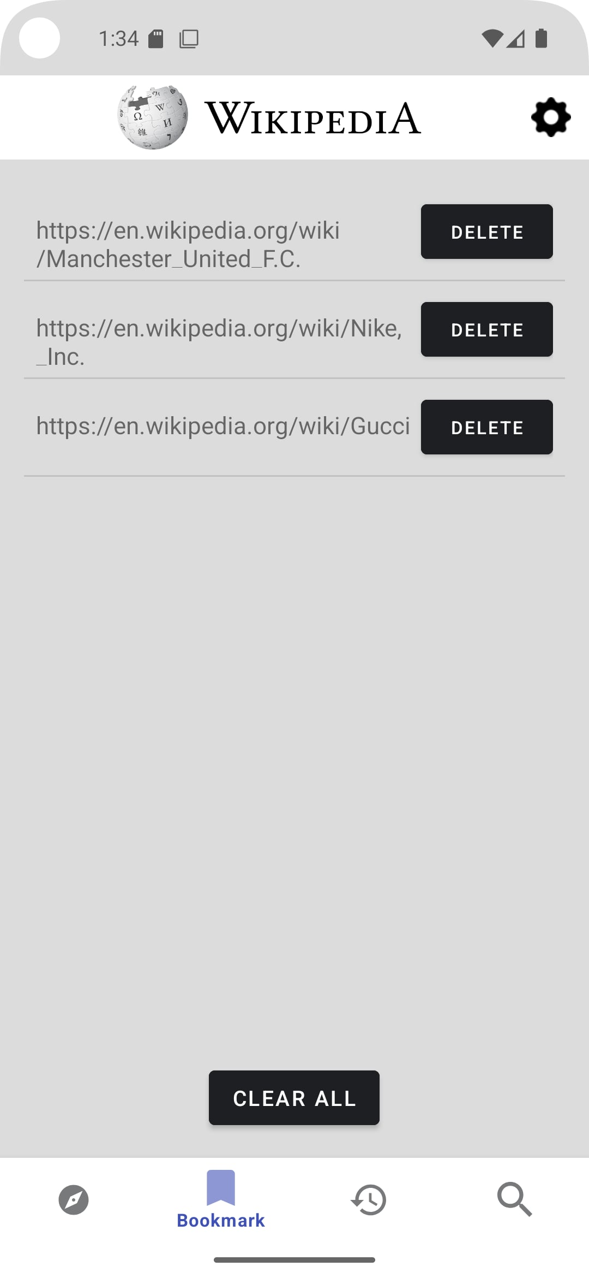
bookmark

Slide 11
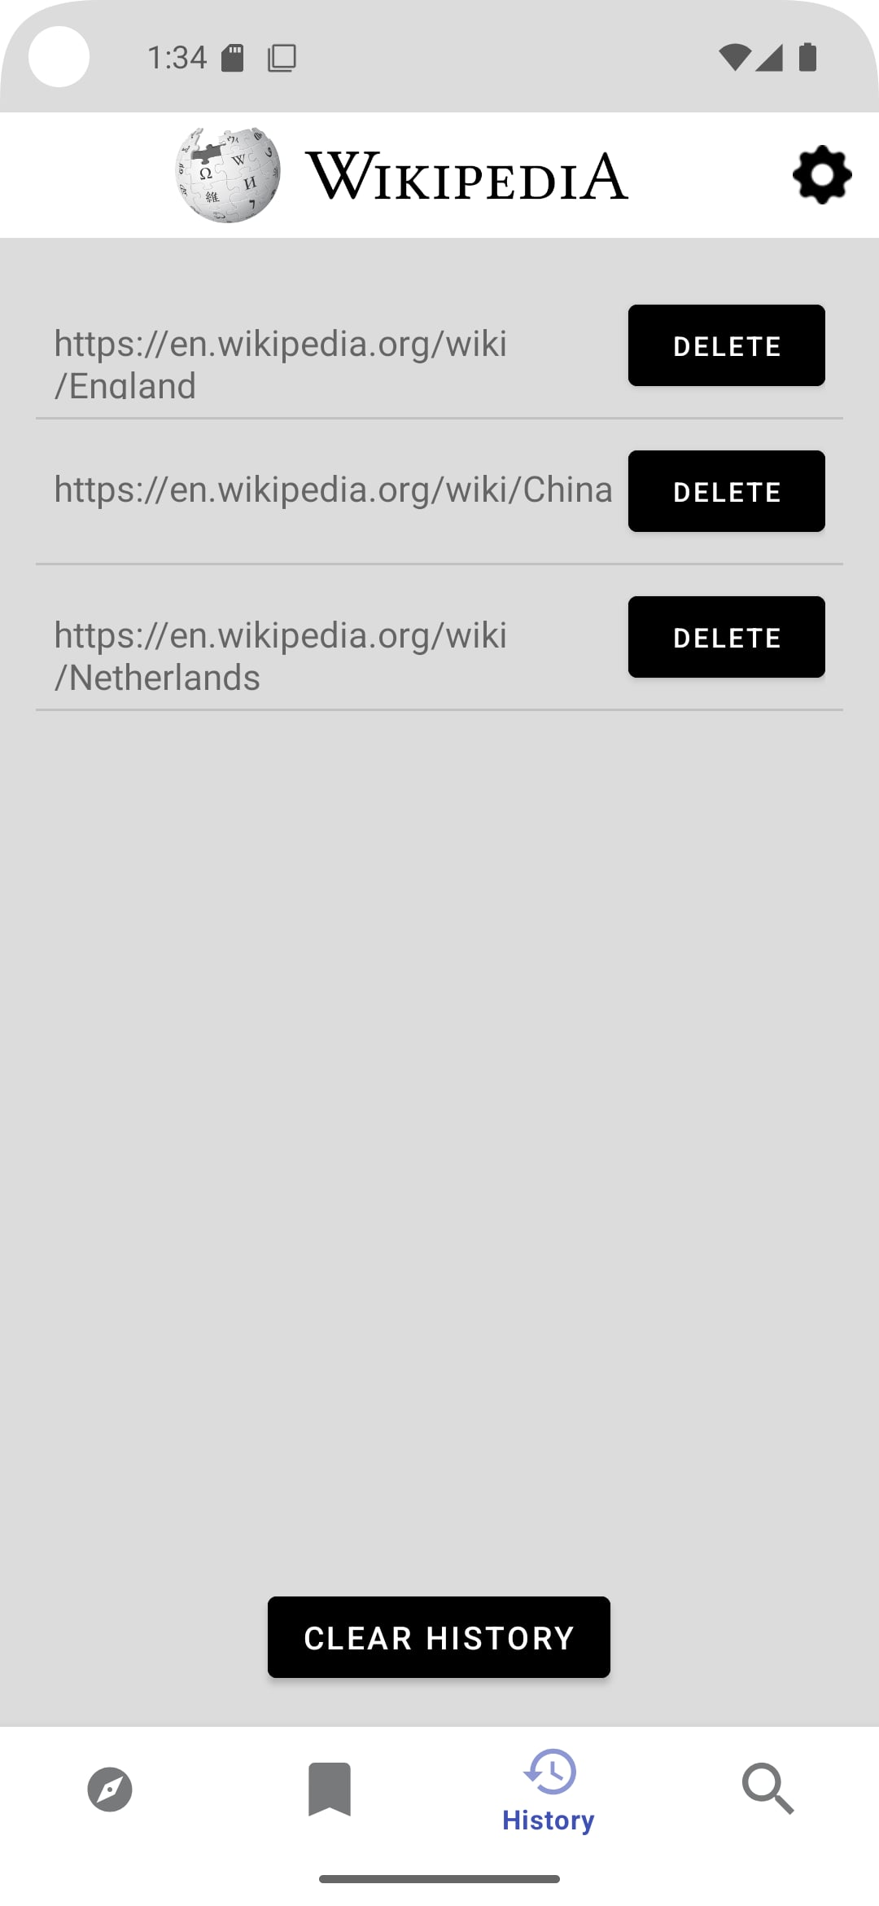
history

Slide 12
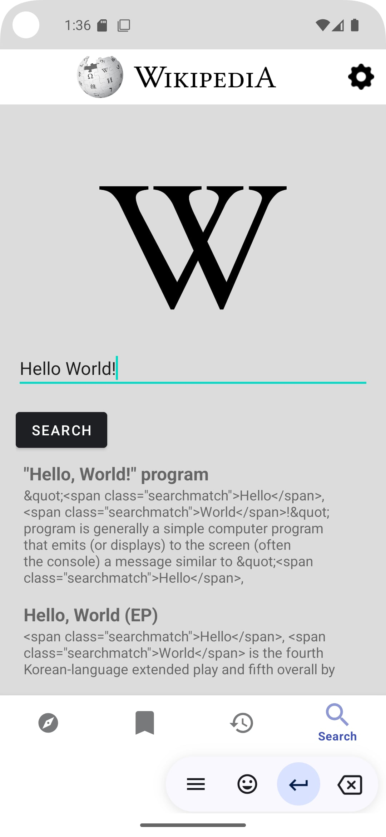
search

Slide 13
i. SETTING
LOGIN
DONATE
LANGUAGE

Slide 14
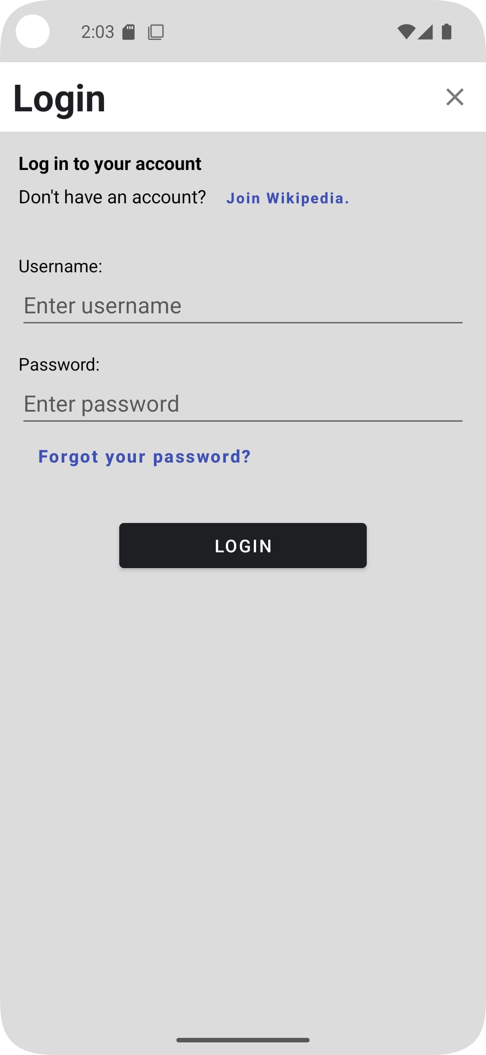
login

Slide 15
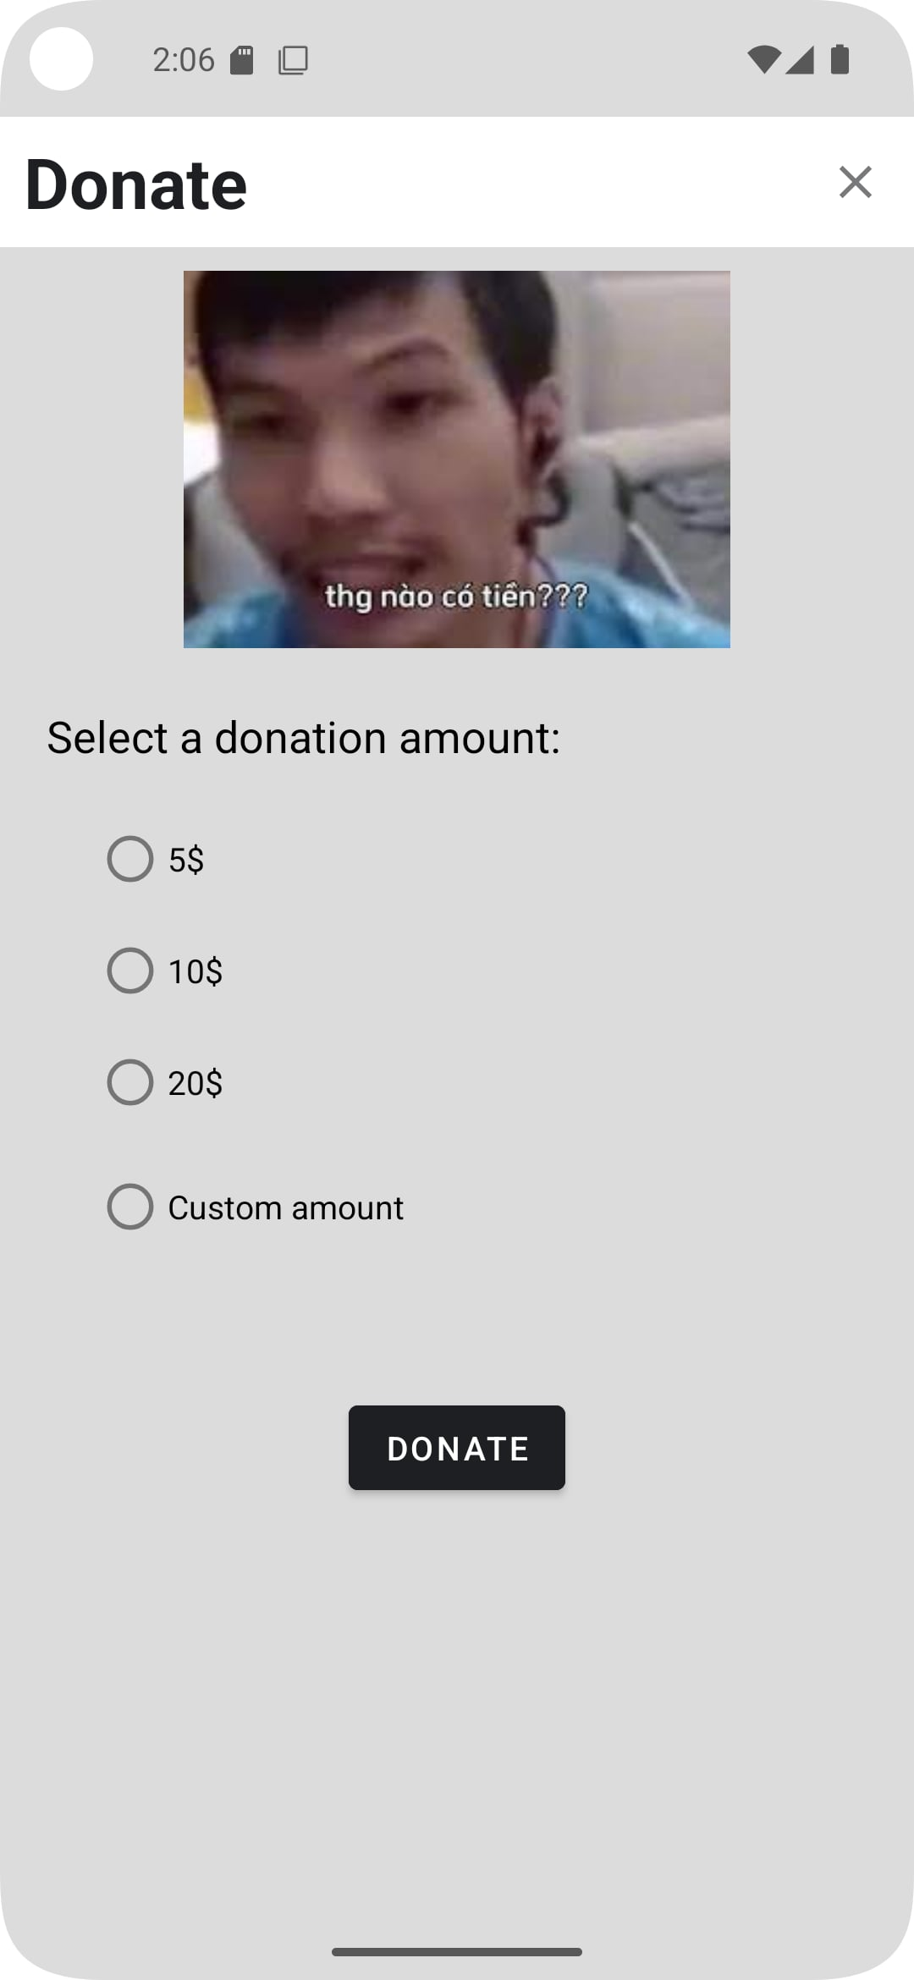
donate

Slide 16
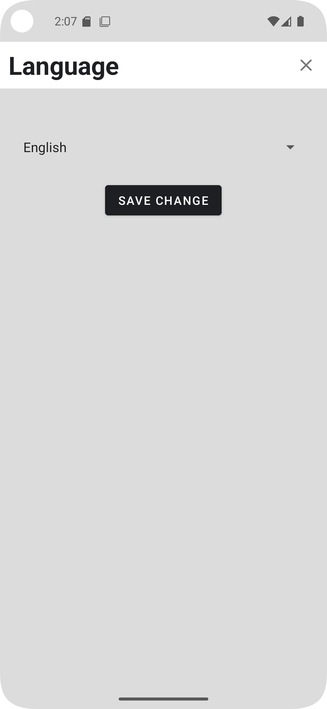
language

Slide 17
Developed product

Slide 18
i. Main activity
EXPLORE
BOOKMARK
HISTORY
SEARCH

Slide 19
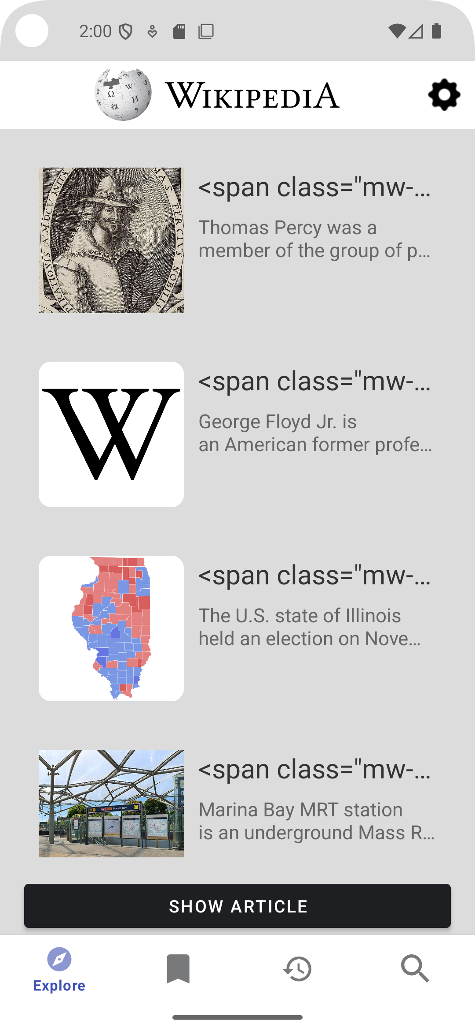
Explore

Slide 20
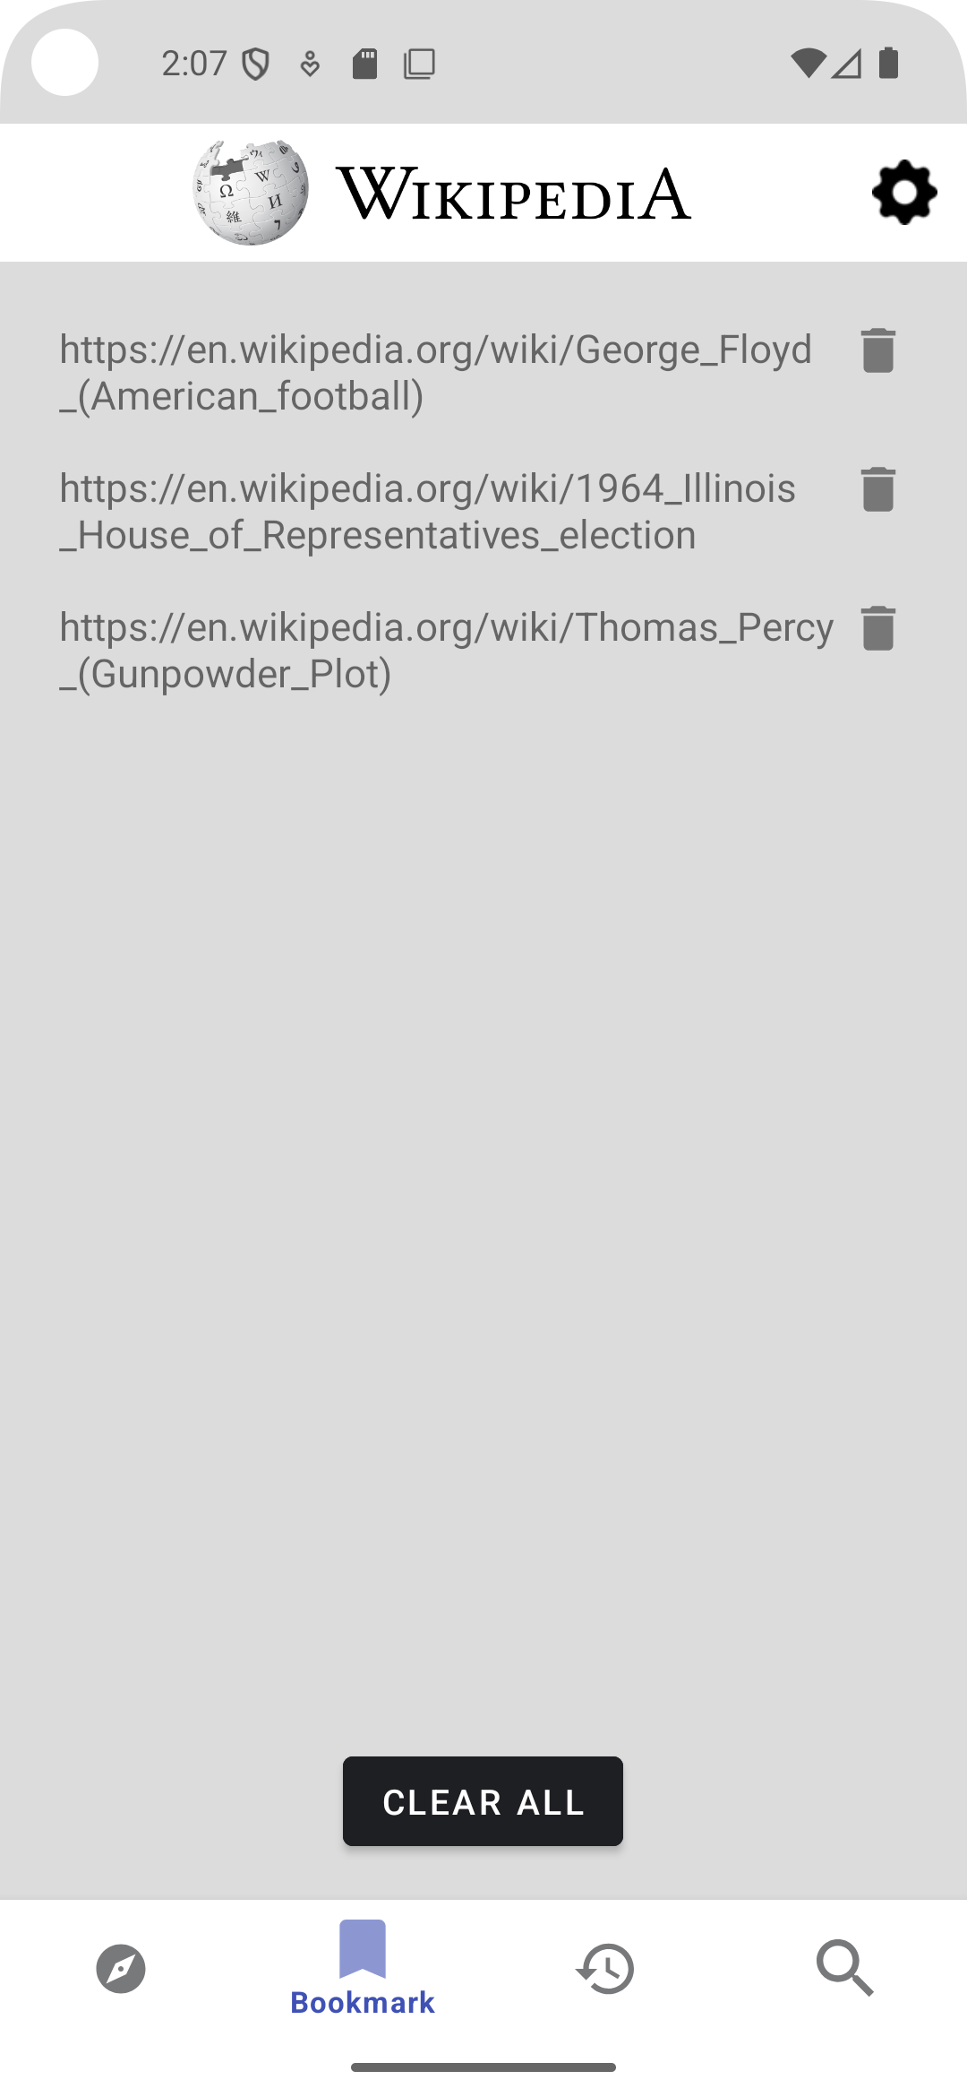
bookmark

Slide 21
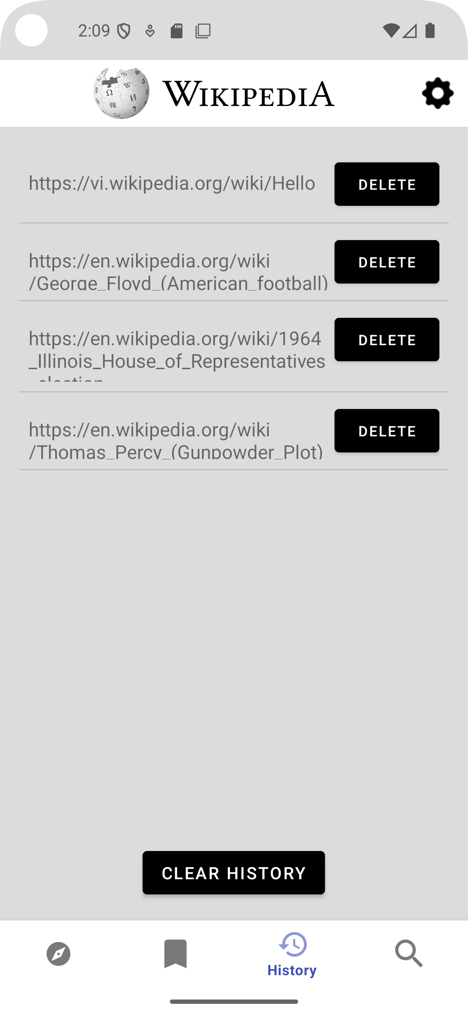
history

Slide 22
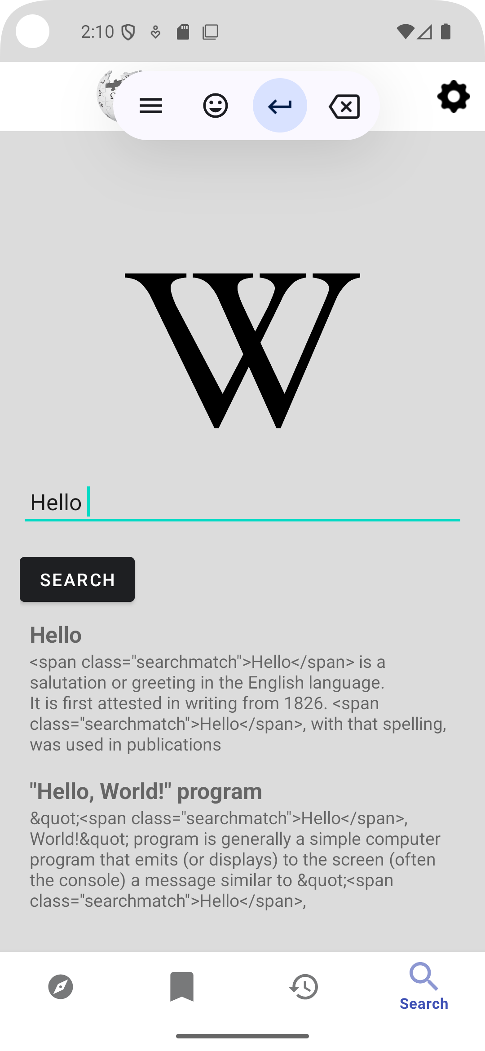
search

Slide 23
i. SETTING activity
LOGIN
DONATE
LANGUAGE

Slide 24
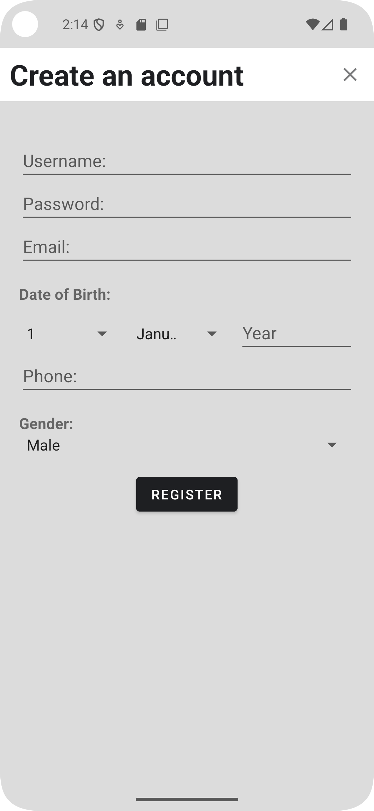
login

Slide 25
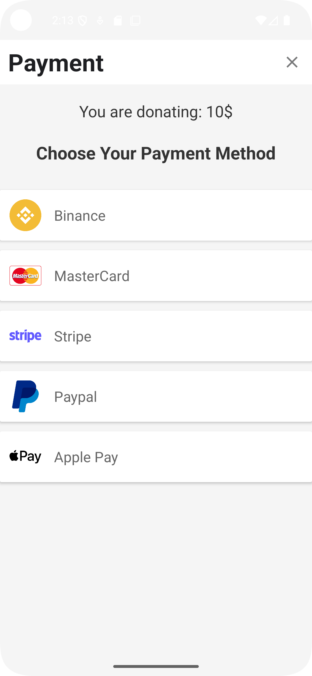
donate

Slide 26
language

Slide 27
Future development

Slide 28
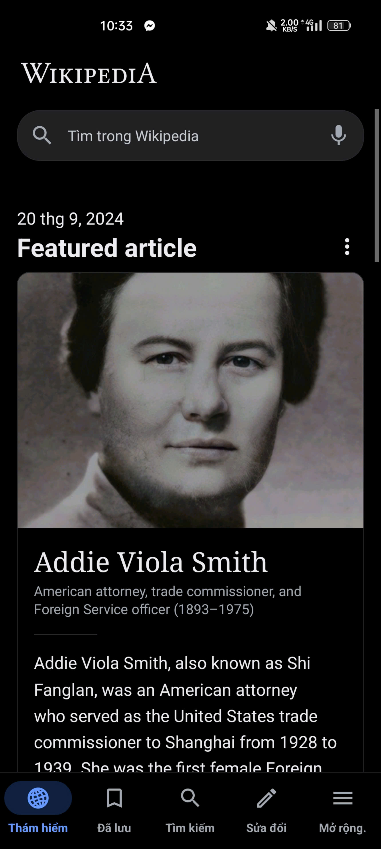
Comparing with the actual app

Slide 29
Possible future development
Improve UI
More functions
More changeable languages

Slide 30
Demo

Slide 31
Thank you for listening

