Slide 1
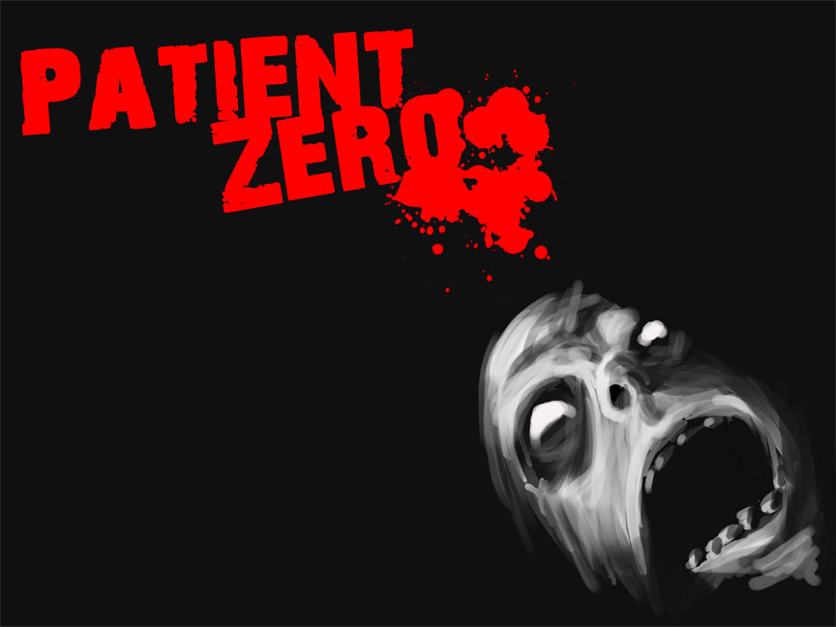
Quinn Baetz
Ryan Teel
Torre Whitmore
Ryan Marzolph
Nick Pulos
Gavin Rehkemper

Slide 2
The Story
Patient Zero puts a unique twist on the popular theme of the zombie game by letting players become the zombie outbreak itself.
The game puts you in control of the patient zero, the sole spreader of the zombie infection. It’s your choice to either kill humans, infect them creating more zombies to do your bidding, or literally become them and take their bodies as your own. Patient zero combines a puzzle top-down real time strategy game with a first person thriller in a mystery to find out how you became patient zero.

Slide 3
Cool Features
RTS/First Person View Switching
RTS allows you to control your zombie minions and have a better feel of the surrounding area
In First Person View you can attack
Enemy AI
We have an advanced waypoint system set up, allowing zombies and humans to move intelligently from place to place.

Slide 4
Cool Features
Character Attributes
There are four main player types(child, doctor, nurse, security guard) and each has specific qualities and attributes that let you progress in the game.
Player Abilities
In the game you are able to kill, zombify, or take over the humans you find. In RTS mode you are able to give specific commands to your zombie minions.

Slide 5
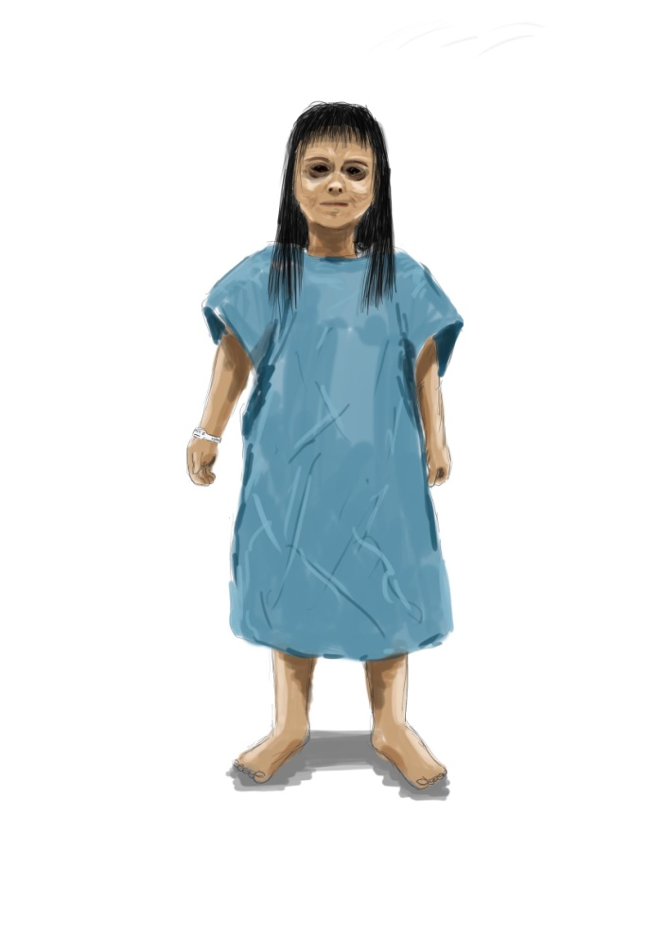
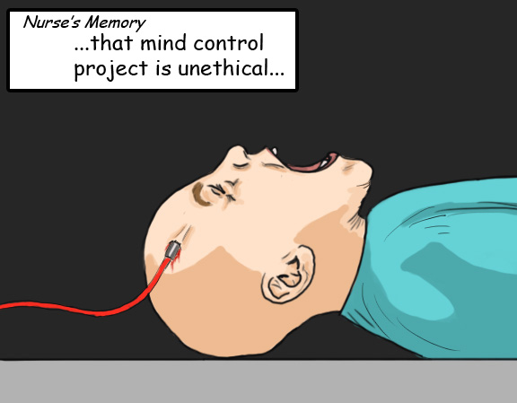
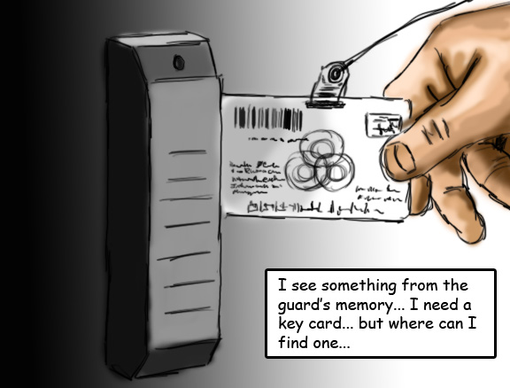
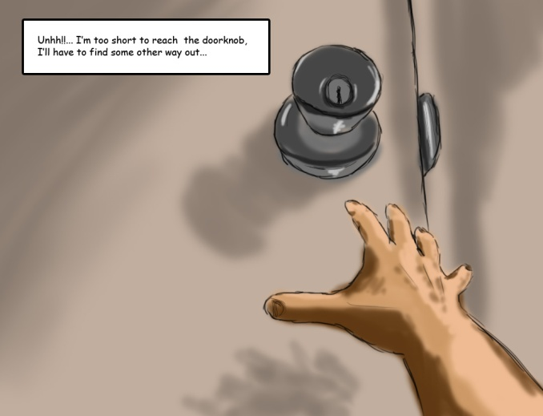
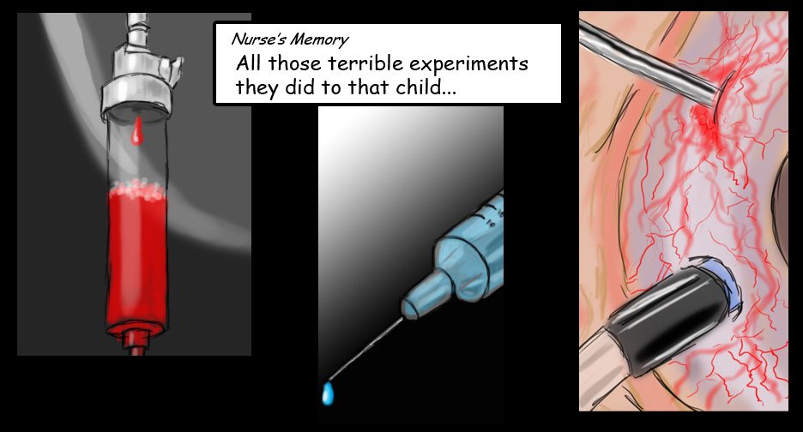
Cool Features
ROCKIN ART

Slide 6
The Team – The Programmers
Quinn Baetz – Team Leader, implementing story, fixing bugs, making sure any unfinished tasks are complete
Gavin Rehkemper – UI Design and implementation

Slide 7
The Team – The Programmers
Torre Whitmore – SVN Guru, worked on RTS, pause script, lights
Ryan Teel – Game Mechanic Superstar, worked on AI, player types, and anything else that he got his hands on

Slide 8
The Team – The Artists
Ryan Marzolph – character/level/object models, animations, textures, Cut Scenes,
Nick Pulos – Cut Scenes, Story, Level Design, level/object models,

