Slide 1

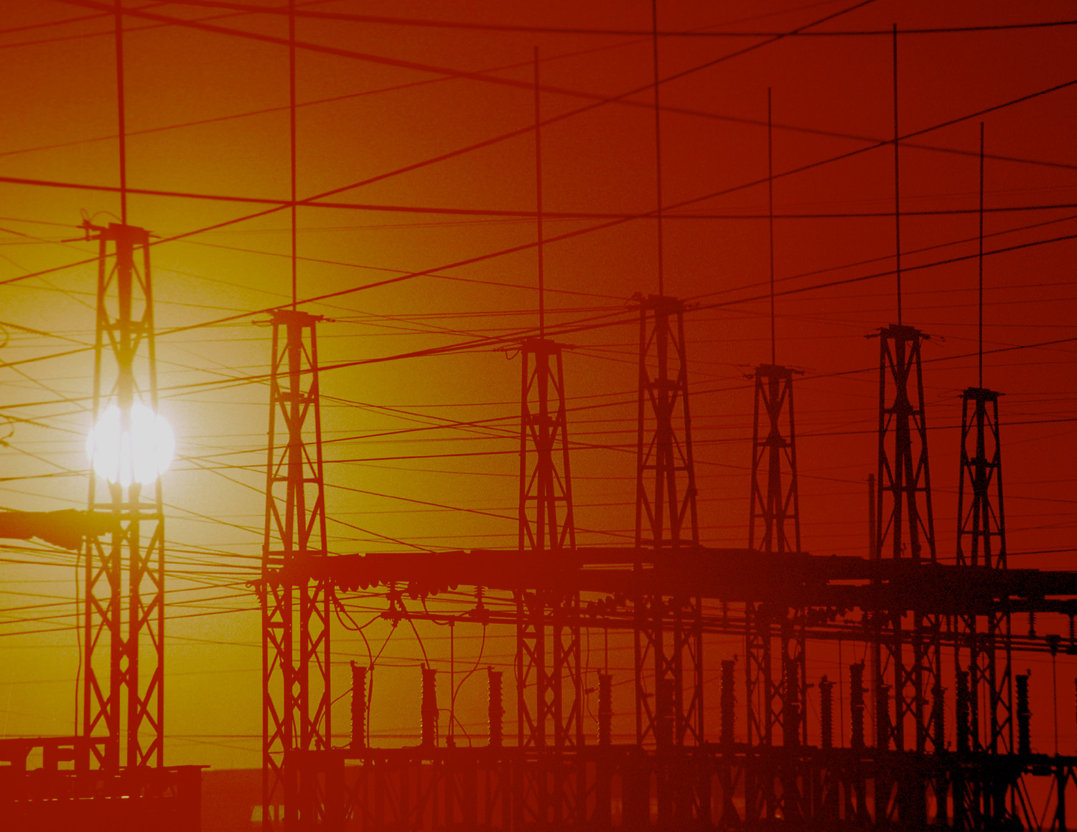





Power Grid Education
Tate, Sebestik, Reese, Overbye
Goals
Dissemination Activities
Link researchers, educators, students, and community members
Develop interactive lessons and activities
Connect with teachers
Engage students
Facilitate knowledge transfer
Broad web based distribution and links
Presentations at state and national conferences
Sharing with schools and educators
IEEE publication
Dissemination grant from Caterpillar
Mapping to Project’s Objectives
Provide resources and information to a broad audience
Increase awareness of power related careers
Broader Impact
Fundamental Questions/Challenges
New education tools for students and teachers
Communicating importance and challenges of a secure power grid to the public
Facilitating understanding of issues related to the power grid including:
  Power generation and demand
  Causes of blackouts
  Communication and delivery security issues
  Economics and emissions
  Impact of wind
  Issues related to storage
How to engage students and others in issues related to energy production, delivery, and use
Most effective techniques to engage middle-school and high school students?
Education Plan
Research scientists and education experts collaborating to develop interactive applets. Topics include:
  Power and Energy in the Home
  The Power Grid
  Power Economics and Emissions
  Wind and Storage
Each applet is accompanied by curriculum materials for teachers and students. The materials are suitable for both formal and informal education environments.
Broad dissemination through
formal and informal mechanisms.
Interaction with Other Projects
The same display library is used by other research groups
Active involvement of project researchers
Future Efforts
Continued work on new lessons:
  Effects of increased wind generation
  Impact of distributed generation
  Research into storage solutions
  Defining the smart grid
Expanded dissemination
Trustworthy Cyber
Infrastructure for Power
University of Illinois • Dartmouth College • Cornell University • Washington State University

