Slide 1
Design Exploitation and mitigation of Web Application Vulnerabilities (Flask Project)
Zain Ali (BITF24A021)
Information Security
Instructor: Sir Huzaifa Nazir
April 2026

Slide 2
Introduction
• Demonstrates common web vulnerabilities
• Built using Flask in a controlled environment
• Shows insecure vs secure implementations

Slide 3
Objectives
• Demonstrate vulnerabilities
• Exploit them practically
• Analyze impact
• Implement secure solutions

Slide 4
System Overview
Client → Flask Server → Database → Response
Session-based authentication
Role-based access (user/admin)

Slide 5
Vulnerabilities Implemented
SQL Injection
IDOR
Weak Password Hashing
Session Issues
Input Validation
CSRF

Slide 6
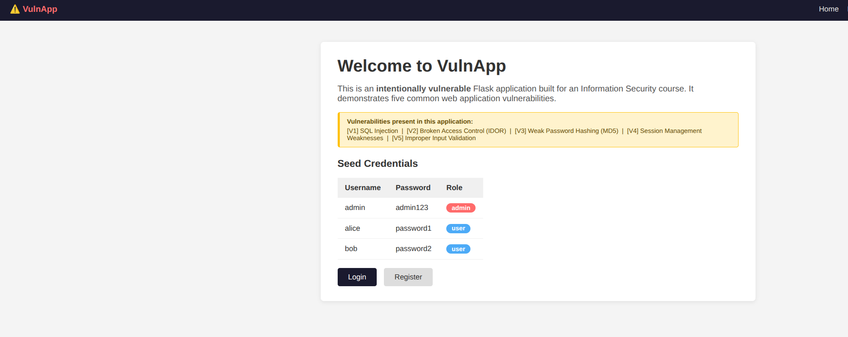

Slide 7
SQL Injection Demo
Payload:
' OR '1'='1 --
Result:
Login bypass as admin

Slide 8
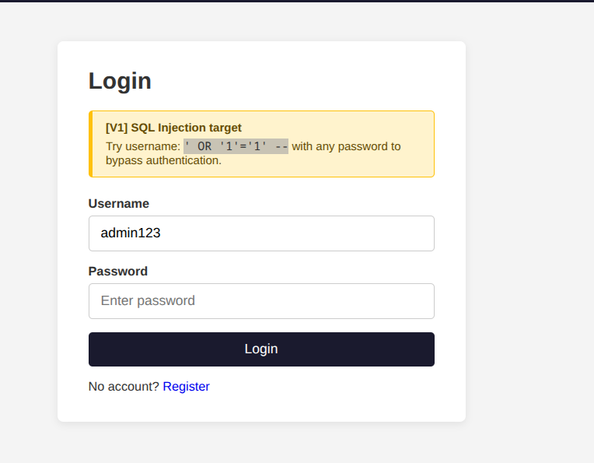
Before SQL injection

Slide 9
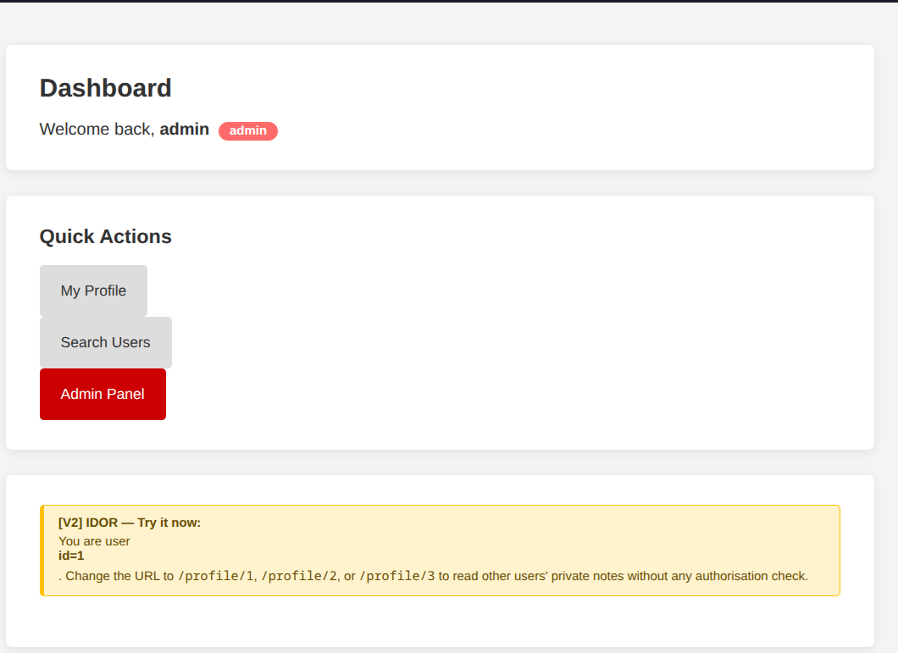
After SQL injection:

Slide 10
IDOR Demo
URL manipulation:
/profile/2 → /profile/1
Result:
Access other user's data

Slide 11
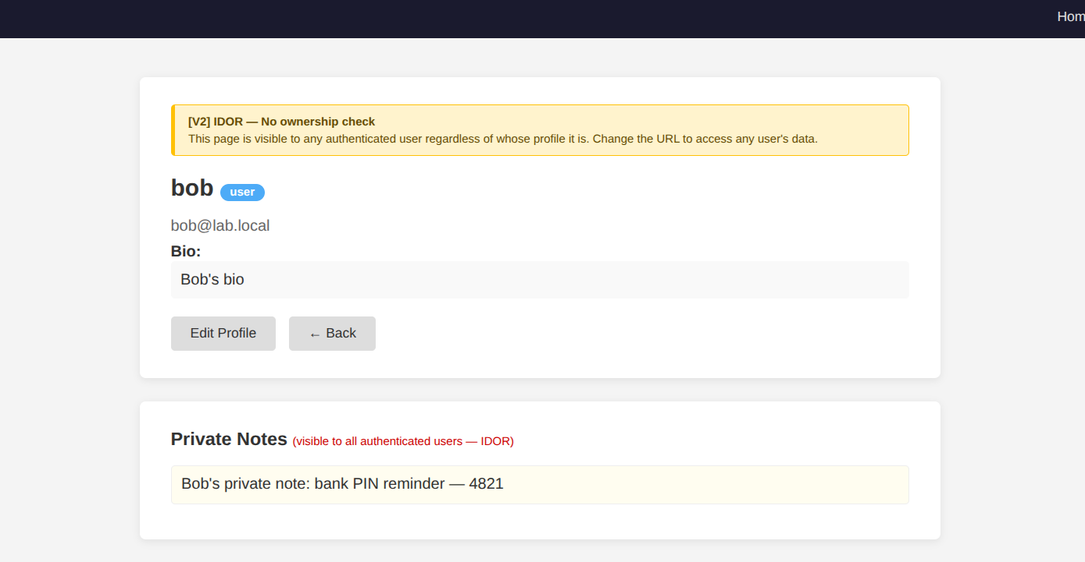
IDOR:Alice or any authenticated user can change the url to view another users private data. For e.g. bob’s PIN is exposed here:

Slide 12
Session Exploit
Weak secret key allows cookie forgery
Result:
Privilege escalation

Slide 13
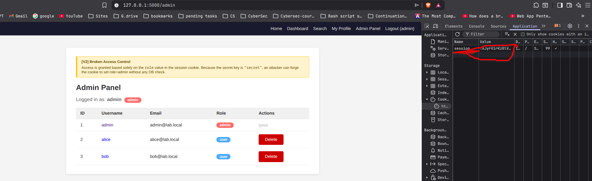
We log in as any user, steal their copy their session cookie values, use a tool to unsign those session cookies , sign it again after decoding and modifying that session cookie that used a weak key and replace the cookie value in dev-tools and access the admin panel without logging in as one.

Slide 14
Secure Version
• SQL Injection fails
• Access control enforced
• Proper validation
Blocked Attack in next slide.

Slide 15
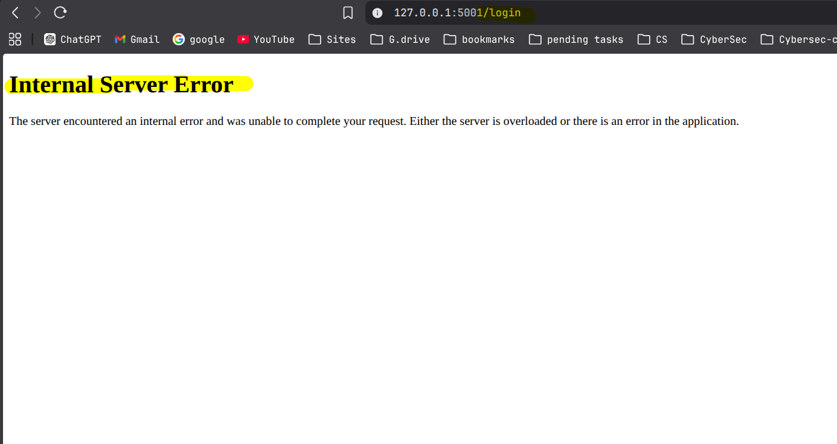
This image shows that an attempt at running a SQL injection generates an internal server error:

Slide 16
Mitigation Techniques
Parameterized queries
bcrypt hashing
Access control checks
Secure sessions
Input validation
CSRF protection

Slide 17
Comparison
Insecure vs Secure:
SQL Injection → Prevented
IDOR → Fixed
MD5 → bcrypt
Weak sessions → Secure sessions

Slide 18
Conclusion
Small mistakes → major vulnerabilities
Secure coding is essential
Understanding attacks improves defense

