Slide 1
Mock Project -Bootloader

Slide 2
Requirements
Design and Implement an application using Bootloader with:
A Boot Program to load and start your Application with 2 mode
Mode 1 – Bootloader Mode Erase old Firmware and Load new Firmware via UART
Mode 2 – Normal Mode Run Application via Reset

Slide 3
Requirement – Bootloader
Mode 1 – Is performed when holding down the SW1 button before plugging in the power (or Reset) => Jump to Bootloader Mode
Mode 2 – Execute after Reset

Slide 4
Requirement – Firmware
Read Temperature Sensor each 1s and save 10 times of data
When PC send a command (0x55) to MCU, it send last 10 times of data to PC.
Flashing to Sector 10
PC
KL46 MCU
Light Sensor

Slide 5
Requirement – Firmware
New Firmware is new version of Old Firmware
It can change the time of Sensor Reading from 1s to 1.5s
It can change UART code from 0x55 to 0xAA

Slide 6
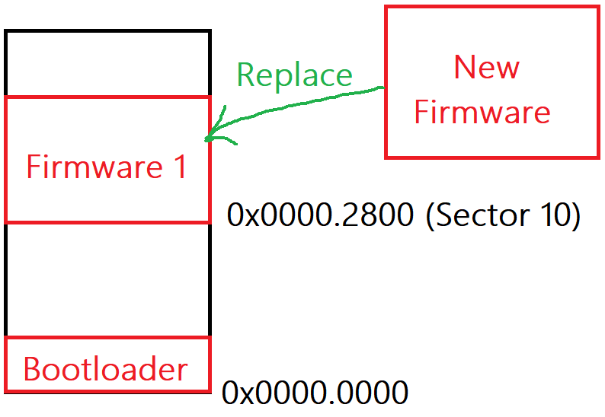
Project Idea (1)
New Firmware will replace the Old Firmware on Sector 10

Slide 7
Project Idea (2)
New Firmware will load to a new position on Flash (Ex Sector 20)
Now Bootloader Program will jump to New Firmware on Sector 20
Old Firmware on Sector 10 is Backup Firmware
Assuming the new firmware has an error, it will jump back to the old firmware
When new firmware has an error, we can hold down the SW1 button and reset to jump to Bootloader Mode. And send a frame code via UART to restore backup firmware.
Assume. You can define a restore frame (String send by PC): “RV01”

Slide 8
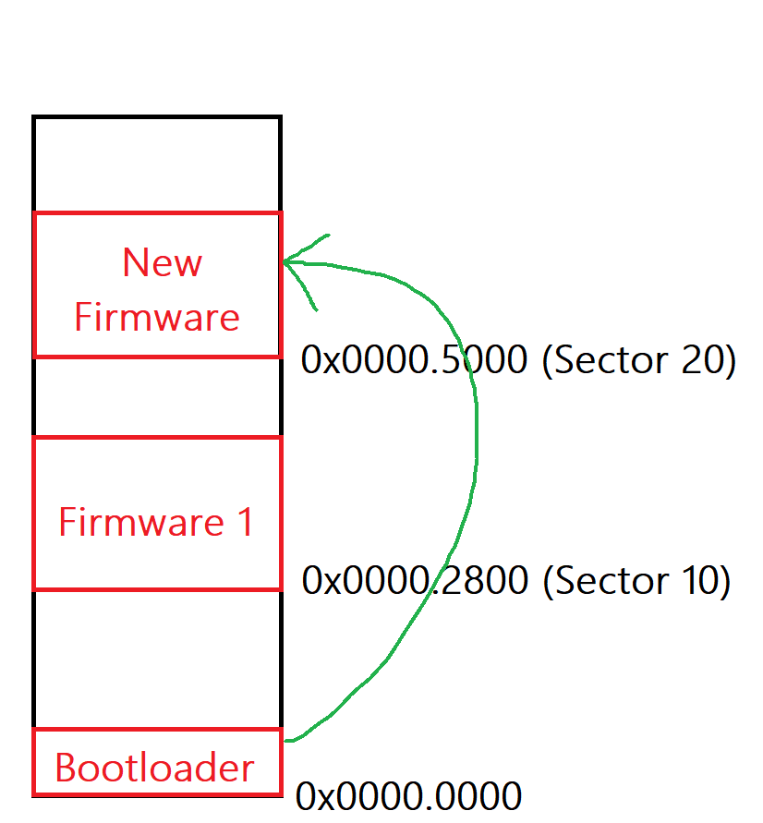
Project Idea (2)

Slide 9
Hint
Divide the project into small programs
Project
Main Application
Receive and Parse SREC Data
Bootloader Handle

Slide 10
Hint - Receive and Parse SREC Data
Transfer large data from computer to microcontroller and write to Flash memory → Easy to lose data
Need to a mechanism to ensure data transmission is correct
Need UART Interrupt to ensure data receiver when PC transfer
Need a mechanism to hold data → Queue
Try to transfer a little Data and write to Flash before Starting

Slide 11
Hint - Bootloader Handle
With Bootloader, we can refer to:
Reset Sequence: https://www.laptrinhdientu.com/2021/09/Core5.html
https://www.laptrinhdientu.com/2021/10/Bootloader7.html

