Slide 1
Learning Long Term Dependencies via Fourier Recurrent Units
(The Statistical Recurrent Unit)
Weiwen Xu

Slide 2
Statistical Recurrent Unit (SRU)
Ungated recurrent unit
Maintain long term sequential dependencies through summary statistics

Slide 3
Summary Statistics?
It’s used to summarize a set of observations in order to communicate the largest amount of information as possible
Location: Mean …
Spread: std, variance …
Shape: skewness …
Dependency: correlation coefficient …
SRU learns long term dependencies in data by keeping moving averages of statistics

Slide 4
Moving Averages?
In statistics, moving average is a calculation to analyze data points by creating a series of averages of different subsets of the full data set. (also called moving mean)
With time series data, imagine a window of defined size, calculate mean of the current window, shift forward, repeat.

Slide 5
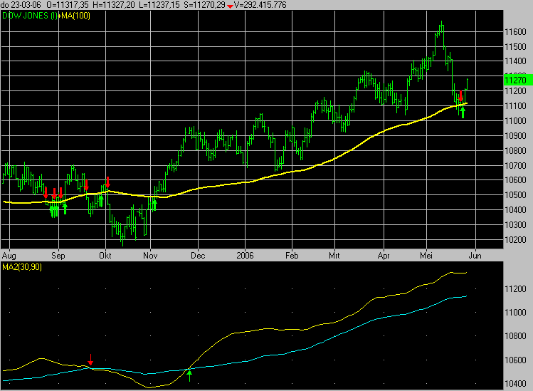
Moving Averages
MA lag current price action (because based on past prices)
Longer time period → greater lag
Shorter MA → short-term trend
Longer MA → long-term trend
Rising MA → uptrend
Declining MA → downtrend
Short-term MA across above long-term
→ upward momentum
Long-term MA across above short-term
→ downward momentum
Ref: https://en.wikipedia.org/wiki/Moving_average#/media/File:MovingAverage.GIF

Slide 6

Moving Averages
Simple Moving Average (SMA)
Cumulative Moving Average (CMA)
Weighted Moving Average (WMA)
Exponential Moving Average (EMA)
α represents the degree of weighting decrease (higher α discounts older observation faster)

Slide 7
Statistical Recurrent Unit (SRU)
Consider:
Compute a vector of statistics ɸ(x_{i}) for each data point x_{i}
Calculate average of these vectors as summary statistics of the sequence
-> This approach treats the sequence as a set of i.i.d. points drawn from some distribution
(Lose temporal information!)

Slide 8
Statistical Recurrent Unit (SRU)
SRU Approach:
Provide temporal information whilst still utilizing averages through recurrent statistics that also depend on the values of previous points.
Provide even more temporal information by considering summary statistics at multiple scales (different α values in EMA)

Slide 9
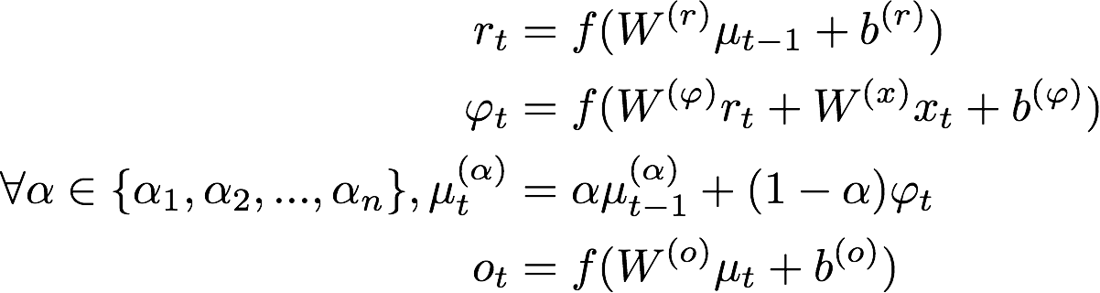


Statistical Recurrent Unit (SRU)
So put everything together as the Statistical Recurrent Unit:
Summary of previous multi-scaled EMA
Recurrent statistics
Multi-scaled EMA

Slide 10
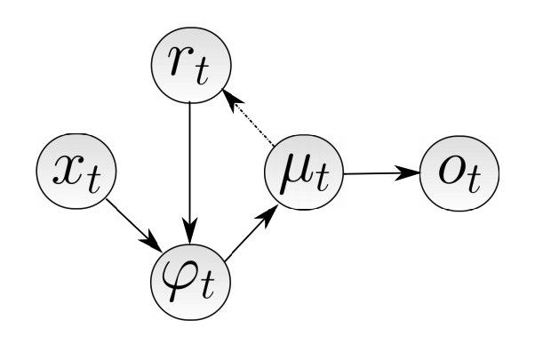
Statistical Recurrent Unit (SRU)
Summary of previous multi-scaled EMA
Multi-scaled EMA
Current input
output
Recurrent statistics

Slide 11
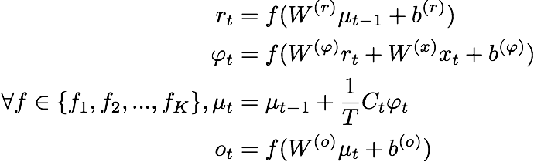
Fourier Recurrent Unit (Fourier analysis instead of EMA)
Utilize the strong expressive power of Fourier basis

Slide 12



Fourier Recurrent Unit

Slide 13

Fourier Recurrent Unit
Utilize the strong expressive power of Fourier basis
Recall: Fourier Expansion
Target function (defined on [0,T])
Fourier coefficient
Fourier basis

Slide 14
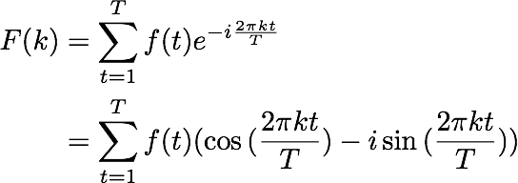
Fourier Recurrent Unit
Recall: Discrete Fourier Transform
In application, all targets are over the real domain

Slide 15
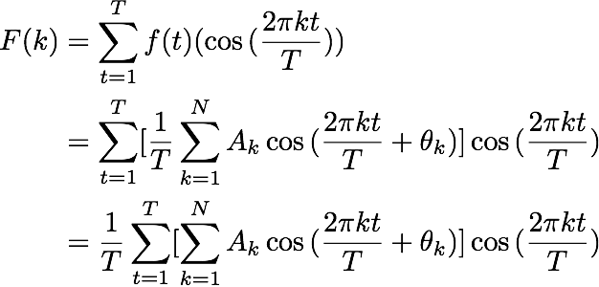

Fourier Recurrent Unit

Slide 16

Fourier Recurrent Unit
Recall update rules
m initialized frequencies from {f₁, f₂, … , f_{K}}
t

Slide 17


Fourier Recurrent Unit
Connection with Residual Learning

Slide 18
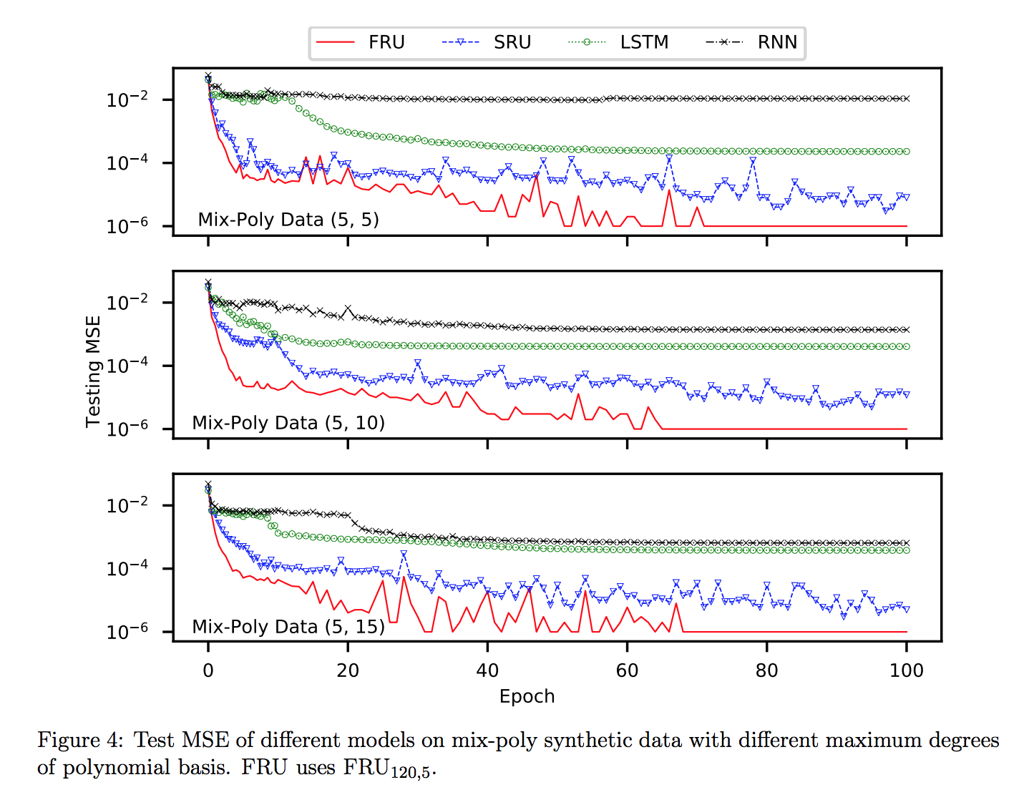
Experimental Results
Synthetic Polynomials (Reconstruct)
Results of polynomials with degree 5,10,15
5 “base” polynomials with degree 5/10/15 and add noise to amplitude and bias
Populated to 4000 (3200 as training, 800 as testing)

Slide 19
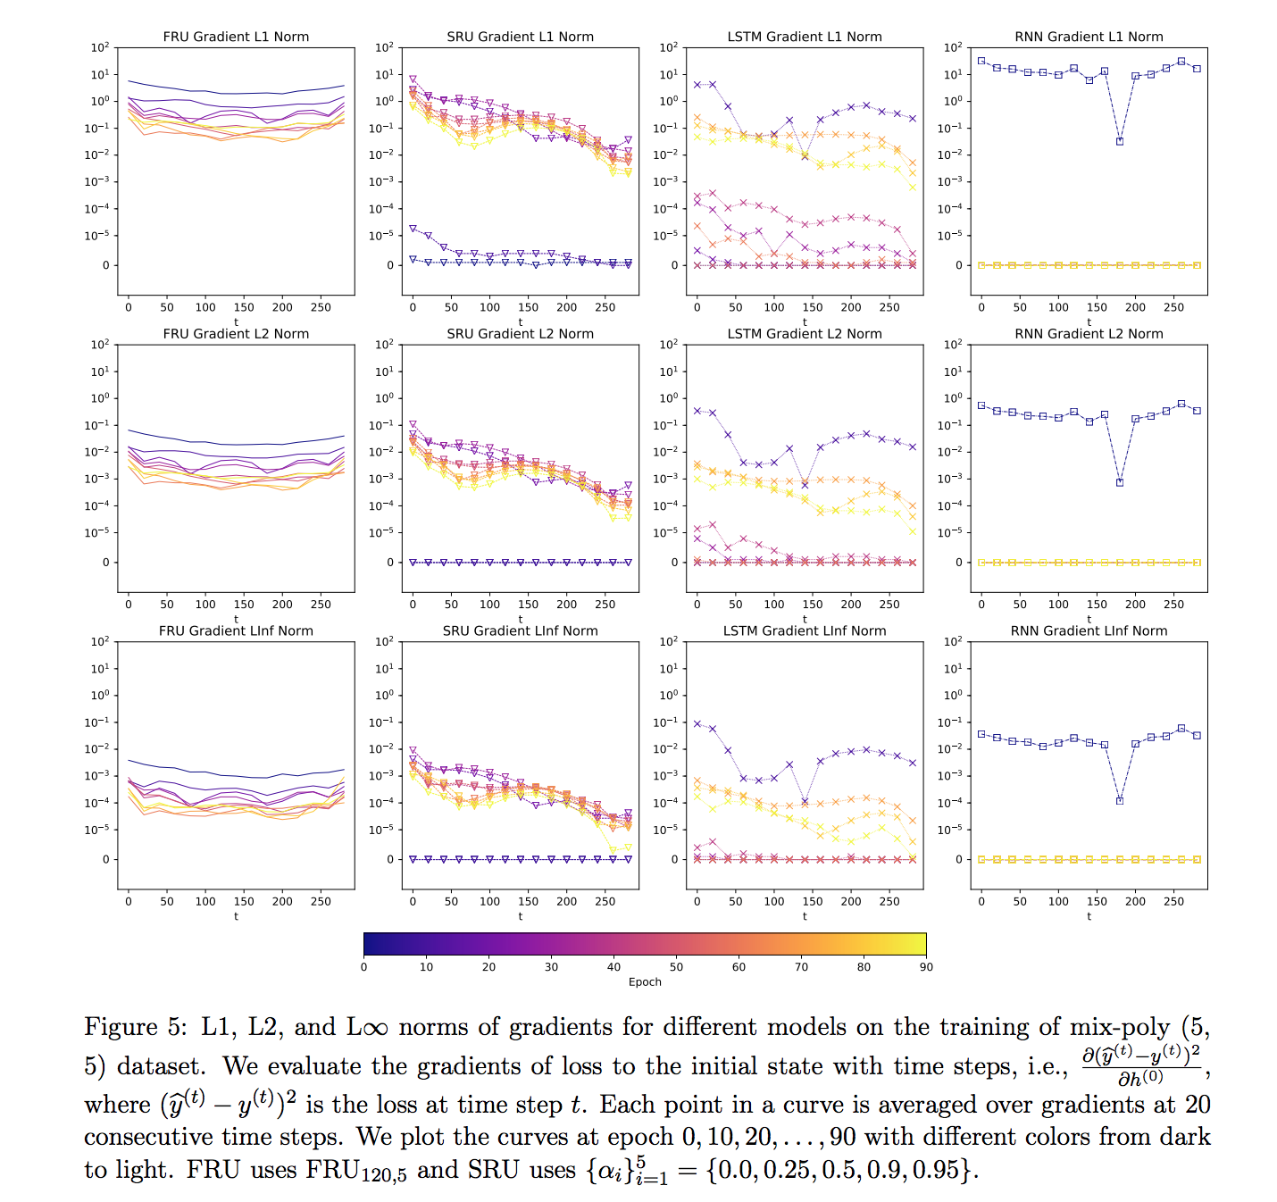

Slide 20
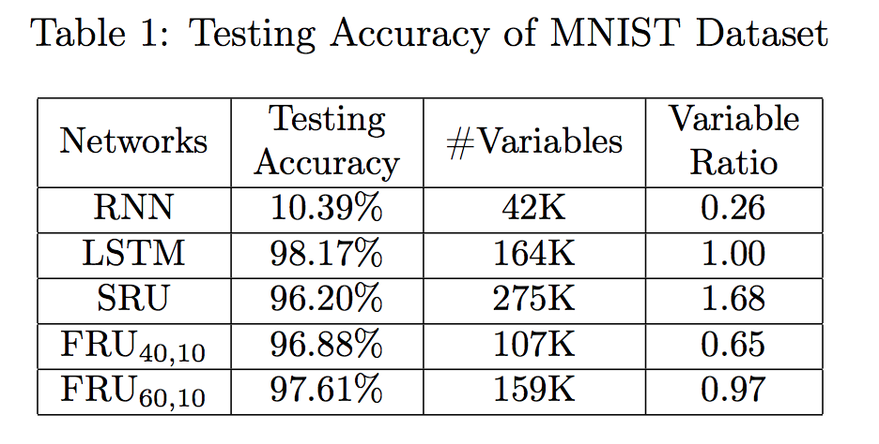
Experimental Results
Pixel-MNIST (Classification)
Image flatten into a sequence with length of 784 -> classify into 10 categories
f are uniformly sampled in log space (0,784)
100 epochs

Slide 21
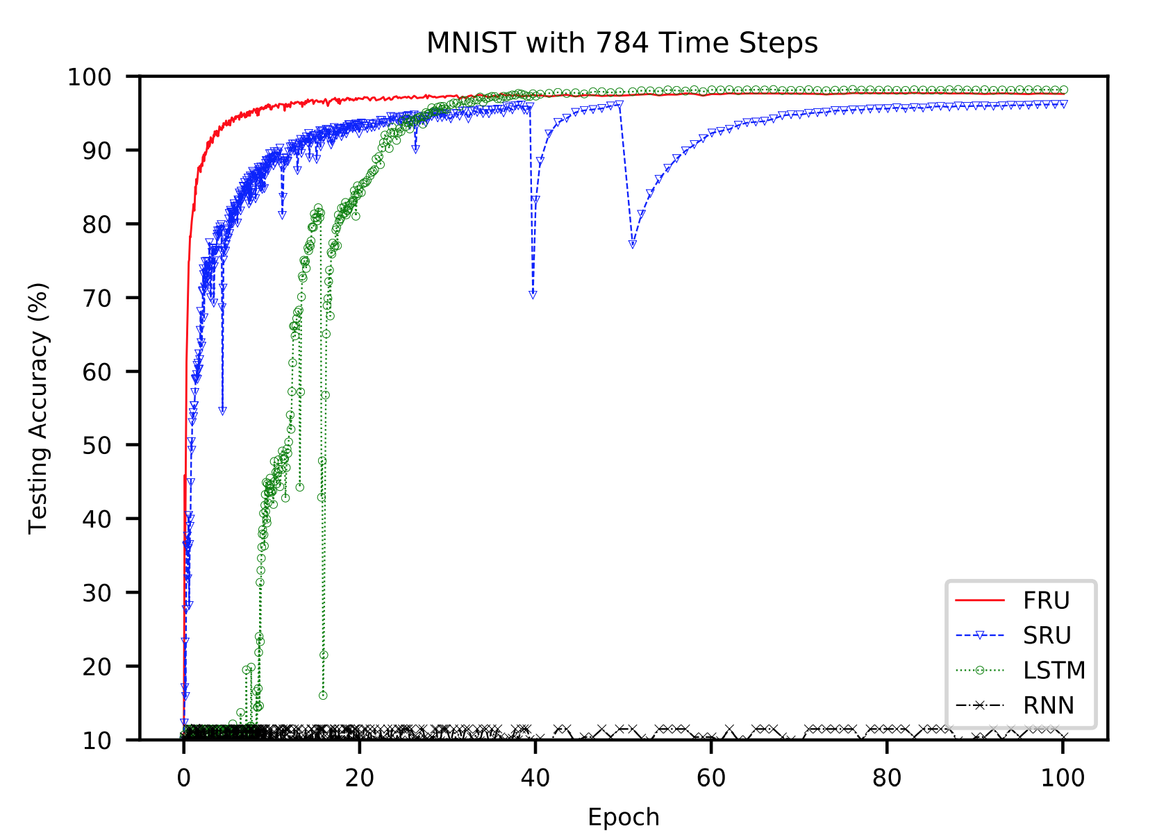

Slide 22
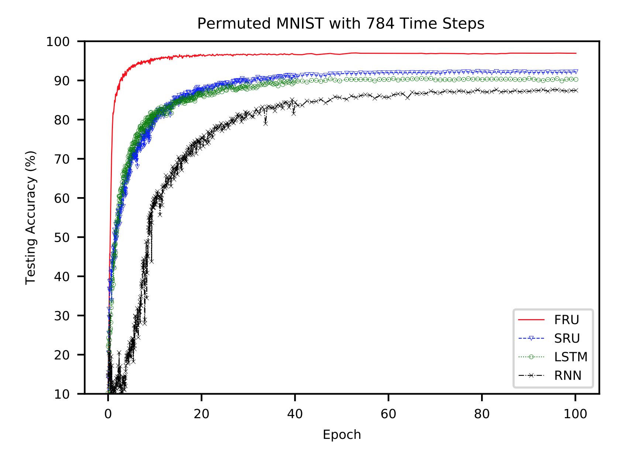
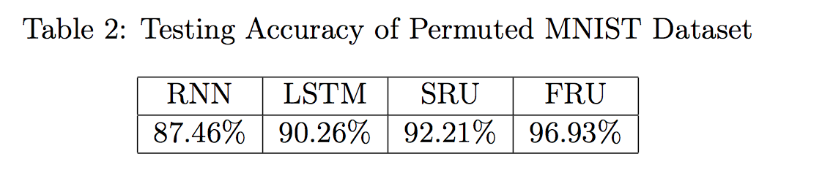
Experimental Results

Slide 23
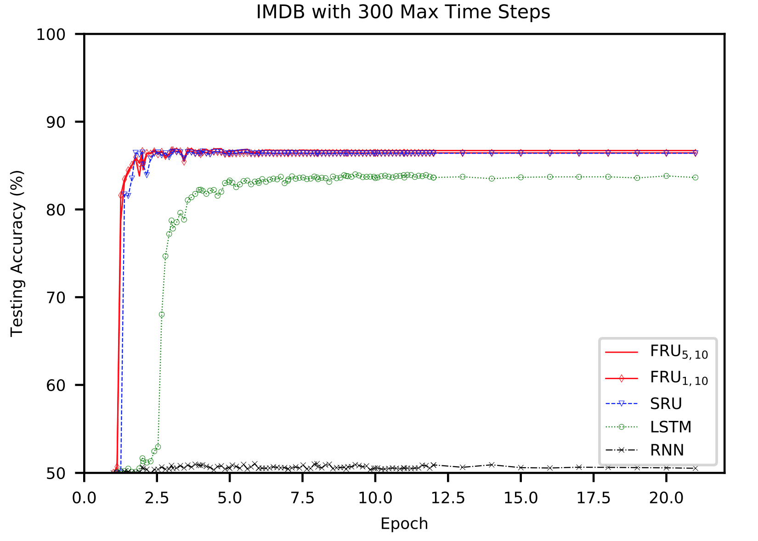
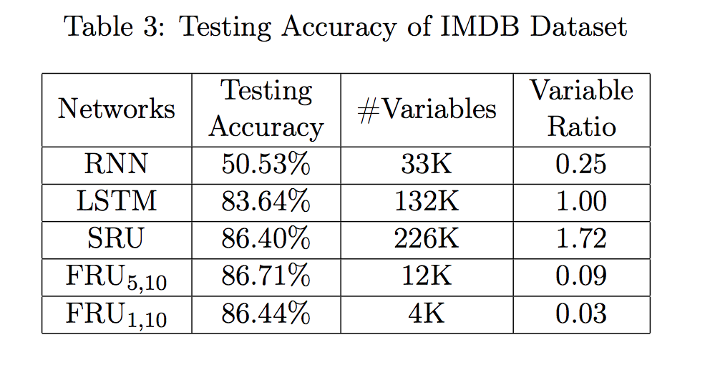
Experimental Results
IMDB Dataset
(Classification)
Truncate all sequences to 300

