Slide 1


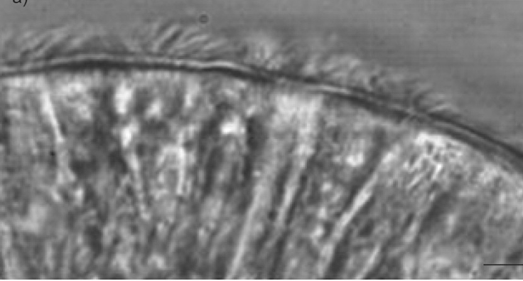
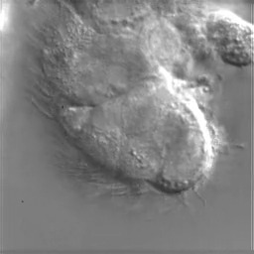



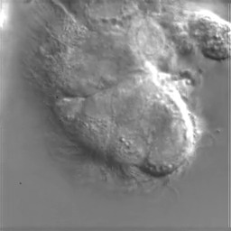














An Unsupervised Approach to Characterizing Ciliary Motion
Nathan Safir, Dr. Shannon Quinn
University of Georgia Computer Science Department
Abstract
.
Architecture
Training and Loss Functions
Dynamics Module
Motile cilia line the outside of some cells in the human body. Cilia sweep rhythmically to transport substances, but diseases that affect the function of cilia known as ciliopathies can cause abnormal ciliary movement, which in turn may damage macroscopic structures in vital organs such as the brain or the lungs. Understanding motion patterns within cilia is an important task, but expert labor can be expensive and time intensive. We thus aim to build an unsupervised model that can characterize the motion patterns of cilia from cilia video data. We propose a modular generative pipeline that uses variational autoencoders to produce low-dimensional representations of ciliary motion patterns while disentangling the spatial and temporal components of the data. This poster presentation will discuss more details on the motivation and design of the pipeline, as well as more information regarding the context of the problem and the theory behind the deep learning techniques implemented in this pipeline.
The model contains the following components:
Preprocessing: An optical flow field is computed for each frame, from which derivative quantities (ex. divergence, curl) are calculated. A segmentation map is also created for each frame and used as a mask.
Appearance Encoder: The output of the preprocessing module is fed to the appearance encoder. The appearance encoder uses a VAE encoder architecture to produce a neighborhood of low dimensional frame embeddings, from which one random sample (z) is taken.
Appearance Decoder: Decodes each embedding in the reconstructed path into a reconstructed appearance frame.
Dynamics Encoder: Encodes the path of appearance with VAE encoder architecture to a neighborhood of points (represented by the red ball) from which one random sample (w) is taken.
Dynamics Decoder: Decodes the vector w into a reconstructed path of points representing the sequence of frame embeddings.
The model involves the use of three separate loss functions:
L_{A} is the appearance loss, equal to the VAE loss for the appearance module.
L_{D} is the dynamics loss, equal to the VAE loss for the dynamics module.
L_{V} is the total video loss, equal to the reconstruction loss between the reconstructed video and the new video.
The VAE Loss is composed of the following terms.
KL divergence (a distance measure) between the prior distribution and the generated posterior distribution. A coefficient before the KL term is used as a hyperparameter [2].
Reconstruction Error, or the quantified difference between the reconstructed path/frame and the original path/frame.
Additional terms may be added for the loss function when more complex VAE-based models are used such as VAE with VampPrior[3].
As discussed previously, the dynamics module (shown in the top of the diagram) encodes and decodes a low-dimensional path representing how the cilia changes in appearance.
Recurrent RNN: Recurrent neural networks (RNNs) are an architecture that is often used to model time-series data. A hidden state is propagated through the architecture while outputs are emitted sequentially.
ResNet[4]: Residual networks (i.e. ResNet) implement skip layers (adding back the previous layer to the result of the next layer) to build deeper networks. ResNet is implemented in the dynamics decoder to model the function or flow-field producing the reconstructed path.
Neural ODE[5]: The Neural ODE family is inspired by ResNet, but instead of using hidden layers, the derivative of the hidden state function is parameterized by the neural networks. In this implementation of Neural ODE”s as the dynamics decoder, the starting point used in the original path is used for the reconstructed path, An ordinary differential equations is then used to find new points given the starting point and derivative function until a new path is created.
Introduction and Proposed Model
Diagram of Pipeline
Conclusion and Future Directions
In the image below [1], the cilia can easily be identified as the hair-like substance on the oustside of the cell boundary. In most videos of healthy cilia, these hairs will move side-to-side in a rhythmically and consistently. Abnormal ciliary motion is often characterized by a lack of movement or seemingly random movement.
Our group proposes a modular, generative pipeline to generate low-dimensional representations of ciliary motion from video data. The pipeline consists of a preprocessing module, an appearance module, and a dynamics module.
The preprocessing module calculates optical flow and derivative quantities (ex. curl) for each frame, as well as a segmentation map for the frame.
The appearance module uses a variational autoencoder (VAE) to generate low-dimensional embeddings of each frame. The sequence of embeddings for each video input is considered a path.
The dynamics module uses another VAE to generate a low-dimensional representation of the path.
The decoders for the dynamics VAE and then then the appearance VAES for each individual frame embedding then decode the point into a sequence of frames, reconstructing the original video.
The motivation behind separating the dynamics and appearance modules is to disentangle the spatial and temporal aspects of cilia video data
$$w$$
This model is still a work in progress; more development is necessary to fully implement the proposed pipeline and yield more conclusive results. Currently, we are also working on implementing a segmentation component in the preprocessing module. After the pipeline is fully implemented, it may be worthwhile to explore less supervised approaches to segmentation that does not require masks to be drawn for each cilia video. After this pipeline is created and trained to the point that cilia video data can be accurately reconstructed, it will also be important to investigate whether motion patterns are meaningfully represented within the dynamics latent space. If meaningful embeddings are produced, it would be interesting to look at potential clinical applications of this model.
Dynamics encoder
Dynamics decoder
$$z_{0}$$
$$z_{1}$$
$$z_{T}$$
$${z′}_{0}$$
$${z′}_{1}$$
$${z′}_{T}$$
Appearance encoder
Appearance encoder
Appearance encoder
Appearance decoder
Appearance decoder
Appearance decoder
References
[1] Disrupted ciliated epithelium shows slower ciliary beat frequency and increased dyskinesia, Thomas et al. 2009.
[2] Beta-VAE, Higgins et al. ICLR 2017
[3] VAE with a VampPrior, Tomczak and Welling. AISTATS 2018
[4] Deep Residual Learning for Image Recognition, He et al. CVPR 2016
[5] Neural Ordinary Diferential Equations, Chen et al. NeurIPS 2018.
Preprocessing
Preprocessing
Preprocessing
$${x′}_{0}$$
$${x′}_{1}$$
$${x′}_{T}$$
Acknowledgements
$$x_{0}$$
$$x_{1}$$
$$x_{T}$$
I would like to thank the other members of the Quinn Lab cilia representation Group for their help. Specifically, I would like to thank Meekail Zain for leading the cilia representation group, Alex Eldridge for pair programming with me throughout this project, and Dr. Shannon Quinn for providing his time and mentorship.

