Slide 1


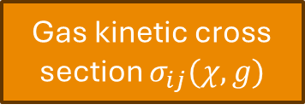








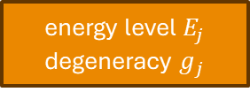



Spin multiplicity $2S+1$
Polarizability $δ$
Species Data (Input)
Gas kinetic cross section $σ_{ij}(χ, g)$
Atomic Spectral data
Composition (element + charge)
Molar mass $M$
Interaction potential $φ$
energy level $E_{j}$
degeneracy $g_{j}$
Calculation
Ionisation energy lowering
Collision integral $Ω_{ij}^{(l)}$
$$δE=f(n_{e},n_{i},z_{i}, T)$$
Density (converging)
Collision integral ${\overset{‾}{Ω}}_{ij}^{(l,s)}$
Gibb’s Energy and chemical potential (at equilibrium)
Partition function
$$Z$$
$$G, μ$$
$q$ Matrix
$\hat{q}$ Matrix
Density at equilibrium
$$n$$
Transport data
Thermodynamic data
$λ$, $μ$, $σ$
$ρ, h$, $c_{p}$
Output

