Slide 1
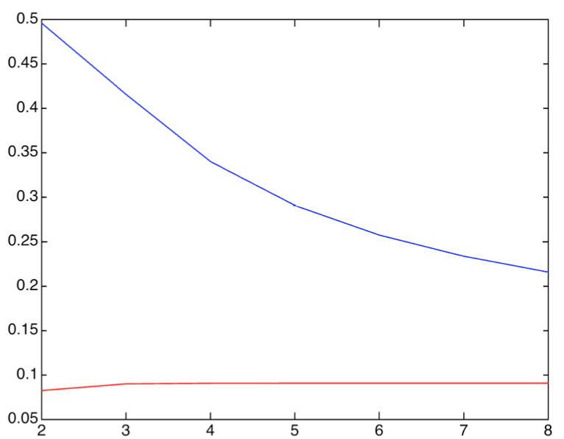
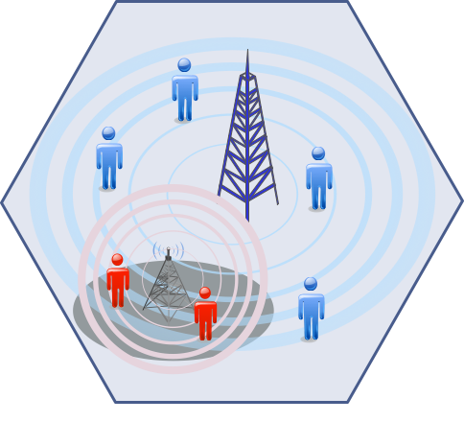







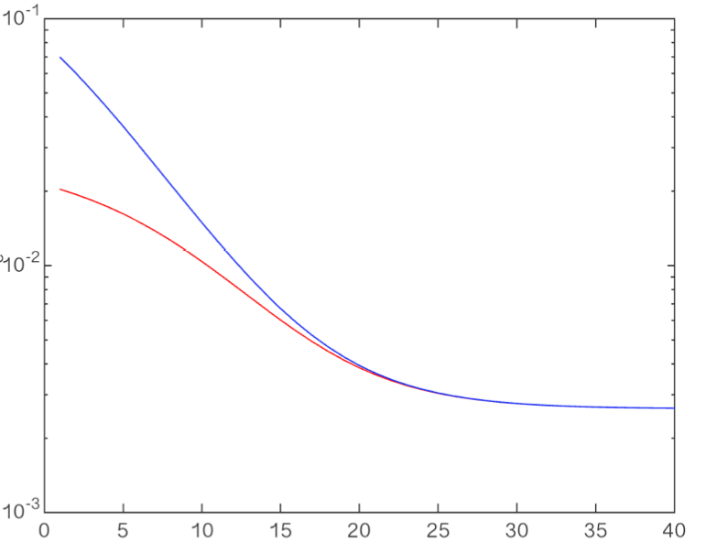
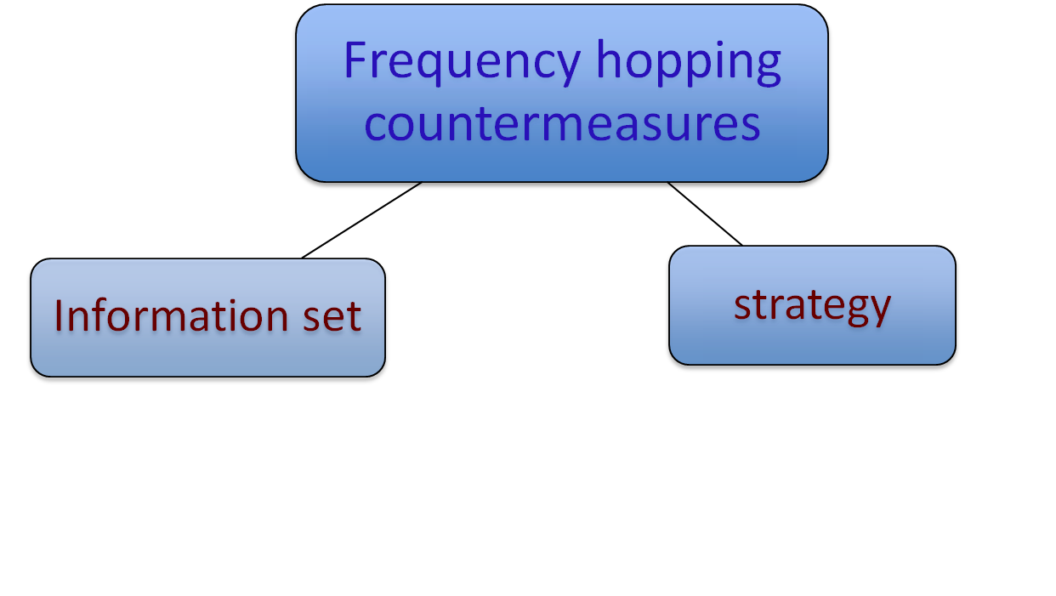
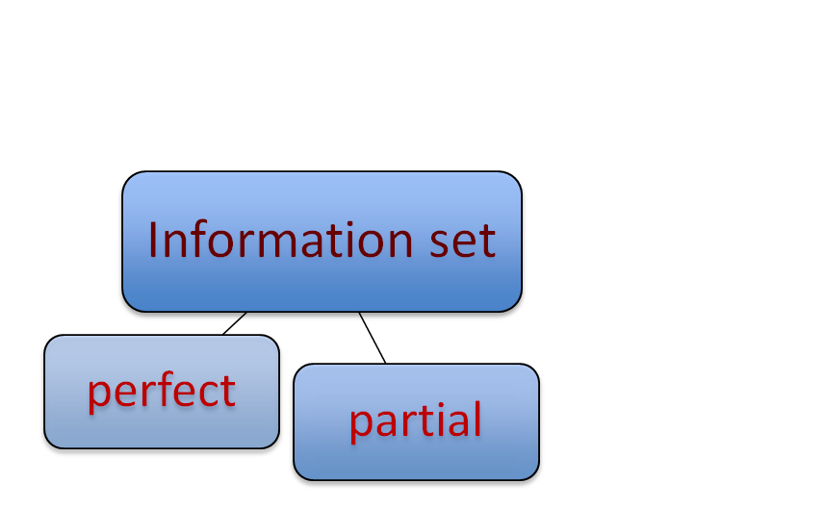
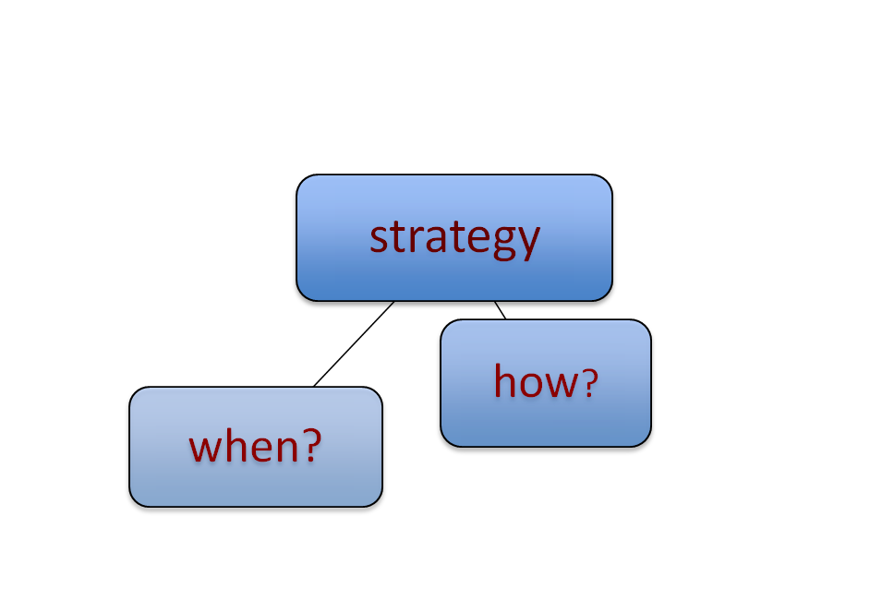

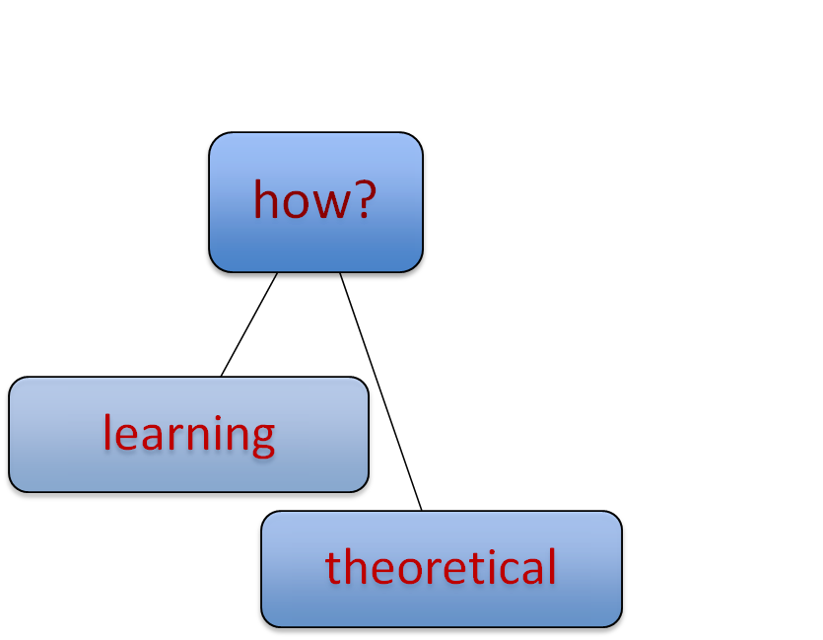
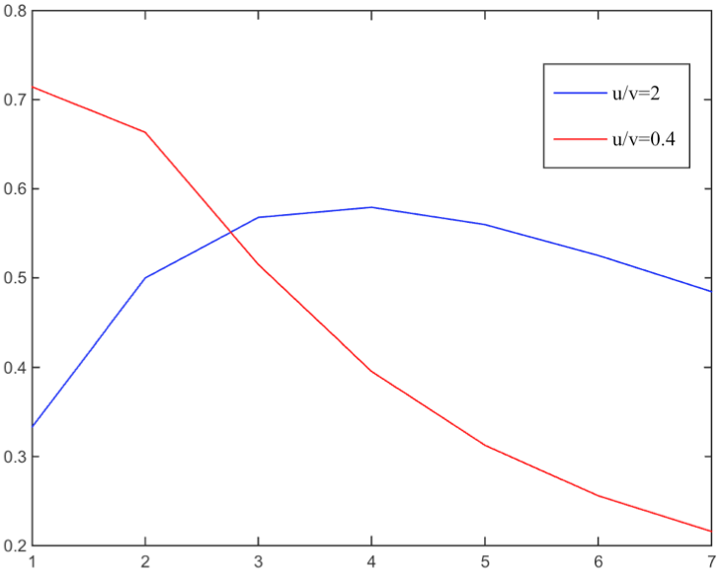
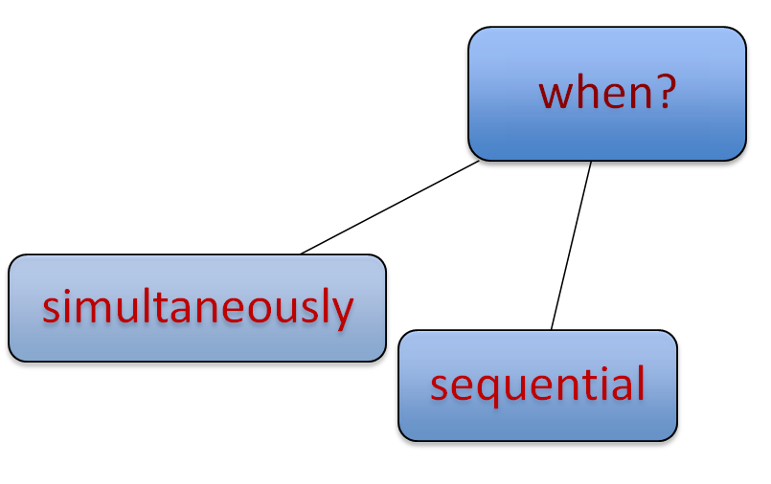
Pseudorandom Time-Hopping Anti-Jamming Technique
for Mobile Cognitive Users
Nadia Adem, Bechir Hamdaoui, and Attila A. Yavuz
{ademn,hamdaoui,attila.yavuz}@eecs.oregonstate.edu
Oregon State University, The School of Electrical Engineering and Computer Science
Cognitive networks jamming issues
A time evasion based idea
Adversary model
Technique analysis – switching probability
Attacker jams by transmitting a Gaussian noise.
It has a limited energy.
jamming can significantly degrade spectrum utilization.
Power
Frequency
frequency hopping
time hopping
Switching probability
Time
Channel model
No transmission duration
Legitimate users transmission
Jammer transmission
Channel availability is modeled as a Markov process.
Number of channels
State of the art of anti-jamming techniques
idle
u
busy
Technique analysis – error probability
Pseudorandom time hopping technique
v
User x
k_{xy}
Technique analysis – jamming probability
User y
k_{xy}
Key Generation center
frequency hopping
time hopping
User b
k_{ab}
Error probability
User a
k_{ab}
Average busy-to-idle time ratio
2
0.4
PRNG(k_{ab} )
11 01 10 01 11 00 01
00
10
01
10
11
Time
Jamming probability
allocated slot
Legitimate-to-jammer power ratio (dB)
Limitations of spectral surfing techniques
lead to a higher switching rate, hence, more communication overhead.
assume accessibility to multiple channels
Number of channels
Conclusion
We proposed a time evasion anti-jamming technique works with arbitrary number of channels. Our method achieves high anti-jamming resiliency with low overhead,
Notes:
State of the art of anti-jamming techniques
The point for this part is
to explain that the existing techniques may differ from one another in the following aspect
the assumptions they make regarding the information users have about attacker and primary users
the type of analysis (theoretical based techniques ((e.g., Markov process) or learning techniques )
The timing of actions some of them assume sequential action for example (jammer act after legitimate users)
however, they all rely on spectral evasion.
A time evasion based idea
The idea to explain that even in one channel, we can make the timing of the transmission random.
The way we derive those is based on Pseudorandom time hopping technique..
Channel model
The channel is modeled as mobile-to-mobile channel where the legitimate users can be in motion.
Technique analysis
Note that jamming results in degrading the performance not denial of service (this is why we have error for different value of jammer power (last figure))
Note that we are not concern about primary users security. We assume that jammer is not jamming them.
– jamming probability (Pj)
Pj is defined as the probability that jammer hits the user slot and channel.
The figure shows for active relatively primary users (Average busy-to-idle time ratio is 2)
Pj starts low for small number of channels. The reason is that, the jammer is not able to have channel access due to primary users activity . As the number of channel increases, Pj starts to increase and then it starts decrease again (more channels less chance for jamming)..
However when Average busy-to-idle time ratio is 0.4 (relatively lower primary users activity level), Pj starts high for small number of channels and then starts to decrease as the number of channels increase.
Technique analysis – switching probability
In our scheme we do not anti-jamming based on spectral surfing hence we switch less (this is useful for example when there is limitation on energy consumption or switching delay)
Technique analysis – error probability (Pe)
In this we consider that users are moving (one of them moves with twice the speed of the other one) and the maximum Doppler frequency multiplied by the slot duration ration is 0.05 .
You might find this helpful
(Those parameter affect the power spectral density (i.e., the way the power is distributed over frequency). The more the speed, roughly speaking, the more the maximum Doppler frequency (which results from the arrival of signals to the moving users at different angle ) the more the signal is spread over frequency. Since we send more than one carrier at the same time (using Orthogonal frequency Division Multiplexing (OFDM) ) the spread make them interfere resulting inter-carrier interference(ICI)
)
We perform slightly better for low legitimate-to-attacker power ratio. The reason is that by sending in shorter time than frequency hopping we are able to avoid the jammer. However, as the legitimate-to-attacker power ratio increases the jammer does not become an issue, but rather the ICI(in other words the mobility effects ) is the issue. You can notice that the Pe become irreducible as the legitimate-to-attacker power ratio exceeds certain value. That is what motivated us in fact to consider channel quality in our journal paper.

