Slide 1
CS/ECE Applied Cryptography
Dr. Attila Altay Yavuz
Big Picture and Organization
Applied Cryptography
Dr. Attila Altay Yavuz
Winter 2016

Slide 2
Outline (current lecture)
Self-introduction
Course Objectives (overview)
  Touching important problems and tools (name & functionality)
  Grading
  Requirements
Example Project Topics
  Decision on your topic, assess your background/commitment
Dr. Attila Altay Yavuz

Slide 3
Self-Intro
Assistant Professor, EECS at Oregon State University
Adjunct Faculty, University of Pittsburgh (Jan. 2013 - now)
Research Scientist, Bosch Research Center (Dec. 2011- Aug. 2014)
  Develop security and privacy research programs
  Privacy-preserving Big Data Technologies (~1M)
  Secure Internet-of Things and Systems (~250K)
Ph.D., North Carolina State University (Jan. 2007- Aug. 2011)
  Compromise Resilient and Compact Crypto for Digital Forensics
MS, Bogazici University (2004-2006)
  Efficient Crypto Mechanisms for Military Ad-hoc Networks
Dr. Attila Altay Yavuz

Slide 4




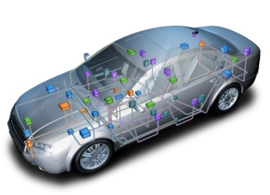
Self-Intro (Cont’)
Research Interests: Applied cryptography, network security, privacy
Academic Collaborations: Upitt, UNC, UCI, Purdue-CIT, CMU
Industry Collaborations: Bosch, Oracle, Cisco, SEI-CMU, ISE
Some Impact Examples:
  Secure Intra-car Networks
  (OEMs, 2018)
  Privacy-Preserving
  Medical Databases
  (HCTM, 2016)
ECU
Dr. Attila Altay Yavuz

Slide 5
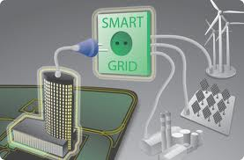

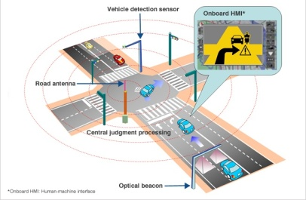
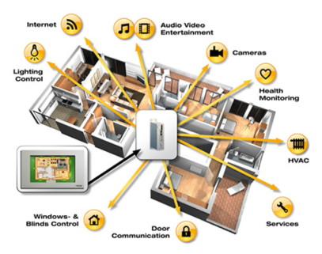



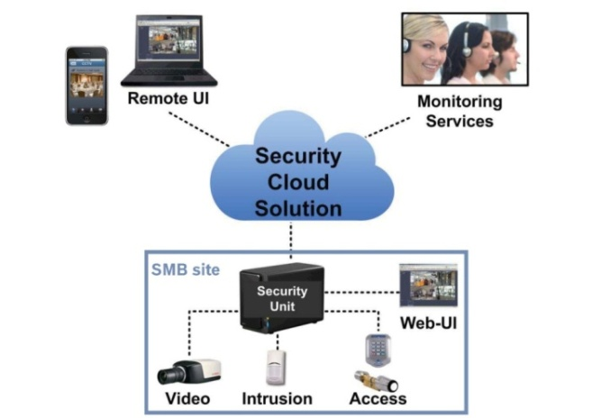
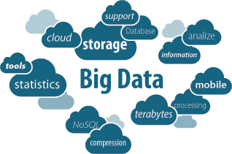



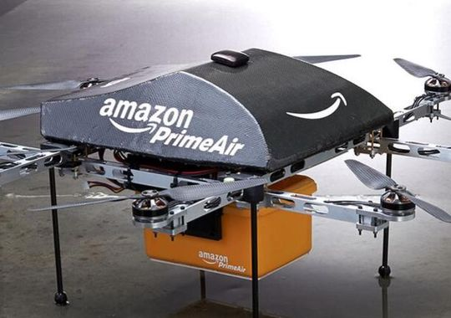
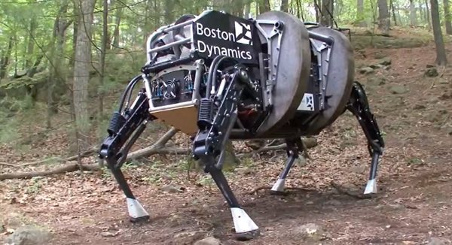

Big Picture: Technology Trends & Vision
Smart-infrastructures and distributed systems
Big Data Technologies
Inter vehicular networks
Long term
Smart-grid
Smart-city
Medium
term
Smart Home
Near term
Digitalized
Healthcare
Inf. Sys.
Cloud-based Applications

Slide 6
Requirements and Challenges
Challenges of Security and Privacy in IoTS
Heterogeneity
High Performance/Scalability
Data Availability
Smart-home and WSNs
Interconnectivity
Cloud-based Services
Vehicular networks (e.g., Car-2-X)
SOMETHING MISSING?

Slide 7
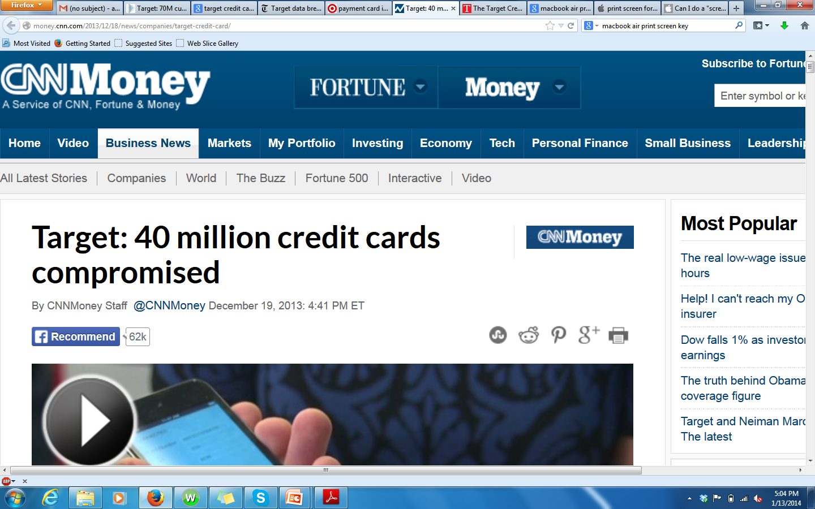
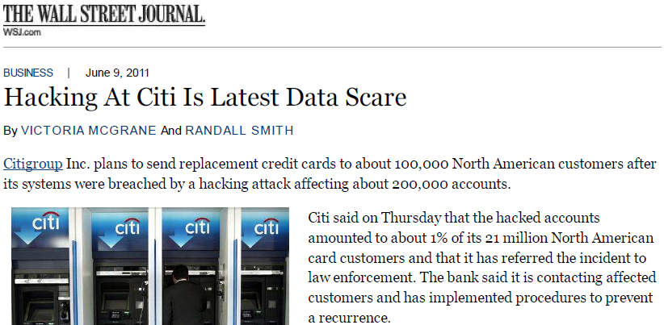
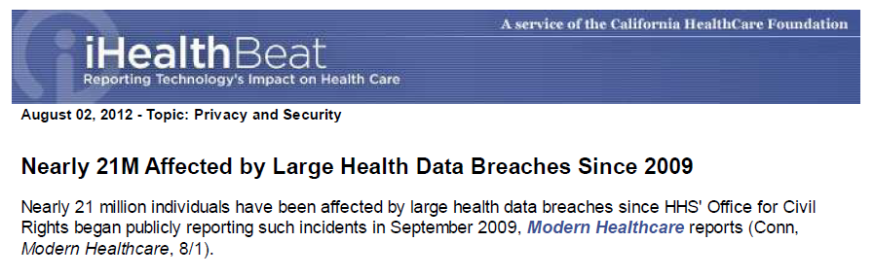
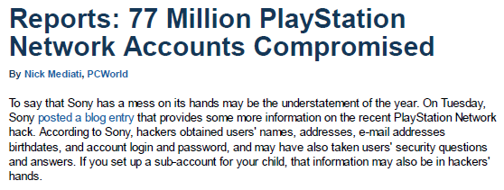
Privacy Breaches: Big Data and IoTS
Need for Privacy Enhancing Technologies

Slide 8
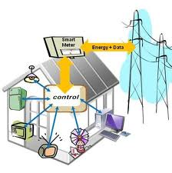
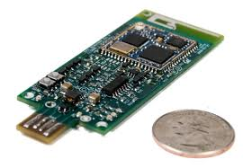
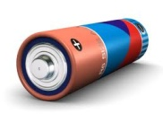
Cyber Physical Systems - Vulnerabilities
Reliable Cyber-Physical Systems (e.g., smart-grid) are vital
  Susceptible: Northeast blackout (2003), 50 million people, $10 billion cost
  Attacks: False data injection [Yao CCS09’], over 200 cyber-attacks in 2013
Vulnerability: Commands and measurements are not authenticated
Requirements for a security method
  Real-time → Extremely fast processing (a few ms)
  Limited bandwidth → Compact
  Several components → Scalability
Limitations of Existing Methods
  PKC is not yet feasible (computation, storage, tag size)
  Symmetric crypto is not scalable (key management)

Slide 9
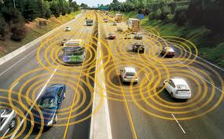

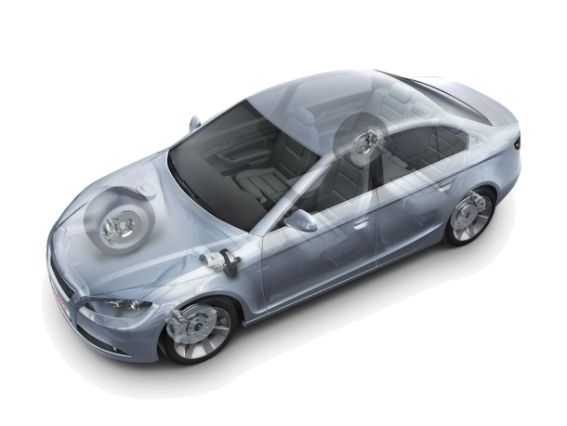


Inter-car and Intra-car Networks
Security Challenges for Smart-Infrastructures (II)
Vulnerability: Commands and measurements are not authenticated
Security for Inter-car Networks
  Manipulate direction/velocity, crashes
Security for Intra-car Networks
  Large attack surface [Usenix '11]
  ECUs of break/acceleration, airbag
Challenges
  Strict safety requirements
  Limited bandwidth, real-time processing
The state-of-art cannot address (as discussed)
ECU
ECU
ECU
Internet

Slide 10
Pillars and Target Topics
Please check course website for material and Syllabus!
Pillar I-II: Authentication and Integrity
  Broadcast Authentication: Internet, wireless net., multi-media, …
    Vehicular networks, power-grid, smart-grid, drones…
  Specialized Signatures: Real-time, compromise-resilient, hybrid, …
Pillar III: Privacy (Confidentiality) and Functionality
  Privacy Enhancing Technologies
  Cloud computing and data outsourcing: SE, ORAM, Garbled Circuits, OT
Pillar IV: Availability and Resiliency (time permits)
  Denial of Service (Client-server application)

Slide 11
Background Requirements
A previously taken cryptography/network security class is a must
  CS 419 Introduction to Network Security
  CS 519 Special Topics on Crypto/NetSec
  CS 419 Cryptography (Mike Rosulek)
  CS/ECE 419 Computer Security (Rakesh Bobba)
  No such course → Please drop this course
A good programming skill is a necessary
  Very good C/C++ experience, Linux
  Java/C# may be ok (but C/C++ rules the crypto world, for good reasons!)
Experience on mobile devices is required for some projects
How to achieve more in less than two months?
  Form sub-teams and integrate them into my research group
  Enforce background requirement
  Volunteers to continue after the course

Slide 12
High-Level Objectives (PETS Track)
Dynamic Symmetric Searchable Encryption (DSSE) (1 lecture)
Privacy in Cognitive Radios (1 lecture)
  LPOS scheme, DB-based approaches, Anti-jamming
Hybrid Cryptography via Signcryption
  Signcrypt >> Sign + encrypt
Oblivious Random Access Memory (2 lecture)
  Basic ORAM, Partition ORAM, Path ORAM
  Novel ORAM constructions with highly efficient constants
Oblivious Dynamic Searchable Encryption (1 lecture)
  A multi-server approach

Slide 13
High-Level Objectives (Authentication Track)
Structure-Free Compact Authentication & HW acceleration
  Vehicular networks, theory to practice
Broadcast Authentication (2 lectures)
  TESLA: Playing with time factor → efficient authentication
  EMSS: Address non-repudiation and sync. issues
Counter DoS: Client-Server Puzzles (2 lectures, optional)
  Hash-based
  DLP-based
Student Presentations

Slide 14
Student Presentations
Depends on the size of the class
Students with no prior presentation opportunity will be prioritized.
Two high-quality paper to be presented. One base paper and one the most recent progress paper → See course website about requirements
Topics to be selected:
  Garbled Circuits
  Oblivious Transfer
  Privacy-preserving data mining I and II (two students 4 papers)
  NTRU cryptosystem
  Cost benefit analysis of PETs
  Mobile system security
  OS security

Slide 15
Potential Projects and Presentations
Depends on class-size, most qualified selected, first come first served
Searchable Encryption (3 student), Thang: hoangmin@oregonstate.edu
  GPU implementation (GPU experience)
  Mobile-device implementation (Android or Apple), prior experience
  Open-source porting, Dropbox and Amazon integration (network programming)
Oblivious Random Access Memory (2), Gabriel: hackebeg@oregonstate.edu
  Reasonable math and C/C++ background
A Survey and cost analysis for PETs (2), Gungor: basag@oregonstate.edu
SPHINCS, Merkle-tree based signatures and traditional signature suite (3) (me)
  Good implementation skills and crypto background
PhD students are encourage to continue their own research.
Send your previous courses and skillsets to project leads or me

Slide 16
Potential Projects and Presentations
PhD students can purse their own research as a part of the course
  Please coordinate with your advisor.
Prior projects (from Fall 2015) continues so no change is needed
Class project is different then co-authoring, which requires:
  Contribution well-beyond class
  Continuous involvement, completing all aspects, active writing efforts
  Potentially 4-6 months more work after the class! But well-worth if you commit

Slide 17
Grading
In-class paper presentation, %35 (subject to change)
  See potential topics at the webpage
  Full lecture style (or a single paper style) + question preparation
Research Project or survey/implementation, %55 (subject to change)
  Discussions with the team leader
  Bi-weekly short reports to me (all together)
  Discussion and agenda for deliverables and grading accordingly
Class attendance/participation %10
  Please let me know if you will continue this course by this week
  You are expected to conduct your research independently.

