Slide 1
CS/ECE 519/599
Applied Cryptography
ADVANCED PRIMITIVES AND TOOLS
Credits: Dr. Peng Ning and Dr. Adrian Perrig
Dr. Attila A. Yavuz
CS/ECE 519/599 -- Advanced Network Security

Slide 2
Outline
Advanced Primitives
  Hash-based: Fundamental for authentication, commitment, etc.
    One-time Signatures
    HORS, variants and its relationship with traditional signatures
    Hash chains
    Merkle-Trees
  Resiliency and Fault-Tolerance
    Secret Sharing
    Rabin’s Information Dispersal
    Bloom Filters
Tools: Denial of Service Protection and more
  Client-server puzzles
    Pre-image based, special image based
    Discrete Log Based Outsourced Puzzles

Slide 3
Advanced Primitives (I)
(Hash-based)
One-time Signatures and Extensions
Dr. Attila A. Yavuz
CS/ECE 519/599 – Advanced Network Security

Slide 4
One-Time Signatures
Basis of all digital signatures
  Valuable tool to learn the principles
Still, the fastest and most secure signature schemes!
  Quantum computer resistant!
Caveat: Impractical for real-life applications
They can be used as a “support unit”, seldomly
  Offline/online signatures
  Tailoring for application (e.g., smart-grid, vehicular)

Slide 5
One-Time Signatures
Use one-way functions without trapdoor
Efficient for signature generation and verification
Caveat: can only use one time
Example: 1-bit one-time signature
  P0, P1 are public values (public key)
  S0, S1 are private values (private key)
S0
P0
S0
S0’
P
S1
P1
S1
S1’

Slide 6
Lamport’s One-Time Signature
Uses 1-bit signature construction to sign multiple bits
Sign 0
S0
S0’
S0’’
S0*
Private values
P0
P0’
P0’’
P0*
…
Public values
P1
P1’
P1’’
P1*
Sign 1
S1
S1’
S1’’
S1*
Private values
Bit 0
Bit 1
Bit 2
Bit n

Slide 7
Improved Construction I
Uses 1-bit signature construction to sign multiple bits
S0
S0’
S0’’
S0*
c0
c0’
c0*
…
…
P0
P0’
P0’’
P0*
p0
p0’
p0*
Bit 0
Bit 1
Bit 2
Bit n
Bit 0
Bit 1
Bit log(n)
Sign message
Checksum bits: encode
# of signature bits = 0

Slide 8
Improved Construction II
Lamport signature has high overhead
Goal: reduce size of public and private key
Approach: use one-way hash chains
S1 = F( S0 )
Sig(0)
Sig(1)
Sig(2)
Sig(3)
Signature
chain
S0
S1
S2
S3
P
Checksum
chain
C3
C2
C1
C0
P = F( S3 || C0 )

Slide 9
Merkle-Winternitz Construction
Intuition: encode sum of checksum chain
Signature
Bits 0,1
S0
S1
S2
S3
Signature
Bits 2,3
S0’
S1’
S2’
S3’
Signature
Bits 4,5
S0’’
S1’’
S2’’
S3’’
P
Checksum
Bits 0,1
C3
C2
C1
C0
Checksum
Bits 2,3
C3’
C2’
C1’
C0’

Slide 10
Hash to Obtain Random Subset (HORS)
Merkle-Winternitz → Still impractical
BiBa (ancestor of HORS, please read)
  Fast signature verification, but
  Signing cost is high
HORS goal:
  Develop a one-time signature scheme with
  Fast signing and verification
  Still same signature sizes with Merkle-Winternitz

Slide 11
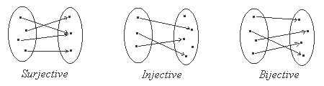
Preliminary: Bijective Function
Bijective function
  Each element of input is mapped onto one and only one element in output
  Each element of output is mapped onto one and only one element in input
  Intuitively, there is a one-to-one correspondence between elements of the two sets

Slide 12
Bijective Function S
Let T = {1, 2, …, t}
S is a bijective function that outputs the m-th k-element subset of T
C(t,k) in total

Slide 13
Initial Scheme: Based on One-way Functions
Generalization of Bos and Chaum one-time signatures
  A distant variant of Lamport OTS!
Key generation
  Generate t numbers of random l-bit values
  Let these be the private key: SK = (s₁,…,s_{t})
  Compute the public key PK = (v₁,…,v_{t}),
    where v_{i} = f(s_{i}) and f() is a one-way function

Slide 14
Signature Generation and Verification
Chose (t,k) s.t. C(t,k) > 2^b,
Sign a b-bit message m, 1 <m 2^b (if not just hash it)
  Use S to find the m-th k-element subset of T:{i₁,…,i_{k}}
  Interpret these elements as integers to chose keys as below:
  The corresponding values (s_{i1},…,s_{ik}) are the signature of m
Verify message m and its signature (s’₁,…, s’_{k})
  Use S to find the m-th k-element subset of T:{i₁,…,i_{k}}
  Verify f(s’₁) = v_{i1},…, f(s’_{k}) = v_{ik}

Slide 15
Efficiency Analysis
Key generation
  Requires t evaluations of the one-way function
  Secret key size = l*t bits
  Public key size = f_{l}*t bits
    f_{l} = length of the one-way function output
Signature generation
  Time to find the m-th k-element subset of T
Verification
  Time to sign + k one-way function operations

Slide 16
Security
Bijective function S
  Each input corresponds to one and only one output
Thus, each b-bit message m corresponds to a different k-element subset of T
  1 < m <2^b < C(t,k)
  Knowing the signature of one message, an attacker has to invert at least one of the remaining t − k values in the public key to forge another signature

Slide 17
An Option for S
Algorithm #1: C(t, k) = C(t−1, k−1) + C(t−1, k)
  If the last element of T belongs to the subset, choose k−1 elements from the remaining t−1 elements
  Otherwise, choose k elements from the remaining t−1 elements
Input: (m, t, k)
Steps:
If m < C(t−1, k−1)
  add t to output and recur on (m, k−1, t−1)
Else
  Add nothing to output and recur on (m – C(t−1, k−1), k, t−1)

Slide 18

HORS: Based on Subset-Resilient Functions
Replace the Bijective function S with a subset-resilient function H
  S(m) has exactly k elements
  S fully guarantees that no two distinct messages have the same k-element subset of T
  H(m) has at most k elements
  H guarantees that it is infeasible to find two distinct messages m₁ and m₂ such that subset of T selected with H
    H(m₁) ≠ H(m₂), implies the infeasibility of subset via H
    Up to r-time signature generation

Slide 19
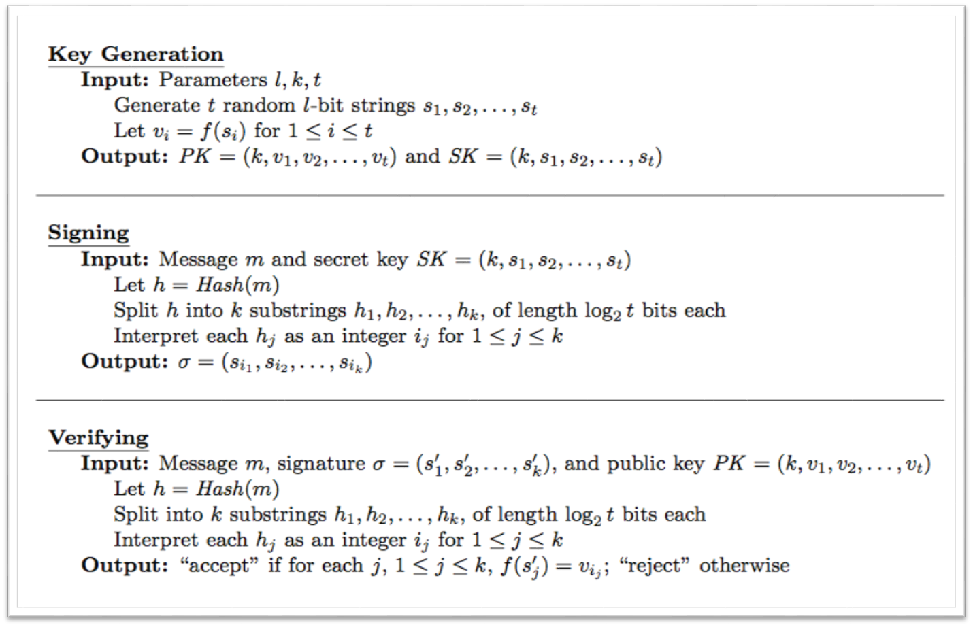
HORS Operations

Slide 20
Influence of HORS
Time-valid HORS
Several Variants for HORS:
  HORSIC, HORS++, HORSE
  Are they practical? (part of your Take-home)
  Can you extend HORS with other crypto primitives?
  One-wayness is not all about hash functions?
  What about modular exponentiation?
  RSA? or DLP/ECDLP? (part of your Take-home)
A digression with ECDSA (to discuss principles)
Structure-Free Rapid Authentication (one of future lecture)

Slide 21
Advanced Primitives (II)
(Hash-based)
Hash Chains
Merkle Hash Trees
Some Applications of them
Dr. Attila A. Yavuz
CS/ECE 519/599 – Advanced Network Security

Slide 22
One-way Hash Chain
Used for many network security applications
  S/Key (now)
  Authenticate data streams (TESLA& EMSS lecture)
  Key derivation in crypto schemes (ETA lecture)
  Forward-security (BAF, HaSAFSS)
  Commitments ( MR-ETA lecture, e-commerce)
Good for authentication of the hash values
Commitment
K_{i}=F(K_{i+1}), F: hash function
K₀
F
K₁
F
K₂
F
K₃
F
K₄
F
F
K_{n}= R

Slide 23
Properties of One-way Hash Chain
Given K_{i}
  Anybody can compute K_{j}, where j<i
  It is computationally infeasible to compute K_{l}, where l > i, if K_{l} is unknown
  Any K_{l} disclosed later can be authenticated by verifying if H^{l-i}(K_{i}) = K_{l}
  Disclosing of K_{i+1} or a later value authenticates the owner of the hash chain
K₀
F
K₁
F
K₂
F
K₃
F
K₄
F
F
K_{n}= R

Slide 24
Using “Disposable” Passwords
Simple idea: generate a long list of passwords, use each only one time
  attacker gains little/no advantage by eavesdropping on password protocol, or cracking one password
Disadvantages
  storage overhead
  users would have to memorize lots of passwords!
Alternative: the S/Key protocol
  based on use of one-way (e.g. hash) function

Slide 25
S/Key Password Generation
Alice selects a password x
Alice specifies n, the number of passwords to generate
Alice’s computer then generates a sequence of passwords
  x₁ = H(x)
  x₂ = H(x₁)
  …
  x_{n} = H(x_{n-1})
x
x (Password)
H
H
H
H
x1
x2
x3
x4

Slide 26
Generation… (cont’d)
Alice communicates (securely) to a server the last value in the sequence: x_{n}
Key feature: no one knowing x_{i} can easily find an x_{i-1} such that H(x_{i-1}) = x_{i}
  only Alice possesses that information

Slide 27
Authentication Using S/Key
Assuming server is in possession of x_{i} …
Server
Alice
i
x_{i-1}
verifies
H(x_{i-1}) = x_{i}
Notes:
Depends on how x is selected.

Slide 28
Limitations
Value of n limits number of passwords
  need to periodically regenerate a new chain of passwords
Does not authenticate server! Example attack:
  real server sends i to fake server, which is masquerading as Alice
  fake server sends i to Alice, who responds with x_{i-1}
  fake server then presents x_{i-1} to real server

Slide 29
Chained Hashes
More general construction than one-way hash chains
Useful for authenticating a sequence of data values D₀ , D₁ , …, D_{N}
H* authenticates entire chain
D₀
D_{N-2}
D_{N-1}
…
H*
H₀
H_{N-1}
D_{N}
H_{N-2}
H( D_{N-1} || H_{N-1} )
H(D_{N})

Slide 30
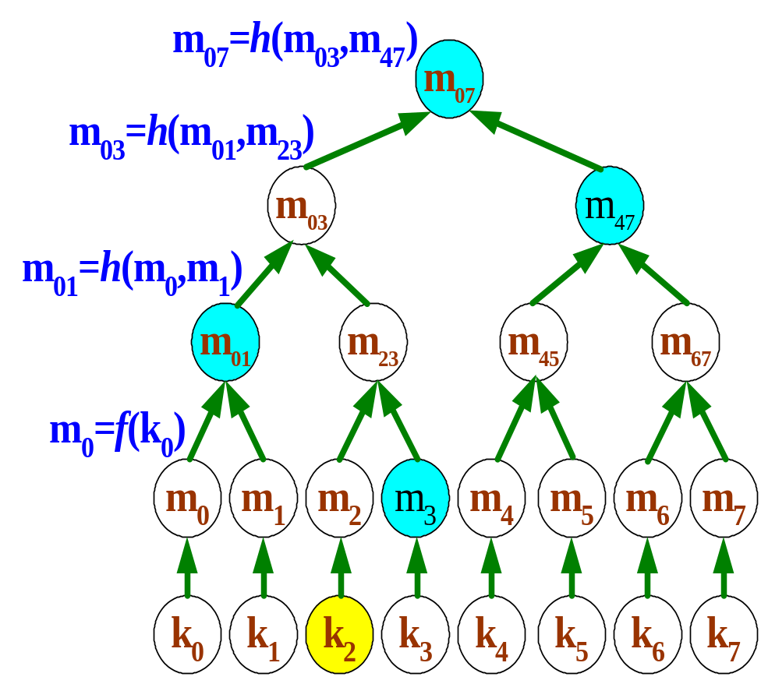
Merkle Hash Tree
A binary tree over data values
  For authentication purpose
The root is the commitment of the Merkle tree
  Known to the verifier.
Example
  To authenticate k₂, send (k₂, m₃,m₀₁,m₄₇)
  Verify
m₀₇= h(h(m₀₁||h(f(k₂)||m₃)||m₄₇)

Slide 31
Merkle Hash Tree (Cont’d)
Hashing at the leaf level is necessary to prevent unnecessary disclosure of data values
Authentication of the root is necessary to use the tree
  Typically done through a digital signature or pre-distribution
Limitation
  All leaf values must be known ahead of time

Slide 32
Untrusted External Storage
Problem: how can we store memory of a secure coprocessor in untrusted storage?
Solution: construct Merkle hash tree over all memory pages
Mallory’s Storage
Secure
Coprocessor
Small persistent
storage

Slide 33
Advanced Primitives (III)
Secret Sharing
Dr. Attila A. Yavuz
CS/ECE 519/599 – Advanced Network Security

Slide 34
Secret Sharing
Objective
  Divide data D into n pieces D₁, …, D_{n} in such a way that
    Knowledge of any k or more D_{i} pieces makes D easy to compute,
    Knowledge of any k − 1 or fewer D_{i} pieces leaves D completely undetermined.
  Such a scheme is called a (k, n) threshold scheme.
Useful when no single entity can be trusted with the secret
  Management of cryptographic keys

Slide 35
Shamir’s Secret Sharing
Underlying fact
  Based on polynomial interpolation.
  Given k points in the 2-d plane (x₁, y₁), … , (x_{k}, y_{k}) with distinct x_{i}’s,
  there is one and only one polynomial q(x) of degree k−1 such that
  q(x_{i})=y_{i} for all i.

Slide 36
Shamir’s Secret Sharing (Cont’d)
Split the secret D
  To divide D into pieces D_{i} …
  Pick a random k − 1 degree polynomial
  q(x) = a₀ + a₁x + … + a_{k-1}x^{k-1}
  in which a₀ = D.
  Evaluate D₁ = q(1), D₂ = q(2), …, D_{n} = q(n).
  The secret shares represent distinct points on the polynomial.

Slide 37
Shamir’s Secret Sharing (Cont’d)
Reconstruction
  Given any subset of k of these D_{i} values (with their identifying indices)
    Find the coefficients of q(x) by interpolation,
    Evaluate D = q(0).
  Given just k – 1 of these values,
    D could be any value
    In other words, D being any value will give one and only one possible polynomial
Alternatively, view these as linear equations.

Slide 38
Advanced Primitives (IV)
Rabin’s Information Dispersal
Dr. Attila A. Yavuz
CS/ECE 519/599 – Advanced Network Security

Slide 39
Motivation
IDA was developed to provide safe and reliable transmission of information in distributed systems.
Inefficiency of retransmission of lost packets
  In multicast transmission, different receivers lose different sets of packets.
  Re-request and retransmission increases delays.
Forward error correction technique might be desirable in distributed systems.

Slide 40
High-level Operations
Dispersal(F, m, n):
  Split input F with redundancy into n pieces F_{i} (1 ≤ i ≤ n).
  |F_{i}|=|F|/m, and m ≤ n
Recovery({Fi_{j} |(1≤ j ≤m), (1≤ i_{j} ≤n)}, m, n):
  Reconstruct F from any m out of the n pieces (F_{i} (1 ≤ i ≤ n))

Slide 41
Dispersal(F, m, n) – Example 1
|F|=32 bytes, m=4, n=8
F
Dispersal(F, 4, 8)
F₁
F₂
F₃
F₄
F₅
F₆
F₇
F₈
  |F_{i}| = 32/4 = 8 bytes (1 ≤ i ≤ n)

Slide 42
Recovery({Fi_{j} |(1≤ j ≤m), (1≤ i_{j} ≤n)}, m, n) – Example 2
|F|=32 bytes, m=4, n=8, |F_{i}|=8 bytes (1 ≤ i ≤ 8)
Assume the following 4(=m) pieces are received.
F₁
F₃
F₄
F₇
Recovery({F₁, F₃, F₄, F₇}, 4, 8)
F

Slide 43
Dispersal(F, m, n)
F = b₁,b₂,…,b_{N}
  N=|F|, and b_{i} represents each byte in F (0 ≤ b_{i} ≤ 255).
  All computations performed in GF(2⁸).
    GF(2⁸) is closed under addition and multiplication.
    Every nonzero element in GF(2⁸) has a multiplicative inverse.
F = (b₁,…,b_{m}),(b_{m+1},…,b_{2m}),…,(b_{N-m+1},…,b_{N})
  S_{i} = (b_{(i-1)m+1},…,b_{im}) ^{T}(1 ≤ i ≤ N/m)
The matrix M_{m × N/m} is constructed as follows:
  M = [ S₁ S₂ … S_{N/m} ]

Slide 44
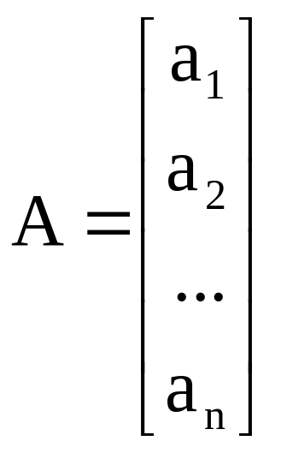
Dispersal(F, m, n)
The matrix A_{n×m} is constructed as follows:
  a_{i} = (a_{i1}, …,a_{im}) (1 ≤ i ≤ n)
    Every subset of m different vectors should be linearly independent.

Slide 45
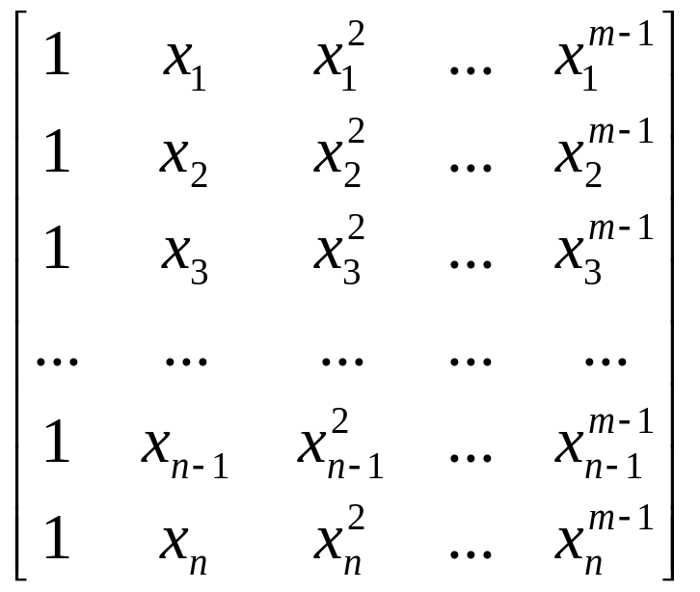
Dispersal(F, m, n)
The following Vandermonde matrix satisfies the property required for A.
  m ≤ n, and all x_{i}’s are nonzero elements in GF(2⁸) and pairwise different.
  Any m different rows are linearly independent, so any matrix composed of a set of any m different rows is invertible.

Slide 46
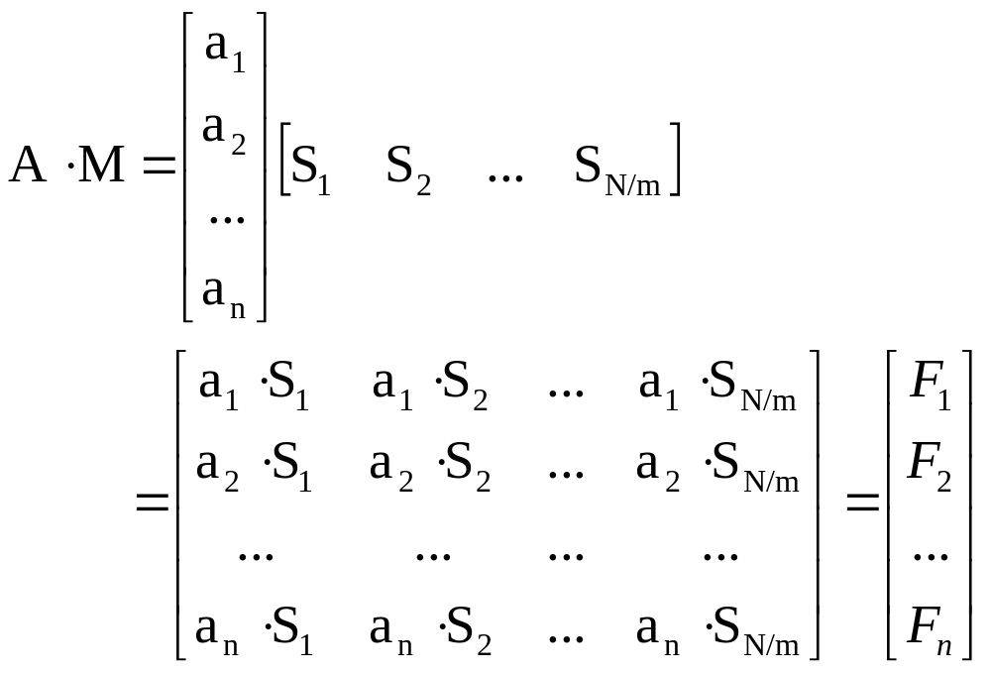
Dispersal(F, m, n)
The n pieces F_{i} (1 ≤ i ≤ n) are computed as follows:
  where a_{i}・S_{k} = a_{i1}b_{(k−1)m+1} + … + a_{im}b_{km}

Slide 47
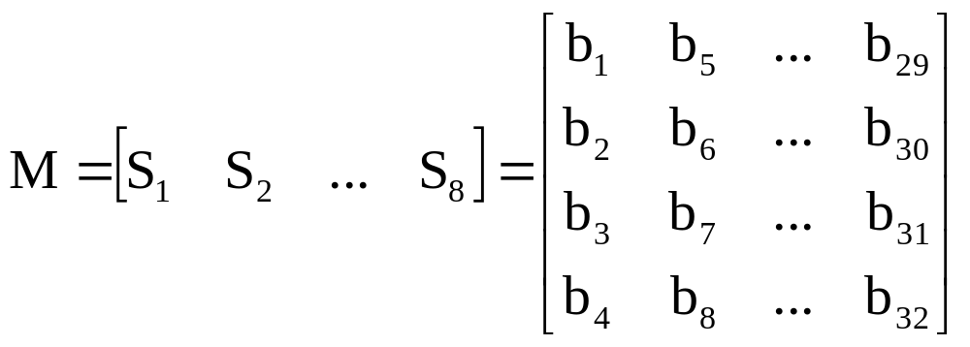
Dispersal(F, m, n) – Example 3
|F|=32 bytes, m=4, n=8
  F = b₁,b₂,…,b₃₂
  Represented as M_{4×8}

Slide 48
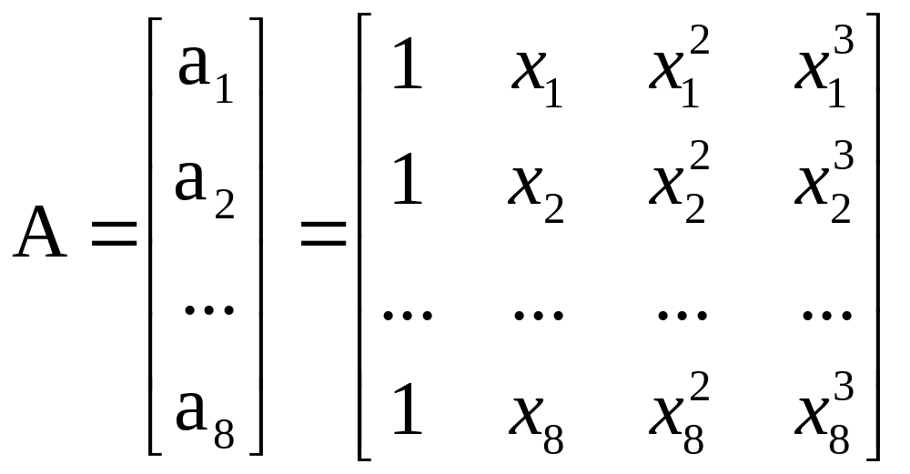
Dispersal(F, m, n) – Example 3
  A_{8×4}

Slide 49
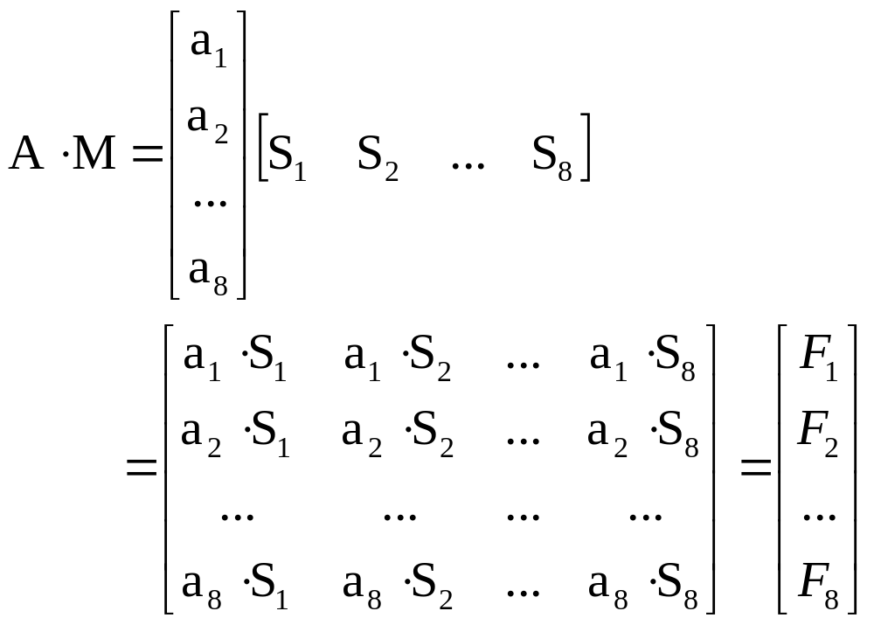
Dispersal(F, m, n) – Example 3
F_{i} (1 ≤ i ≤ 8) are computed as follows:

Slide 50
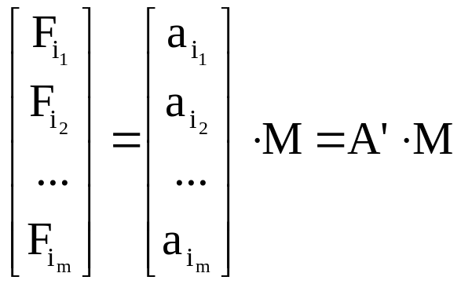
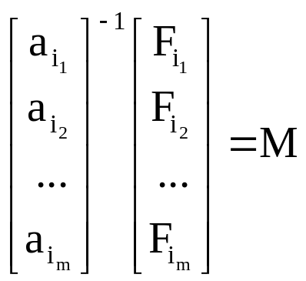
Recovery({Fi_{j} |(1≤ j ≤m), (1≤ i_{j} ≤n)}, m, n)
Given m pieces Fi_{j} ( (1≤ j ≤m), (1≤ i_{j} ≤n) ),
M can be recovered from the given m pieces Fi_{j} ( (1≤ j ≤m), (1≤ i_{j} ≤n) ) because A’ is invertible.

Slide 51
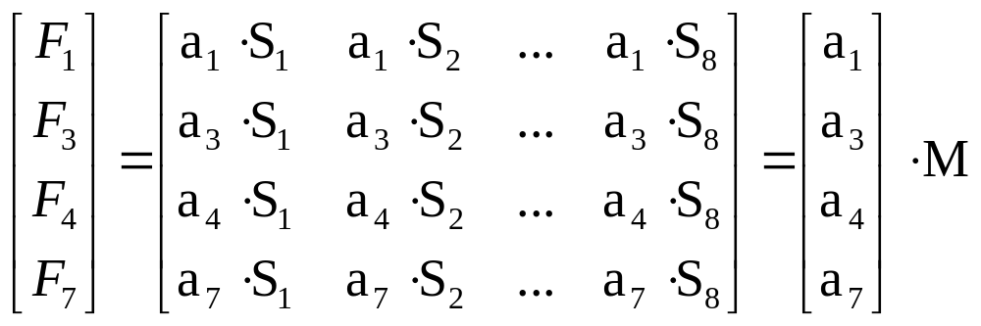
Recovery({Fi_{j} |(1≤ j ≤m), (1≤ i_{j} ≤n)}, m, n) – Example 4
|F|=32 bytes, m=4, n=8
In example 3, F_{i} (1 ≤ i ≤ 8) pieces of 8 bytes are resulted.
Assume that {F₁,F₃,F₄,F₇} are received among them.

Slide 52
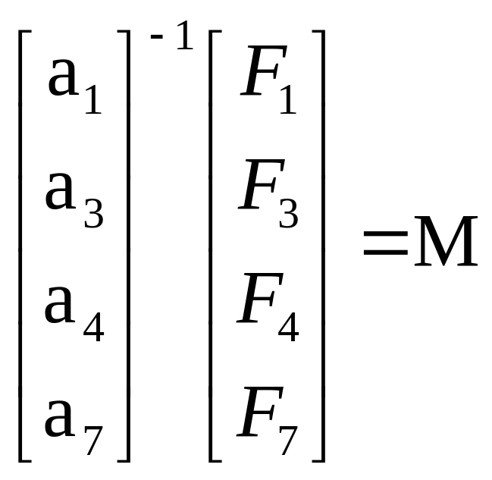
Recovery({Fi_{j} |(1≤ j ≤m), (1≤ i_{j} ≤n)}, m, n) – Example 4
The original data M can be recovered by the following computation:

Slide 53
Advanced Primitives (V)
Bloom Filters
Dr. Attila A. Yavuz
CS/ECE 519/599 – Advanced Network Security

Slide 54
Bloom Filters
It is used to verify that some data is not in the database (mismatch)
  List of bad credit card numbers
  Useful when the data consumes a very small portion of search space
A bloom filter is a bit string
k hash functions that map the data into n bits in the bloom filter

Slide 55
A Simple Example
Use a bloom filter of 16 bits
  H₁(key) = key mod 16
  H₂(key) = key mod 14 + 2
Insert numbers 27, 18, 29 and 28
1
1
1
1
1
1
1
1 2 3 4 5 6 7 8 9 10 11 12 13 14 15
Check for 22:
  H₁(22) = 6, H₂(22) = 10 (not in filter)
Check for 51
  H₁(51) = 3, H₂(51) = 11 (false positive)

Slide 56

Probability of False Positive
Consider an m-bit Bloom filter with k hash functions
  After inserting n elements, the probability of false positive

Slide 57
Advanced Tools (I)
Denial of Service Mitigation
Client Puzzles Based on
Pre-image of Crypto Hash Functions
Dr. Attila A. Yavuz
CS/ECE 519/599 – Advanced Network Security

Slide 58
Client Puzzles
The problem being addressed
  Denial of Service (DoS) attacks
Three basic constructions
  Use pre-image of crypto hash functions
  Use special image of crypto hash functions
  Use constrained discrete logarithm problem (DLP)

Slide 59


An Example Scenario: TCP SYN Flooding
“TCP connection, please.”
“TCP connection, please.”
“O.K. Please send ack.”
“O.K. Please send ack.”
Buffer

Slide 60





Client Puzzle: Intuition
???
O.K.
Please solve this
puzzle.
Table for four
at 8 o’clock.
Name of Mr. Smith.
O.K.,
Mr. Smith
Restauranteur

Slide 61
Client Puzzle: Intuition
A puzzle takes an hour to solve
There are 40 tables in restaurant
Reserve at most one day in advance
A legitimate patron can easily reserve a table

Slide 62
Client Puzzle: Intuition
???
???
???
???
???
???
An attacker has to reserve many tables to have a real impact
→ too many puzzles to solve

Slide 63

The Client Puzzle Protocol
Service request M
Server
Client
Buffer
O.K.

Slide 64
Puzzle Basis: Partial Hash Image
?
k bits
pre-image X
?
partial-image X’
160 bits
hash
image Y
Pair (X’, Y) is k-bit-hard puzzle

Slide 65
Puzzle Basis (Cont’d)
Only way to solve puzzle (X’,Y) is brute force method. (hash function is not invertible)
Expected number of steps (hash) to solve puzzle: 2^{k} / 2 = 2^{k-1}

Slide 66
Puzzle Construction
Client
Server
Service request M
Secret S

Slide 67
Puzzle Construction
Server computes:
secret S
time T
request M
hash
Puzzle
pre-image X
hash
image Y

Slide 68
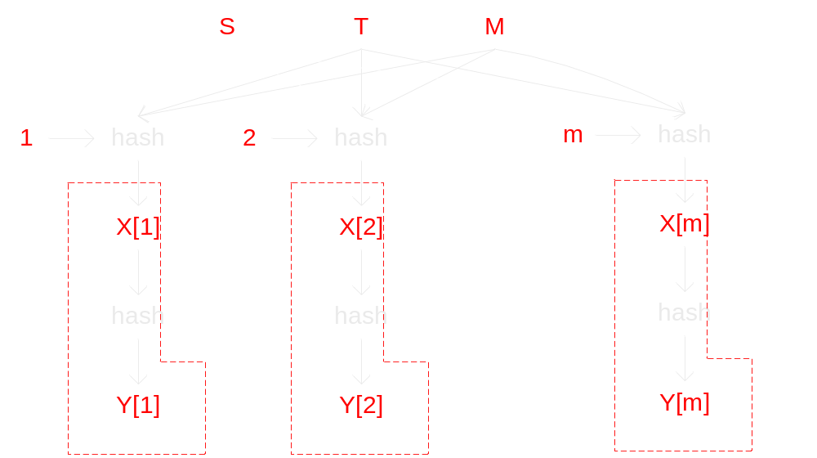
Sub-puzzle
Construct a puzzle consisting of m k-bit-hard sub-puzzles.
Increase the difficulty of guessing attacks.
Expected number of steps to solve: m×2^{k-1}.
Notes:
Why not use k+logm bit puzzles?
Probability of guessing the right solution is different in these two cases.

Slide 69
Why not use k+logm bit puzzles?
(k+logm)-bit puzzle
  Expected number of trials m×2^{k-1}
But for random guessing attacks, the successful probability
  One (k+logm)-bit puzzle
    2^{-(k+logm)} (e.g., 2^{-(k+3)})
  m k-bit subpuzzles
    (2^{-k})^{m} = 2^{-km} (e.g., 2^{-8k})

Slide 70
Puzzle Properties
Puzzles are stateless
Puzzles are easy to verify
Hardness of puzzles can be carefully controlled
Puzzles use standard cryptographic primitives

Slide 71
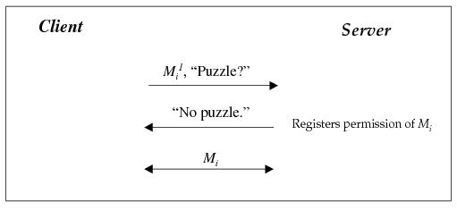
A Possible Way to use Client Puzzle
Client puzzle protocol (normal situation)
M_{i}¹ : first message of i-th execution of protocol M

Slide 72
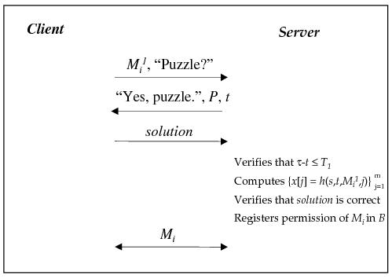
A Possible Way to use Client Puzzle
Client puzzle protocol (under attack)

Slide 73
Advanced Tools (II)
Denial of Service Mitigation
Client Puzzles Based on
Special Image of Crypto Hash Functions
Dr. Attila A. Yavuz
CS/ECE 519/599 – Advanced Network Security

Slide 74
New Requirements from the Puzzle
Preserve the previous properties
The same puzzle can be given to several clients
  Knowing solution for a client should not help the other (e.g., the adversary) to find another solution
  Broadcast puzzles!
  Not one-to-one connection required to initiate.
The server should be able to pre-compute the broadcast puzzles. Even faster at online stage
  Previous: M hash operations per-client (1-1),
A client can re-use the same broadcast puzzle to create multiple solutions, multiple access tickets

Slide 75
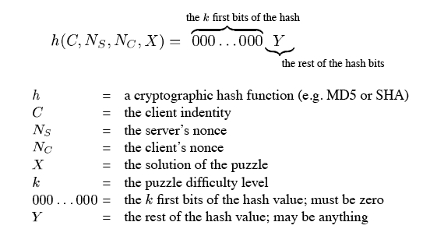
Puzzle Construction
S → All clients (broadcast): Digitally sign: k, Ts, N_{S}
Client C → S: C, N_{S}, N_{C}, X
S: verify h(C, N_{S}, N_{C}, X) has k leading zero’s

Slide 76
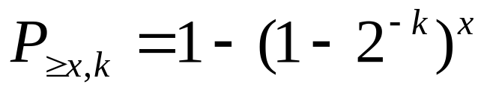
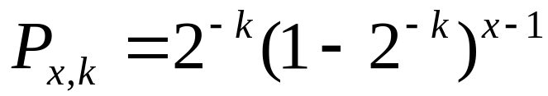
Expected Cost of Finding a Puzzle Solution
Given puzzle strength k, the probability of finding a solution
  After x trials:
  At the x-th trial:
Expected number of trials to find a solution is 2^{k}

Slide 77
Advanced Tools (III)
Denial of Service Mitigation
Client Puzzles Based on
Constrained Discrete Logarithm Problem
Dr. Attila A. Yavuz
CS/ECE 519/599 – Advanced Network Security

Slide 78
Client Puzzle based on Constrained DLP
Context
  Client puzzle outsourcing for DoS resistance
Motivation
  Client puzzle mechanism can become the target of DoS attacks
    Servers have to validate solutions which require resources
  Puzzles must be solved online
    User time is more important than CPU time

Slide 79
Properties of the Solution
The creation of puzzles is outsourced to a secure entity, the bastion
  Create puzzle with no regard to which server is going to use them
Verifying puzzle solutions is a table lookup
Clients can solve puzzles offline ahead of time
A puzzle solution gives access to a virtual channel for a short time period

Slide 80


Bastion
G: A group of prime numbers with generator g.
Pick r_{c,t} ∈ Z_{q}
a_{c,t} ∈ [r_{c,t}, (r_{c,t} + l) mod q]
Let g_{c,t} = g^{f’(a)} , puzzle π_{c,t} = (g_{c,t}, r_{c,t})
π_{c,t}
π_{c,t} for all channels
Pub: Y₁ = g ^{X1}
Server
Virtual Channels
Priv: X₁
Enumerate l values to solve a_{c,t}
Take the easy way
Solution is σ_{c,t} = Y₁^{f’(a)}
σ_{c,t} = g_{c,t}^{X1}

Slide 81
Pub: Y₁
Pub: Y₂
Server 1
Virtual Channels
Priv: X₁
Pub: Y₃
σ_{c,t} = g_{c,t}^{X1}
Server 2
Server 1: σ_{c,t} = Y₁^{f’(a)}
Virtual Channels
Priv: X₂
Server 2: σ_{c,t} = Y₂^{f’(a)}
σ_{c,t} = g_{c,t}^{X2}
Server 3: σ_{c,t} = Y₃^{f’(a)}
Server 3
Virtual Channels
Priv: X₃
σ_{c,t} = g_{c,t}^{X3}

Slide 82
Puzzle Properties
Unique puzzle solutions
  Each puzzle has a unique solution
Per-channel puzzle distribution
  Puzzles are unique per each
  (server, channel, time period) triplet
Per-channel puzzle solution
  If a client has a solution for one channel, he can calculate a solution for another server with the same channel easily

Slide 83
System Description
Solutions for puzzles are only valid for the time period T_w (e.g., 20 mins)
Client:
  During T_i, download puzzles for T_{i+1} and solve (pre-computability, online client efficiency)
  Get a server public key if available
  Append the puzzle and send request
Server Per-channel puzzle solution
  During T_i, download puzzles for T_{i+1} and solve (can take short cut due to priv. key), only once for T_i
  Checking solution is a lookup
  Can renew channel access by renewing PK

