Slide 1
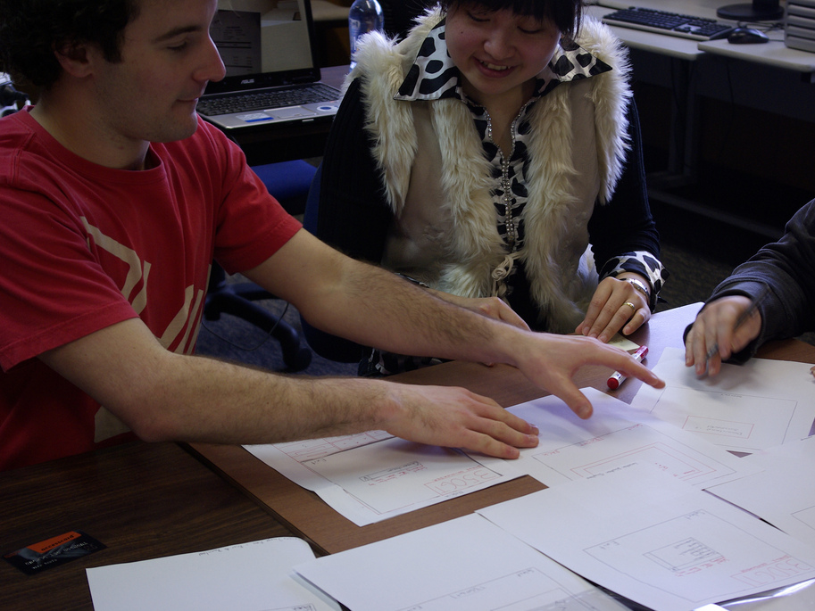
Paper
Prototyping
http://www.flickr.com/photos/21218849@N03/3901372331/sizes/l/

Slide 2
Customers and users should be your friends
They probably know much more about the problem than you do.
They probably have some ideas about how to solve the problem.
They are your best resource for discovering your own mistakes before you start to code.

Slide 3
Risk: an unwanted event that has negative consequences
Risk impact: the loss that would result if a risk turns into a problem
  Measured in time, quality, cost
Risk likelihood: probability that the risk will turn into a problem
  Risk exposure = impact * likelihood
Risk control: the degree to which you can reduce exposure

Slide 4
Risk management
Risk management
  Risk assessment
    Risk identification
    Risk analysis
    Risk prioritization
  Risk control
    Risk reduction
    Risk management planning
    Risk resolution

Slide 5
Example risks in an e-commerce application
Risk: mobile phones (unexpectedly) need to be supported
  Impact: 30% of revenue? Likelihood: ???
Risk: credit card validation component cannot handle debit cards
  Impact: 10% of revenue? Likelihood: ???

Slide 6
Risk management and prototyping
Traditional requirements-gathering
  Good for controlling risks regarding what the system should do
  But don’t know what the system should look like
Prototyping
  Good for controlling risks regarding what the system should look like
  Not so good for non-visual aspects of the system

Slide 7
Top ten risks
Personnel shortfalls
Unrealistic schedules and budgets
Developing the wrong software functions
Developing the wrong user interface
Gold plating
Continuing stream of requirements changes
Shortfalls in externally performed tasks
Shortfalls in externally furnished components
Real-time performance shortfalls
Straining computer science capabilities
Personnel shortfalls
Unrealistic schedules and budgets
Developing the wrong software functions **
Developing the wrong user interface ***
Gold plating ***
Continuing stream of requirements changes **
Shortfalls in externally performed tasks *
Shortfalls in externally furnished components *
Real-time performance shortfalls
Straining computer science capabilities *

Slide 8
The general idea of prototyping
You depict what you think the system should look like.
You test the prototypes with customers or (preferably) users.
You fix up the prototypes and use what you learn to implement the real system.

Slide 9
Waterfall kinds of processes
Requirements analysis
Prototyping
Design
Implementation
Testing
Operation

Slide 10
Spiral kinds of processes
Draft a menu of
program designs
Analyze risk &
prototype
Draft a menu of
architecture designs
Analyze risk &
prototype
Draft a menu of
requirements
Analyze risk &
prototype
Establish
requirements
Plan
Establish
architecture
Plan
Operation
Testing
Implementation
Establish
program design

Slide 11
Different kinds of prototypes
Throwaway prototypes
  Paper prototypes: sketches on pieces of paper
  Low-fidelity prototypes: implemented with a tool (e.g.: Photoshop)
Evolutionary prototypes
  High-fidelity prototypes: implemented on the target platform… not fully functional, but destined to be incorporated into the final product

Slide 12
Paper prototypes
Sketch on paper and/or post-it notes
Don’t worry (much) about colors, fonts, icons
Doesn’t need to be beautiful
Does need to show all important UI elements
Does need to be intelligible by users

Slide 13
Example system
Here are the functional requirements:
System will have web pages for mobile phones where citizens can report panhandlers
Certain users called “volunteers” will
view reports and “claim” panhandlers
After visiting a claimed panhandler to offer social services (e.g.: counseling), a volunteer can mark a panhandler’s report as “done”

Slide 14
Example system
Here’s a panhandler report state chart
Report status
New
(just reported)
claim
unclaim
Done
(visited by volunteer)
Claimed
(by volunteer)
mark done
succeeds

Slide 15
“Testing” prototypes
Pretend to be the computer while a user tries to perform a use case with your prototype
Let the user interface speak for itself
  So shut up and see if the user can do it himself!!!
If the user misunderstands the user interface, then fix it on the spot if you can.
  Principle: the user is always right (in prototyping)

Slide 16
UC#1: Report panhandler
Actor: any user
Preconditions: user views site in mobile browser
Postconditions: system records report
Flow of events:
  User selects a city
  User enters information about the panhandler
  System validates inputs
  System records report in database

Slide 17
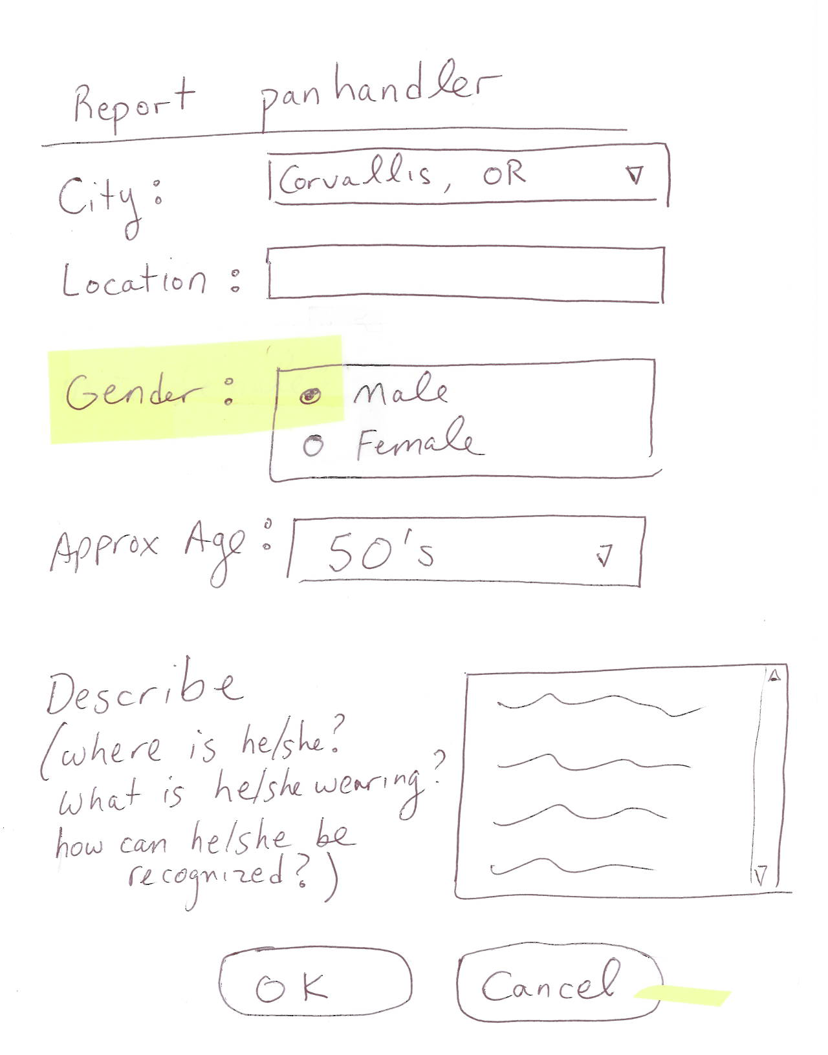
  User selects a city
  User enters information about the panhandler
  System validates inputs
  System records report in database

Slide 18
UC#2: Process panhandler
Actor: volunteer (member of task force)
Preconditions: volunteer logged in via mobile browser
Flow of events:
  Volunteer reviews list or map of panhandlers
  Volunteer marks report as “claimed”
  System records report as claimed
  Volunteer visits the panhandler
  Volunteer marks report as “done”
  System records report as done

Slide 19
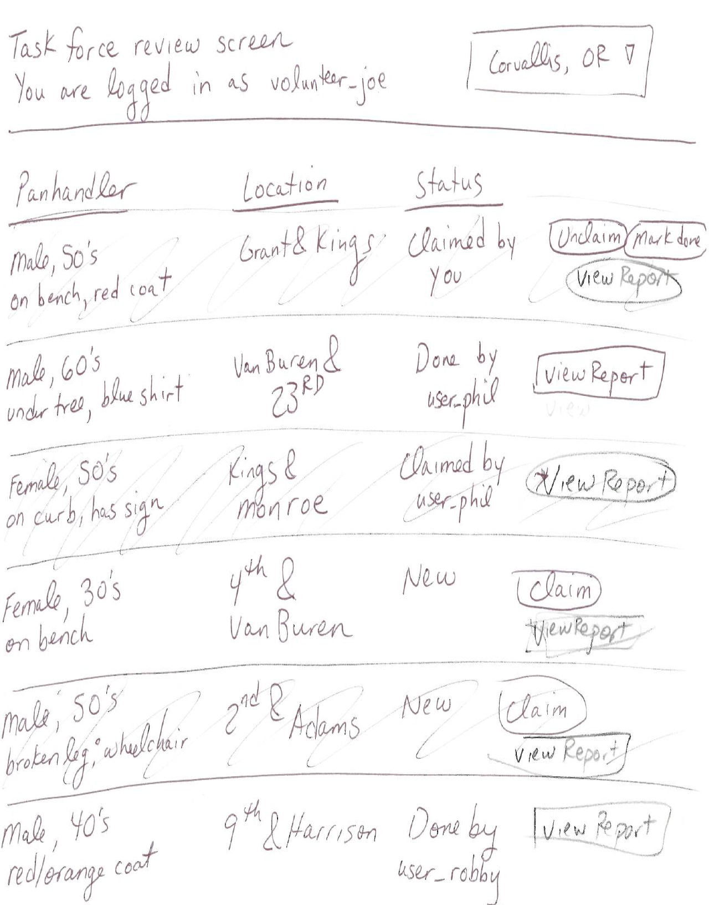
  Volunteer reviews list or map of panhandlers
  Volunteer marks report as “claimed”
  System records report as claimed
  Volunteer visits the panhandler
  Volunteer marks report as “done”
  System records report as done

Slide 20
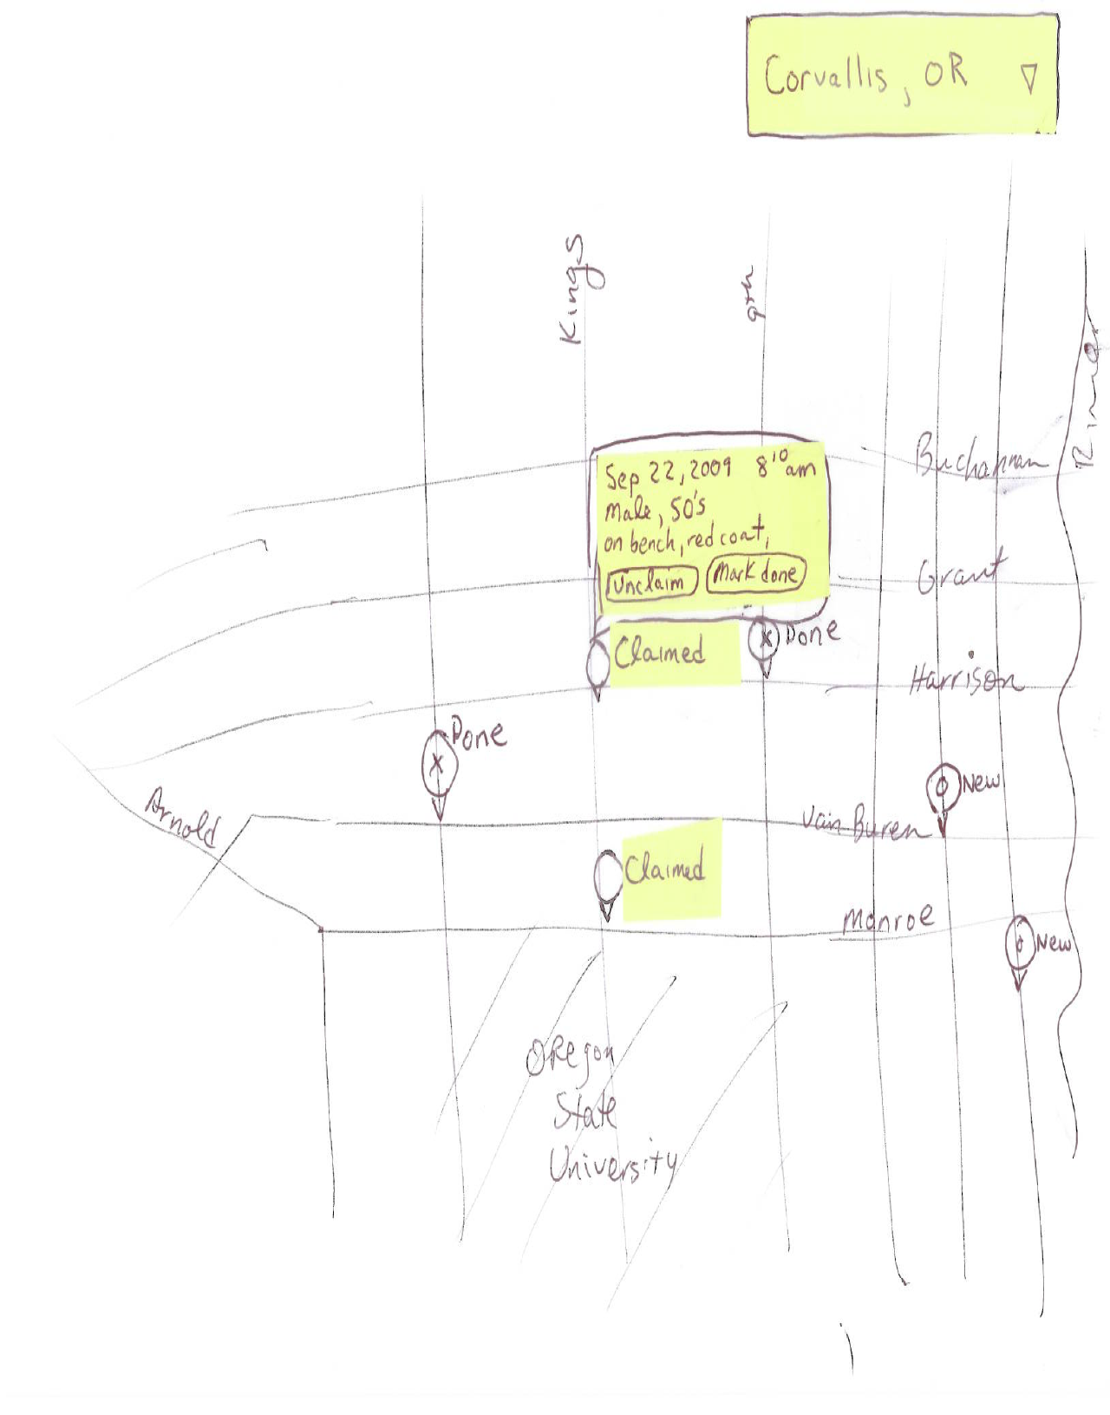
  Volunteer reviews list or map of panhandlers
  Volunteer marks report as “claimed”
  System records report as claimed
  Volunteer visits the panhandler
  Volunteer marks report as “done”
  System records report as done

Slide 21
Some problems revealed by prototype
What happens during “validation” of a panhandler report?
How does the volunteer navigate from the “list view” to the “map view”?
What happens if there are lots and lots of reports… how does the user make sense of it?
So what happens when the user marks a panhandler report as “done”?

Slide 22
Non-visual problems that the prototype might not catch
What if there are duplicate reports?
How do new cities get added to the system?
Do users need to be authenticated to make a panhandler report? Why/why not?
Is the mapping interface really going to run properly in a mobile browser? Sounds risky.
Identifying such problems requires techniques beyond prototyping.

Slide 23
Low-fidelity prototypes
Fidelity = “faithfulness” or closeness to what the ultimate product would look like
  Paper prototypes are “ultra low” fidelity
Low-fidelity prototypes can be made in
  Photoshop
  PowerPoint
  HTML
  Any other tool that’s cheap and easy to use

Slide 24
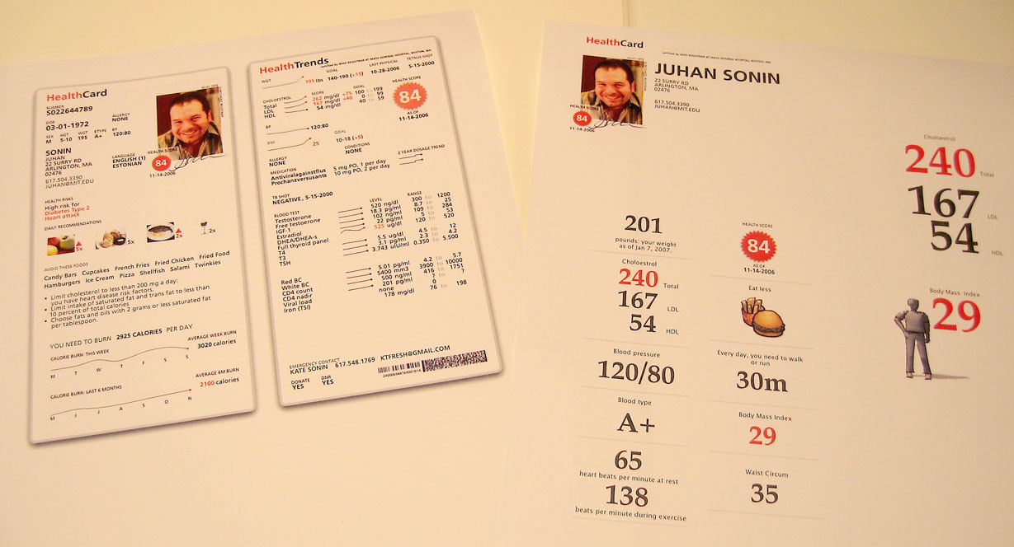
Promoting health awareness with a
“know your numbers” card & system
http://www.flickr.com/photos/juhansonin/347137175/sizes/o/

Slide 25
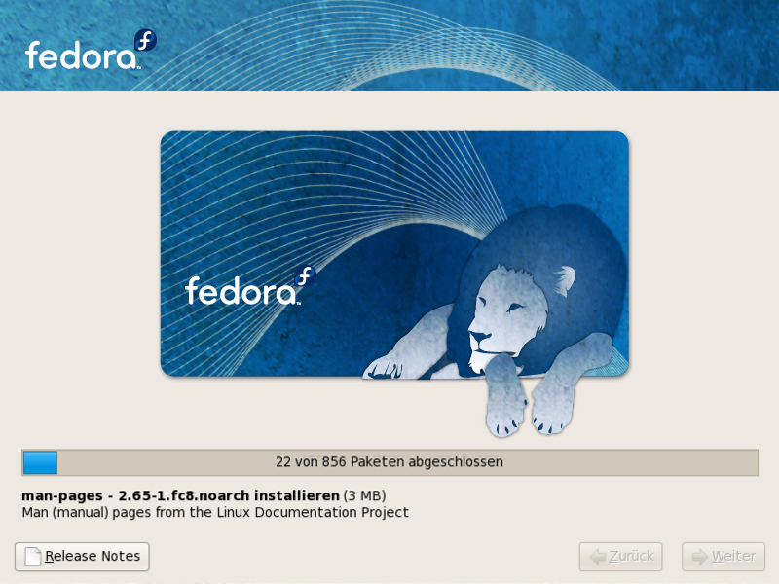
Prototype splash-screen for Anaconda, an installer framework for Linux
http://www.flickr.com/photos/sstorari/3671284171/sizes/o/

Slide 26
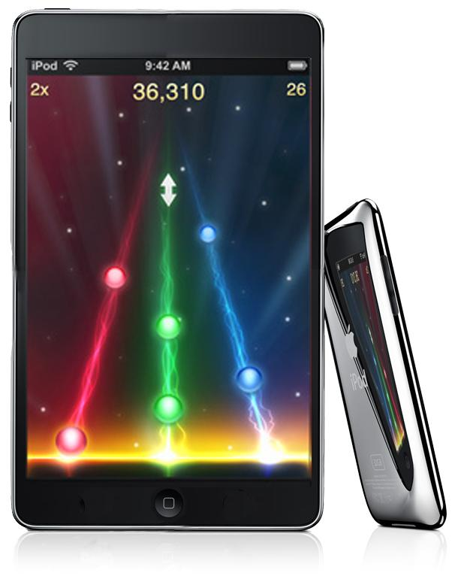
Prototype of what an iPod might look like with a 320x480 resolution
http://www.flickr.com/photos/ben30/2866006814/sizes/o/

Slide 27
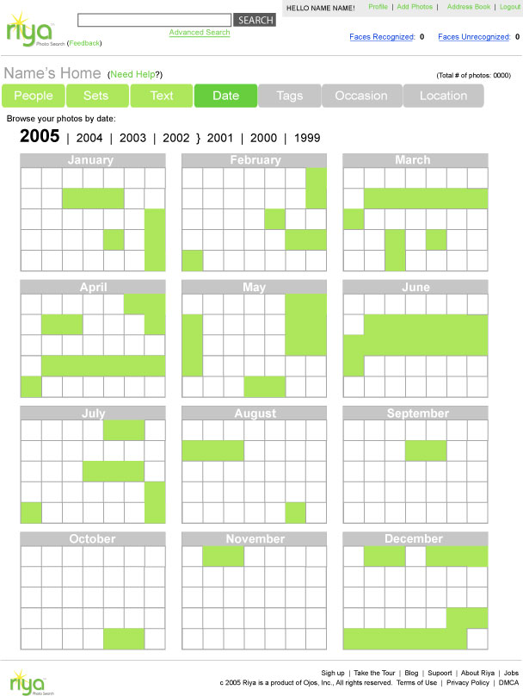
Prototype of a site for managing and sharing photos
http://www.flickr.com/photos/
missrogue/68077527/sizes/o/

Slide 28
Paper vs low-fidelity
Low-fidelity lets you explore
  Colors, fonts, iconography, etc
But low-fidelity
  Is more expensive
  Requires somebody with design “skillz”
  Is harder to fix on the fly
And neither one can detect certain problems…

