Slide 1
CS/ECE 419/478
Applied Cryptography
ADVANCED KEY ESTABLISHMENT AND GROUP KEY MANAGEMENT METHODS
Credits: Dr. Peng Ning, Dr. Wensheng Zhang
Dr. Attila A. Yavuz
CS/ECE 419/478 – Introduction to Network Security

Slide 2
Outline
Group Diffie-Hellman Key Exchange
  GDH.1, GDH.2, GDH.3
Tree-based Group Diffie-Hellman Key Exchanged
  Member Join-Leave, Partition, Merges
Group Key Distribution Methods
  Forward and backward security
  Iolus
  Logical Key Hierarchy
  Key Graphs

Slide 3
GROUP KEY MANAGEMENT (I)
Group Diffie-Hellman
Key Exchange Schemes
Dr. Attila A. Yavuz

Slide 4
Group Communication
A group consists of multiple members
Messages sent by one sender are received by all the other group members

Slide 5
Secure Group Communication
Messages sent by a valid group member can only be understood by the other valid members
  Others may receive the messages, but are unable to understand them
  Typical approach: Encrypt the group messages with a key only known to the valid group members

Slide 6
Group Key Management
Group key management
  Ensure only valid group members have access to the group key
  The REAL problem for secure group communication

Slide 7
Desired Properties of Group Key Management
Group key secrecy
  It is at least computationally infeasible for an adversary to discover any group key
Forward secrecy
  A passive adversary who knows a contiguous subset of old group keys cannot discover subsequent group keys
  Do not confuse with PFS
Backward secrecy
  A passive adversary who knows a contiguous subset of group keys cannot discover preceding group keys
Group key independence
  The combination of forward and backward secrecy.

Slide 8
Stateful v.s. Stateless
Stateful
  Decryption of new key depends on previous keys
  Group member should keep track of all rekeying messages
  Members should be online
Stateless
  Decryption of new key depends on establishment key set that is assigned when member join
  Group members don’t need to keep track of rekeying messages
  Members can be offline

Slide 9
Types of Group Key Management
Group key agreement
  Group keys are determined collectively by all group members
  Usually extended from D-H key exchange
Group key distribution
  Group keys are determined and distributed by a group key manager

Slide 10
Outline
Review of the basic two-party D-H key exchange
Generic n-party D-H key agreement
Three specific protocols
  GDH.1
  GDH.2
  GDH.3

Slide 11
Two-Party Diffie-Hellman Key Exchange
Alice
Bob
Pick secret S_{a} randomly
Compute T_{A} = g^{Sa} mod p
Send T_{A} to Bob
Compute T_{B}^{Sa} mod p
Pick secret S_{b} randomly
Compute T_{B} = g^{Sb} mod p
Send T_{B} to Bob
Compute T_{A}^{Sb} mod p
Shared key is reached at both parties: g^{SaSb} mod p

Slide 12
Notations
n: number of participants in the protocol
α: exponentiation base
q: order of the algebraic group
M_{i}: i-th group member, i is the index
N_{i}: random exponent generated by group member M_{i}
S: subsets of {N₁, …, N_{n}}
Π(S): product of all elements in subset S
K_{n}: group key shared among n members

Slide 13
Generic n-Party D-H Key Agreement
Setup
  All n participants agree on a cyclic group G, of order q and the base α
  Each member M_{i} chooses a random value N_{i} ∈ G

Slide 14
Generic n-Party D-H Key Agreement (Cont’d)
Generic Protocol:
  Distributively revealing and computing a subset of {α^{Π(S)}|S ⊂{N₁, …, N_{n}}}
  From these subsets, member M_{i} computes
  α^{N1…Ni-1Ni+1…Nn} mod q
  Finally, M_{i} computes the shared key
  K = α^{N1…Nn} mod q

Slide 15
Generic n-Party D-H Key Agreement (Cont’d)
Security
  The generic n-party D-H protocol is secure if the 2-party D-H protocol is secure
  Proof: by induction on n
Remaining problem
  Consider {α^{Π(S)}|S ⊂{N₁, …, N_{n}}}
  What (S) to distribute, and how?

Slide 16
GDH.1
Consists of an upflow stage and a downflow stage
Upflow:
M₁
M₂
M₃
…
M_{n}
Downflow:
M₁
M₂
M₃
…
M_{n}

Slide 17
GDH.1 (Cont’d)
Upflow
  M_{i} receives the set {α^{N1}, α^{N1N2}, …, α^{N1…Ni-1}} and forwards to M_{i+1} {α^{N1}, α^{N1N2}, …, α^{N1…Ni}}, i ∈ [1, n-1]
Example
  M₄ receives the set
    {α^{N1}, α^{N1N2}, α^{N1N2N3}}
  and forwards to M₅
    {α^{N1}, α^{N1N2}, α^{N1N2N3}, α^{N1N2N3N4}}

Slide 18
GDH.1 (Cont’d)
Downflow
  M_{i} uses the last intermediate value to compute K_{n} (1<i<=n)
  M_{i} then raises all remaining values to the power of N_{i} and forwards the resulting set to M_{i-1}
Example
  M₄ receives the set
    {α^{N5}, α^{N1N5}, α^{N1N2N5}, α^{N1N2N3N5}}
  and forwards to M₃
    {α^{N5N4}, α^{N1N5N4}, α^{N1N2N5N4}}

Slide 19
GDH.1 (Cont’d)
How many rounds?
  __________
How many messages in GDH.1?
  __________
How many exponentiations per M_{i}?
  __________
Upflow:
M₁
M₂
M₃
…
M_{n}
Downflow:
M₁
M₂
M₃
…
M_{n}
Notes:
Rounds: 2(n-1);
Messages: 2(n-1)
Exponentiations per Mi: (I+1) for I<n, n for Mn

Slide 20
GDH.2
Consists of an upflow stage and a broadcast stage
  Use broadcast to reduce communication overhead
Upflow:
M₁
M₂
M₃
…
M_{n}
Broadcast:
M₁
M₂
M₃
…
M_{n}

Slide 21
GDH.2 (Cont’d)
Upflow
  M_{i} composes i intermediate values and one cardinal value and forwards the resulting set to M_{i+1} (i < n)
Example:
  M₄ receives the set
    {α^{N1N2N3}, α^{N1N2}, α^{N1N3}, α^{N2N3}}
  and forwards to M₅
    {α^{N1N2N3N4}, α^{N1N2N3}, α^{N1N2N4}, α^{N1N3N4}, α^{N2N3N4}}

Slide 22
GDH.2 (Cont’d)
Downflow
  M_{n} raises every intermediate value to the power of N_{n} broadcasts the resulting values to all group members, in another word
  M_{n} broadcasts the set {α^{N1…Ni-1Ni+1…Nn} } to M_{i} (i < n)
Example
  M₄ receives the set {α^{N1N2N3N5} } from M₅ (Assume n=5)

Slide 23
GDH.2 (Cont’d)
How many rounds?
  __________
How many messages in GDH.2?
  __________
How many exponentiations per M_{i}?
  __________
Upflow:
M₁
M₂
M₃
…
M_{n}
Broadcast:
M₁
M₂
M₃
…
M_{n}
Notes:
Rounds: n;
Messages: n;
Combined message size: (n-1)(n/2+2)-1;
Exponentiations per Mi: (I+1) for I<n, n for Mn

Slide 24
GDH.3
Consists of an upflow stage, a broadcast stage, a response stage, and final broadcast stage
  Reduce the number of exponentiations per group member.
Upflow:
M₁
M₂
M₃
…
M_{n-1}
Broadcast:
M₁
M₂
M₃
…
M_{n-1}
Response:
M₁
M₂
M₃
M_{n}
Broadcast:
M₁
M₂
M₃
…
M_{n}

Slide 25
GDH.3 (Cont’d)
Upflow
  M_{i} (i ∈ [1, n-2]) receives α^{N1…Ni-1}, and
  forwards to M_{i+1} α^{N1…Ni},
Broadcast
  M_{n-1} broadcasts α^{N1…Nn-1} to M_{i} (i ≠ n-1)

Slide 26
GDH.3 (Cont’d)
Response
  M_{i} (i < n) factors out its own component and forwards α^{N1…Ni-1 Ni+1…Nn-1} to M_{n}
Broadcast
  M_{n} raises every input to the power of N_{n} and broadcasts the resulting set {α^{N1…Ni-1Ni+1…Nn} } to M_{i} (i < n)

Slide 27
GDH.3 (Cont’d)
How many rounds?
  __________
How many messages in GDH.2?
  __________
How many exponentiations per M_{i}?
  __________
Notes:
Rounds: n+1;
Messages: 2n-1;
Combined message size: 3(n-1);
Exponentiations per Mi: 4 for I < n-1; 2 for n-1; n for n.

Slide 28
Comparison
GDH.1 GDH.2 GDH.3
Rounds 2(n-1) n n+1
Messages 2(n-1) n 2n-1
Total message size n(n-1) (n-1)(n/2+2)-1 3(n-1)
Exp ops per M_{i} i+1, n i+1, n 4, 2, n
Total exp ops (n+3)n/2-1 (n+3)n/2-1 5n-6

Slide 29
Alteration of Group Membership
GDH.1 does not support efficient member addition/deletion.
GDH.2 & GDH.3
  Member addition
    Consider the new member as the new M_{n+1}
  Member deletion
    M_{n} regenerates its secret N_{n} and re-executes the protocol from the second stage.

Slide 30
GROUP KEY MANAGEMENT (II)
Tree-based Group Diffie-Hellman
Key Exchange Schemes
Dr. Attila A. Yavuz

Slide 31
Membership Operations
Formation
Group partition
Member add
Member leave
Group merge

Slide 32
Membership Operations
Join: a prospective member wants to join
Leave: a member wants to (or is forced to) leave
Partition: a group is split into smaller groups
  Network failure: network event causes disconnectivity
  Explicit partition: application decides to split the group
Merge: two or more groups merge to form one group
  Network fault heal: previously disconnected partitions reconnect
  Explicit merge: application decides to merge multiple pre-existing groups into a single group

Slide 33
Tree-Based Group Diffie Hellman
Simple: One function is enough to implement it
Fault-tolerant: Robust against cascade faults
Secure
  Contributory
  Provable security
  Key independence
Efficient
  d is the height of key tree ( < O(log₂ N)), and N is the number of users
  Maximum number of exponentiations per node 3d

Slide 34
Key Tree (General)
g^{gn1gn2n3 gn6gn4n5}
g^{n1gn2n3}
g^{n6gn4n5}
n1
g^{n2n3}
g^{n4n5}
n6
n2
n3
n4
n5

Slide 35
Key Tree (n3’s view)
GROUP KEY
GROUP KEY
= g^{gn1gn2n3 gn6gn4n5}
g^{n1gn2n3}
g^{n1gn2n3}
g^{gn6gn4n5}
g^{gn6gn4n5}
g^{n1}
g^{n2n3}
g^{n1}
g^{n2n3}
g^{gn4n5}
g^{n6}
g^{n2}
g^{n2}
n3
n3
g^{n4}
g^{n5}
Any member who knows blinded keys on every nodes and
its session random can compute the group key.
Member knows all keys on the key-path and all blinded keys
Co-path: Set of siblings of nodes on the key-path
Key-path: Set of nodes on the path from member node to root node

Slide 36
Join (n3’s view)
g^{n3gn1n2}
g^{gn1n2}
n3
n3
g^{n1}
g^{n2}
Tree(n4)
g^{n4}

Slide 37
Join (n3’s view)
g^{n3gn1n2}
g^{gn1n2gn3n4}
g^{gn1n2}
n3
g^{n3n4}
g^{n1}
g^{n2}
n3
g^{n4}

Slide 38
Leave (n2’s view)
g^{gn1n2gn3n4}
g^{n1n2}
g^{gn3n4}
g^{n1}
g^{n1}
n2
n2
g^{n3}
g^{n4}

Slide 39
Leave (n2’s view)
g^{gn1n2gn3n4}
g^{n1n2}
g^{gn3n4}
n2
n2
g^{n3}
g^{n4}

Slide 40
Leave (n2’s view)
g^{n2’gn3n4}
n2’
g^{gn3n4}
g^{n3}
g^{n4}

Slide 41
Partition (n5’s view)
g^{gn1gn2n3 gn6gn4n5}
g^{gn1gn2n3}
g^{n6gn4n5}
g^{n1}
g^{gn2n3}
g^{n4n5}
n6
g^{n6}
g^{n6}
n2
g^{n2}
g^{n2}
g^{n3}
g^{n4}
n5
n5

Slide 42
Partition (n5’s view)
g^{n1}
g^{n2n3}
g^{n4n5}
g^{n3}
g^{n4}
n5

Slide 43
Partition (n5’s view)
g^{gn1n3gn4n5’}
g^{gn1n3}
g^{n4n5}
g^{n4n5’}
g^{n1}
g^{n3}
g^{n3}
g^{n4}
n5
n5
n5
n5’
Change share

Slide 44
Partition: Both Sides
g^{n1}
g^{n6}
g^{n2}
g^{n3}
g^{n4}
n5

Slide 45
Partition: Both sides (N5 and N6)
g^{gn1n3gn4n5’}
g^{n2n6’}
g^{gn1n3}
g^{n4n5’}
g^{n2}
n6
n6’
g^{n1}
g^{n3}
n2
g^{n4}
n5’

Slide 46
Merge (N2’s view)
g^{gn6n7}
g^{gn1n2gn5gn3n4}
g^{n6}
g^{n7}
g^{n1n2}
g^{gn5gn3n4}
g^{n1n2}
g^{n1}
n2
g^{gn3n4}
g^{n5}
g^{n1}
n2
n2
g^{n3}
g^{n4}

Slide 47
Merge (to intermediate node)
g^{ggn1n2gn6n7gn5gn3n4}
g^{gn1n2gn6n7}
g^{gn5gn3n4}
n1
g^{n1n2}
g^{gn6n7}
g^{gn3n4}
g^{n5}
g^{n1}
n2
n2
g^{n6}
g^{n7}
g^{n3}
g^{n4}

Slide 48
Tree Management: do one’s best
Join or Merge Policy
  Join to leaf or intermediate node, if height of the tree will not increase.
Leave or Partition policy
  No one can expect who will leave or be partitioned out.
  No policy for leave or partition event
Successful
  Still maintaining logarithmic (height < 2 log2 N)

Slide 49
Discussion
Efficiency
  Average number of mod exp: 2 log₂ n
  Maximum number of round: log₂ n
Robustness is easily provided due to self-stabilization property

Slide 50
GROUP KEY MANAGEMENT (III)
Group Key Distribution
Iolus
LKH, Key Graphs
Dr. Attila A. Yavuz

Slide 51
Outline
Overview of group key distribution
A naïve solution
Iolus: A Framework for Scalable Secure Multicasting
Logical key hierarchy (LKH)

Slide 52


Group Key Distribution
Group key
manager
Group members
Group session keys are determined by the group manager
  Usually used for large groups.

Slide 53
A Naïve Solution
Use a separate secure unicast connection from the group manager to EACH group member.
Requirement
  Each client shares a unique key with the controller.
Poor scalability:
  n secure unicast connections
  n secret keys

Slide 54
Problems Specific to Group Communication
“1 affects n” problem
  The actions of one member affects the entire group
Group key
manager
Old members
New member joins

Slide 55
Iolus
Divide a large group into smaller groups
Introduce entities that manage and connect the subgroups
  Group security controllers (GSC)
    Control the entire group
  Group security intermediaries (GSI)
    Control the subgroups on behalf of GSC
  GSC and GSI are both referred to as group security agent (GSA)
  With GSC as the root, GSAs form a hierarchy of subgroups
    A lower-level GSA is a member of the group headed by the higher-level GSA

Slide 56
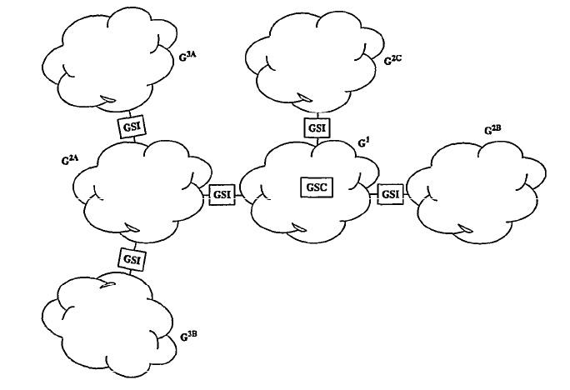
Iolus (Cont’d)

Slide 57
Iolus (Cont’d)
Joins
  GSA generates K_{GSA-MBR}
  Store this key along with other information
  Send K_{GSA-MBR} to the new member in a secure channel
  Generate a new group key K’_{G}
  Send {K’_{G}}K_{G} to the group
  Send K’_{G} to the new member in a secure channel

Slide 58
Iolus (Cont’d)
Leaves
  Generate a new group key K’_{G}
  Send K’_{G} to each member MBR individually in the secure channel encrypted with K_{GSA-MBR}

Slide 59
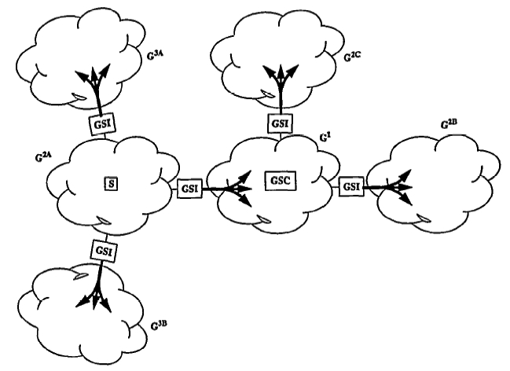
Iolus (Cont’d)
Data transmission
  Data retransmitted within each subgroup

Slide 60
Iolus (Cont’d)
Iolus for group key management
  Replace the data with the group key in data transmission

Slide 61



Key Tree Approaches
Two types of keys
  SEKs (Session Encryption Key)
  KEKs (Key Encryption Key)
A Group Controller constructs a tree based hierarchy of KEKs
Group key
Group Controller
N: number of members
Logical entities
D: tree degree
+
ln
(
N
)
depth
1
ln
(
d
)
members

Slide 62
Logical Key Hierarchy (LKH)
Keys are organized in a (logical) hierarchical tree
  Group key is located at the root
  Key encryption keys are the non-root, non-leave nodes
  Each member corresponds to one leave node
Updates the group key and the key encryption key by means of the encryption of key-nodes
Rekey with only O(logN) messages

Slide 63
LKH (Cont’d)
Initialization
K0
GKCs
N secure channels
K11
K12
K21
K22
K23
K24
K31
K32
K33
K34
K35
K36
K37
K38
M1
M2
M3
M4
M5
M6
M7
M8

Slide 64
LKH (Cont’d)
Member leave
ln
(
N
)
Rekeying Messages
ln
(
d
)
GKCs
K0
K’0
K34 { K0’}
K34 { K11’}
K34 { K22’}
K21 { K0’}
K21 { K11’}
K12 { K0’}
K11
K’11
K12
K21
K22
K’22
K23
K24
K31
K32
K34
K35
K36
K37
K38
M1
M2
M3
M4
M5
M6
M7
M8

Slide 65

LKH (Cont’d)
Member join
ln
(
N
)
Rekeying messages
GKCs
ln
(
d
)
K0
K’0
K31 { K21’}
K31 { K11’}
K31 { K0’}
K21 { K21’}
K11 { K11’}
K0 { K0’}
K11
K’11
K12
K21
K’21
K22
K23
K24
K31
K32
K33
K34
K35
K36
K37
K38
M1
M2
M3
M4
M5
M6
M7
M8

Slide 66
User, Key, or Group Oriented Rekeying
Different performance/reliability trade-offs
User-oriented re-keying
  Grouping re-keying messages by users
Key-oriented re-keying
  Grouping re-keying messages by keys
Group-oriented re-keying
  Putting all re-keying messages together to generate a big, fat message

Slide 67
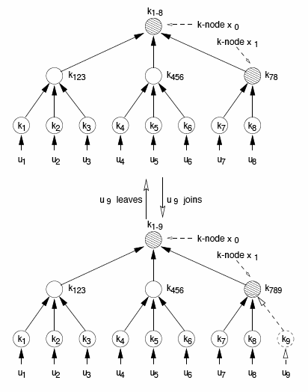



Example
User oriented
Key oriented
Group oriented

