Slide 1

Schedule & effort
http://www.flickr.com/photos/28481088@N00/315671189/sizes/o/

Slide 2
Planning big projects
Figure out what the project entails
  Requirements, architecture, design
Figure out dependencies & priorities
  What has to be done in what order?
Figure out how much effort it will take
Plan, refine, plan, refine, …

Slide 3
Example: Twitter repression report
UC#1: Report repression
UC#2: Clarify tweet
Repressed citizen
UC#3: View reports
Concerned public
UC#3a: View on map
UC#3b: View as RSS feed

Slide 4
One possible architecture
Twitter
Façade
Twitter
Tweet
processor
Geocoder
Façade
Geocoder
Database
MySQL
Mapping
Web site
RSS
Web service
Google maps
Apache+PHP

Slide 5
Activity graph: shows dependencies of a project’s activities
Do Twitter facade
1a
Do tweet processor
Do geocode facade
2
1c
Test & debug components
1b
3
Design db
Do map output
Do RSS output
Milestone 2: DB contains real data
Milestone 3: DB contains real, reliable data
Milestone 4: Ready for public use
3a
Test & debug map
3b
4
Advertise
Test & debug RSS

Slide 6
Activity graph: shows dependencies of a project’s activities
Filled circles for start and finish
One circle for each milestone
Labeled arrows indicate activities
  What activity must be performed to get to a milestone?
  Dashed arrows indicate “null” activities

Slide 7
Effort
Ways to figure out effort for activities
  Expert judgment
  Records of similar tasks
  Effort-estimation models
  Any combination of the above

Slide 8
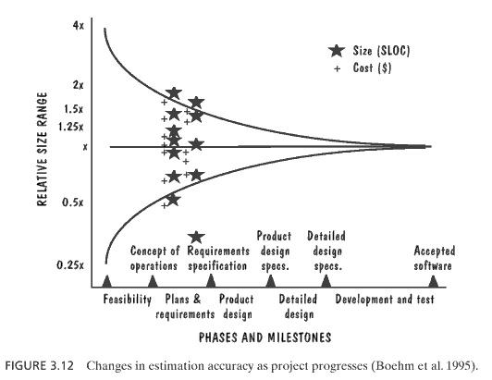
Expect to refine effort estimates
Pfleeger & Atlee

Slide 9
Effort: expert judgment
Not a terrible way to make estimates, but…
  Often vary widely
  Often wrong
  Can be improved through iteration & discussion
How long to do the following tasks:
  Read tweets from Twitter via API?
  Send tweets to Twitter via API?
  Generate reports with Google maps?

Slide 10
Effort: records of similar tasks
Personal software process (PSP)
  Record the size of a component (lines of code)
    Breakdown # of lines added, reused, modified, deleted
  Record time taken
    Breakdown planning, design, implement, test, …
  Refer to this data when making future predictions
Can also be done at the team level

Slide 11
Effort: estimation models
Algorithmic (e.g.: COCOMO)
  Inputs = description of project + team
  Outputs = estimate of effort required
Machine learning (e.g.: CBR)
  Gather descriptions of old projects + time taken
  Run a program that creates a model
  ➔ You now have a custom algorithmic method
    Same inputs/outputs as algorithmic estimation method

Slide 12
Using COCOMO-like models
Assess the system’s complexity
Compute the # of application points
Assess the team’s productivity
Compute the effort

Slide 13
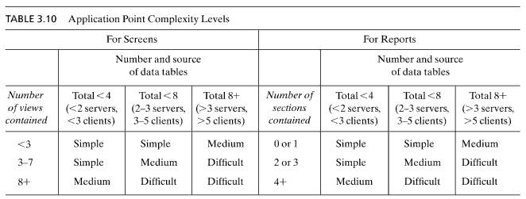
Assessing complexity
e.g.: A screen for editing the database involves 6 database tables, and it has 4 views.
This would be a “medium complexity screen”.
This assessment calls for lots of judgment.
Pfleeger & Atlee

Slide 14
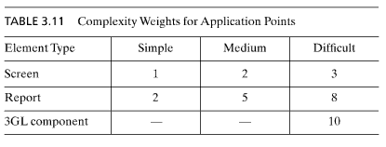
Computing application points (a.p.)
e.g.: A medium complexity screen costs 2 application points.
3GL component = reusable programmatic component that you create
Pfleeger & Atlee

Slide 15
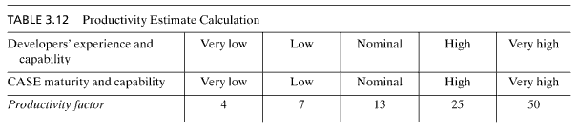
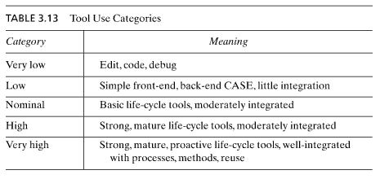
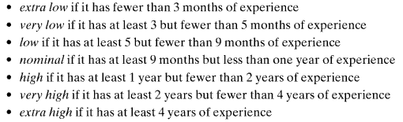
Assessing team capabilities
e.g.: Productivity with low experience + nominal CASE… productivity = (7+13)/2 = 10
application points per person-month (assuming NO vacation or weekends!!!!!)
Pfleeger & Atlee

Slide 16
A word about CASE tools
“Some typical CASE tools are:
  Configuration management tools
  Data modeling tools
  Model transformation tools
  Program transformation tools
  Refactoring tools
  Source code generation tools, and
  Unified Modeling Language”
  Wikipedia

Slide 17
Identify screens, reports, components
3GL components
- Tweet processor
- Twitter façade
- Geocoder façade
Reports
- Mapping web site
- RSS web service
Twitter
Façade
Twitter
Tweet
processor
Geocoder
Façade
Geocoder
Database
MySQL
Mapping
Web site
RSS
Web service
Google maps
Apache+PHP

Slide 18
Use complexity to compute application points
3GL components
- Tweet processor
- Twitter façade
- Geocoder façade
Reports
- Mapping web site
- RSS web service
Simple model assumes that
all 3GL components are 10
application points.
3*10 = 30 a.p.
Displays data from only a
few database tables (3? 4?)
Neither has multiple sections.
Each is probably a “simple”
report, 2 application points.
2*2 = 4 a.p.
30 + 4 = 34 a.p.

Slide 19
Assess the team’s productivity
& compute effort
At one company where I worked…
  Extensive experience with websites, XML
  But no experience with Twitter or geocoders
  Since 20 of the 34 a.p. are on this new stuff, assume very low experience
  Virtually no CASE support… very low
➔ productivity = (4 + 4) / 2 = 4 a.p. / month
So 34 a.p. would take 8.5 person-months
Note: this assumes no vacation or weekends

Slide 20
Distribute the person-months over the activity graph
Do Twitter façade (1.25)
1a
Do tweet processor (1.00)
Do geocode façade (1.25)
2
1c
Test & debug components (3.75)
1b
3
Design db (0.25)
Do map output (0.25)
Do RSS output (0.25)
3a
Test & debug map (0.25)
3b
4
Advertise (1.0?)
Test & debug RSS (0.25)

Slide 21
The magic behind distributing person-months
Divide person-months between implementation and other activities
(design, testing, debugging)
  Oops, forgot to include an activity for testing and debugging the components… revise activity graph
Notice that some activities aren’t covered
  E.g.: advertising; either remove from diagram or use other methods of estimation

Slide 22
Do you believe those numbers?
Ways to get more accurate numbers:
  Revise numbers based on expert judgment or PSP
  Perform a “spike”… try something out and actually see how long it takes
  Use more sophisticated models to analyze how long components will really take
  Use several models and compare
Expect to revise estimates as project proceeds

Slide 23
Further analysis may give revised estimates…
Do Twitter façade (1.50)
1a
Do tweet processor (0.50)
Do geocode façade (0.75)
2
1c
Test & debug components (4.25)
1b
3
Design db (0.25)
Do map output (0.50)
Do RSS output (0.25)
3a
Test & debug map (0.25)
3b
Test & debug RSS (0.25)

Slide 24
Critical path: longest route through the activity graph
Sort all the milestones in “topological order”
  i.e.: sort milestones in terms of dependencies
For each milestone (in order), compute the earliest that the milestone can be reached from its immediate dependencies

Slide 25
Example: computing critical path
1.50
Do Twitter façade (1.50)
1a
2.00
Do tweet processor (0.50)
Do geocode façade (0.75)
2
1c
1.50
Test & debug components (4.25)
1b
3
Design db (0.25)
0.25
6.25
Do map output (0.50)
Do RSS output (0.25)
6.75
3a
7.00
Test & debug map (0.25)
3b
6.50
Test & debug RSS (0.25)

Slide 26
Example: tightening the critical path
1.50
Do Twitter façade (1.50)
1a
2.00
Do tweet processor (0.50)
Do geocode façade (0.75)
2
1c
1.50
1b
2.00
Design db (0.25)
0.25
3
Test & debug components (4.25)
Do map output (0.50)
What if we get started on the reports as soon as we have a (buggy) version of the database and components?
Do RSS output (0.25)
2.50
3a
6.25
Test & debug map (0.25)
3b
2.25
Test & debug RSS (0.25)

Slide 27
Slack time
Activity slack =
latest possible start time –
earliest possible start time
Indicates how “spare time” that activity has (in case something goes wrong)
Activities on the critical path always have zero slack time

Slide 28
Example: computing slack time
1.50
Do Twitter façade (1.50)
1a
2.00
Do tweet processor (0.50)
Do geocode façade (0.75)
Slack = 0.75
2
1c
1.50
1b
2.00
Design db (0.25)
Slack = 1.25
0.25
3
Test & debug components (4.25)
Do map output (0.50)
Slack = 3.50
e.g.: If the finish is done at 6.25, then 3a cannot start later than 6.00. The slack is then latest start – earliest = 6.00 – 2.50 = 3.50.
Do RSS output (0.25)
Slack = 3.75
2.50
3a
6.25
Test & debug map (0.25)
Slack = 3.50
3b
2.25
Test & debug RSS (0.25)
Slack = 3.75

Slide 29
Gantt Chart
Shows activities on a calendar
  Useful for visualizing ordering of tasks & slack
  Useful for deciding how many people to hire
One bar per activity
Arrows show dependencies between activities
Milestones appear as diamonds

Slide 30
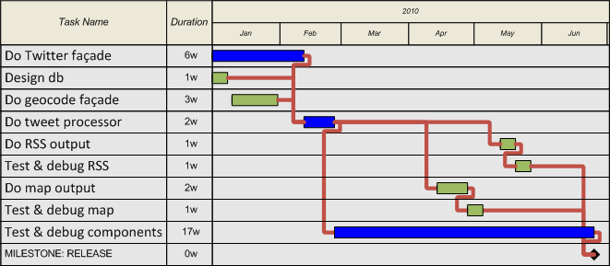
Example Gantt chart
Gantt chart quickly reveals that we only need to hire two people (blue & green)

Slide 31
Compare this lecture to your textbook
Did you notice that this lecture started with a set of requirements and an architecture?
In contrast, your textbook assumes that you are scheduling before you have requirements and an architecture.
What are the pros and cons of each approach?

Slide 32
What’s next for you?
Updated vision statement
  Your chance for extra credit!!!!
  Upload to usual web site by THURSDAY
Midterm will be released this evening.
  Take-home midterm
  Will be due before class on TUESDAY
  Will be an individual exam

