Slide 1
CS/ECE Network Security
Hash-based Primitives
Credits: Dr. Peng Ning and Dr. Adrian Perrig
Dr. Attila A. Yavuz

Slide 2
One-Time Signatures
Basis of all digital signatures
  Valuable tool to learn the principles
Still, the fastest and most secure signature schemes!
  Quantum computer resistant!
Caveat: Impractical for real-life applications
They can be used as a “support unit”, seldomly
  Offline/online signatures
  Tailoring for application (e.g., smart-grid, vehicular)

Slide 3
One-Time Signatures
Use one-way functions without trapdoor
Efficient for signature generation and verification
Caveat: can only use one time
Example: 1-bit one-time signature
  P0, P1 are public values (public key)
  S0, S1 are private values (private key)
S0
P0
S0
S0’
P
S1
P1
S1
S1’

Slide 4
Lamport’s One-Time Signature
Uses 1-bit signature construction to sign multiple bits
Sign 0
S0
S0’
S0’’
S0*
Private values
P0
P0’
P0’’
P0*
…
Public values
P1
P1’
P1’’
P1*
Sign 1
S1
S1’
S1’’
S1*
Private values
Bit 0
Bit 1
Bit 2
Bit n

Slide 5
Improved Construction I
Uses 1-bit signature construction to sign multiple bits
S0
S0’
S0’’
S0*
c0
c0’
c0*
…
…
P0
P0’
P0’’
P0*
p0
p0’
p0*
Bit 0
Bit 1
Bit 2
Bit n
Bit 0
Bit 1
Bit log(n)
Sign message
Checksum bits: encode
# of signature bits = 0

Slide 6
Improved Construction II
Lamport signature has high overhead
Goal: reduce size of public and private key
Approach: use one-way hash chains
S1 = F( S0 )
Sig(0)
Sig(1)
Sig(2)
Sig(3)
Signature
chain
S0
S1
S2
S3
P
Checksum
chain
C3
C2
C1
C0
P = F( S3 || C0 )

Slide 7
Hash to Obtain Random Subset (HORS)
Merkle-Winternitz → Still impractical
BiBa (ancestor of HORS, please read)
  Fast signature verification, but
  Signing cost is high
HORS goal:
  Develop a one-time signature scheme with
  Fast signing and verification
  Still same signature sizes with Merkle-Winternitz

Slide 8
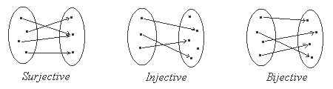
Preliminary: Bijective Function
Bijective function
  Each element of input is mapped onto one and only one element in output
  Each element of output is mapped onto one and only one element in input
  Intuitively, there is a one-to-one correspondence between elements of the two sets

Slide 9
Bijective Function S
Let T = {1, 2, …, t}
S is a bijective function that outputs the m-th k-element subset of T
C(t,k) in total

Slide 10
Initial Scheme: Based on One-way Functions
Generalization of Bos and Chaum one-time signatures
  A distant variant of Lamport OTS!
Key generation
  Generate t numbers of random l-bit values
  Let these be the private key: SK = (s₁,…,s_{t})
  Compute the public key PK = (v₁,…,v_{t}),
    where v_{i} = f(s_{i}) and f() is a one-way function

Slide 11
Signature Generation and Verification
Chose (t,k) s.t. C(t,k) > 2^b,
Sign a b-bit message m, 1 <m 2^b (if not just hash it)
  Use S to find the m-th k-element subset of T:{i₁,…,i_{k}}
  Interpret these elements as integers to chose keys as below:
  The corresponding values (s_{i1},…,s_{ik}) are the signature of m
Verify message m and its signature (s’₁,…, s’_{k})
  Use S to find the m-th k-element subset of T:{i₁,…,i_{k}}
  Verify f(s’₁) = v_{i1},…, f(s’_{k}) = v_{ik}

Slide 12
Efficiency Analysis
Key generation
  Requires t evaluations of the one-way function
  Secret key size = l*t bits
  Public key size = f_{l}*t bits
    f_{l} = length of the one-way function output
Signature generation
  Time to find the m-th k-element subset of T
Verification
  Time to sign + k one-way function operations

Slide 13
Security
Bijective function S
  Each input corresponds to one and only one output
Thus, each b-bit message m corresponds to a different k-element subset of T
  1 < m <2^b < C(t,k)
  Knowing the signature of one message, an attacker has to invert at least one of the remaining t − k values in the public key to forge another signature

Slide 14
An Option for S
Algorithm #1: C(t, k) = C(t−1, k−1) + C(t−1, k)
  If the last element of T belongs to the subset, choose k−1 elements from the remaining t−1 elements
  Otherwise, choose k elements from the remaining t−1 elements
Input: (m, t, k)
Steps:
If m < C(t−1, k−1)
  add t to output and recur on (m, k−1, t−1)
Else
  Add nothing to output and recur on (m – C(t−1, k−1), k, t−1)

Slide 15

HORS: Based on Subset-Resilient Functions
Replace the Bijective function S with a subset-resilient function H
  S(m) has exactly k elements
  S fully guarantees that no two distinct messages have the same k-element subset of T
  H(m) has at most k elements
  H guarantees that it is infeasible to find two distinct messages m₁ and m₂ such that subset of T selected with H
    H(m₁) ≠ H(m₂), implies the infeasibility of subset via H
    Up to r-time signature generation

Slide 16
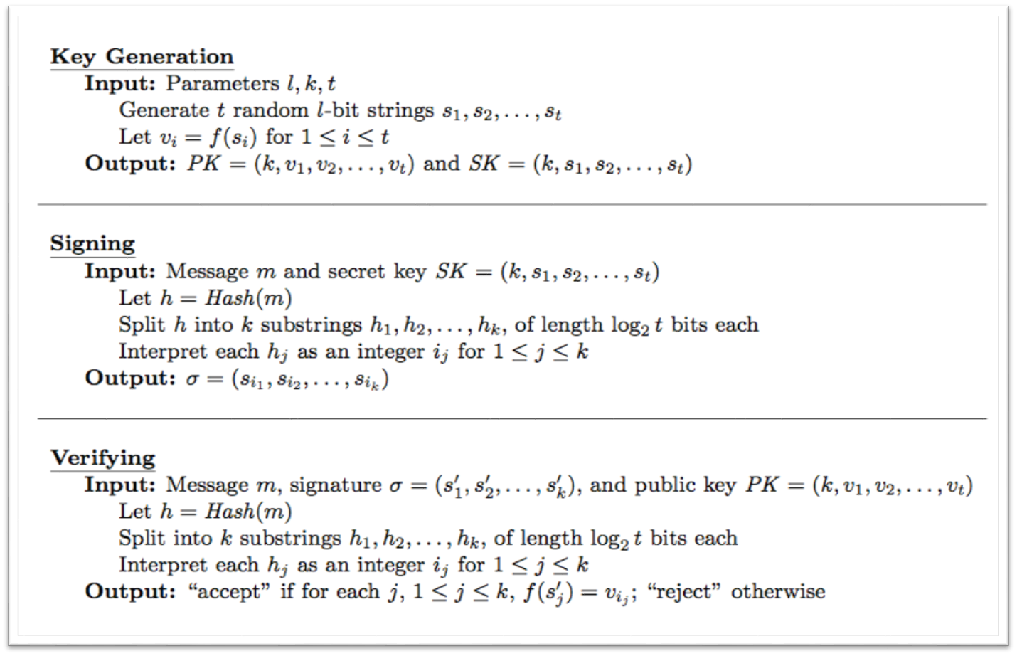
HORS Operations

Slide 17
Influence of HORS
Time-valid HORS
Several Variants for HORS:
  HORSIC, HORS++, HORSE
  Are they practical? (part of your Take-home)
  Can you extend HORS with other crypto primitives?
  One-wayness is not all about hash functions?
  What about modular exponentiation?
  RSA? or DLP/ECDLP? (part of your Take-home)
A digression with ECDSA (to discuss principles)
Structure-Free Rapid Authentication (one of future lecture)

Slide 18
One-way Hash Chain
Used for many network security applications
  S/Key (now)
  Authenticate data streams (TESLA& EMSS lecture)
  Key derivation in crypto schemes (ETA lecture)
  Forward-security (BAF, HaSAFSS)
  Commitments ( MR-ETA lecture, e-commerce)
Good for authentication of the hash values
Commitment
K_{i}=F(K_{i+1}), F: hash function
K₀
F
K₁
F
K₂
F
K₃
F
K₄
F
F
K_{n}= R

Slide 19
Properties of One-way Hash Chain
Given K_{i}
  Anybody can compute K_{j}, where j<i
  It is computationally infeasible to compute K_{l}, where l > i, if K_{l} is unknown
  Any K_{l} disclosed later can be authenticated by verifying if H^{l-i}(K_{i}) = K_{l}
  Disclosing of K_{i+1} or a later value authenticates the owner of the hash chain
K₀
F
K₁
F
K₂
F
K₃
F
K₄
F
F
K_{n}= R

Slide 20
Using “Disposable” Passwords
Simple idea: generate a long list of passwords, use each only one time
  attacker gains little/no advantage by eavesdropping on password protocol, or cracking one password
Disadvantages
  storage overhead
  users would have to memorize lots of passwords!
Alternative: the S/Key protocol
  based on use of one-way (e.g. hash) function

Slide 21
S/Key Password Generation
Alice selects a password x
Alice specifies n, the number of passwords to generate
Alice’s computer then generates a sequence of passwords
  x₁ = H(x)
  x₂ = H(x₁)
  …
  x_{n} = H(x_{n-1})
x
x (Password)
H
H
H
H
x1
x2
x3
x4

Slide 22
Generation… (cont’d)
Alice communicates (securely) to a server the last value in the sequence: x_{n}
Key feature: no one knowing x_{i} can easily find an x_{i-1} such that H(x_{i-1}) = x_{i}
  only Alice possesses that information

Slide 23
Authentication Using S/Key
Assuming server is in possession of x_{i} …
Server
Alice
i
x_{i-1}
verifies
H(x_{i-1}) = x_{i}
Notes:
Depends on how x is selected.

Slide 24
Limitations
Value of n limits number of passwords
  need to periodically regenerate a new chain of passwords
Does not authenticate server! Example attack:
  real server sends i to fake server, which is masquerading as Alice
  fake server sends i to Alice, who responds with x_{i-1}
  fake server then presents x_{i-1} to real server

Slide 25
Chained Hashes
More general construction than one-way hash chains
Useful for authenticating a sequence of data values D₀ , D₁ , …, D_{N}
H* authenticates entire chain
D₀
D_{N-2}
D_{N-1}
…
H*
H₀
H_{N-1}
D_{N}
H_{N-2}
H( D_{N-1} || H_{N-1} )
H(D_{N})

Slide 26
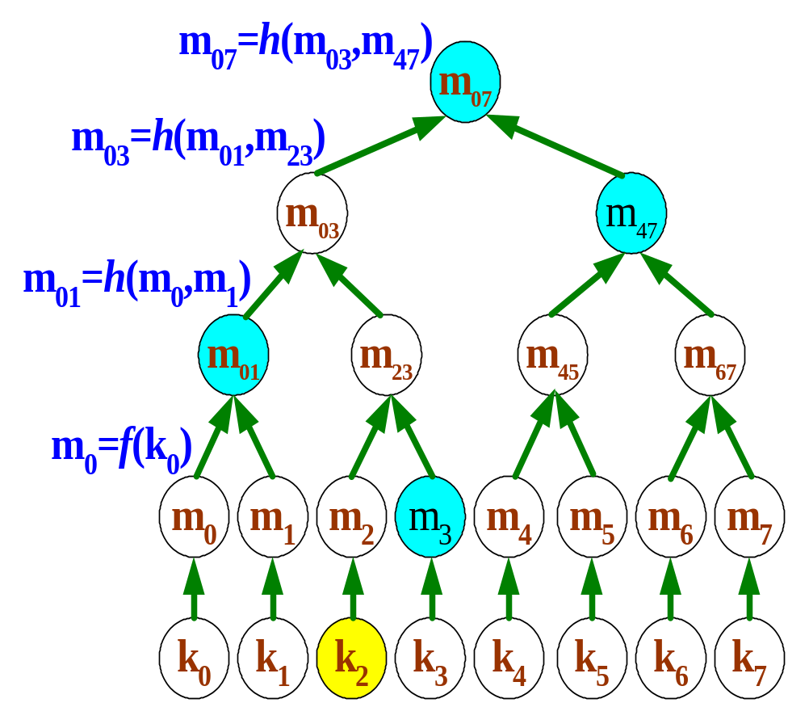
Merkle Hash Tree
A binary tree over data values
  For authentication purpose
The root is the commitment of the Merkle tree
  Known to the verifier.
Example
  To authenticate k₂, send (k₂, m₃,m₀₁,m₄₇)
  Verify
m₀₇= h(h(m₀₁||h(f(k₂)||m₃)||m₄₇)

Slide 27
Merkle Hash Tree (Cont’d)
Hashing at the leaf level is necessary to prevent unnecessary disclosure of data values
Authentication of the root is necessary to use the tree
  Typically done through a digital signature or pre-distribution
Limitation
  All leaf values must be known ahead of time

Slide 28
Untrusted External Storage
Problem: how can we store memory of a secure coprocessor in untrusted storage?
Solution: construct Merkle hash tree over all memory pages
Mallory’s Storage
Secure
Coprocessor
Small persistent
storage

