Slide 1
CS/ECE Introduction to Network Security
Dr. Attila Altay Yavuz
Big Picture and Organization
Introduction to Network Security
Dr. Attila Altay Yavuz
Spring 2015

Slide 2
Outline (current lecture)
Self-introduction
Big Picture
  Grand-vision, problems and challenges
Course Objectives (overview)
  Touching important problems and tools (name & functionality)
  Going over Syllabus
Further info about this course
  Grading
  Requirements
  Position of this course in “OSU-Security Landscape”
Dr. Attila Altay Yavuz

Slide 3
Self-Intro
Assistant Professor, EECS at Oregon State University
Adjunct Faculty, University of Pittsburgh (Jan. 2013 - now)
Research Scientist, Bosch Research Center (Dec. 2011- Aug. 2014)
  Develop security and privacy research programs
  Privacy-preserving Big Data Technologies (~1M)
  Secure Internet of Things and Systems (~250K)
Ph.D., North Carolina State University (Jan. 2007- Aug. 2011)
  Compromise Resilient and Compact Crypto for Digital Forensics
MS, Bogazici University (2004-2006)
  Efficient Crypto Mechanisms for Military Ad-hoc Networks
Dr. Attila Altay Yavuz

Slide 4




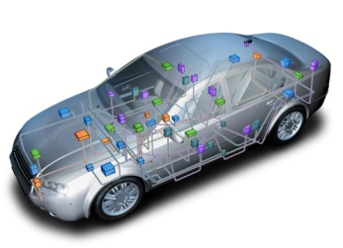
Self-Intro (Cont’)
Research Interests: Applied cryptography, network security, privacy
Academic Collaborations: Upitt, UNC, UCI, Purdue-CIT, CMU
Industry Collaborations: Bosch, Oracle, Cisco, SEI-CMU, ISE
Some Impact Examples:
  Secure Intra-car Networks
  (OEMs, 2018)
  Privacy-Preserving
  Medical Databases
  (HCTM, 2016)
ECU
Dr. Attila Altay Yavuz

Slide 5


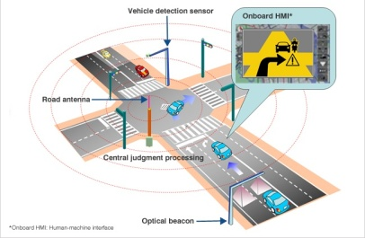
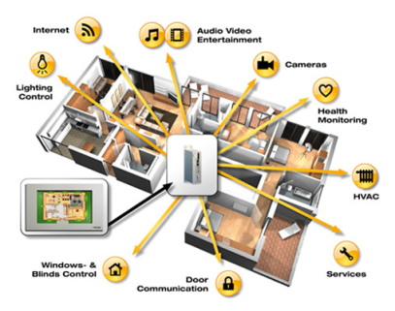



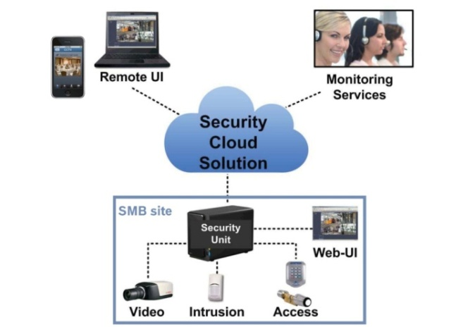




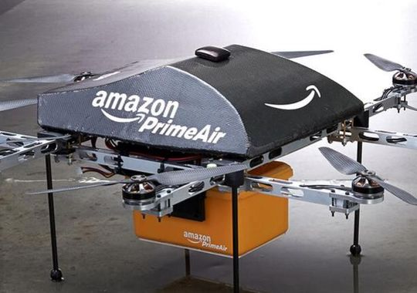
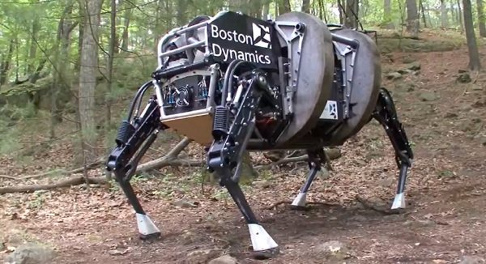

Big Picture: Technology Trends & Vision
Smart-infrastructures and distributed systems
Big Data Technologies
Inter vehicular networks
Long term
Smart-grid
Smart-city
Medium
term
Smart Home
Near term
Digitalized
Healthcare
Inf. Sys.
Cloud-based Applications

Slide 6
Requirements and Challenges
Challenges of Security and Privacy in IoTS
Heterogeneity
High Performance/Scalability
Data Availability
Smart-home and WSNs
Interconnectivity
Cloud-based Services
Vehicular networks (e.g., Car-2-X)
SOMETHING MISSING?

Slide 7
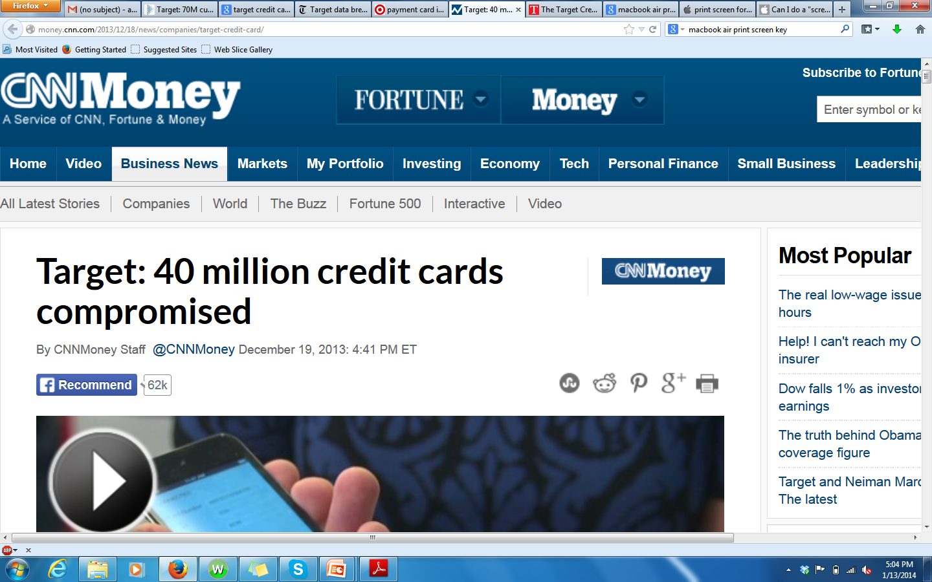
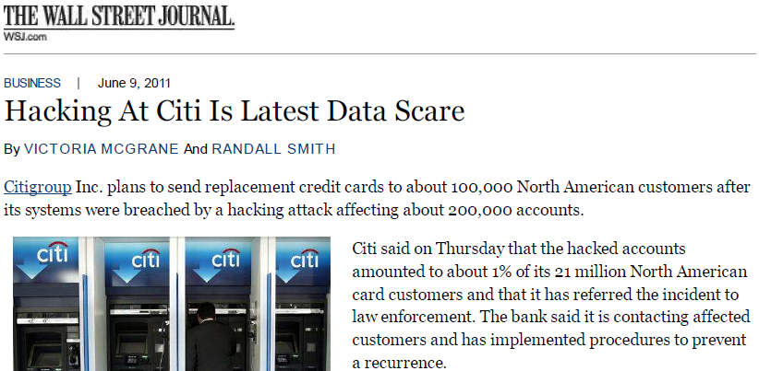
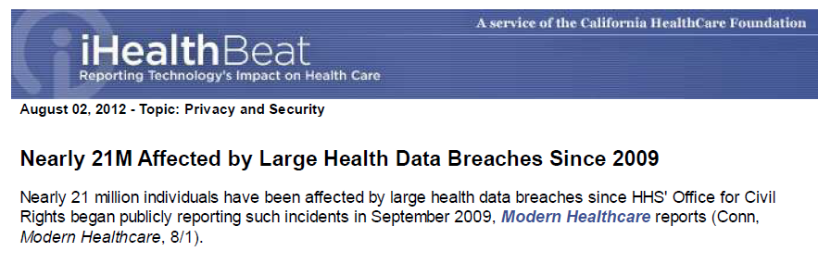
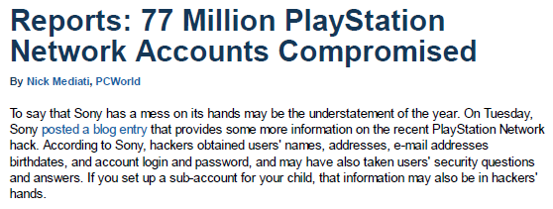
Privacy Breaches: Big Data and IoTS
Need for Privacy Enhancing Technologies

Slide 8

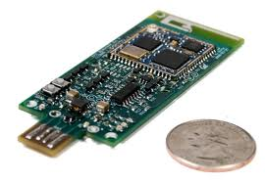

Cyber Physical Systems - Vulnerabilities
Reliable Cyber-Physical Systems (e.g., smart-grid) are vital
  Susceptible: Northeast blackout (2003), 50 million people, $10 billion cost
  Attacks: False data injection [Yao CCS09’], over 200 cyber-attacks in 2013
Vulnerability: Commands and measurements are not authenticated
Requirements for a security method
  Real-time → Extremely fast processing (a few ms)
  Limited bandwidth → Compact
  Several components → Scalability
Limitations of Existing Methods
  PKC is not yet feasible (computation, storage, tag size)
  Symmetric crypto is not scalable (key management)

Slide 9
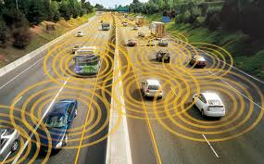

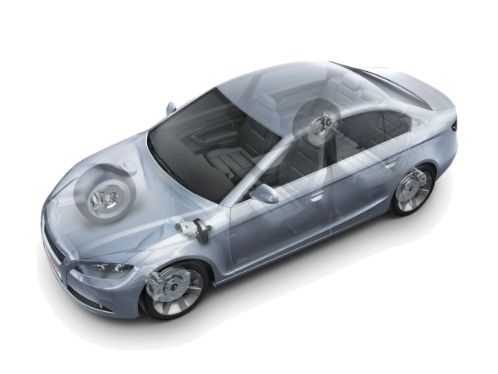


Inter-car and Intra-car Networks
Security Challenges for Smart-Infrastructures (II)
Vulnerability: Commands and measurements are not authenticated
Security for Inter-car Networks
  Manipulate direction/velocity, crashes
Security for Intra-car Networks
  Large attack surface [Usenix '11]
  ECUs of break/acceleration, airbag
Challenges
  Strict safety requirements
  Limited bandwidth, real-time processing
The state-of-art cannot address (as discussed)
ECU
ECU
ECU
Internet

Slide 10
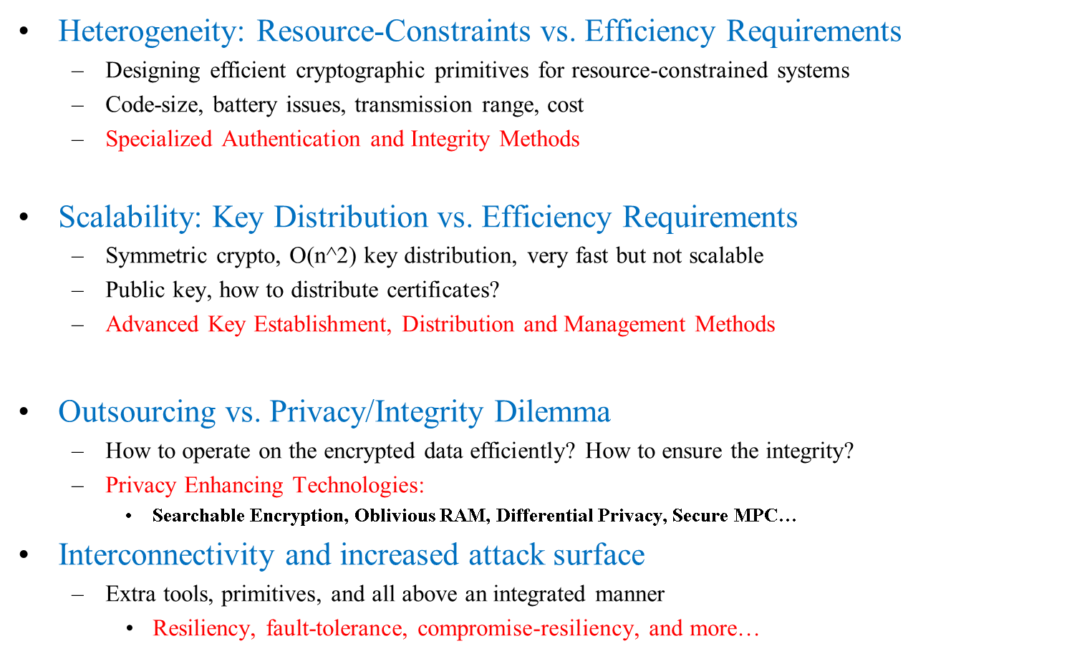
Some Challenges – About Landspace

Slide 11
Pillars and Key Cyber Security Approaches
Pillar I-II: Authentication and Integrity
  Broadcast Authentication: Internet, wireless net., multi-media, …
    Vehicular networks, power-grid, smart-grid, drones…
  Specialized Signatures: Real-time, compromise-resilient, hybrid, …
Pillar III: Privacy (Confidentiality) and Functionality
  Privacy Enhancing Technologies
  Cloud computing and data outsourcing: SE, DF, MPC, ORAM, PoR
  Privacy-preserving data mining
Pillar IV: Availability and Resiliency
  Denial of Service (Client-server application)
  Fault-tolerance via redundancy and secret sharing, effective storage
    Packet loss (any comm. medium)
    Active adversaries

Slide 12
Outline (current lecture)
Self-introduction
Big Picture
  Grand-vision, problems and challenges
Course Objectives (overview)
  Touching important problems and tools (name & functionality)
  Going over Syllabus (from webpage)
Further info about this course
  Grading
  Requirements
  Position of this course in “OSU-Security Landscape”
Dr. Attila Altay Yavuz

Slide 13
High-Level Objectives
Create foundations/background to tackle these challenges!
Cryptographic primitives and Net. Sec. foundations:
  Essential cryptographic building blocks
  Crypto primitives
  Their properties and use
Basic Service: Authentication
  Primitives and protocols
Key Management and Establishment Protocols
Net. Sec. Protocols and some Adv. Topics

Slide 14
Outline (current lecture)
Self-introduction
Big Picture
  Grand-vision, problems and challenges
Course Objectives (overview)
  Touching important problems and tools (name & functionality)
  Going over Syllabus
Further info about this course
  Grading
  Requirements
  Position of this course in “OSU-Security Landscape”
Dr. Attila Altay Yavuz

Slide 15
Requirements and Grading
CS 372 is required. A basic understanding of security mechanisms is good.
Homeworks, %50 (3 or 4 HWs)
Midterm %20, Final %25
Class attendance, participation %5
HWs are non-trivial and research-oriented (10-14 days, plenty of time!)
Cover a concept related to class topics as a complementary aspect
  E.g., Block ciphers and DES will be covered in-class, AES will be explored in HW
Research and exploration of concepts
  Research problem X is vital and addresses Y, explain the most recent methods in your words
  by reading and distilling respected conference/journal papers…
  Compare and contrast protocol X and Y w.r.t. parameters A,B,C…
  No extensive programming assignments are considered for now (not hands-on focused)
Traditional questions involving design and explanations from class material
Design, analysis and construction of primitives/protocols (not implement them)
  Crypto architecture, cryptographic engineer or researcher
Midterm and final will capture both course material and HWs

Slide 16
OSU-Cyber Security Landscape
Cyber Security with a focus on System Aspects (with hands-on focus)
  Undergraduate: DADE, Introduction to Security
  Graduate: System Security, Distributed Systems
Cyber Security with a focus on Theorem Aspects (with sec. model/proof focus)
  Undergraduate: Introduction to Crypto
  Graduate: Theoretical Cryptography, Complexity Theory
Cyber Security with a focus on Bridging Theory and Practice
  Undergraduate: Introduction to Network Security
    Focus on the design and analysis of schemes and protocols
    Prepare for research-oriented track: Crypto Architect, Cryptographic Engineering, move towards research career
    Prepare the below grad courses plus grad-level system security courses
  Graduate: Full research and project oriented, aim for research labs. and academia
  Special Topics: Advanced Network Security
  Special Topics: Applied Cryptography
  Some (ultra brief) aspects described

