Slide 1

Chapter 17
Security at the
Transport Layer:
SSL and TLS
Copyright © The McGraw-Hill Companies, Inc. Permission required for reproduction or display.

Slide 2
Chapter 17
Objectives
❏ To discuss the need for security services at the transport layer of the Internet model
❏ To discuss the general architecture of SSL
❏ To discuss the general architecture of TLS
❏ To compare and contrast SSL and TLS

Slide 3
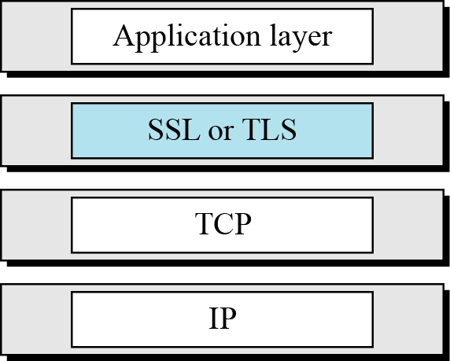
17 Continued
Figure 17.1 Location of SSL and TLS in the Internet model

Slide 4
17-1 SSL ARCHITECTURE
SSL is designed to provide security and compression services to data generated from the application layer.
Topics discussed in this section:
17.1.1 Services
17.1.2 Key Exchange Algorithms
17.1.3 Encryption/Decryption Alogrithms
17.1.4 Hash Algorithms
17.1.5 Cipher Suite
17.1.6 Compression Algorithms
17.1.7 Crypography Parameter Generation
17.1.8 Session and Connections

Slide 5
17.1.1 Services
Fragmentation
Compression
Message Integrity
Confidentiality
Framing

Slide 6
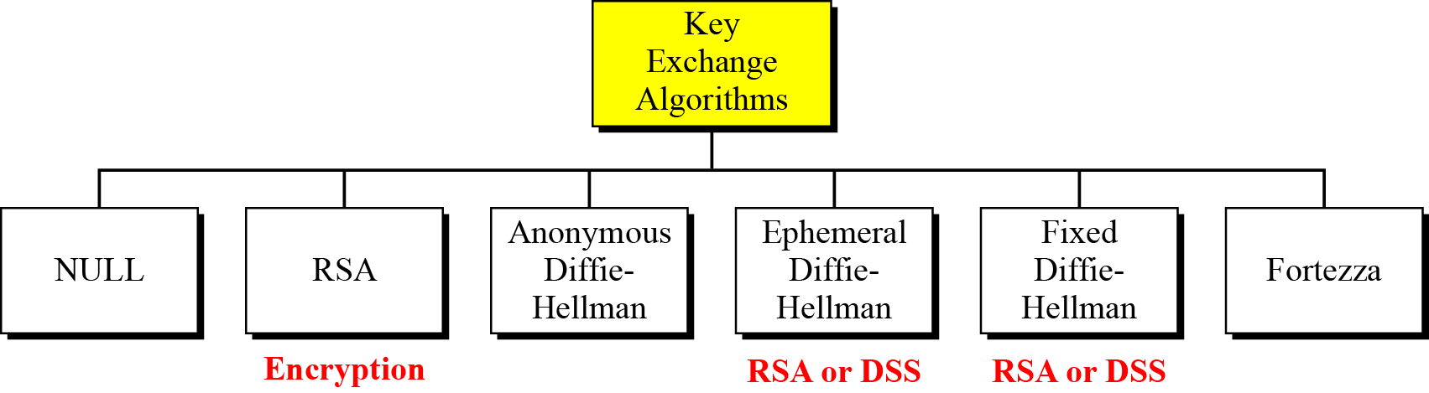
17.1.2 Key Exchange Algorithms
Figure 17.2 Key-exchange methods

Slide 7

17.1.2 Continued
Null
There is no key exchange in this method. No pre-master secret is established between the client and the server.
Note
Both client and server need to know the value of the pre-master secret.

Slide 8
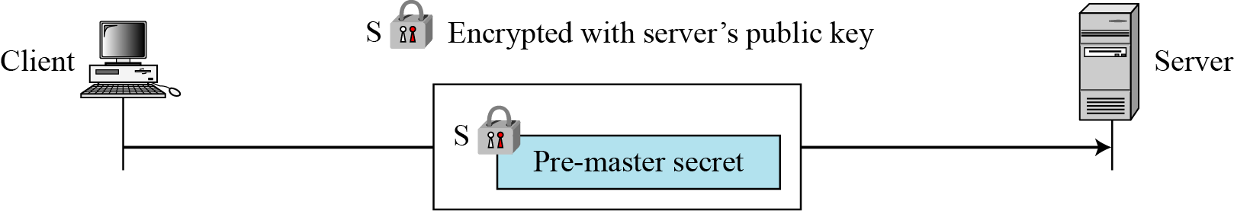
17.1.2 Continued
RSA
Figure 17.3 RSA key exchange; server public key

Slide 9
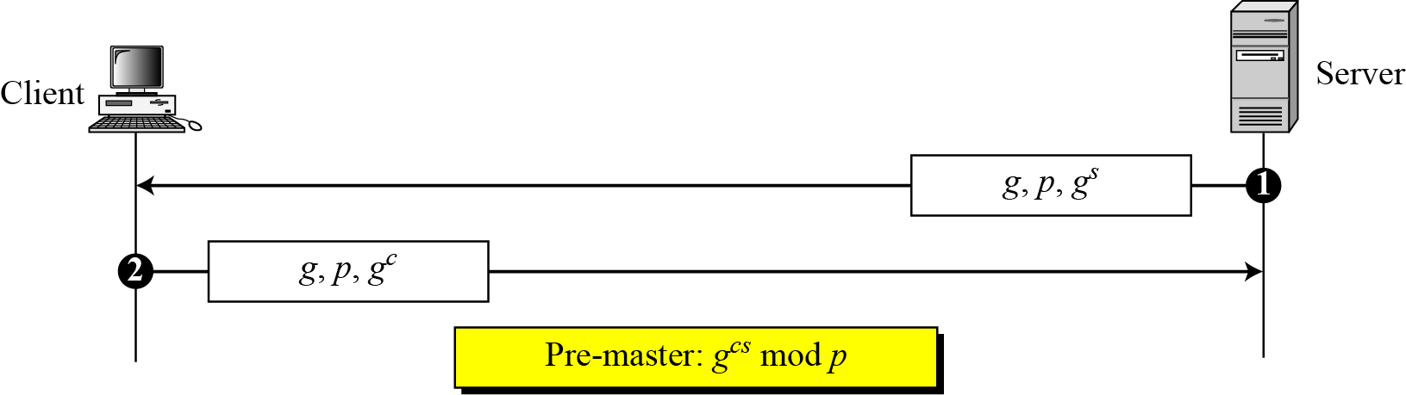
17.1.2 Continued
Anonymous Diffie-Hellman
Figure 17.4 Anonymous Diffie-Hellman key exchange

Slide 10
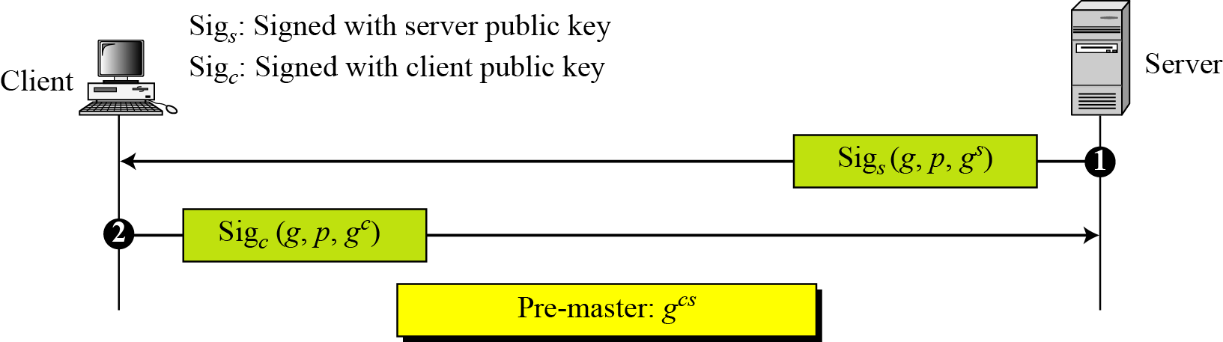
17.1.2 Continued
Ephemeral Diffie-Hellman key exchange
Figure 17.5 Ephemeral Diffie-Hellman key exchange

Slide 11
17.1.2 Continued
Fixed Diffie-Hellman
Another solution is the fixed Diffie-Hellman method. All entities in a group can prepare fixed Diffie-Hellman parameters (g and p).
Fortezza
Fortezza is a registered trademark of the U.S. National Security Agency (NSA). It is a family of security protocols developed for the Defense Department.

Slide 12
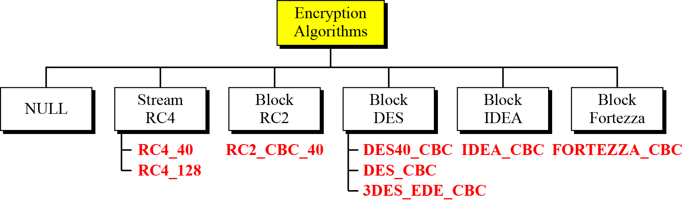
17.1.3 Encryption/Decryption Algorithms
Figure 17.6 Encryption/decryption algorithms

Slide 13
17.1.3 Continued
NULL
The NULL category simply defines the lack of an encryption/decryption algorithm.
Stream RC
Two RC algorithms are defined in stream mode.
Block RC
One RC algorithm is defined in block mode.
DES
All DES algorithms are defined in block mode.

Slide 14
17.1.3 Continued
IDEA
The IDEA algorithm defined in block mode is IDEA_CBC, with a 128-bit key.
Fortezza
The one Fortezza algorithm defined in block mode is FORTEZZA_CBC.

Slide 15
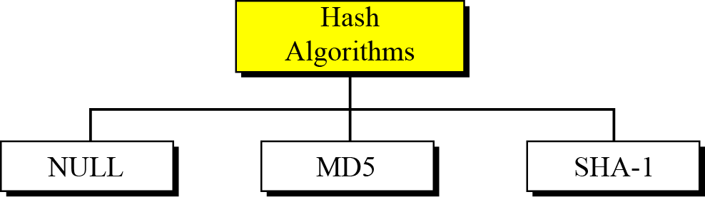
17.1.4 Hash Algorithm
Figure 17.7 Hash algorithms for message integrity

Slide 16
17.1.4 Continued
NULL
The two parties may decline to use an algorithm. In this case, there is no hash function and the message is not authenticated.
MD5
The two parties may choose MD5 as the hash algorithm. In this case, a 128-key MD5 hash algorithm is used.
SHA-1
The two parties may choose SHA as the hash algorithm. In this case, a 160-bit SHA-1 hash algorithm is used.

Slide 17

17.1.5 Cipher Suite
The combination of key exchange, hash, and encryption algorithms defines a cipher suite for each SSL session.

Slide 18
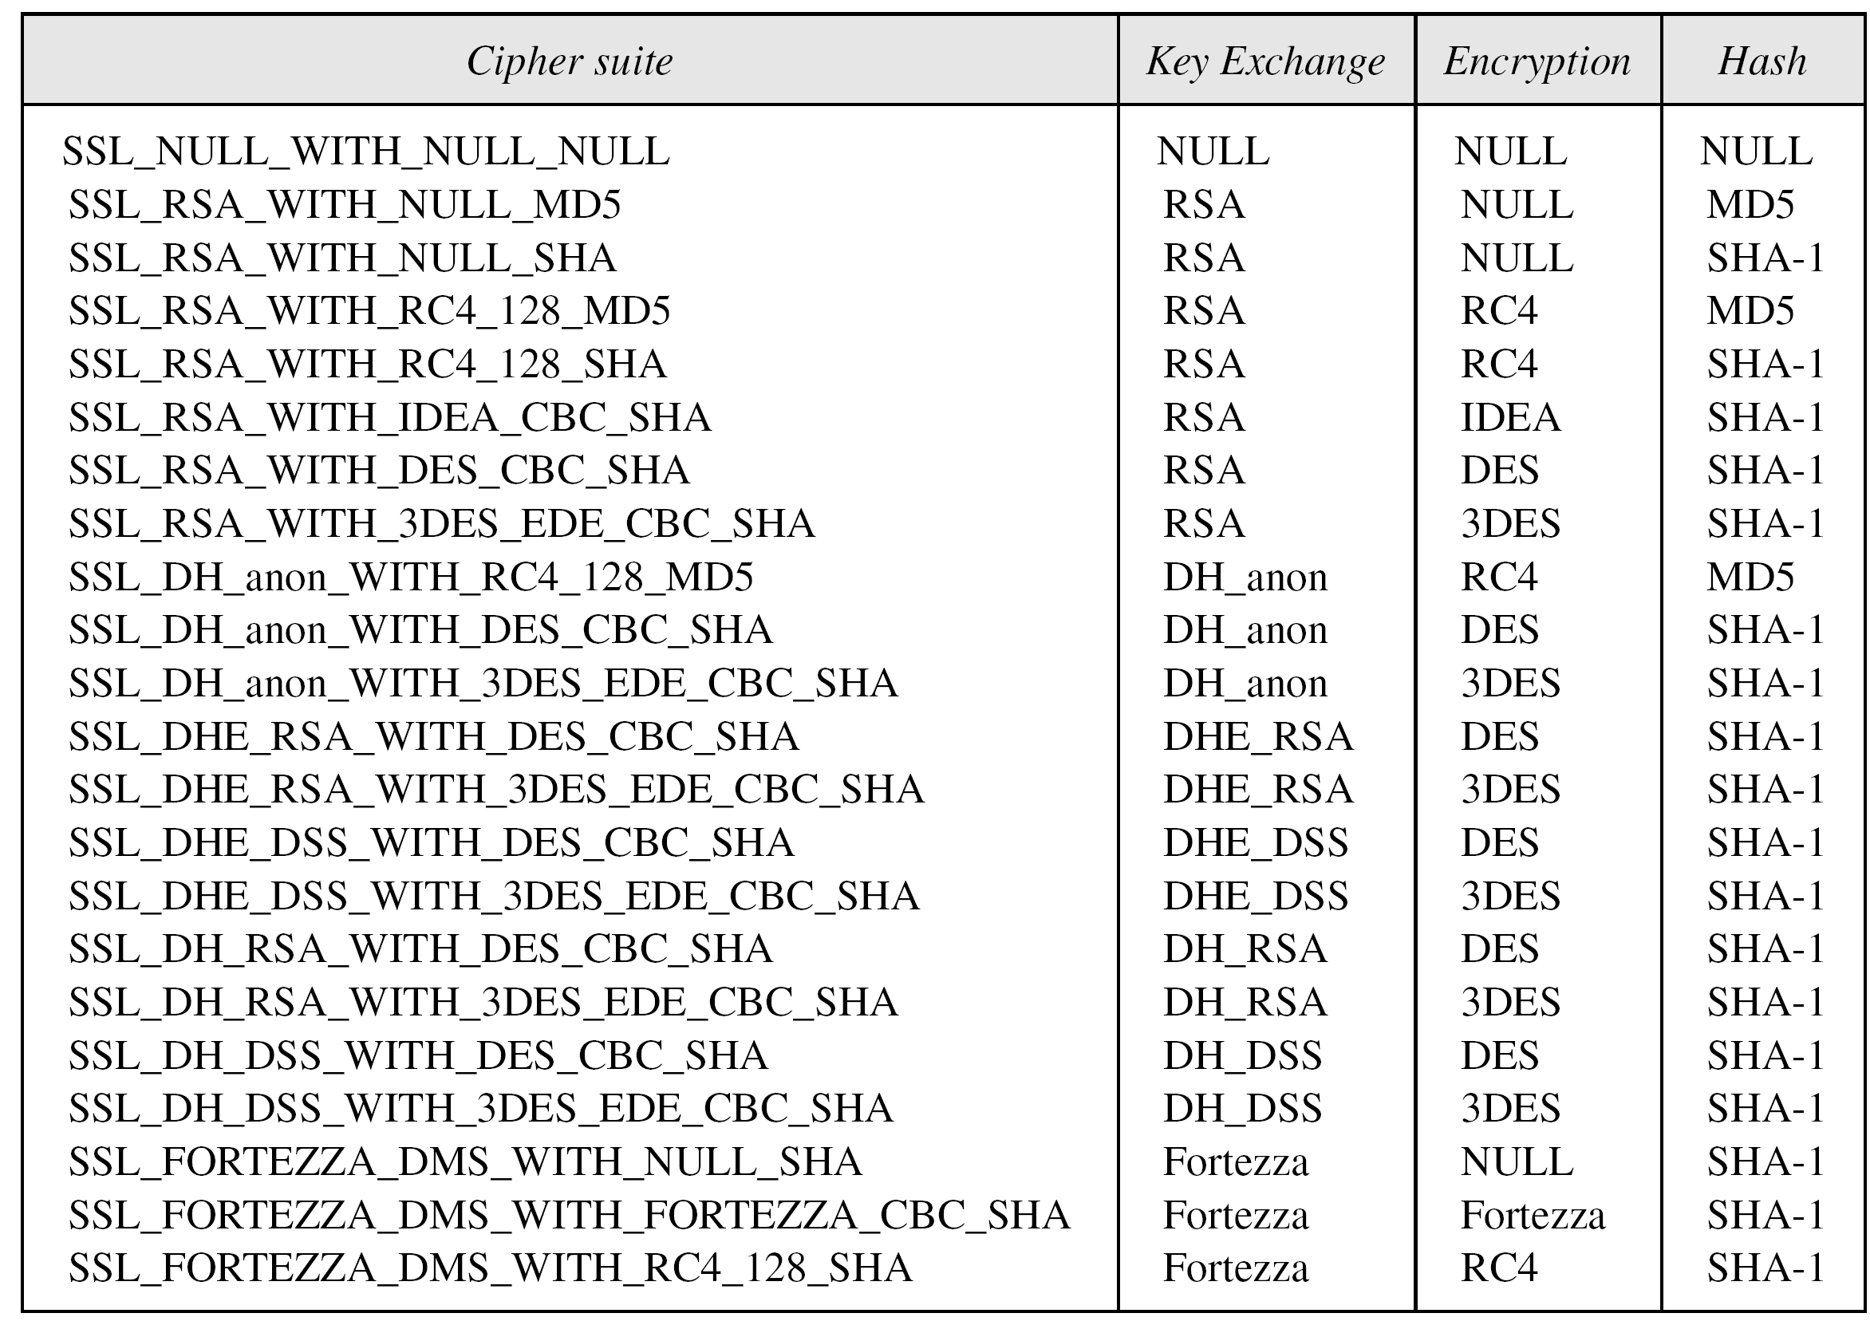
17.1.5 Continued
Table 17.1 SSL cipher suite list

Slide 19
17.1.6 Compression Algorithms
Compression is optional in SSLv3. No specific compression algorithm is defined for SSLv3. Therefore, the default compression method is NULL.

Slide 20
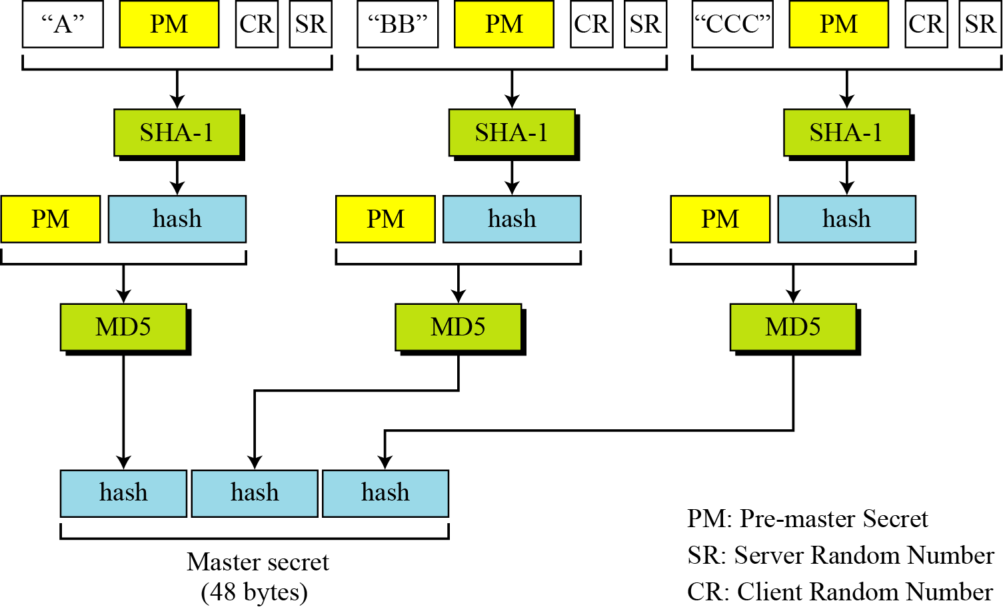
17.1.7 Cryptographic Parameter Generation
Figure 17.8 Calculation of master secret from pre-master secret

Slide 21
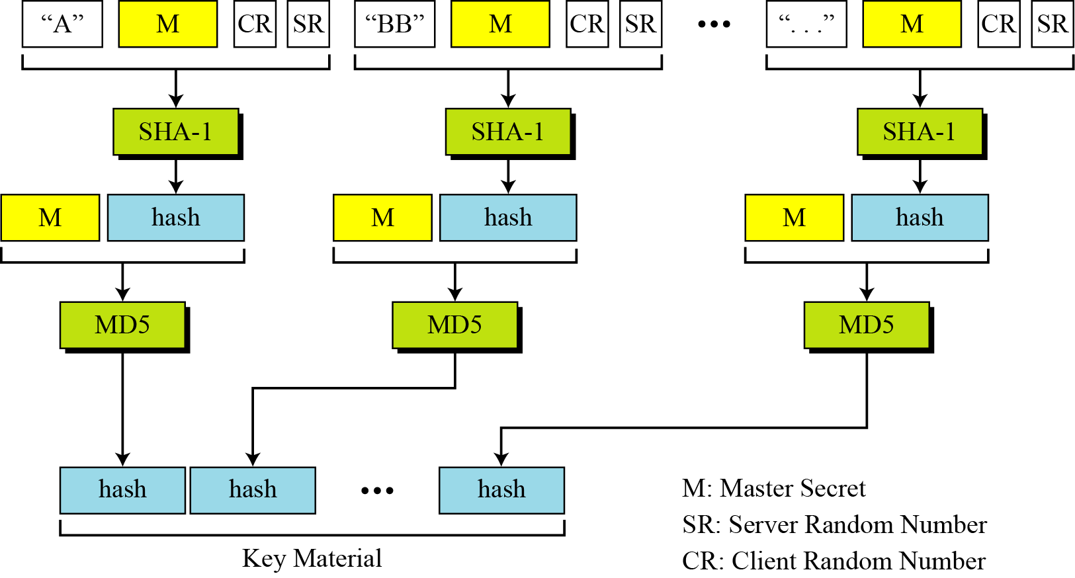
17.1.7 Continued
Figure 17.9 Calculation of key material from master secret

Slide 22
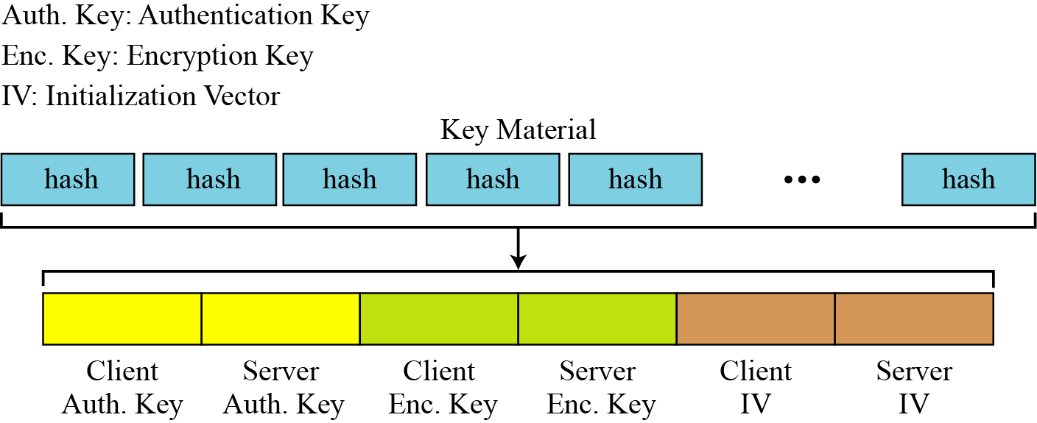
17.1.7 Continued
Figure 17.10 Extractions of cryptographic secrets from key material

Slide 23
17.1.8 Sessions and Connections
Note
In a session, one party has the role of a client and the other the role of a server;
in a connection, both parties have equal roles, they are peers.

Slide 24
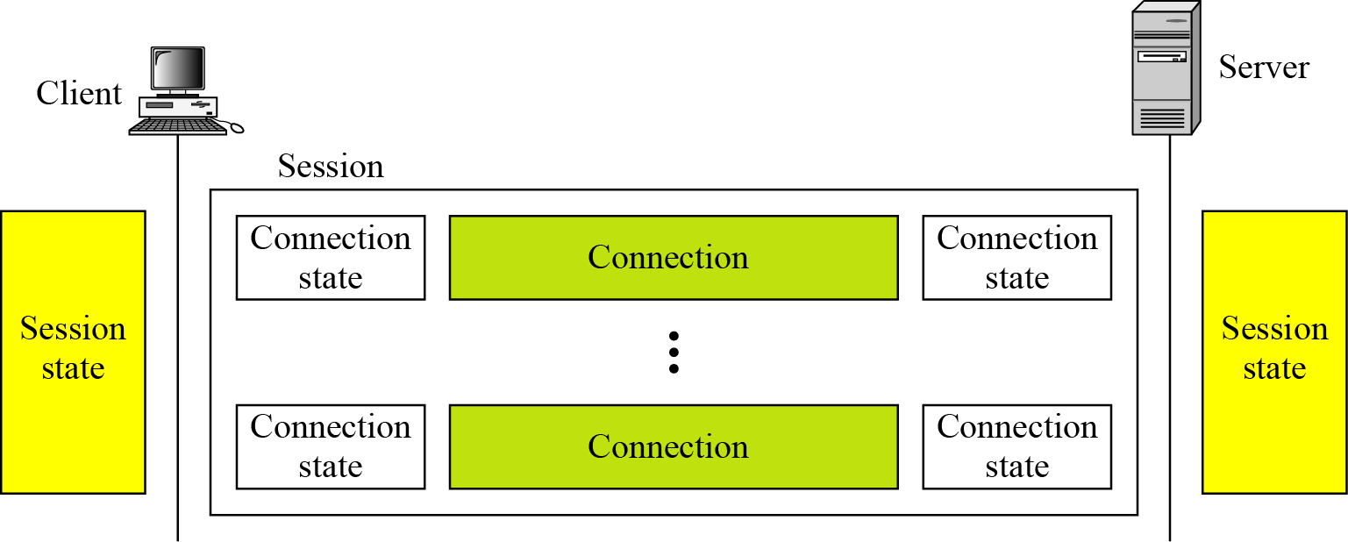
17.1.8 Continued
Figure 17.11 A session and connections

Slide 25
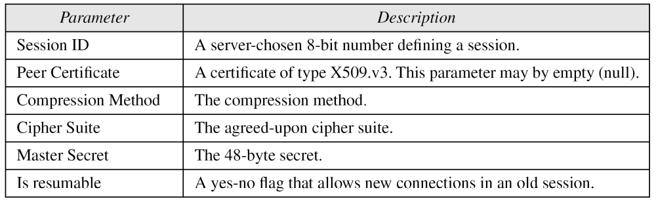
17.1.8 Continued
Session State
Table 17.2 Session state parameters

Slide 26
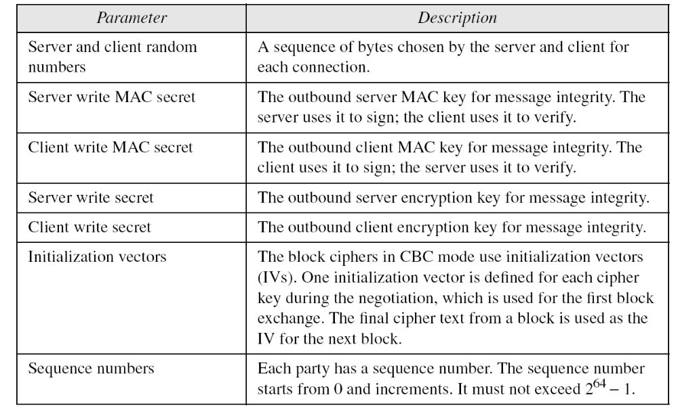
17.1.8 Continued
Connection State
Table 17.3 Connection state parameters

Slide 27
17.1.8 Continued
Note
The client and the server have six different cryptography secrets: three read secrets
and three write secrets.
The read secrets for the client are the same as the write secrets for the server and vice versa.

Slide 28
17-2 Four Protocols
We have discussed the idea of SSL without showing how SSL accomplishes its tasks. SSL defines four protocols in two layers, as shown in Figure 17.12.
Topics discussed in this section:
17.2.1 Handshake Protocol
17.2.2 ChangeCipher Spec Protocol
17.2.3 Alert Protocol
17.2.4 Record Protocol

Slide 29
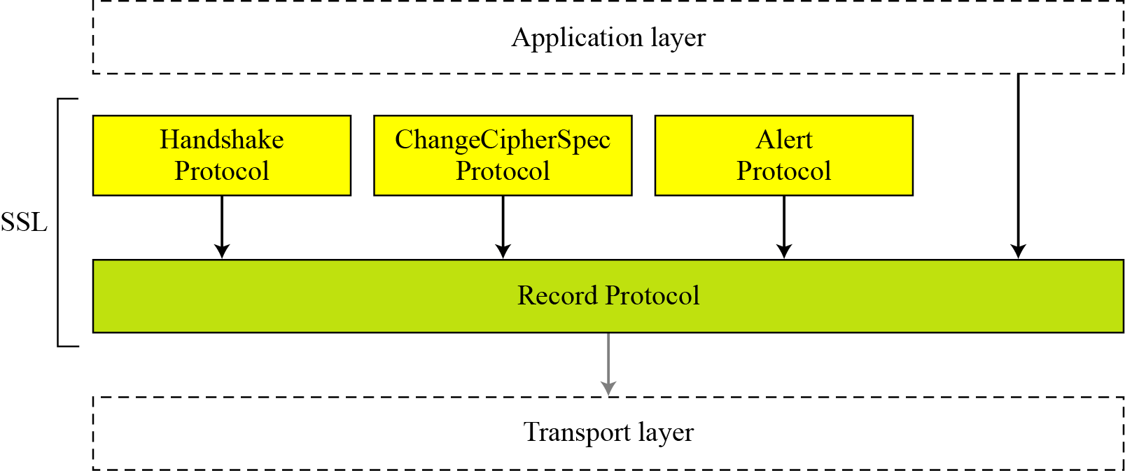
17.2. Continued
Figure 17.12 Four SSL protocols

Slide 30
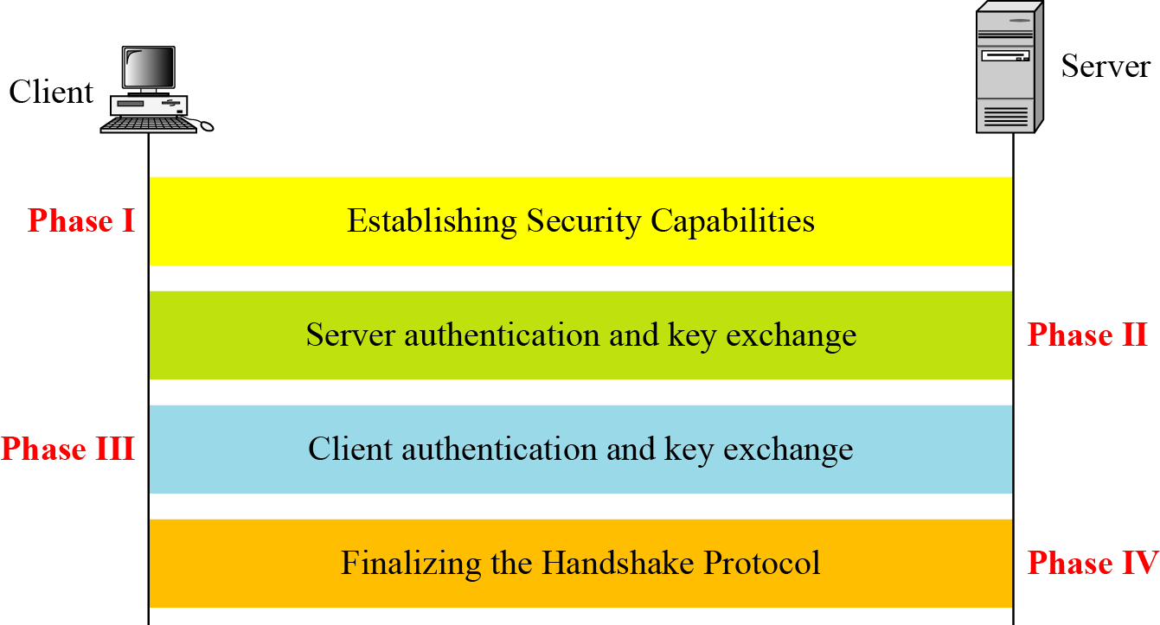
17.2.1 Handshake Protocol
Figure 17.13 Handshake Protocol

Slide 31
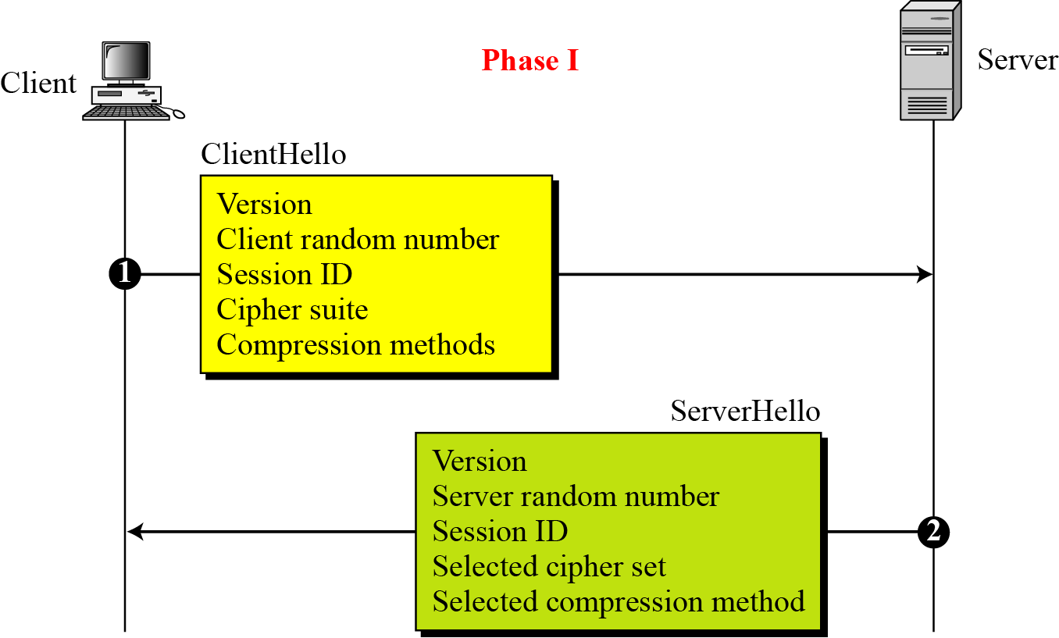
17.2.1 Continued
Figure 17.14 Phase I of Handshake Protocol

Slide 32
17.2.1 Continued
Note
After Phase I, the client and server know the following:
❏ The version of SSL
❏ The algorithms for key exchange, message
authentication, and encryption
❏ The compression method
❏ The two random numbers for key
generation

Slide 33
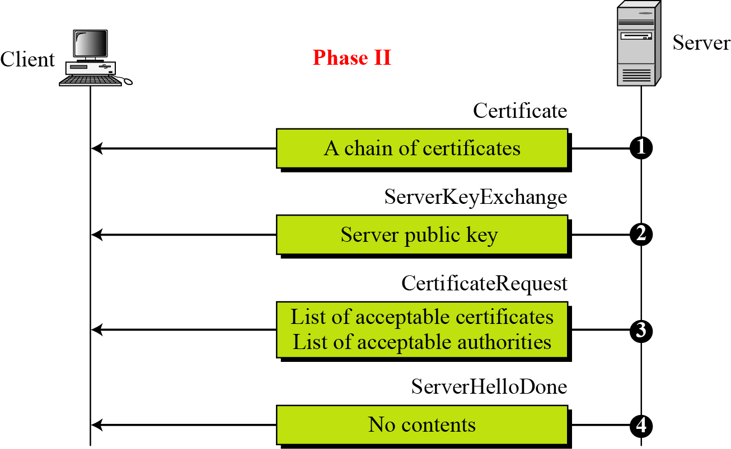
17.2.1 Continued
Figure 17.15 Phase II of Handshake Protocol

Slide 34
17.2.1 Continued
Note
After Phase II,
❏ The server is authenticated to the client.
❏ The client knows the public key of the
server if required.

Slide 35
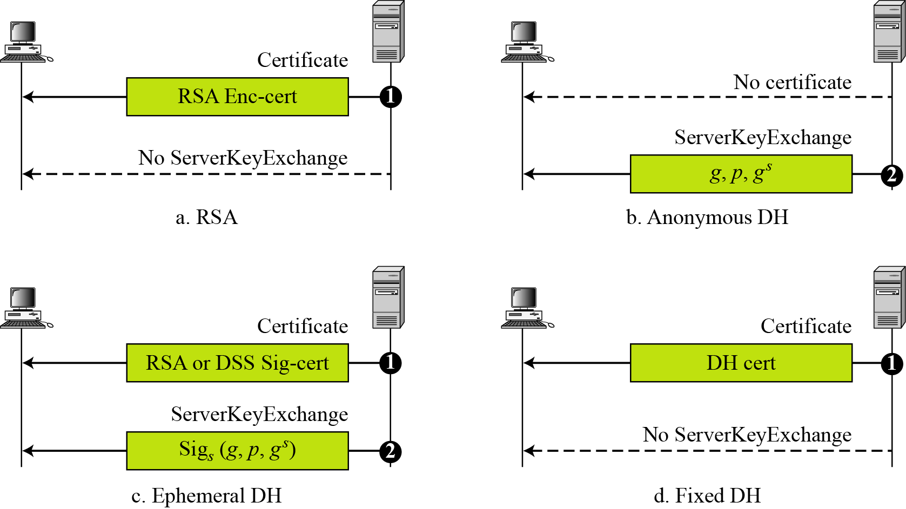
17.2.1 Continued
Figure 17.16 Four cases in Phase II

Slide 36
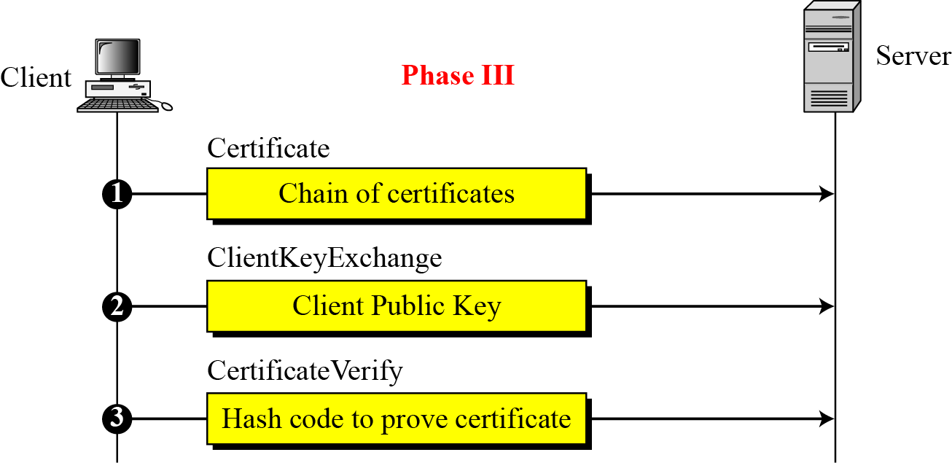
17.2.1 Continued
Figure 17.17 Phase III of Handshake Protocol

Slide 37
17.2.1 Continued
Note
After Phase III,
❏ The client is authenticated for the server.
❏ Both the client and the server know the
pre-master secret.

Slide 38
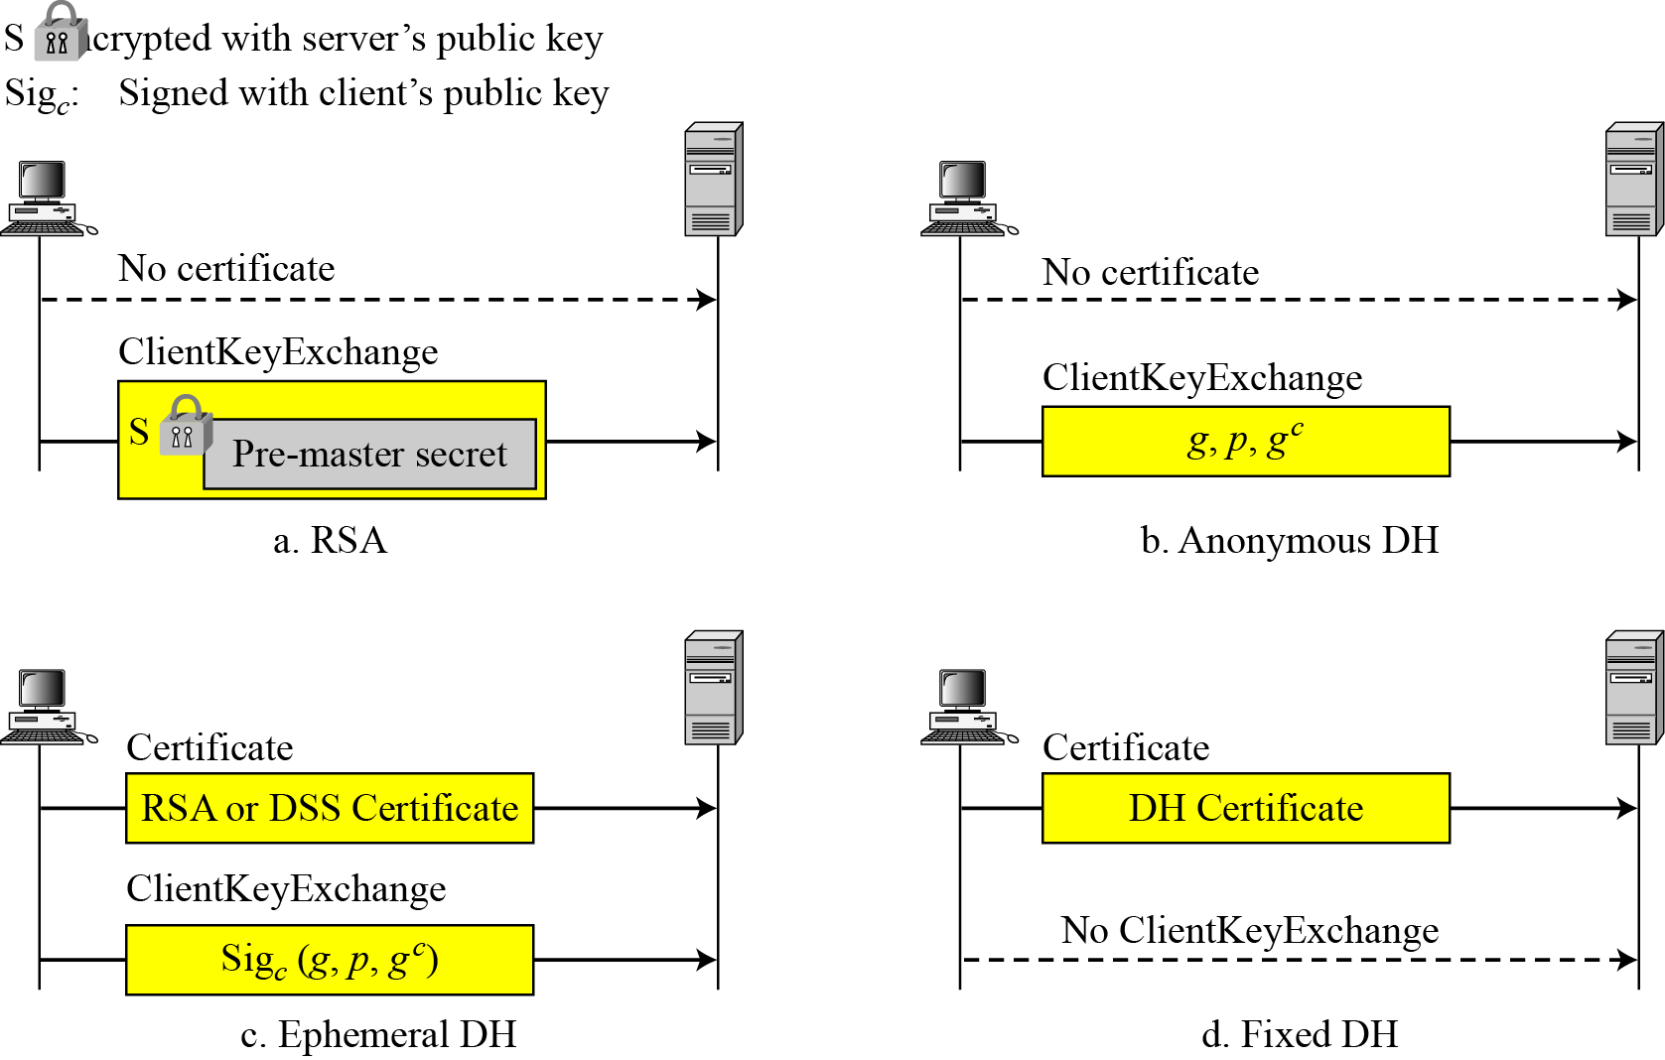
17.2.1 Continued
Figure 17.18 Four cases in Phase III

Slide 39
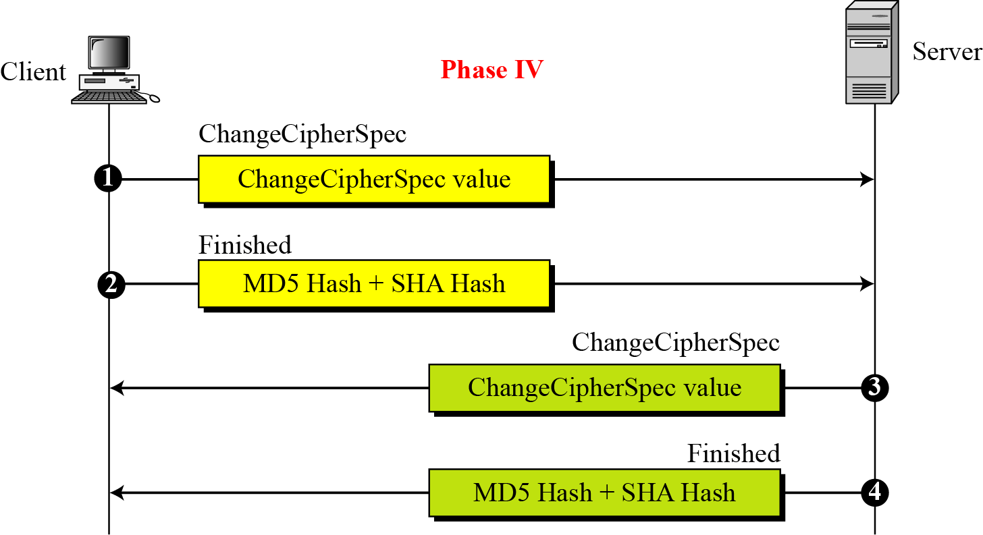
17.2.1 Continued
Figure 17.19 Phase IV of Handshake Protocol

Slide 40
17.2.1 Continued
Note
After Phase IV, the client and server are ready to exchange data.

Slide 41
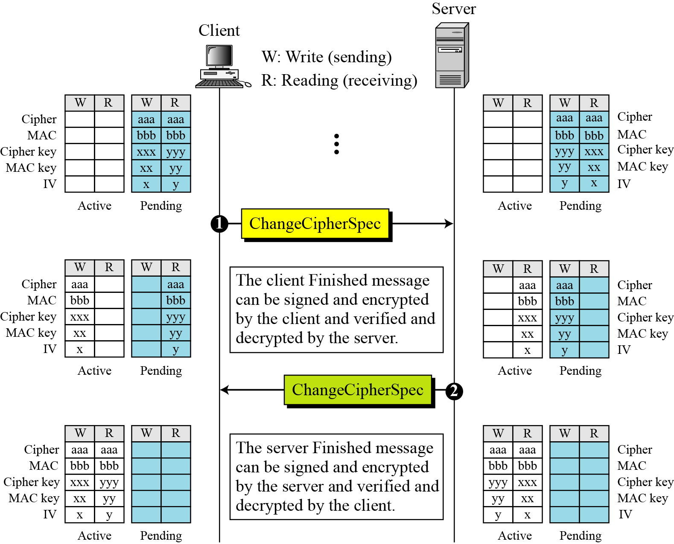
17.2.2 ChangeCipherSpec Protocol
Figure 17.20 Movement of parameters from pending
state to active state

Slide 42
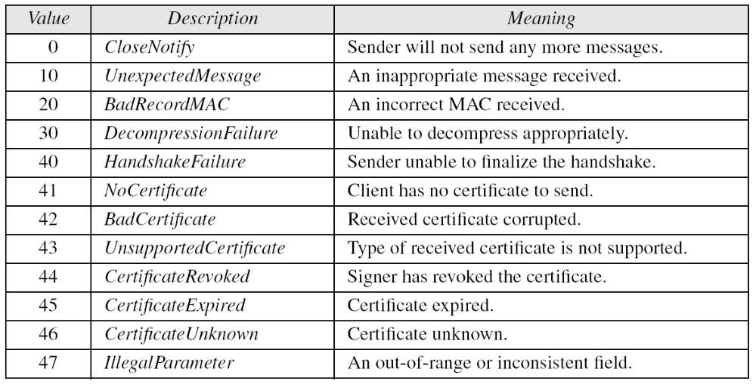
17.2.3 Alert Protocol
Table 17.4 Alerts defined for SSL

Slide 43
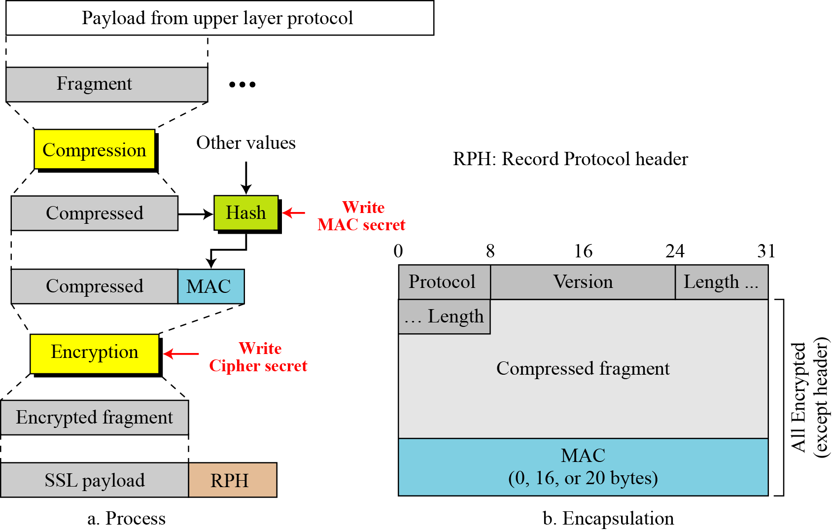
17.2.4 Record Protocol
Figure 17.21 Processing done by the Record Protocol

Slide 44
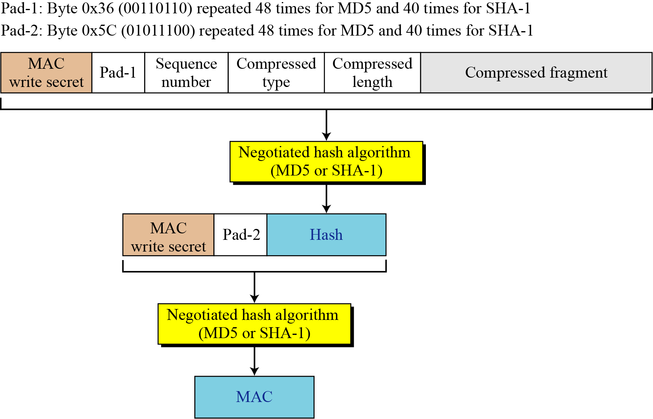
17.2.4 Continued
Figure 17.22 Calculation of MAC

Slide 45
17-3 SSL MESSAGE FORMATS
As we have discussed, messages from three protocols and data from the application layer are encapsulated in the Record Protocol messages.
Topics discussed in this section:
17.3.1 ChangeCipherSpec Protocol
17.3.2 Alert Protocol
17.3.3 Handshake Protocol
17.3.4 Application Data

Slide 46
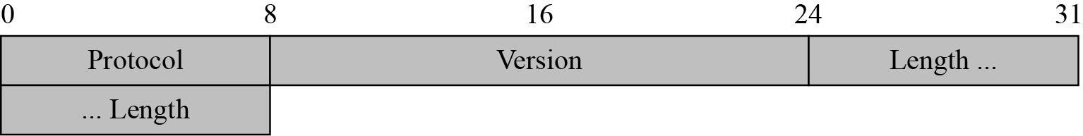
17.3 Continued
Figure 17.23 Record Protocol general header

Slide 47
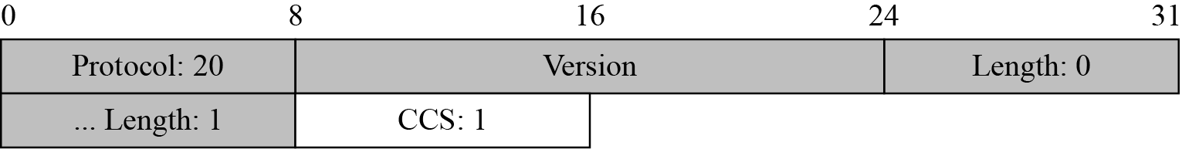
17.3.1 ChangeCipherSpec Protocol
Figure 17.24 ChangeCipherSpec message

Slide 48
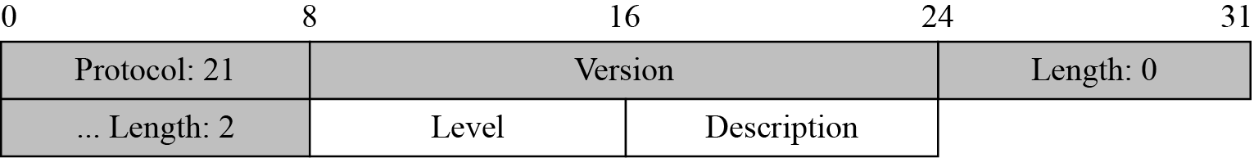
17.3.2 Alert Protocol
Figure 17.25 Alert message

Slide 49
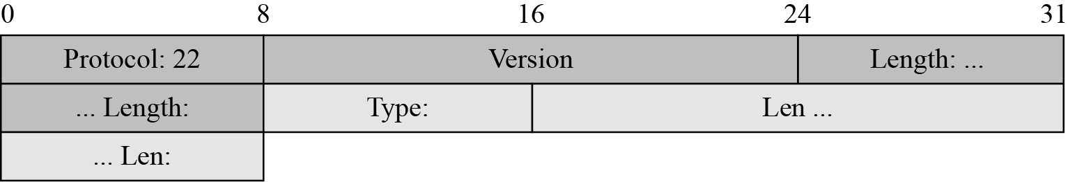
17.3.3 Handshake Protocol
Figure 17.26 Generic header for Handshake Protocol

Slide 50
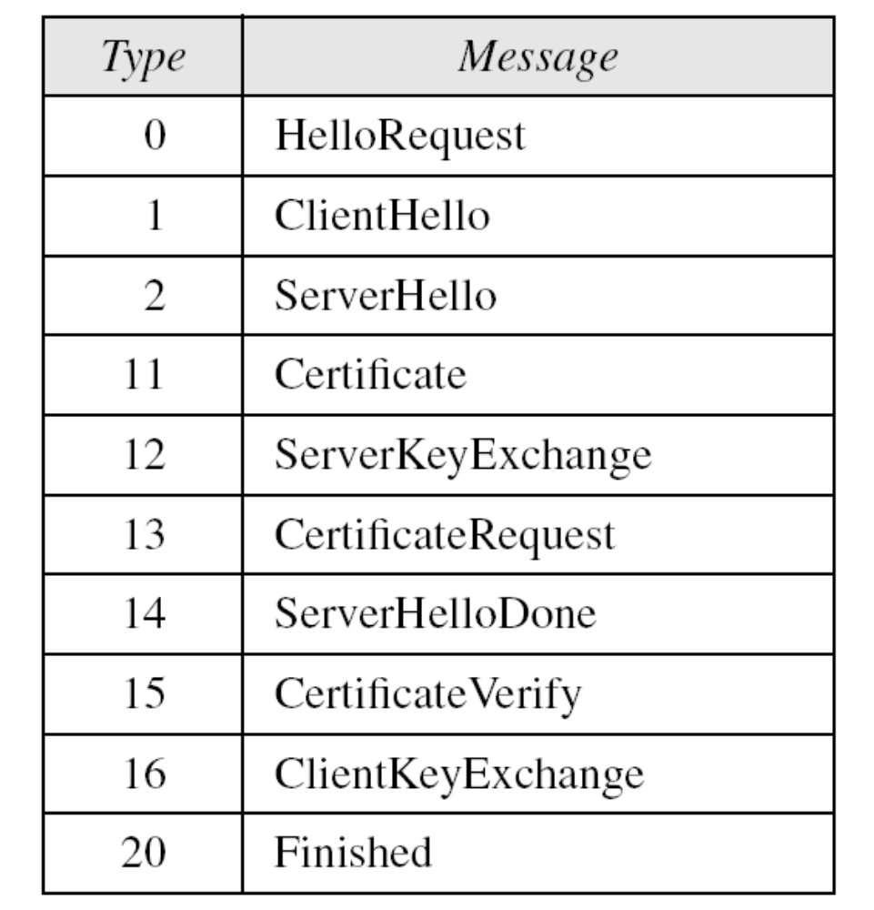
17.3.3 Continued
Table 17.5 Types of Handshake messages

Slide 51
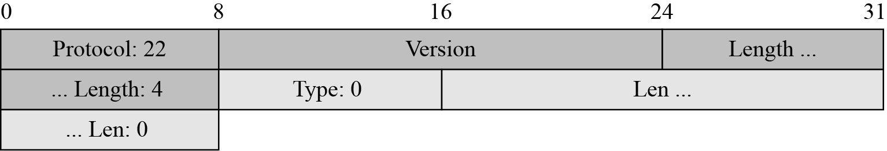
17.3.3 Continued
Figure 17.27 Virtual tributary types

Slide 52
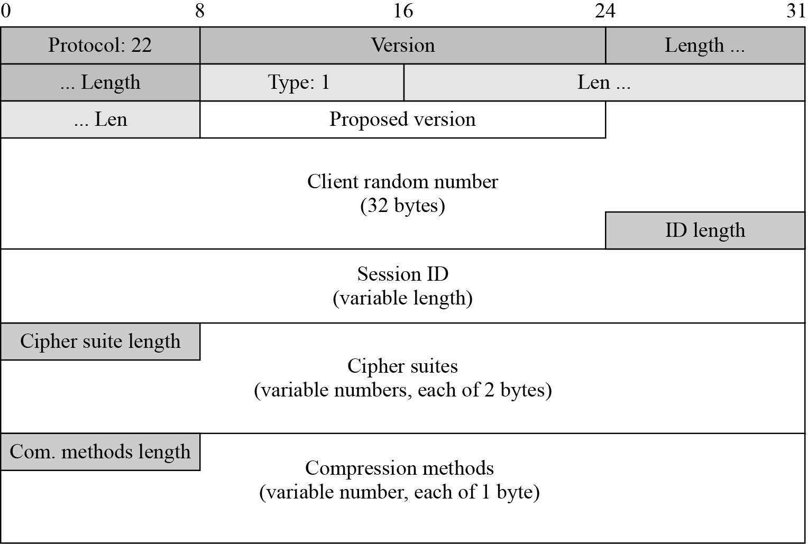
17.3.3 Continued
Figure 17.28 ClientHello message

Slide 53
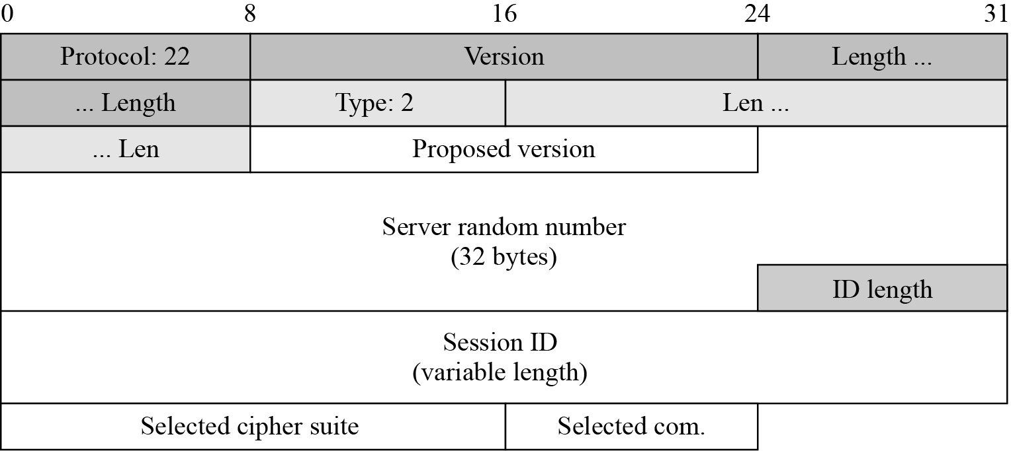
17.3.3 Continued
Figure 17.29 ServerHello message

Slide 54
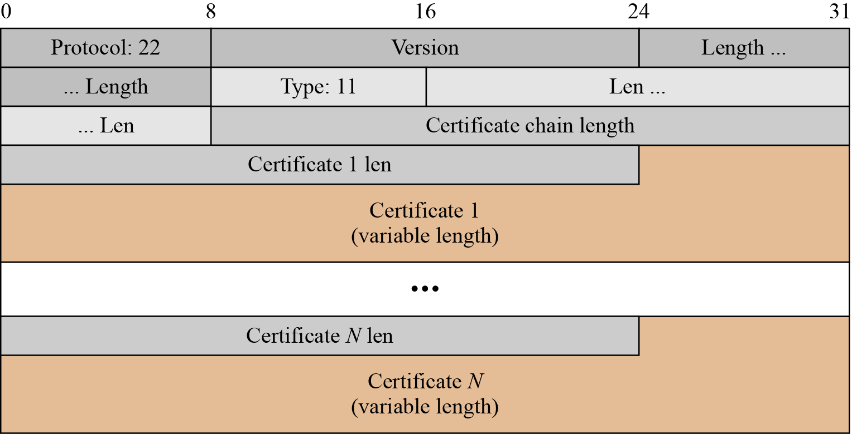
17.3.3 Continued
Figure 17.30 Certificate message

Slide 55
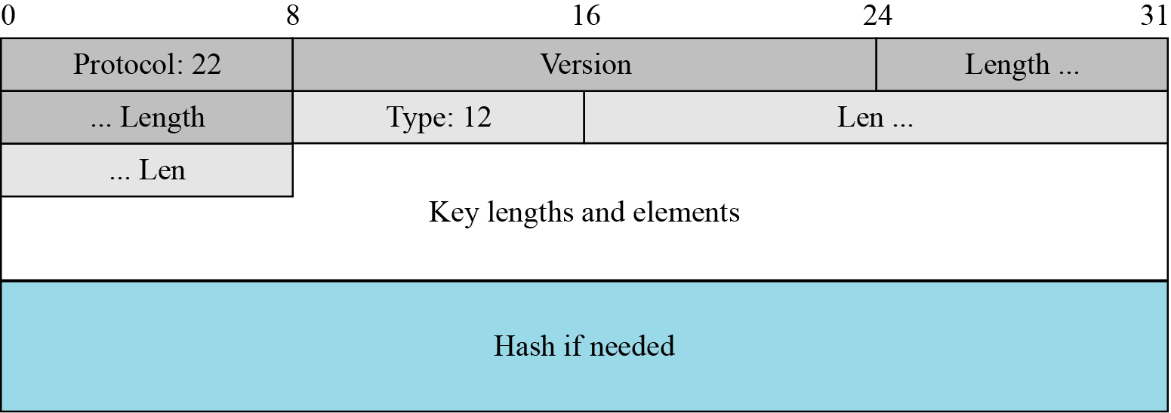
17.3.3 Continued
Figure 17.31 ServerKeyExchange message

Slide 56
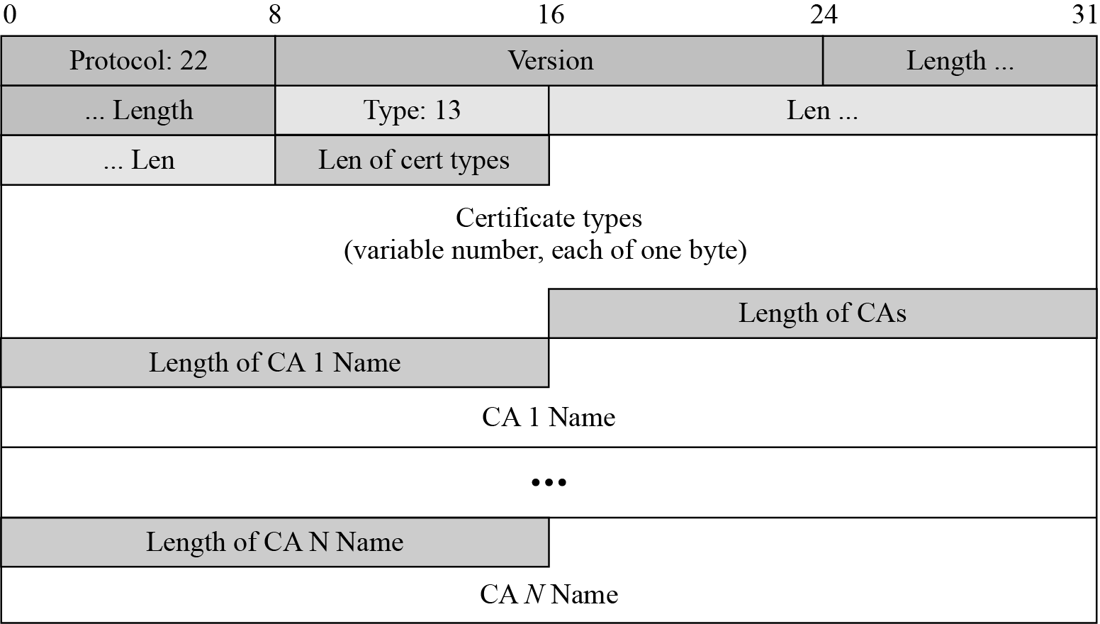
17.3.3 Continued
Figure 17.32 CertificateRequest message

Slide 57
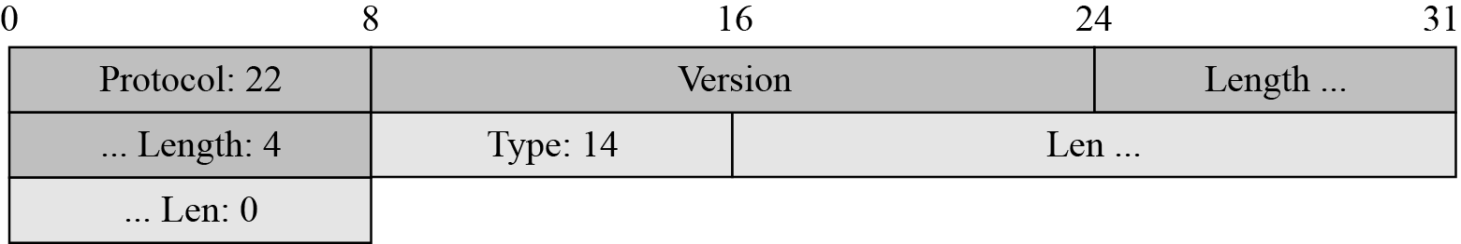
17.3.3 Continued
Figure 17.33 ServerHelloDone message

Slide 58
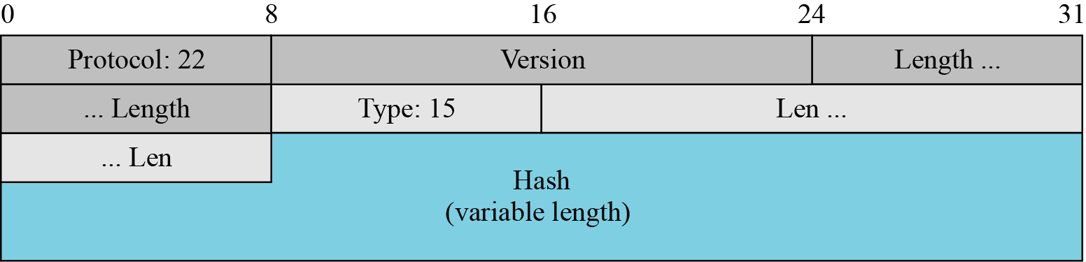
17.3.3 Continued
Figure 17.34 CertificateVerify message

Slide 59
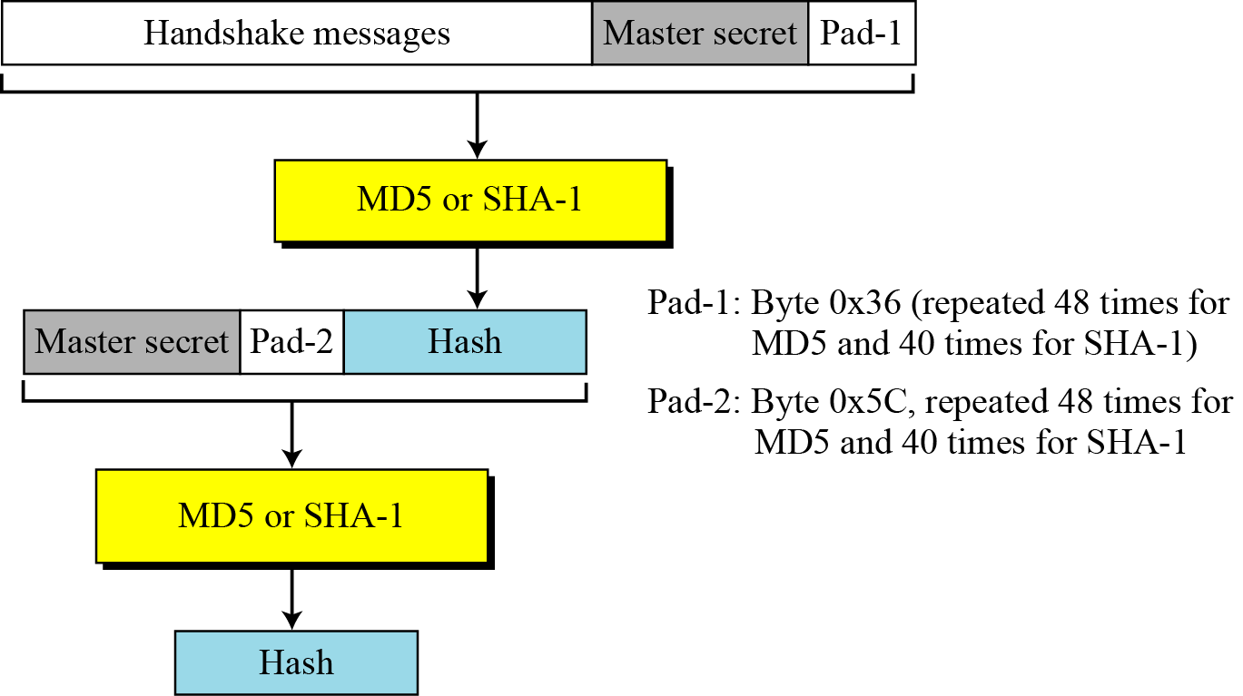
17.3.3 Continued
Figure 17.35 Hash calculation for CertificateVerify message

Slide 60
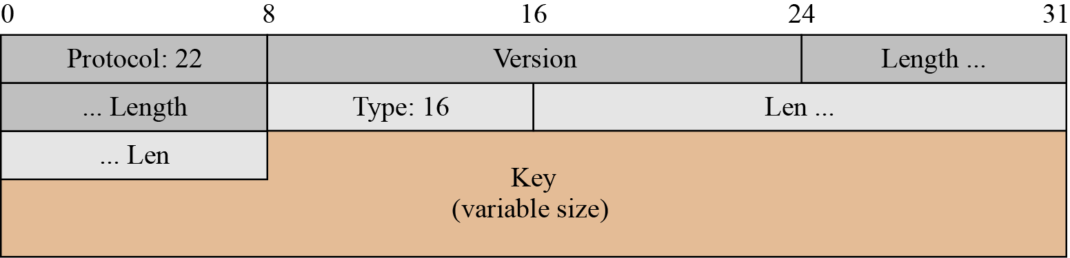
17.3.3 Continued
Figure 17.36 ClientKeyExchange message

Slide 61
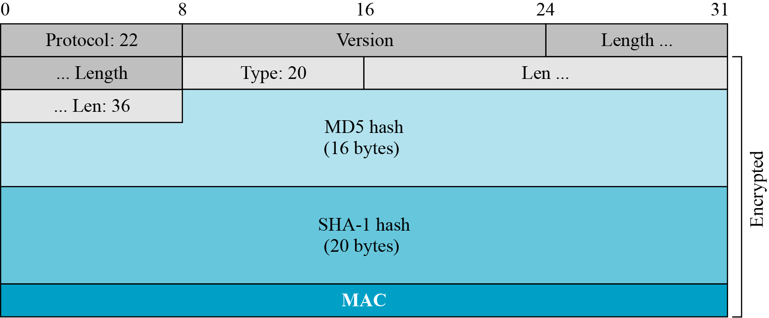
17.3.3 Continued
Figure 17.37 Finished message

Slide 62
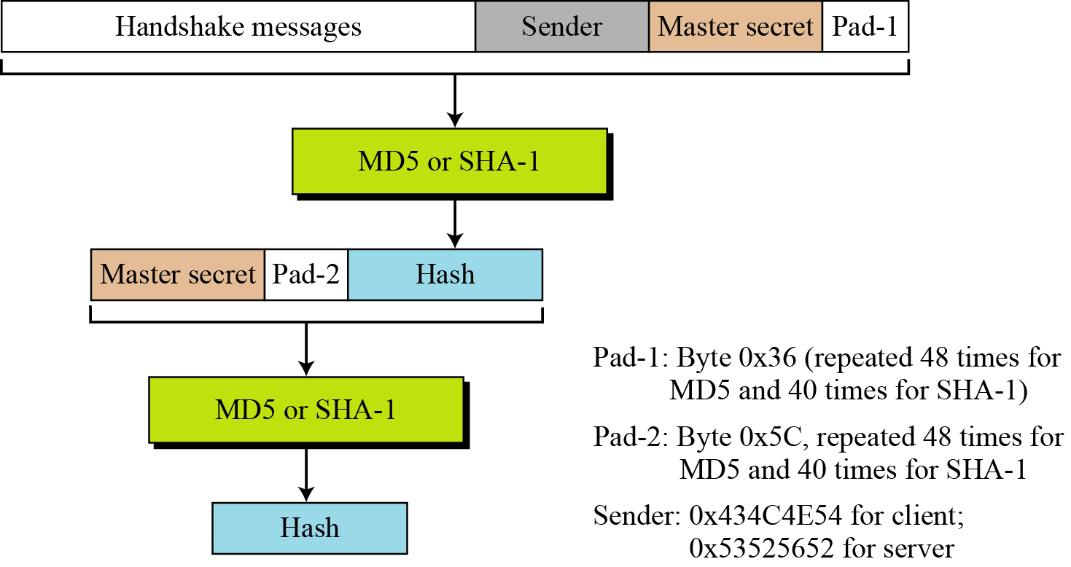
17.3.3 Continued
Figure 17.38 Hash calculation for Finished message

Slide 63
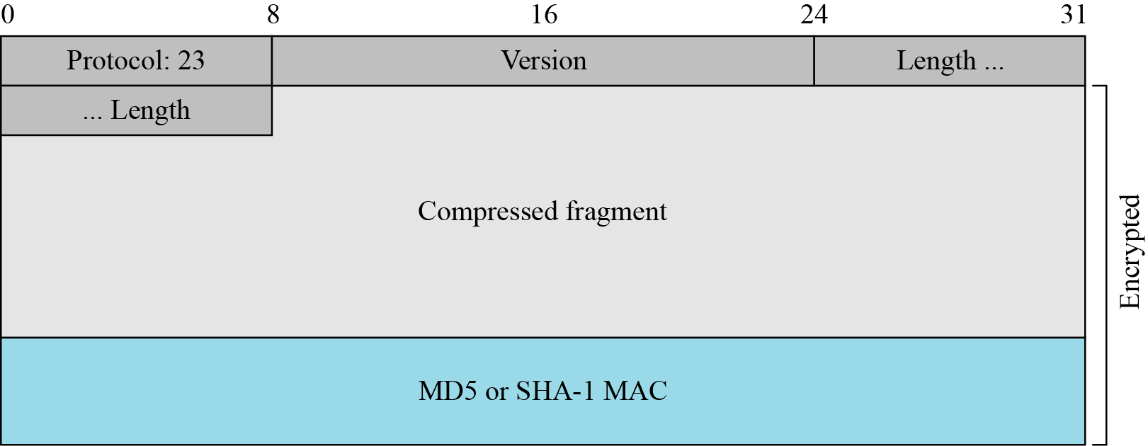
17.3.3 Application Data
Figure 17.39 Record Protocol message for application data

Slide 64
17-4 Transport Layer Security (TLS)
The Transport Layer Security (TLS) protocol is the IETF standard version of the SSL protocol. The two are very similar, with slight differences.
Topics discussed in this section:
17.4.1 Version
17.4.2 Cipher Suite
17.4.3 Generation of Cryptographic Secrets
17.4.4 Alert Protocol
17.4.5 Handshake Protocol
17.4.6 Record Protocol

Slide 65
17.4.1 Version
The first difference is the version number (major and minor). The current version of SSL is 3.0; the current version of TLS is 1.0. In other words, SSLv3.0 is compatible with TLSv1.0.

Slide 66
17.4.2 Cipher Suite
Another minor difference between SSL and TLS is the lack of support for the Fortezza method. TLS does not support Fortezza for key exchange or for encryption/decryption. Table 17.6 shows the cipher suite list for TLS (without export entries).

Slide 67
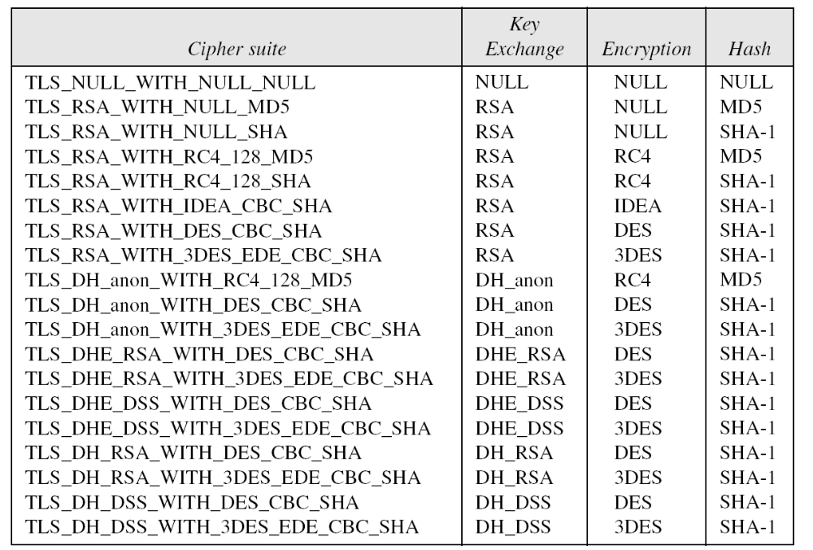
17.4.2 Continued
Table 17.6 Cipher Suite for TLS

Slide 68
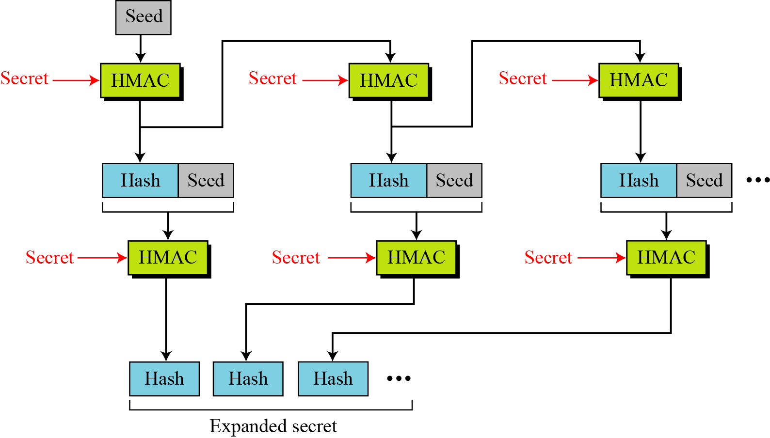
17.4.3 Generation of Cryptographic Secrets
Figure 17.40 Data-expansion function

Slide 69
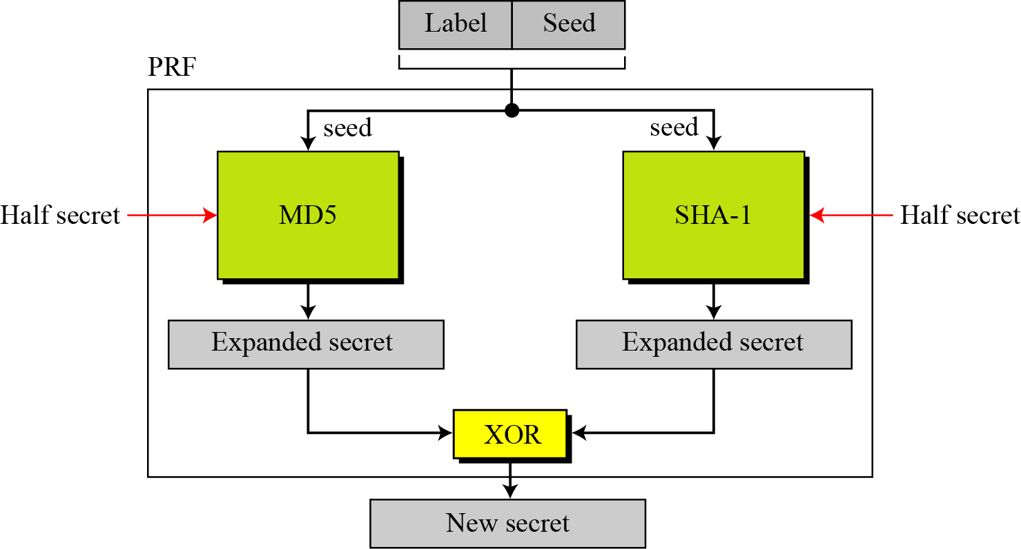
17.4.3 Continued
Figure 17.41 PRF

Slide 70
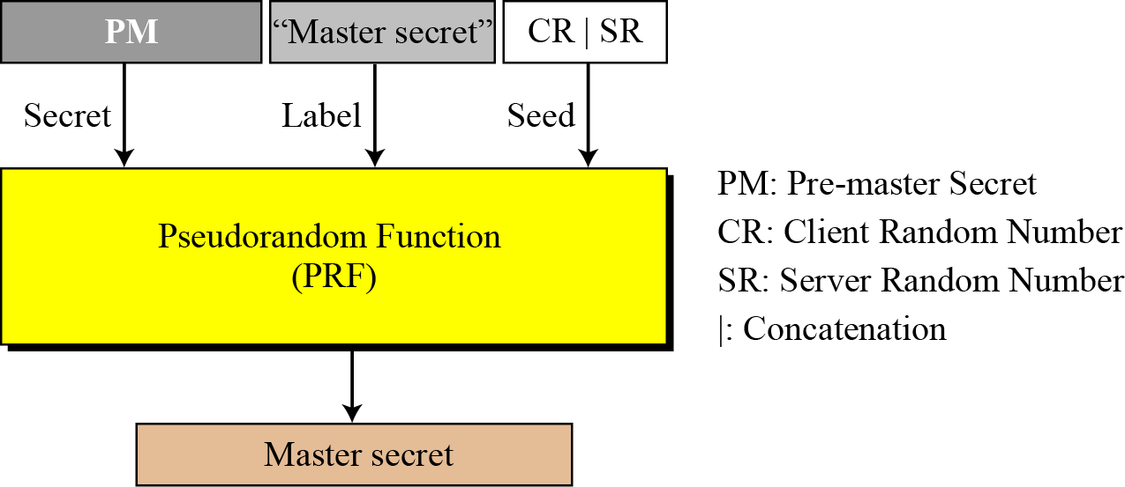
17.4.3 Continued
Figure 17.42 Master secret generation

Slide 71
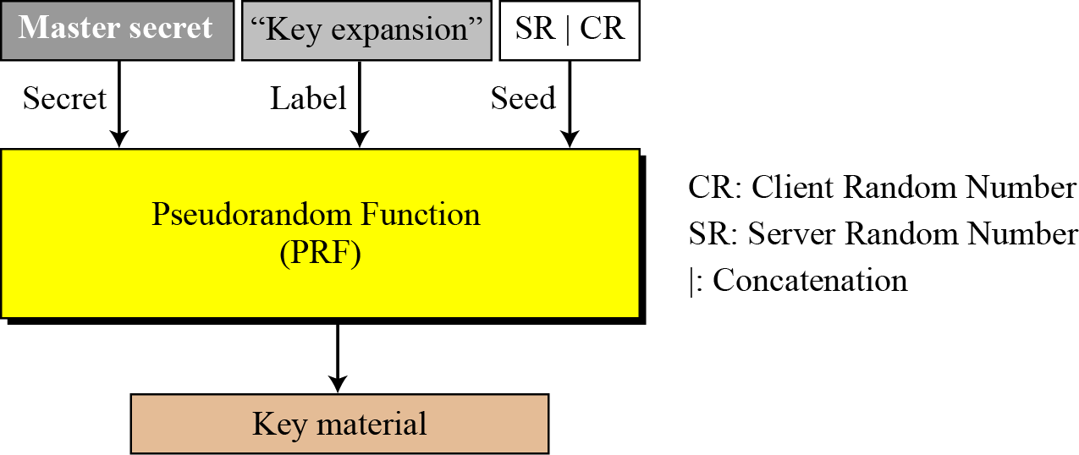
17.4.3 Continued
Figure 17.43 Key material generation

Slide 72
17.4.4 Alert Protocol
TLS supports all of the alerts defined in SSL except for NoCertificate. TLS also adds some new ones to the list. Table 17.7 shows the full list of alerts supported by TLS.

Slide 73
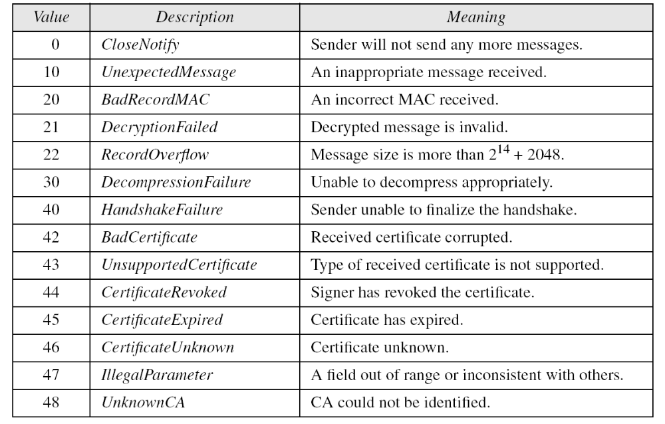
17.4.4 Continued
Table 17.7 Alerts defined for TLS

Slide 74

17.4.5 Handshake Protocol
Figure 17.44 Hash for CertificateVerify message in TLS

Slide 75

17.4.5 Continued
Figure 17.45 Hash for Finished message in TLS

Slide 76

17.4.6 Record Protocol
Figure 17.46 HMAC for TLS

