Slide 1
CS/ECE Network Security
Dr. Attila Altay Yavuz
Symmetric Crypto
Credit: Prof. Dr. Peng Ning for slides
Network Security
Dr. Attila Altay Yavuz
Spring 2015

Slide 2
Secret Key Cryptography
plaintext
ciphertext
plaintext
Encryption
Decryption
key
Same key is used for both encryption and decryption
  this one key is shared by two parties who wish to communicate securly
Also known as symmetric key cryptography, or shared key cryptography

Slide 3
Applications of Secret Key Crypto
Communicating securely over an insecure channel
  Alice encrypts using shared key
  Bob decrypts result using same shared key
Secure storage on insecure media
  Bob encrypts data before storage
  Bob decrypts data on retrieval using the same key

Slide 4
Applications… (Cont’d)
Message integrity
  Alice computes a message integrity code (MIC) from the message, then encrypts with shared key
  Bob decrypts the MIC on receipt, and verifies that it agrees with message contents
Authentication
  Bob can verify Alice sent the message
  how is that possible?
Notes:
How is that possible: challenge-response scheme

Slide 5
Generic Block Encryption
Converts one input plaintext block of fixed size k bits to an output ciphertext block also of k bits
Benefits of large k? of short k?
…
plaintext
block 0
block 1
block 2
key
Encryption
…
ciphertext
block 0
block 1
block 2
Notes:
k should be long enough to thwart known-plaintext attacks, but not too long (for performance reasons)

Slide 6
Key Sizes
Keys should be selected from a large potential set, to prevent brute force attacks
Secret key sizes
  40 bits were considered adequate in 70’s
  56 bits used by DES were adequate in the 80’s
  128 bits are adequate for now
If computers increase in power by 40% per year, need roughly 5 more key bits per decade to stay “sufficiently” hard to break (or more!)
Notes:
ensures probability of successfully guessing the key is low
makes time to try them all infeasible

Slide 7
Notation
Notation | Meaning
X ⊕ Y | Bit-wise exclusive-or of X and Y
X || Y | Concatenation of X and Y
K{m} E_{K}(m) | Message m encrypted with secret key K

Slide 8
Two Principles for Cipher Design
Confusion:
  Make the relationship between the <plaintext, key> input and the <ciphertext> output as complex (non-linear) as possible
Diffusion:
  Spread the influence of each input bit across many output bits
  Randomness via key will spread
Notes:
=k*2^k
=k*logk
=consecutive Ps or Ss do not improve security

Slide 9
Exploiting the Principles
Idea: use multiple, alternating permutations and substitutions, e.g.,
  S→P→S→P→S→…
  P→S→P→S→P→…
Do they have to alternate? e.g….
  S→S→S→P→P→P→S→S→…??
Confusion is mainly accomplished by substitutions
Diffusion is mainly accomplished by permutations
Example ciphers: DES, AES
Notes:
=k*2^k
=k*logk
=consecutive Ps or Ss do not improve security

Slide 10
Secret Key… (Cont’d)
Basic technique used in secret key ciphers: multiple applications of alternating substitutions and permutations
plaintext
S
P
S
P
…
S
ciphertext
…
key
Examples : (DES, AES) → S-P Networks
Notes:
Make the connection to classical ciphers!
secret key crypto uses substitution and cipher as building blocks
also uses XOR operation extensively, as in one-time pad

Slide 11
Basic Form of Modern Block Ciphers
Plaintext block
Key
Preprocessing
Sub-Key Generation
Rounds of
Encryption
i=1,2,…,n
Sub-Key #1
Sub-Key #2
Sub-Key #3
…
Sub-Key #n
Postprocessing
Ciphertext block

Slide 12
FEISTEL CIPHERS
Feistel Cipher has been a very influential “template” for designing a block cipher
Major benefit: can do encryption and decryption with the same hardware
Examples: DES, RC5

Slide 13
One “Round” of Feistel Encryption
Break input block i into left and right halves L_{i} and R_{i}
Copy R_{i} to create output half block L_{i+1}
Half block R_{i} and key K_{i} are “scrambled” by function f
XOR result with input half-block L_{i} to create output half-block R_{i+1}
Input block i
L_{i}
R_{i}
K_{i}
f
⊕
L_{i+1}
R_{i+1}
Output block i+1

Slide 14
One “Round” of Feistel Decryption
Just reverse the arrows!
Output block i+1
L_{i}
R_{i}
K_{i}
f
⊕
L_{i+1}
R_{i+1}
Input block i

Slide 15
Complete Feistel Cipher: Encryption
Plaintext (2w bits)
L₀
R₀
K₁
Round 1
⊕
f
K₂
Round i
⊕
f
L₂
…
…
R₂
K_{n}
⊕
f
Round n
note this
final swap!
L_{n}
R_{n}
L_{n+1}
R_{n+1}
CSC/ECE 574
Ciphertext (2w bits)
Dr. Peng Ning

Slide 16
Feistel Cipher: Decryption
Ciphertext (2w bits)
L₀
R₀
K_{n}
Round 1
⊕
f
K_{n-1}
Round i
⊕
f
L₂
…
…
R₂
K₁
⊕
f
Round n
note this
final swap!
L_{n}
R_{n}
L_{n+1}
R_{n+1}
CSC/ECE 574
Plaintext (2w bits)
Dr. Peng Ning

Slide 17
Parameters of a Feistel Cipher
Block size
Key size
Number of rounds
Subkey generation algorithm
“Scrambling” function f

Slide 18
Comments
Decryption is same as encryption, only reversing the order in which round keys are applied
  Reversability of Feistel cipher derives from reversability of XOR
Function f can be anything
  Hopefully something easy to compute
  There is no need to invert f

Slide 19
FEISTEL: DES (Data Encryption Standard)
Standardized in 1976 by NBS
  proposed by IBM,
  Feistel cipher
Criteria (official)
  provide high level of security
  security must reside in key, not algorithm
  not patented
  must be exportable
  efficient to implement in hardware
Notes:
See Kipnis, lect6.pdf, slides 10-38

Slide 20
DES Basics
Blocks: 64 bit plaintext input,
64 bit ciphertext output
Rounds: 16
Key: 64 bits
  every 8th bit is a parity bit, so really 56 bits long
64 bit
plaintext
block
DES Encryption
64 bit
ciphertext
block
56 bit key (+ 8 bits parity)
Notes:
See Kipnis, lect6.pdf, slides 10-38

Slide 21
DES Top Level View
64-bit Input
56-bit Key
Generate
round keys
Initial Permutation
48-bit K₁
Round 1
48-bit K₂
Round 2
…
48-bit K₁₆
Round 16
Swap Halves
Final Permutation
64-bit Output

Slide 22
Advanced Encryption Standard
(AES)
Network Security
Spring 2015

Slide 23
Overview
Selected from an open competition, organized by NSA
  winner: Rijndael algorithm, standardized as AES
Some similarities to DES (rounds, round keys, alternate permutation+substitution)
  but not a Feistel cipher
Block size = 128 bits
Key sizes = 128, 192, or 256
Main criteria: secure, well justified, fast (both HW and SW)
Give high and moderate-level design
Code-level is optional
Galois Field arithmetic will be briefly discussed

Slide 24
AES-128 State
Each plaintext block of 16 bytes is arranged as 4 columns of 4 bytes each
a₀ | a₁ | a₂ | a₃ | a₄ | a₅ | a₆ | a₇ | a₈ | a₉ | a₁₀ | a₁₁ | a₁₂ | a₁₃ | a₁₄ | a₁₅
a₀ | a₄ | a₈ | a₁₂
a₁ | a₅ | a₉ | a₁₃
a₂ | a₆ | a₁₀ | a₁₄
a₃ | a₇ | a₁₁ | a₁₅
(Padding necessary for messages not a multiple of 16 bytes)

Slide 25
One AES-128 Round
Apply S-box function to each byte of the state (i.e., 16 substitutions)
Rotate…
  (row 0 of state is unchanged)
  row 1 of the state left 1 column
  row 2 of the state left 2 columns
  row 3 of the state left 3 columns
Apply MixColumn function to each column of state
  last round omits this step

Slide 26
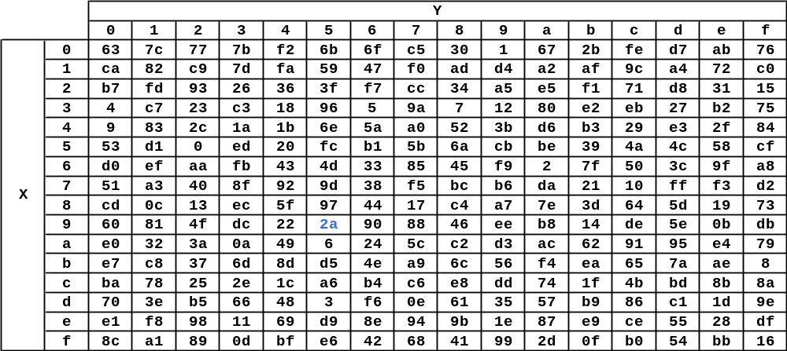
Round Step 1. AES S-Box
Each byte of state is replaced by a value from following table
  eg. byte with value 0x95 is replaced by byte in
  row 9 column 5, which has value 0x2A
Notes:
Inversion in GF(2⁸)
Bitwise linear transformation
Xor with a constant
S-box constructed using defined transformation of values in GF(2^8)
S-box constructed using a simple math formula using a non-linear function – 1/x.

Slide 27
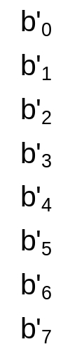

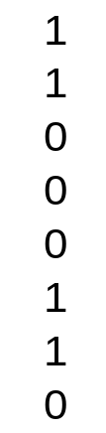
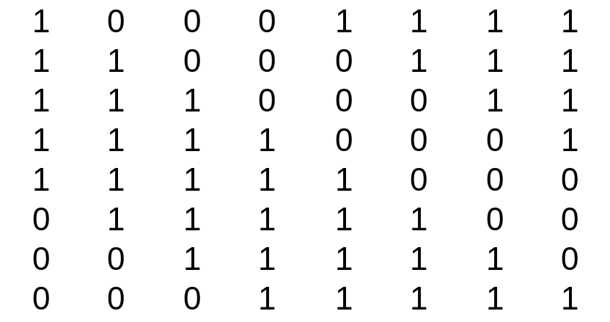
S-Box (Cont’d)
The S-Box is what makes AES a non-linear cipher
For every value of b there is a unique value for b’
  It is faster to use a substitution table (and easier).
=
+
x = b⁻¹ in GF(2^8), i.e., x is the inverse of byte b

Slide 28
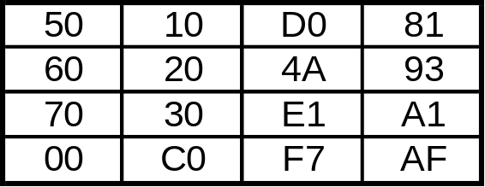
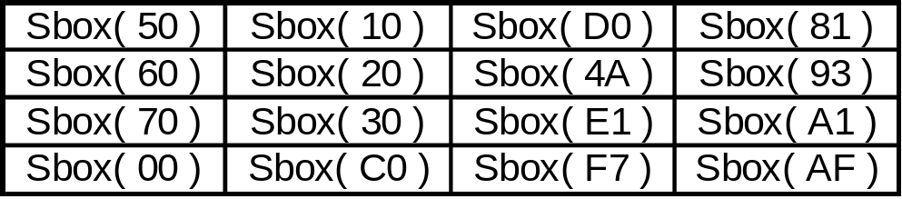
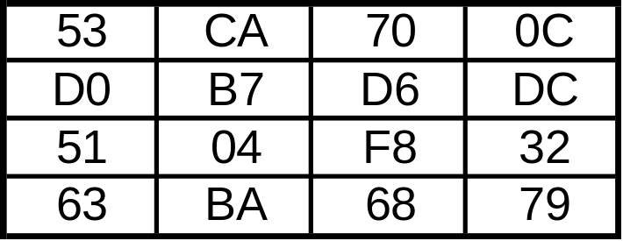
S-Box Example
The S-Box is what makes AES a non-linear cipher
State
After SubBytes

Slide 29
Round Step 2. Rotate (Example)
Before Shift Rows
After Shift Rows
53 | CA | 70 | 0C
D0 | B7 | D6 | DC
51 | 04 | F8 | 32
63 | BA | 68 | 79
53 | CA | 70 | 0C
B7 | D6 | DC | D0
F8 | 32 | 51 | 04
79 | 63 | BA | 68

Slide 30
Round Step 3. MixColumn Function
Applied to each column of the state
For each column, each byte a_{i}…a_{i+3} of the column is used to look up four 4-byte intermediate columns t_{i}…t_{i+3} from a table (next slide)
The intermediate columns t_{i}…t_{i+3} are then combined (next slide + 1):
  rotate vertically so top octet of t_{i} is in same row as input octet (a_{i})
  XOR the four rotated columns together

Slide 31
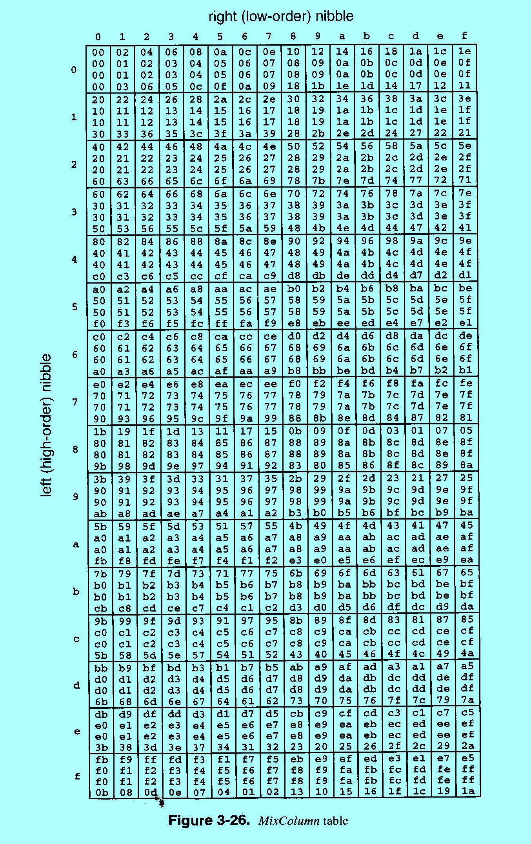
MixColumn… (Cont’d)
Part of the MixColumn table:
right (low-order) nibble (4 bits)
left (high-order) nibble (4 bits)

Slide 32
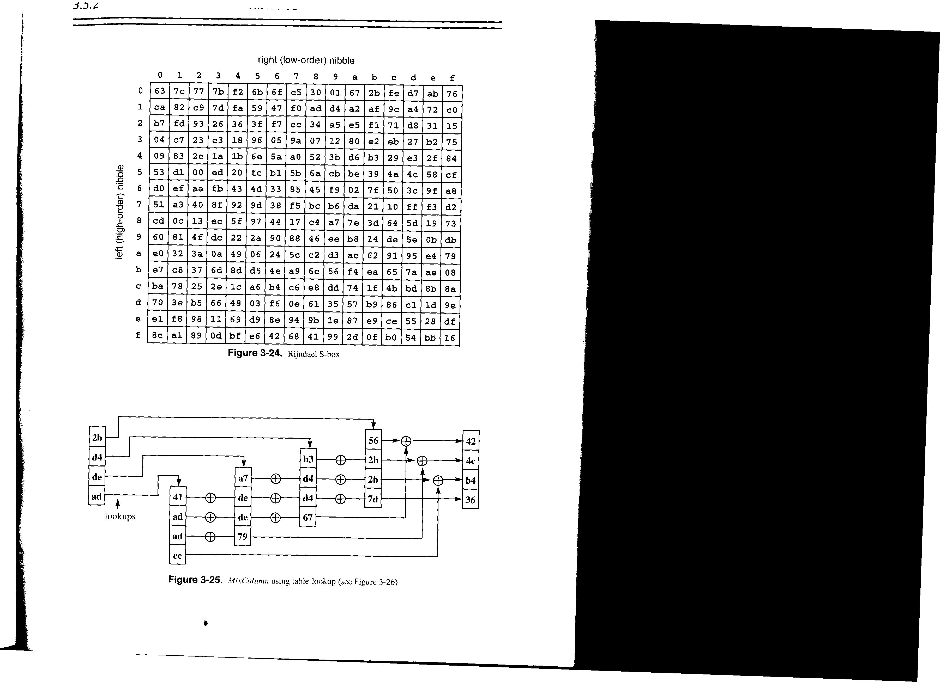
MixColumn… (Cont’d)
Example
Need fig 3-25 here

Slide 33
Generating Round Keys in AES-128
The key (16 bytes) is arranged in 4 columns of 4 rows, as for the input (plaintext) block)
Deriving the round keys
makes use of a table
of constants:
Removes symmetry and
linearity from
key expansion
Round i | Constant c_{i}
1 | 0x6C
2 | 0xD8
3 | 0xAB
4 | 0x4D
5 | 0x9A
6 | 0x2F
7 | 0x5E
8 | 0xBC
9 | 0x63
10 | 0xC6

Slide 34
Round Keys… (Cont’d)
For i^{th} round of keys, i = 1..10
for column index j = 0
temp = column 3 of
(i-1)^{th} (previous) round
rotate temp upward one byte
S-Box transform each byte
of temp
XOR first byte of temp with c_{i}

S
c_{i}
for column index j = 1..3
temp = column j-1 of i^{th} (this) round
result = temp XOR j^{th} column of key round i-1

Slide 35
Key Expansion Rationale
Designed to resist known attacks
Design criteria include
  knowing part of the key doesn’t make it easy to find entire key
  key expansion must be invertible, but enough non-linearity to hinder analysis
  should be fast to compute, simple to describe and analyze
  key bits should be diffused into the round keys

Slide 36

Mathematics
AES Operates on the binary field GF(2⁸)
  this can be represented as a polynomial b(x) with binary coefficients b {0,1}:
b₇x⁷ + b₆x⁶ + b₅x⁵ + b₄x⁴ + b₃x³ + b₂x² + b₁x + b₀
Multiplication in GF(2⁸) consists of multiplying two polynomials modulo an irreducible polynomial of degree 8
  AES uses the following irreducible polynomial
m(x) = x⁸ + x⁴ + x³ + x + 1

Slide 37
AES-128 Decryption (Conceptual)
Run cipher in reverse, with inverse of each operation replacing the encryption operations
Inverse operations:
  XOR is its own inverse
  inverse of S-box is just the inverse table
  (next slide)
  inverse of rotation in one direction is rotation in other direction
  inverse of MixColumn is just the inverse table
  (next slide + 1)

Slide 38
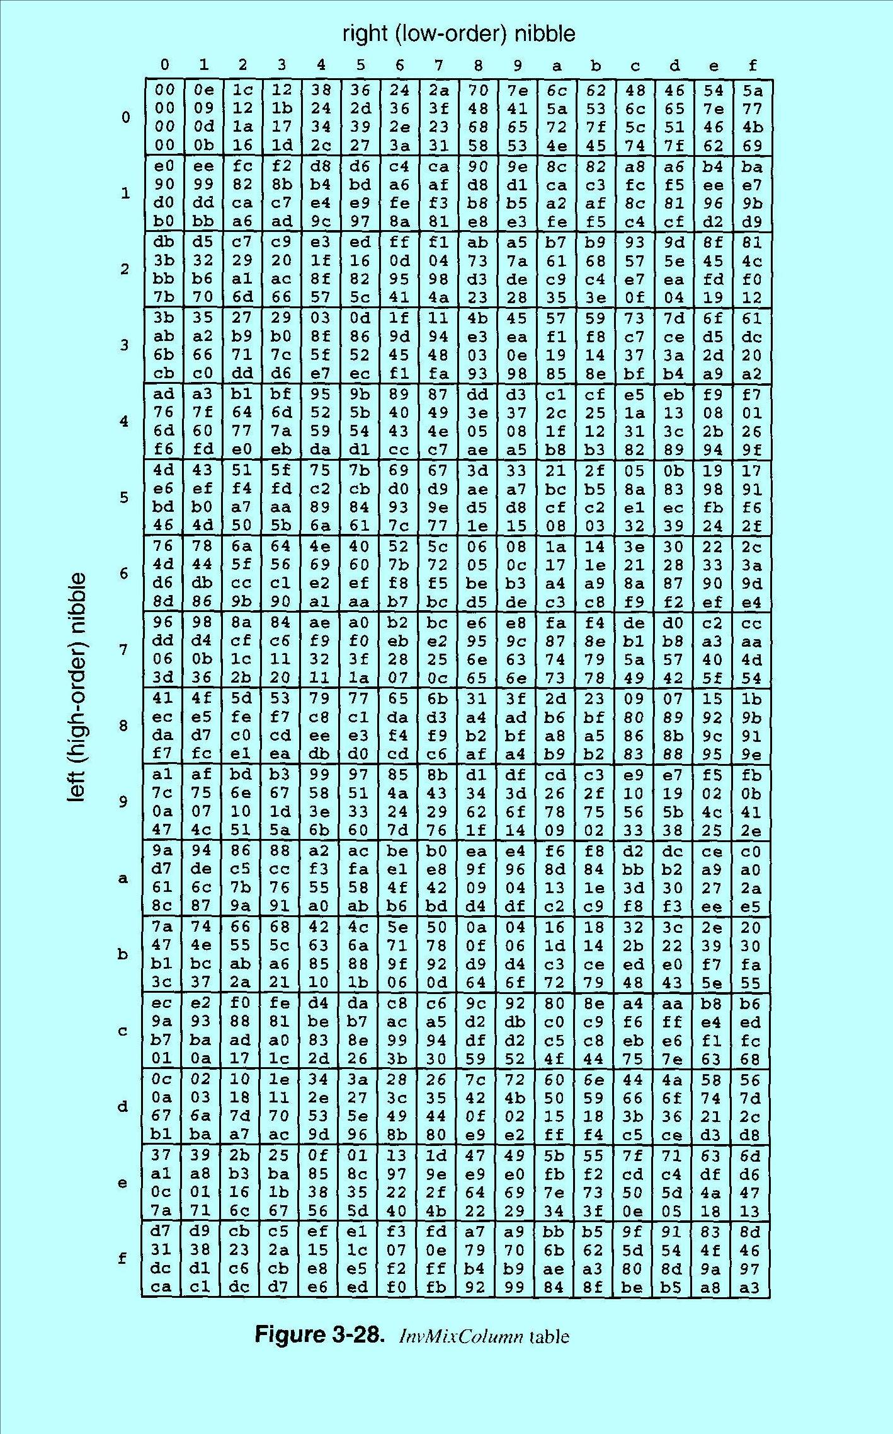
InvMixColumn
right (low-order) nibble (4 bits)
left (high-order) nibble (4 bits)

Slide 39
AES Decryption (Actual)
Run cipher in forward direction, except…
  use inverse operations
  apply round keys in reverse order
  apply InvMixColumn to round keys K1..K9

Slide 40
AES Assessment
Speed: about 16 clock cycles/byte on modern 32-bit CPUs
  200 MByte/s on a PC, no special hardware!
No known successful attacks on full AES
  best attacks work on 7−9 rounds (out of 10−14 rounds)
Clean design
For brute force attacks, AES-128 will take
4*10²¹ X ( = 2⁷² ) more effort than DES

Slide 41
Attacks on AES
Differential Cryptanalysis: based on how differences in inputs correlate with differences in outputs
  greatly reduced due to high number of rounds
Linear Cryptanalysis: based on correlations between input and output
  S-Box & MixColumns are designed to frustrate Linear Analysis
Side Channel Attacks: based on peculiarities of the implementation of the cipher

Slide 42
Side Channel Attacks
Timing Attacks: measure the time it takes to do operations
  some operations, with some operands, are much faster than other operations, with other operand values
  provides clues about what internal operations are being performed, and what internal data values are being produced
Power Attacks: measures power to do operations
  changing one bit requires considerably less power than changing many bits in a byte

Slide 43
Summary
Secret key crypto is (a) good quality, (b) faster to compute than public key crypto, and (c) the most widely used crypto
DES strong enough for non-critical applications, but triple-DES is better
AES even better (stronger and much faster), has versions with 128-, 192-, and 256-bit keys
Secret key crypto requires “out-of-band”, bilateral key negotiation/agreement

Slide 44
Symmetric Crypto - Modes of Operation
ECB, CBC, OFB and CTR
Network Security
Spring 2015

Slide 45
Processing with Block Ciphers
Most ciphers work on blocks of fixed (small) size
How to encrypt long messages?
Modes of operation
  ECB (Electronic Code Book)
  CBC (Cipher Block Chaining)
  OFB (Output Feedback)
  CFB (Cipher Feedback)
  CTR (Counter)

Slide 46
Issues for Block Chaining Modes
Information leakage
  Does it reveal info about the plaintext blocks?
Ciphertext manipulation
  Can an attacker modify ciphertext block(s) in a way that will produce a predictable/desired change in the decrypted plaintext block(s)?
  Note: assume the structure of the plaintext is known, e.g., first block is employee #1 salary, second block is employee #2 salary, etc.

Slide 47
Issues… (Cont’d)
Parallel/Sequential
  Can blocks of plaintext (ciphertext) be encrypted (decrypted) in parallel?
Error propagation
  If there is an error in a plaintext (ciphertext) block, will there be an encryption (decryption) error in more than one ciphertext (plaintext) block?

Slide 48
Electronic Code Book (ECB)
Plaintext ⇒
M₁ M₂ M₃ M₄
64
64
64
46 +
padding
Key
E
E
E
E
64
64
64
64
Ciphertext ⇒
C₁ C₂ C₃ C₄
The easiest mode of operation; each block is independently encrypted

Slide 49
ECB Decryption
M₁ M₂ M₃ M₄
64
64
64
46 +
padding
Key
D
D
D
D
64
64
64
64
C₁ C₂ C₃ C₄
Each block is independently decrypted

Slide 50
ECB Properties
Does information leak?
Can ciphertext be manipulated profitably?
Parallel processing possible?
Do ciphertext errors propagate?
M₁ M₂ M₃ M₄
M₁ M₄ M₃ M₂
64
64
64
46 +
padding
Key
D
D
D
D
64
64
64
64
C₁ C₄ C₃ C₂
C₁ C₂ C₃ C₄
CSC/ECE 574
Notes:
Information leaks: two ciphertext blocks that are the same
Manipulation: can switch ciphertext blocks, predictable results on plaintext
Parallel: yes
Propagate: no

Slide 51



ECB Properties
M₁ M₂ M₃ M₄
M₁ M₄ M₃ M₂
46 +
padding
Input
Key
ECB Encryption
Encryption with other modes of operation
Message is clear(!) !
Notes:
Information leaks: two ciphertext blocks that are the same
Manipulation: can switch ciphertext blocks, predictable results on plaintext
Parallel: yes
Propagate: no

Slide 52
Cipher Block Chaining (CBC)
M₁ M₂ M₃ M₄
64
64
64
46 +
padding
Initialization
Vector
Key
E
E
E
E
64
64
64
64
C₁ C₂ C₃ C₄
Chaining dependency: each ciphertext block depends on all preceding plaintext blocks

Slide 53
Initialization Vectors
Initialization Vector (IV)
  Used along with the key; not secret
  For a given plaintext, changing either the key, or the IV, will produce a different ciphertext
  Why is that useful?
IV generation and sharing
  Random; may transmit with the ciphertext
  Incremental; predictable by receivers

Slide 54
CBC Decryption
M₁ M₂ M₃ M₄
64
64
64
46 +
padding
Initialization
Vector
Key
D
D
D
D
64
64
64
64
C₁ C₂ C₃ C₄
How many ciphertext blocks does each plaintext block depend on?

Slide 55
CBC Properties
Does information leak?
  Identical plaintext blocks will produce different ciphertext blocks
Can ciphertext be manipulated profitably?
  ???
Parallel processing possible?
  no (encryption), yes (decryption)
Do ciphertext errors propagate?
  yes (encryption), a little (decryption)
Notes:
flipping bit i of ciphertext block l will result in flipping bit i of decrypted plaintext block l+1

Slide 56
Output Feedback Mode (OFB)
Initialization
Vector
one-time pad
Pseudo-Random Number Generator
64
Key
E
E
E
E
M₁ M₂ M₃ M₄
64
64
64
46 + padding
64
64
64
64
C₁ C₂ C₃ C₄

Slide 57
OFB Decryption
IV
one-time pad
64
Key
E
E
E
E
M₁ M₂ M₃ M₄
64
64
64
46 + padding
64
64
64
64
C₁ C₂ C₃ C₄

Slide 58
OFB Properties
Does information leak?
  identical plaintext blocks produce different ciphertext blocks
Can ciphertext be manipulated profitably?
  ???
Parallel processing possible?
  no (generating pad), yes (XORing with blocks)
Do ciphertext errors propagate?
  ???
Notes:
Changing a bit of the ciphertext changes the corresponding bit of the plaintext

Slide 59
OFB … (Cont’d)
If you know one plaintext/ciphertext pair, can easily derive the one-time pad that was used
  i.e., should not reuse a one-time pad!
Conclusion: IV must be different every time

Slide 60
Cipher Feedback Mode (CFB)
IV
64
Key
E
E
E
E
64
64
64
64
M₁ M₂ M₃ M₄
64
64
64
46 + padding
64
64
64
64
C₁ C₂ C₃ C₄
Ciphertext block C_{j} depends on all preceding plaintext blocks

Slide 61

CFB Decryption
IV
64
Key
E
E
E
E
64
64
64
64
M₁ M₂ M₃ M₄
64
64
64
46 + padding
64
64
64
64
C₁ C₂ C₃ C₄

Slide 62
CFB Properties
Does information leak?
  Identical plaintext blocks produce different ciphertext blocks
Can ciphertext be manipulated profitably?
  ???
Parallel processing possible?
  no (encryption), yes (decryption)
Do ciphertext errors propagate?
  ???
Notes:
can modify any single block in a predictable way, although next decrypted plaintext block will be garbled
Error in plaintext block will affect all later ciphertext blocks, but error in ciphertext block will affect only two plaintext blocks
Claim: if you XOR two ciphertext blocks, you will get the XOR of the corresponding plaintext blocks, and if you know
one plaintext, you will know the other. Not correct, except for the first ciphertext block.

Slide 63
Counter Mode (CTR)
IV
IV++
IV++
64
Key
E
E
E
M₁ M₂ M₃
64
64
64
64
64
64
C₁ C₂ C₃

Slide 64
CTR Mode Properties
Does information leak?
  Identical plaintext block produce different ciphertext blocks
Can ciphertext be manipulated profitably
  ???
Parallel processing possible
  Yes (both generating pad and XORing)
Do ciphertext errors propagate?
  ???
Allow decryption the ciphertext at any location
  Ideal for random access to ciphertext
Notes:
can modify any single block in a predictable way (flipping bits)

Slide 65
Symmetric Crypto – Message Authentication Codes (MACs)
Network Security
Spring 2015

Slide 66
Message Authentication
Encryption easily provides confidentiality of messages
  only the party sharing the key (the “key partner”) can decrypt the ciphertext
How to use encryption to authenticate messages? That is,
  prove the message was created by the key partner
  prove the message wasn’t modified by someone other than the key partner

Slide 67
Approach #1
The quick and dirty approach
If the decrypted plaintext “looks plausible”, then conclude ciphertext was produced by the key partner
  i.e., illegally modified ciphertext, or ciphertext encrypted with the wrong key, will probably decrypt to random-looking data
But, is it easy to verify data is “plausible-looking”? What if all data is plausible?
Notes:
NEED PICTURE HERE

Slide 68
Approach #2: Plaintext+Ciphertext
Sender
Receiver
P
P
E
K
C
C
K
C
Accept /Reject
E
Compare
Send plaintext and ciphertext
  receiver encrypts plaintext, and compares result with received ciphertext
  forgeries / modifications easily detected
  any problems / drawbacks?
Notes:
but does not provide confidentiality

Slide 69
Approach #3: Use Residue
Encrypt plaintext using DES CBC mode, with IV set to zero
  the last (final) ciphertext output block is called the residue
M₁ M₂ M₃ M₄
64
64
64
padding
IV = 00…0
Key
E
E
E
E
64
64
64
64
C₁ C₂ C₃
RESIDUE
Notes:
NEED PICTURE HERE
authenticates message, but does not provide confidentiality

Slide 70
Approach #3… (Cont’d)
Sender
Receiver
P
P
E
Residue
only
K
K
Residue
only
E
Compare
Transmit the plaintext and this residue
  receiver computes same residue, compares to the received residue
  forgeries / modifications highly likely to be detected

Slide 71
Message Authentication Codes
MAC: a small fixed-size block (i.e., independent of message size) generated from a message using secret key cryptography
  also known as cryptographic checksum

Slide 72
Requirements for MAC
Given M and MAC(M), it should be computationally infeasible (expensive) to construct (or find) another message M’ such that MAC(M’) = MAC(M)
MAC(M) should be uniformly distributed in terms of M
  for randomly chosen messages M and M’,
  P( MAC(M)=MAC(M’) ) = 2^{-k}, where k is the number of bits in the MAC

Slide 73
Requirements … (cont’d)
Knowing MAC(M1), MAC(M2), . . . of some (known or chosen) messages M1, M2, . . ., it should be computationally infeasible for an attacker to find the MAC of some other message M’

Slide 74
Summary
ECB mode is not secure
  CBC most commonly used mode of operation
CTR is ideal with AES
  Highly recommended
MACs use crypto to authenticate messages at a small cost of additional storage / bandwidth
  but at a high computational cost

