Slide 1
Acquisition Co SQL Project
Kristen Tran

Slide 2
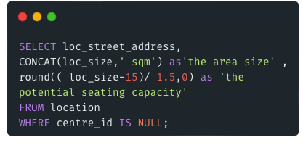
Data Analysis Question
1. List of non-shopping centre locations containing the location's full address, the area size, and the potential seating capacity? (assuming that min. service area is 15 sqm and 1.5 sqm per seating), e.g. for 125 sqm area, the area available for seating is 110 sqm, therefore can hold 73 seats.
loc_id | centre_id | loc_street_address | loc_suburb | loc_state | loc_postcode | loc_size | hasSeating
1 | NULL | 6 Springfield Blvd | Springfield | TAS | 7533 | 138.00 | 1
2 | 2 | Shop 6 | Chadstone | VIC | 3113 | 54.00 | 0
Location

Slide 3
Data Analysis Question
1. List of non-shopping centre locations containing the location's full address, the area size, and the potential seating capacity? (assuming that min. service area is 15 sqm and 1.5 sqm per seating), e.g. for 125 sqm area, the area available for seating is 110 sqm, therefore can hold 73 seats.
Result
loc_street_address | area size (sqm) | potential seating capacity | loc_street_address | area size (sqm) | potential seating capacity | loc_street_address | area size (sqm)
6 Springfield Blvd | 138.00 | 82 | 6 Springfield Blvd | 138.00 | 82 | 6 Springfield Blvd | 138.00
15 Springfield Blvd | 116.00 | 67 | 15 Springfield Blvd | 116.00 | 67 | 15 Springfield Blvd | 116.00
23 3rd St | 203.00 | 125 | 23 3rd St | 203.00 | 125 | 23 3rd St | 203.00
loc_street_address | area size (sqm) | potential seating capacity | loc_street_address | area size (sqm) | potential seating capacity | loc_street_address | area size (sqm)
6 Springfield Blvd | 138.00 | 82 | 6 Springfield Blvd | 138.00 | 82 | 6 Springfield Blvd | 138.00

Slide 4
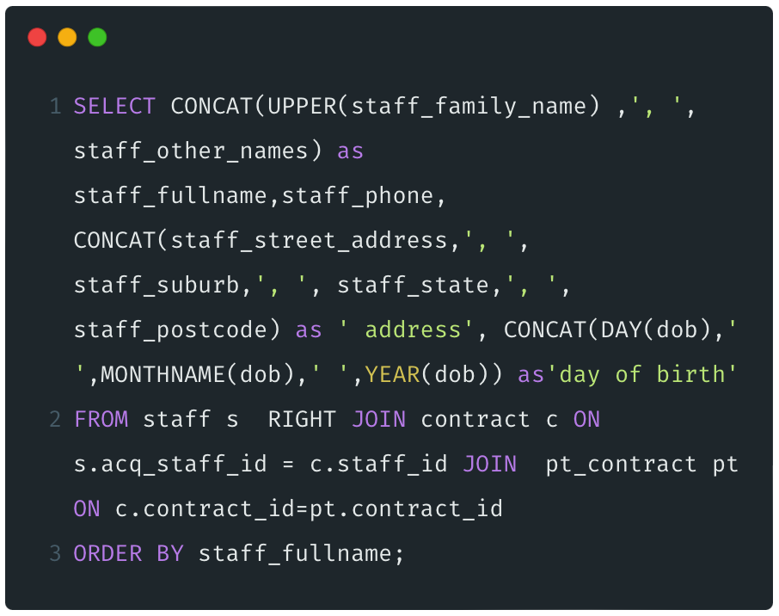
Data Analysis Question
2. Casual staff contact directory containing their full contact details (full name, phone number, complete address, and date of birth) sorted alphabetically based on the full name.
staff
acq_staff_id | c_staff_id | staff_family_name | staff_other_names | staff_phone | staff_street_address | staff_suburb | staff_state | staff_postcode | dob | email
1 | 001 | Freedman | Jeremy | 0477122226 | 11 Quimby St | Springfield | TAS | 7112 | 1982-03-12 | freedman@mymail.com.au
2 | 002 | Bellows | Rory B | 0412836227 | 62 Kearney St | Springfield | TAS | 7123 | 1986-07-21 | rbb@yahooooo.com.au
contract
contract_id | staff_id | company_id | contract_start_date
1 | 1 | 1 | 2020-12-12
2 | 1 | 1 | 2021-10-01
pt_contract
contract_id | pt_hours_per_wk | pt_hourly_rate | pt_super_amt
2 | 20 | 22.31 | 1780.00
4 | 15 | 23.12 | 1383.73

Slide 5
Data Analysis Question
2. Casual staff contact directory containing their full contact details (full name, phone number, complete address, and date of birth) sorted alphabetically based on the full name.
Result
Staff Fullname | Staff Phone | Address | Date of Birth
BELLOWS, Rory B | 0412836227 | 62 Kearney St, Springfield, TAS, 7123 | 21 July 1986
FREEDMAN, Jeremy | 0477122226 | 11 Quimby St, Springfield, TAS, 7112 | 12 March 1982
KURTOFSKY, Herschel S | 0411888222 | 33 Kearney St, Springfield, TAS, 7123 | 15 March 1981

Slide 6
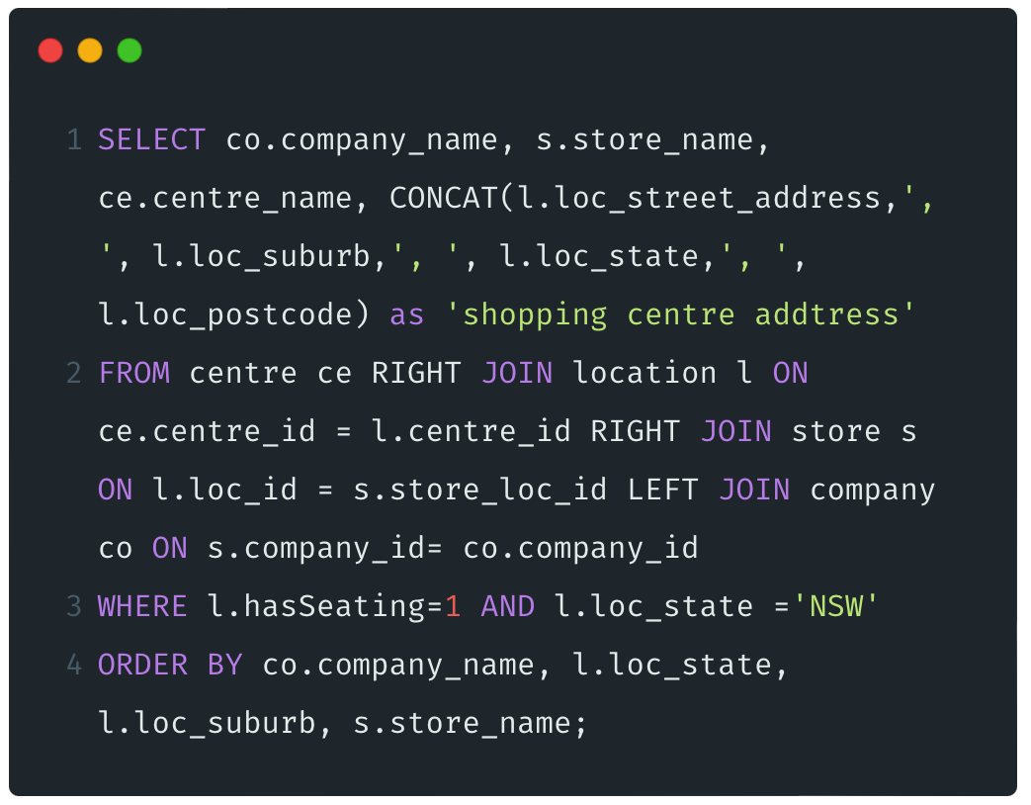
Data Analysis Question
3. List of shopping centre stores with sit-down service containing the company's name, store's name, shopping centre's name and full address, all the stores located within a shopping centre that offer sit-down service in a specific state (choose one). The list should be sorted alphabetically based on the company's name, store's state, suburb, and name.
location
Result
loc_id | centre_id | loc_street_address | loc_suburb | loc_state | loc_postcode | loc_size | hasSeating
1 | NULL | 6 Springfield Blvd | Springfield | TAS | 7533 | 138.00 | 1
2 | 2 | Shop 6 | Chadstone | VIC | 3113 | 54.00 | 0
centre
store
centre_id | centre_name
1 | Macquarie Shopping Centre
2 | Chatstone Shopping Centre
acq_store_id | c_store_id | store_name | store_loc_id | company_id | store_mgr_id
1 | TAS01 | Springfield Boulevard | 1 | 1 | 2
2 | VIC01 | Chadstone | 2 | 1 | NULL
3 | NULL | Springfield | 3 | 2 | 4
company
company_id | acq_com_id | company_name
1 | 1 | BigW
2 | 2 | Woolworth

Slide 7
Data Analysis Question
3. List of shopping centre stores with sit-down service containing the company's name, store's name, shopping centre's name and full address, all the stores located within a shopping centre that offer sit-down service in a specific state (choose one). The list should be sorted alphabetically based on the company's name, store's state, suburb, and name.
Result
Company Name | Store Name | Centre Name | Shopping Centre Address
KCF | Macquarie Park | Chatstone Shopping Centre | Shop DF2, Macquarie Park, NSW, 2341
Soul Origin | Parramatta | Westfield Parramatta | Shop A03, Parramatta, NSW, 2150
Woolworth | Parramatta | Westfield Homebush | Shop H07, Homebush, NSW, 2233
Woolworth | Macquarie Park | Macquarie Shopping Centre | Shop 132, Macquarie Park, NSW, 2113

Slide 8
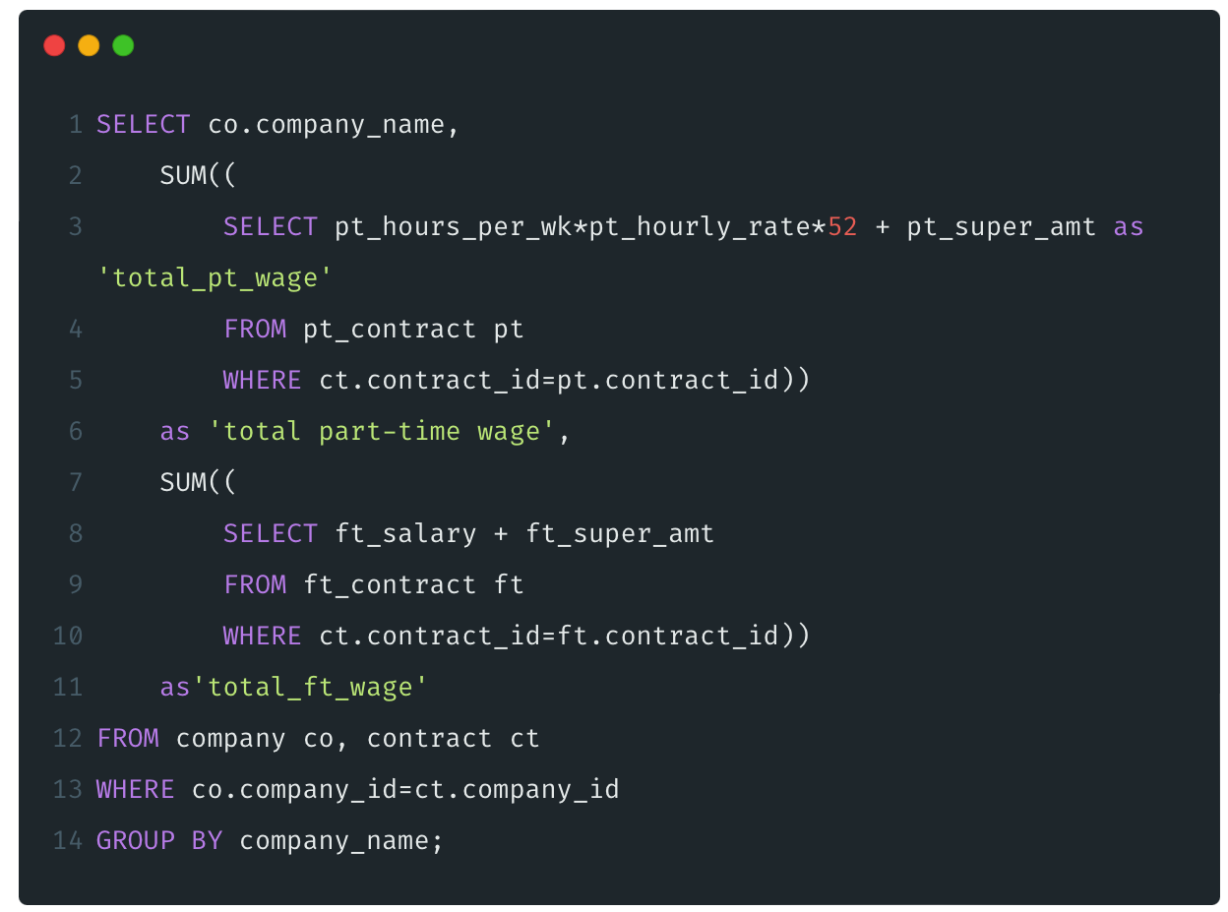
Data Analysis Question
4. Yearly total part-time and full-time staff wage overview containing the company's name and the total yearly wage of all staff. Part-time staff yearly wage can be calculated based on agreed minimum hours per week, the hourly rate plus the superannuation. There are 52 weeks in a year. Full-time staff yearly wage is the salary amount.
company
pt_contract
company_id | acq_com_id | company_name
1 | 1 | BigW
2 | 2 | Woolworth
contract_id | pt_hours_per_wk | pt_hourly_rate | pt_super_amt
2 | 20 | 22.31 | 1780.00
4 | 15 | 23.12 | 1383.73
contract
contract_id | staff_id | company_id | contract_start_date
1 | 1 | 1 | 2020-12-12
2 | 1 | 1 | 2021-10-01
ft_contract
contract_id | ft_salary | ft_super_amt
3 | 50000 | 5250.00
7 | 48500 | 5000.00

Slide 9
Data Analysis Question
4. Yearly total part-time and full-time staff wage overview containing the company's name and the total yearly wage of all staff. Part-time staff yearly wage can be calculated based on agreed minimum hours per week, the hourly rate plus the superannuation. There are 52 weeks in a year. Full-time staff yearly wage is the salary amount.
Result
Company Name | Total Part-Time Wage | Total Full-Time Wage
BigW | 80471.29 | 55250.00
Soul Origin |  | 56375.00
Woolworth |  | 53500.00

Slide 10
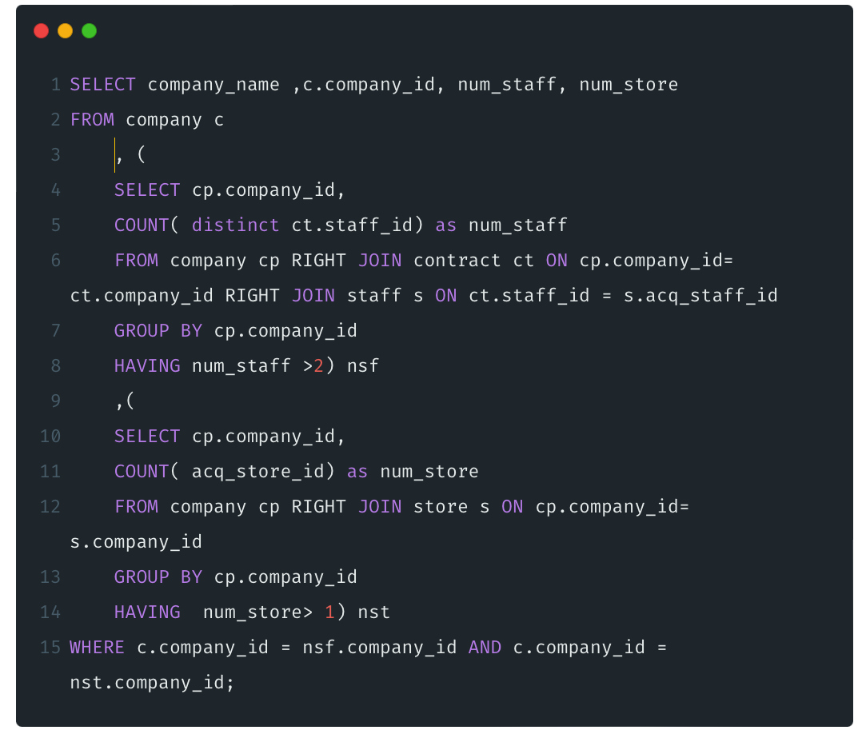
Data Analysis Question
5.Large acquisition overview containing the company's name, the number of stores, and the number of staff. A company is considered a large acquisition if it has more than 2 stores or more than 3 staff.
staff
acq_staff_id | c_staff_id | staff_family_name | staff_other_names | staff_phone | staff_street_address | staff_suburb | staff_state | staff_postcode | dob | email
1 | 001 | Freedman | Jeremy | 0477122226 | 11 Quimby St | Springfield | TAS | 7112 | 1982-03-12 | freedman@mymail.com.au
2 | 002 | Bellows | Rory B | 0412836227 | 62 Kearney St | Springfield | TAS | 7123 | 1986-07-21 | rbb@yahooooo.com.au
contract
store
contract_id | staff_id | company_id | contract_start_date
1 | 1 | 1 | 2020-12-12
2 | 1 | 1 | 2021-10-01
acq_store_id | c_store_id | store_name | store_loc_id | company_id | store_mgr_id
1 | TAS01 | Springfield Boulevard | 1 | 1 | 2
2 | VIC01 | Chadstone | 2 | 1 | NULL
3 | NULL | Springfield | 3 | 2 | 4
company
company_id | acq_com_id | company_name
1 | 1 | BigW
2 | 2 | Woolworth

Slide 11
Data Analysis Question
5.Large acquisition overview containing the company's name, the number of stores, and the number of staff. A company is considered a large acquisition if it has more than 2 stores or more than 3 staff.
nsf
Result
company_id | num_staff
1 | 3
Company Name | Company ID | Number of Staff | Number of Stores
BigW | 1 | 3 | 2
nst
company_id | num_store
1 | 2
2 | 3
3 | 2
4 | 2

Slide 12
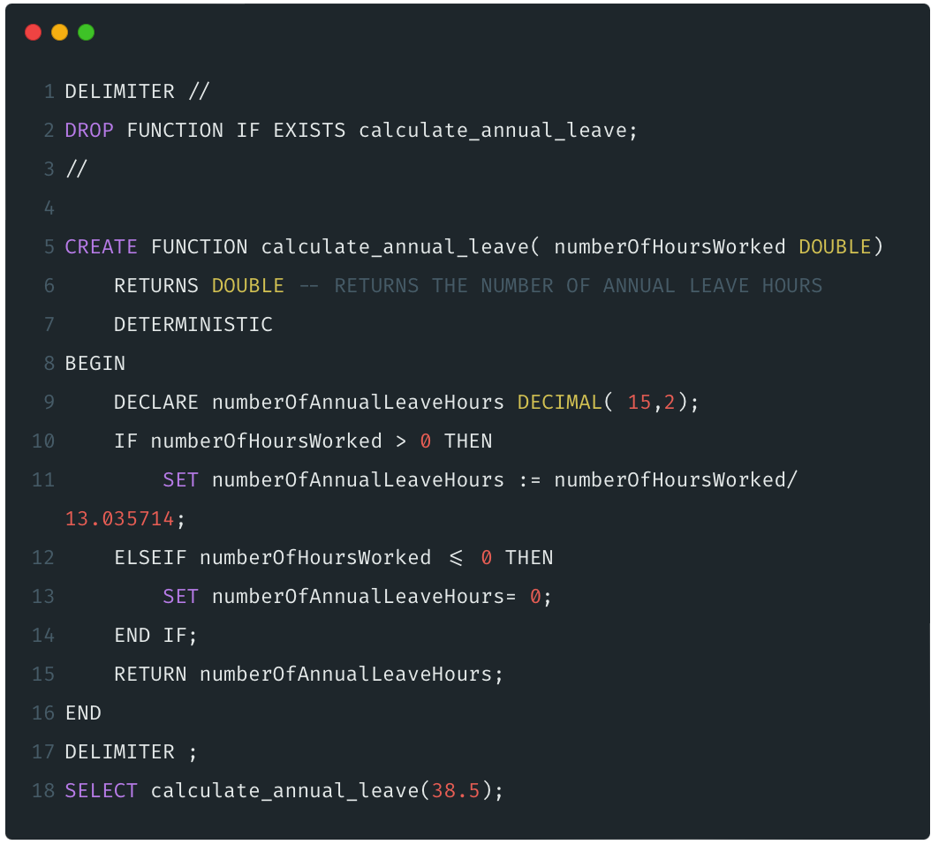
Function- Annual Leave Calculation - Handling Numbers and Rates (e.g., Full-Time and Part-Time Rates)
Calculate the amount of annual leave an individual should receive based on the hours they have worked.
A person working a full year is entitled to 4 weeks of annual leave.
The function operates only with positive numbers.
If a negative number of hours worked is input, the output will be 0 annual leave hours.

