Slide 1
Quality assessment of digital image correlation (DIC) speckle patterns
MATLAB App Documentation
Department of Aeronautics, Imperial College London

Slide 2
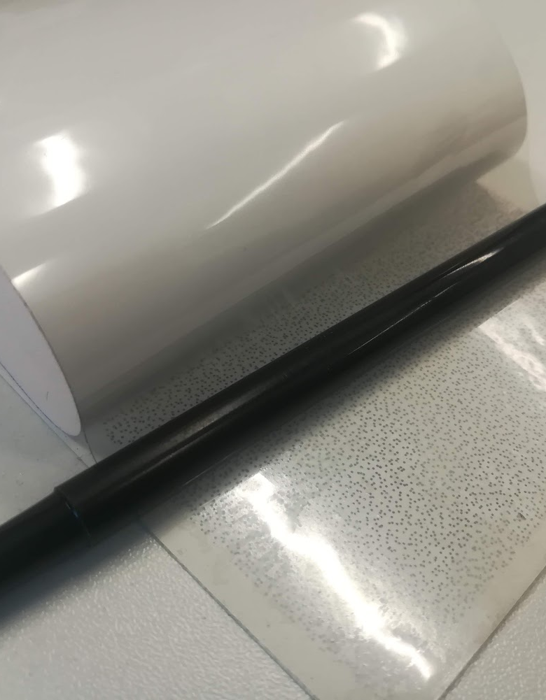
Outline
Motivation
Explanation of different quality metrics
Mean Intensity Gradient (MIG)
Speckle Size
Shannon Entropy
Conclusion

Slide 3
Motivation
A combined, open-source application that can be used by researchers in the field to quantitatively assess speckle patterns applied to bodies.
Can upload an image file of speckle pattern of your choice to run.
Different metrics used to give a holistic perspective on the quality of the speckle pattern.
Other features for added flexibility, such as enabling user to crop speckle pattern image.
Error message functionality (e.g., if a file is not selected before the program is run).

Slide 4


Mean Intensity Gradient (MIG)
- Preferred values: > 20-25 (Pan et al. 2010)
$$δ_{f}=\sum_{i=1}^{W}{\sum_{j=1}^{H}{\frac{\left|∇f\left(x_{ij}\right)\right|}{W×H}}}$$
$\left|∇f\left(x_{ij}\right)\right|=\sqrt{f_{x}{\left(x_{ij}\right)}^{2}+f_{y}{\left(x_{ij}\right)}^{2}}$
1. Pan B, Lu Z, Xie H. Mean intensity gradient: An effective global parameter for quality assessment of the speckle patterns used in digital image correlation. Optics and Lasers in Engineering. 2010 Apr;48(4):469–77.
‌

Slide 5
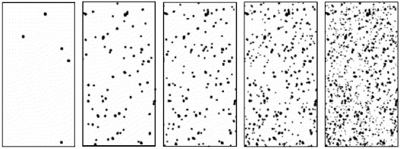
Speckle Size
Threshold value is calculated using Otsu’s algorithm for greyscale images
Recommended values of 3-7 pixels (Sutton et al. 2008)
Fig 1. How adjusting threshold intensity affects binary speckle pattern
2. Sutton MA, Jean-José Orteu, Schreier H, Springerlink (Online Service. Image Correlation for Shape, Motion and Deformation Measurements: Basic Concepts,Theory and Applications. New York, Ny: Springer Us; 2009.
Notes:
10/01/2020

Slide 6


Shannon Entropy
Measures expected value of grey-value probability distribution.
Sum of probability of an intensity value p multiplied by its logarithm.
Intensities range from 0 to 255 for an 8-bit greyscale image ($β=8$ below).
Preferred values: > 6 (Liu et al. 2015)
3. Liu, X et al. (2015). Quality assessment of speckle patterns for digital image correlation by Shannon entropy. Optik - International Journal for Light and Electron Optics.

Slide 7
Thank you!
Dr Gustavo Quino
g.quino-quispe@imperial.ac.uk
me@gquino.com

Slide 8
Documentation of Code Improvement and Validation
By Joshua Bobin

Slide 9
Literature-Code Comparison (Unresized)

Slide 10
Literature-Code Comparison (Resized)

Slide 11
Speckle Pattern A (Threshold = 165)

Slide 12
Speckle Pattern A: Speckle Radius vs Threshold

Slide 13
Speckle Pattern B: Speckle Radius vs Threshold

Slide 14
Speckle Pattern C: Speckle Radius vs Threshold

Slide 15
Compare with grey-level distributions!
Note the peak of frequency around the 180-210 grey-value range…

Slide 16
Speckle B Grey Level Distribution

Slide 17
Speckle C Grey Level Distribution

