Slide 1
Nutrition.ly
Giving the World One Less Thing to Worry About

Slide 2
What is a Food Drought?
An area that has low access to fresh groceries
Usually afflicts lower-income neighborhoods
Long travel distances/times to get food

Slide 3
What is Nutrition.ly
Visualizes data illustrating prominence of food droughts
Informs users about those that are afflicted
Allows users to donate money
Money is used to open and maintain food banks

Slide 4
Marketability
The general public would be the users of the app
The clients we would market the app to would be humanitarian organizations like the Red-Cross
Raise awareness on Food Drought and allow people to help this issue
Startup for creating Food Banks

Slide 5

Technologies Used

Slide 6

Technologies Used

Slide 7


Technologies Used

Slide 8

Technologies Used

Slide 9

Technologies Used

Slide 10

Technologies Used

Slide 11

Technologies Used

Slide 12

Technologies Used

Slide 13

Technologies Used

Slide 14

Technologies Used

Slide 15
Data Sources

Slide 16

Data Sources

Slide 17
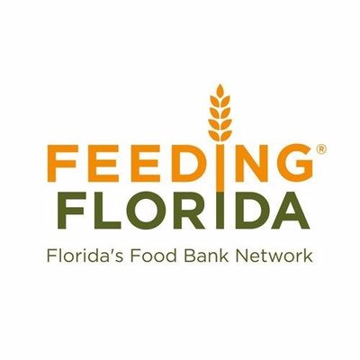
Data Sources

Slide 18

Data Sources

Slide 19
The Web Application

Slide 20
The Web Application

Slide 21

The Web Application

Slide 22
The Web Application

Slide 23
Issues
Connecting Angular.js to Flask
Extracting meaningful data
Inability to embed animated sliders
Connecting PayPal to Firebase

Slide 24
Future Work
Have profiles to track donations
Scale beyond state of Florida
More robust donation
Live feed of donations per county
Provide more resources to support the cause
Ex: Providing locations of nearby food banks to volunteer at

Slide 25
Demonstration

