Slide 1
Insurance profiling
Valknut solutions

Slide 2
Recess sprint details
Compilation of Social media parameters research documentation, as per client’s request
Meeting with Telesure (our client’s client)
Telesure made major changes to the scope of our project which led to a slightly different approach
Sprint planning meeting to discuss project changes

Slide 3
Collaborative pair programming for 5 days as a team in one location
Weight estimation of sprint backlog
Follow up meeting after completion of previous sprint and to receive next sprint backlog
Multiple stand up meetings per day

Slide 4
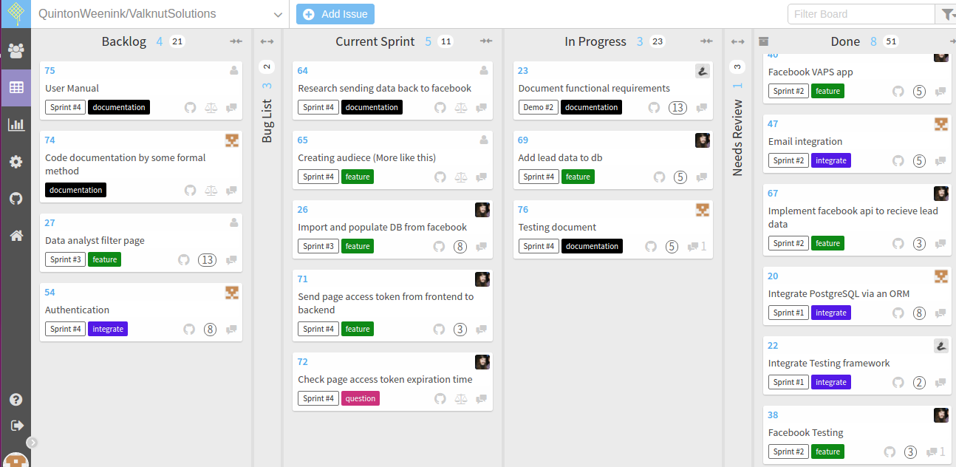

Slide 5
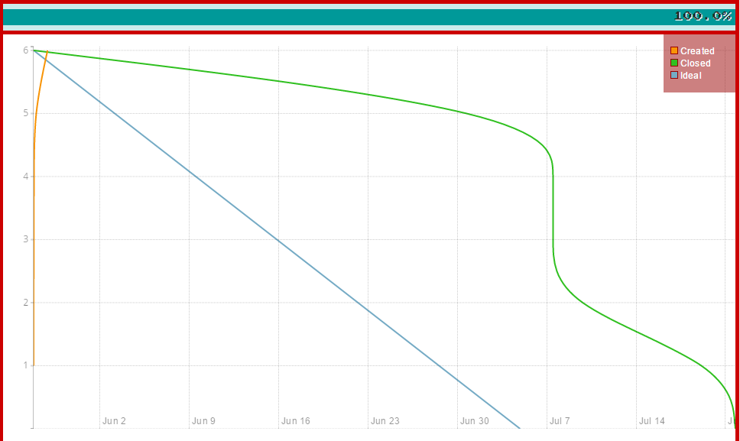
Sprint #1

Slide 6
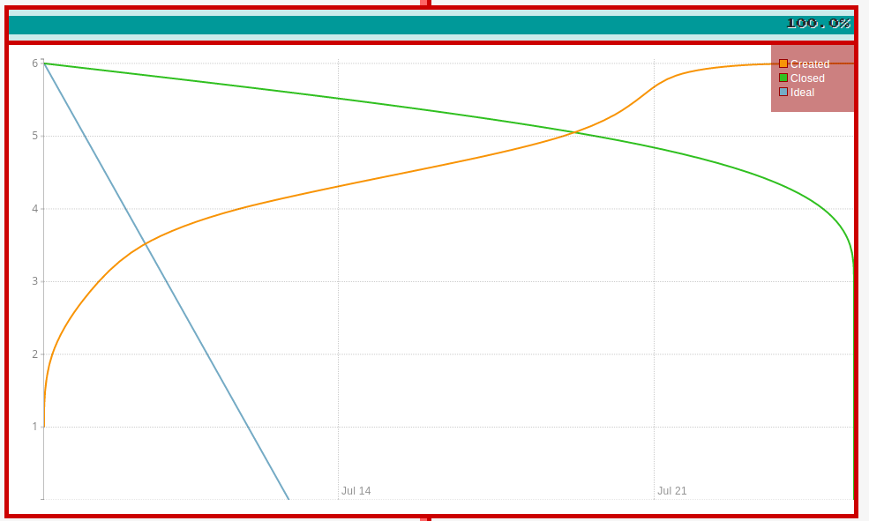
Sprint #2

Slide 7
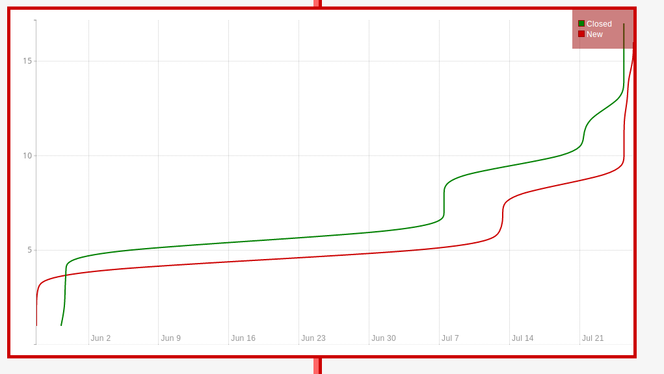
60 day summary

Slide 8
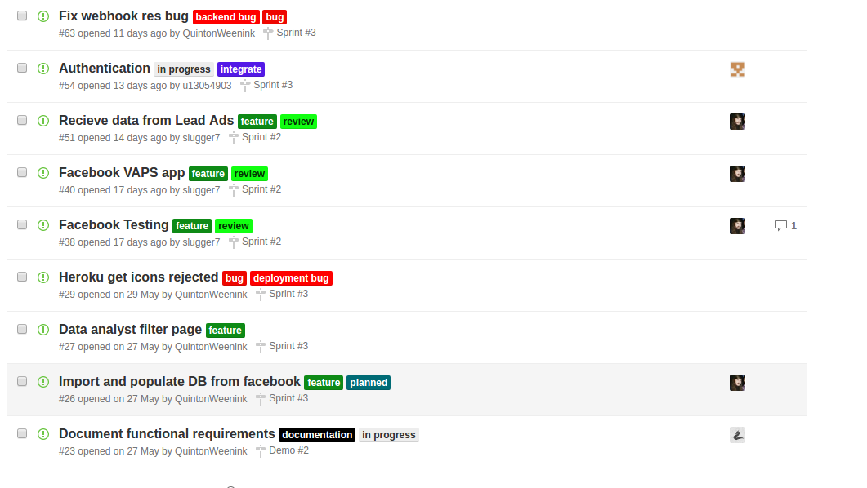

Slide 9
List of features added
Database integration via Sequelize using Postgresql including deployment and development configurations
Sign in with Facebook to get permissions to manage the analyst’s Facebook pages linked with the specific advertisment
This data is saved in our Pages model, thereafter Facebook sends through the Lead ad id to initialize the Advertisement.
A user will fill in the Lead ad and a lead id will be sent through to our api. A call to Facebook’s graph api will be called to get the filled in form data and saved in our User model

Slide 10
Implementation of RESTful API for front-end Angular and backend API calls
Integration of the testing framework Mocha with some route functionality tests
Implementation of email functionality
Deployment to live server hosted on the Heroku platform
Version control branching
Update of Functional requirements document with uses case, domain model and version changes of document

