Slide 1
Yappi !
Open Platform for
Real Time
Data Distribution

Slide 2
Yappi !
“Yappi ! is a platform for distribution of real time data”
PLATFORM
DISTRIBUTION
REAL TIME DATA

Slide 3
Yappi !
“Yappi ! is a platform for distribution of real time data”
PLATFORM
DISTRIBUTION
REAL TIME DATA

Slide 4

Yappi ! is a Platform
<DEFINITON >
Standing surface that can support other things and is used to give better visibility of stability
-- Wikipedia --
</DEFINITION>

Slide 5
Yappi !
“Yappi ! is a platform for
distribution of real time data”
PLATFORM
DISTRIBUTION
REAL TIME DATA

Slide 6

Yappi ! is for distribution
<QUOTE>
“The future is
here. It's just not
widely distributed yet”
William Gibson (1948 - )
</QUOTE>

Slide 7
Yappi !
“Yappi ! is a platform for
distribution of real time data”
PLATFORM
DISTRIBUTION
REAL TIME DATA

Slide 8

Yappi ! is for Real Time Data
<QUOTE>
Things are more like they
are now than they ever
were before.
Dwight D. Eisenhower
(1890 - 1969)
</QUOTE>

Slide 9
Yappi !
You now know what Yappi ! is
Next:
what you can do with Yappi !

Slide 10
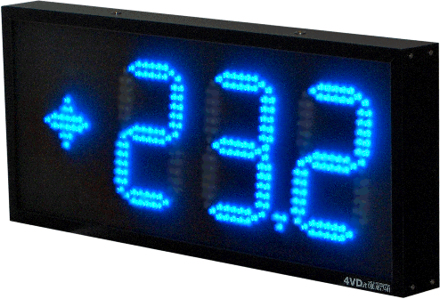
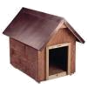


What can Yappi do ?
Distribute real time content example:
Send current temperature at my place
to many peers

Slide 11

What can Yappi do ?
Distribute real time content example:
Current results of a football leage

Slide 12
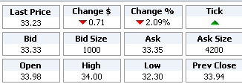
What can Yappi do ?
Yappi Inc. Stock Price
Distribute real time content example:
Current results of a football leage

Slide 13
Yappi Participants
Yappi! Network
Yappi! Contributor
Yappi! Consumer

Slide 14
Yappi Contributors
Yappi Contributors are the nodes that originate content.
Strictly speaking there could be more than one contributor for the same kind of data. For example, there could be 2 different people updating on real time the results of the English football leage and injecting the data into the network.
A Yappi contributor can be as well a Yappi! consumer
A Yappi! Contributor

Slide 15
Yappi Consumer
Yappi Consumers are the nodes that receive content
A Yappi consumer can as well be a Yappi contributor
Yappi Consumers redistribute the content to other peers
Yappi consumers receive content from other consumers or directly from the contributor
A Yappi! Consumer

Slide 16

Yappi Data
Yappi ! Data is the representation of a real time event using XML format
Data Types provide models to represent events of the same kind
example: Temperature, Stock price
Data Entities are specific applications of the type to a given context
example: Temperature in Madrid, IBM stock price
Data Ticks are once in time value of a given context, usually current value of a data entity
example: Temperature in Madrid NOW

Slide 17
Yappi Data Model
Data Type
Temperatures
Data Entity
Temperature in Madrid
Temperature in Geneva
Data Ticks
3 April 2006 10:00:01 10C
3 April 2006 10:19:12 11C
3 April 2006 10:41:41 12C
3 April 2006 11:06:14 13C
3 April 2006 11:22:32 14C
… ...
3 April 2006 09:10:14 08C
3 April 2006 09:34:02 09C
3 April 2006 10:01:13 10C
3 April 2006 10:46:42 11C
3 April 2006 11:02:51 12C
… ...

Slide 18


Yappi Entity Code
YEC
YEC: A unique identifier for a data entity.
example: MADRID.TEMP
Temperature in Madrid.
It is made of 2 elements:
  Context Identifier: MADRID
  Data Type: TEMP

Slide 19
Yappi Rules !
It's not enough to create magic. You have to create a price for magic, too. You have to create rules.
Eric A. Burns, Gossamer Commons, 06-15-05
Anybody can Contribute data for the network
Anybody can Register new data types
If you consume data, you redistribute it
If you contribute data, it should be validated
If you consume data, you validate it
Data that fails validation is not redistributed
Consumers can simultaneously receive data from several peers
If you want to distribute data, you have to declare it
If you want to consume data, you must know its YEC

Slide 20
Yappi Rules !
It's not enough to create magic. You have to create a price for magic, too. You have to create rules.
Eric A. Burns, Gossamer Commons, 06-15-05
Anybody can Contribute data for the network
Anybody can Register new data types
If you consume data, you redistribute it
If you contribute data, it should be validated
If you consume data, you validate it
Data that fails validation is not redistributed
Consumers can consume data from several peers
If you want to distribute data, you have to declare it
If you want to consume data, you must know its YEC

Slide 21
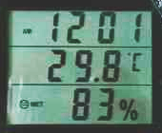
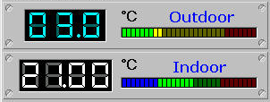
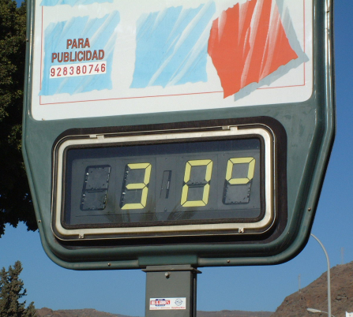
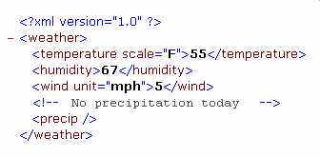
Yappi Data Types
Data Types provide a model to represent events of the same kind:
Examples:
  Temperature
  Football Score
  Stock Price

Slide 22
Yappi Data Types
Data Entities are specific applications of the event to a given context:
Temperature in Madrid
Score of Barcelona FC – Manchester
* Stock Price of Yappi Ltd.

Slide 23
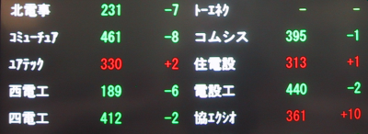
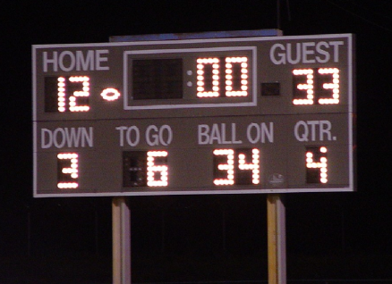
Yappi Data Types

