Slide 1
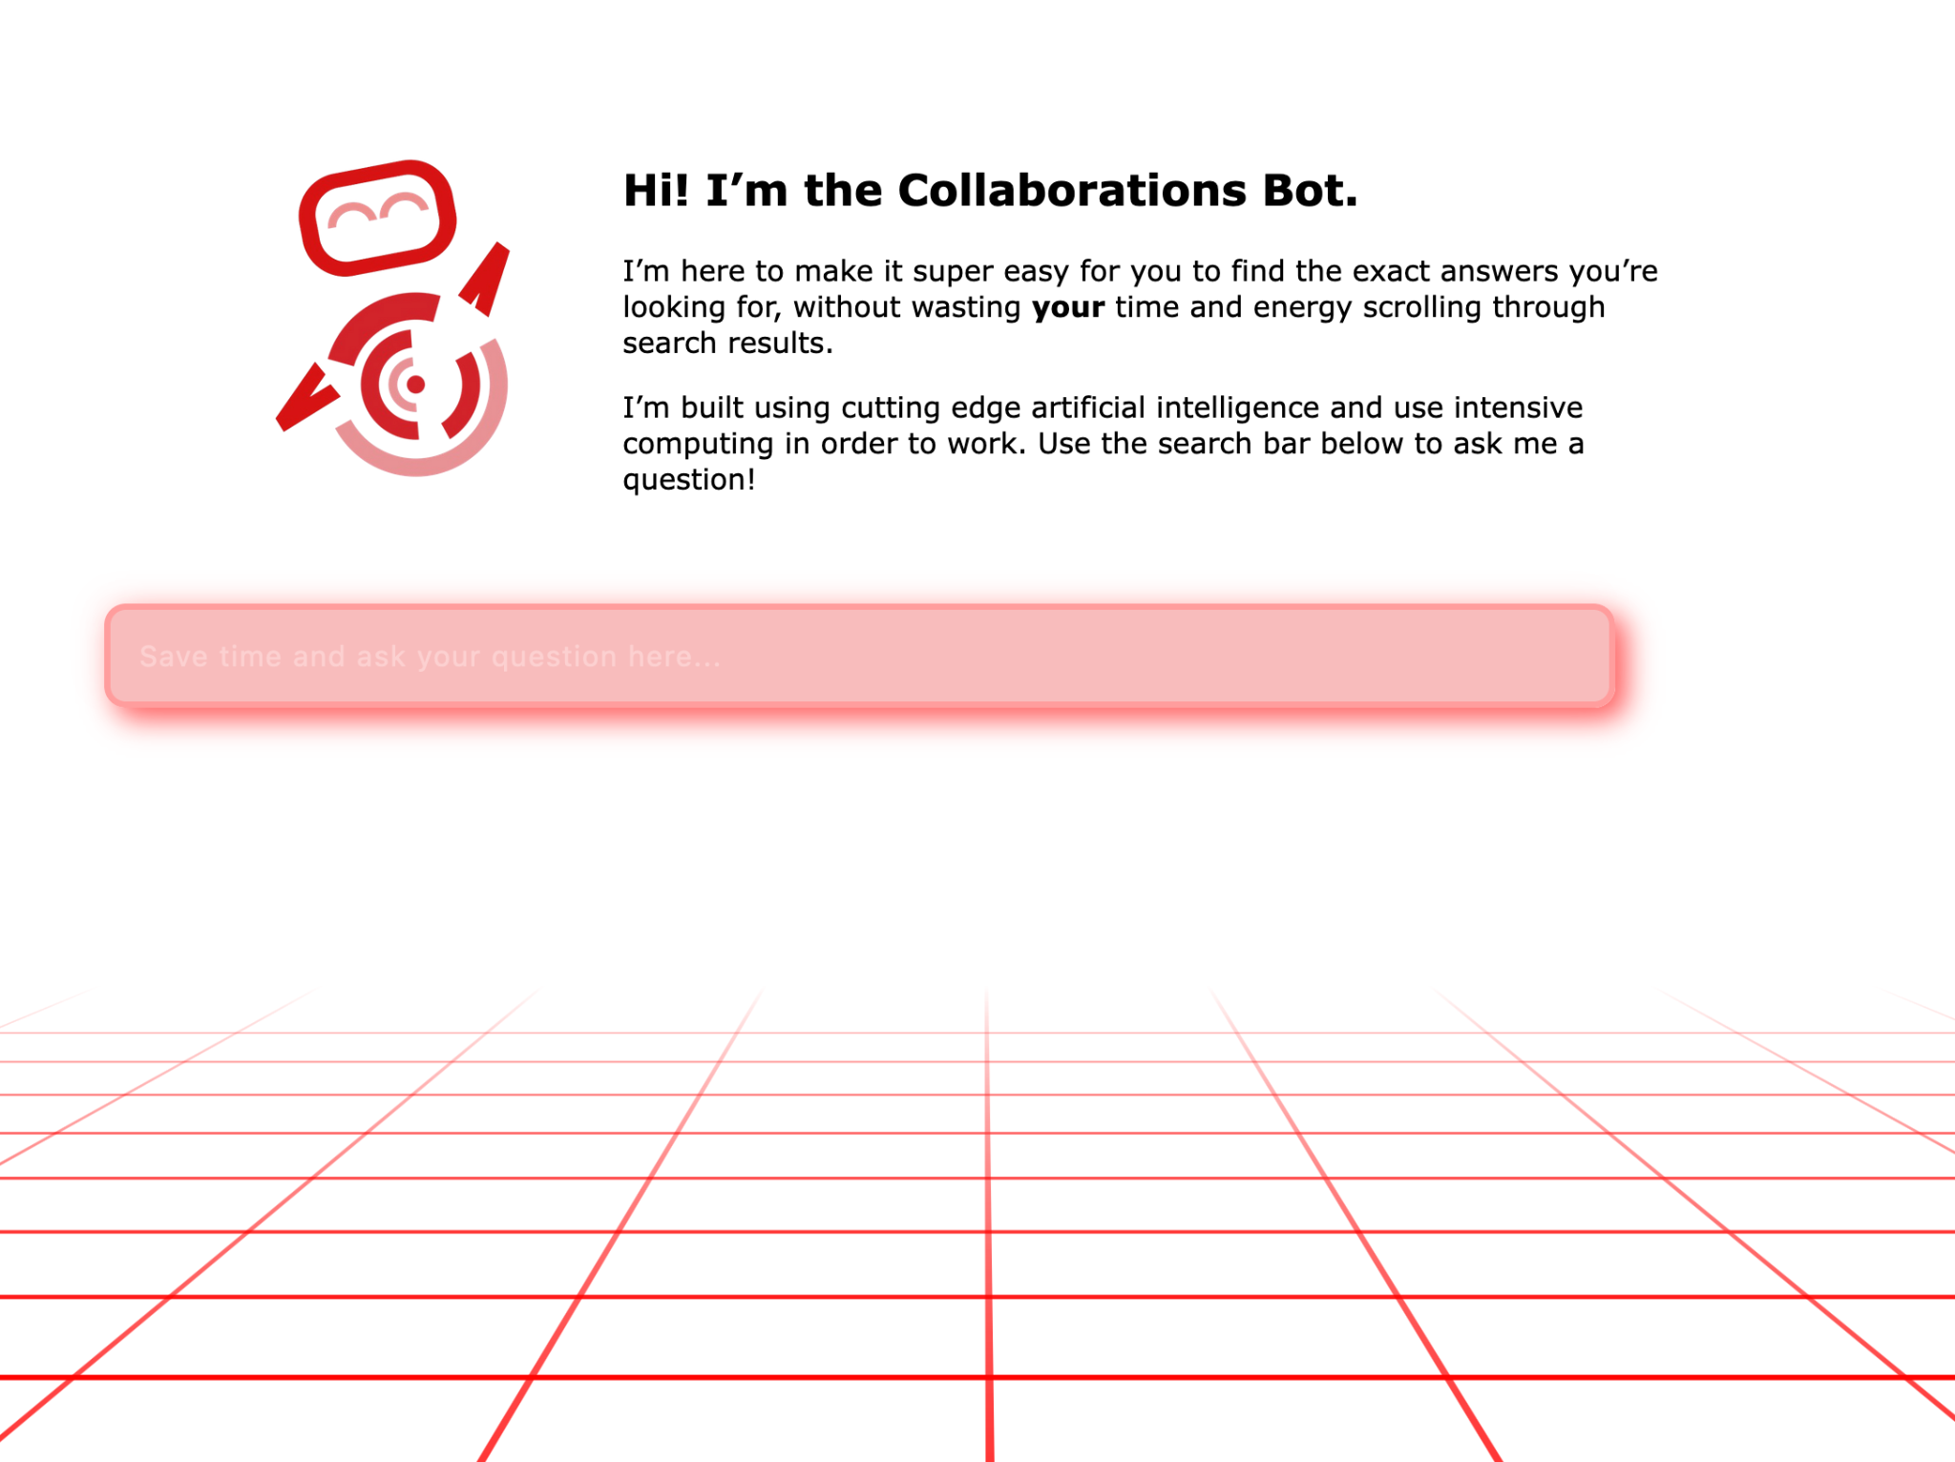

Run! For Runtime
(powered by Al Gore-rithm)
https://github.com/quirksahern/Runtime

Slide 2
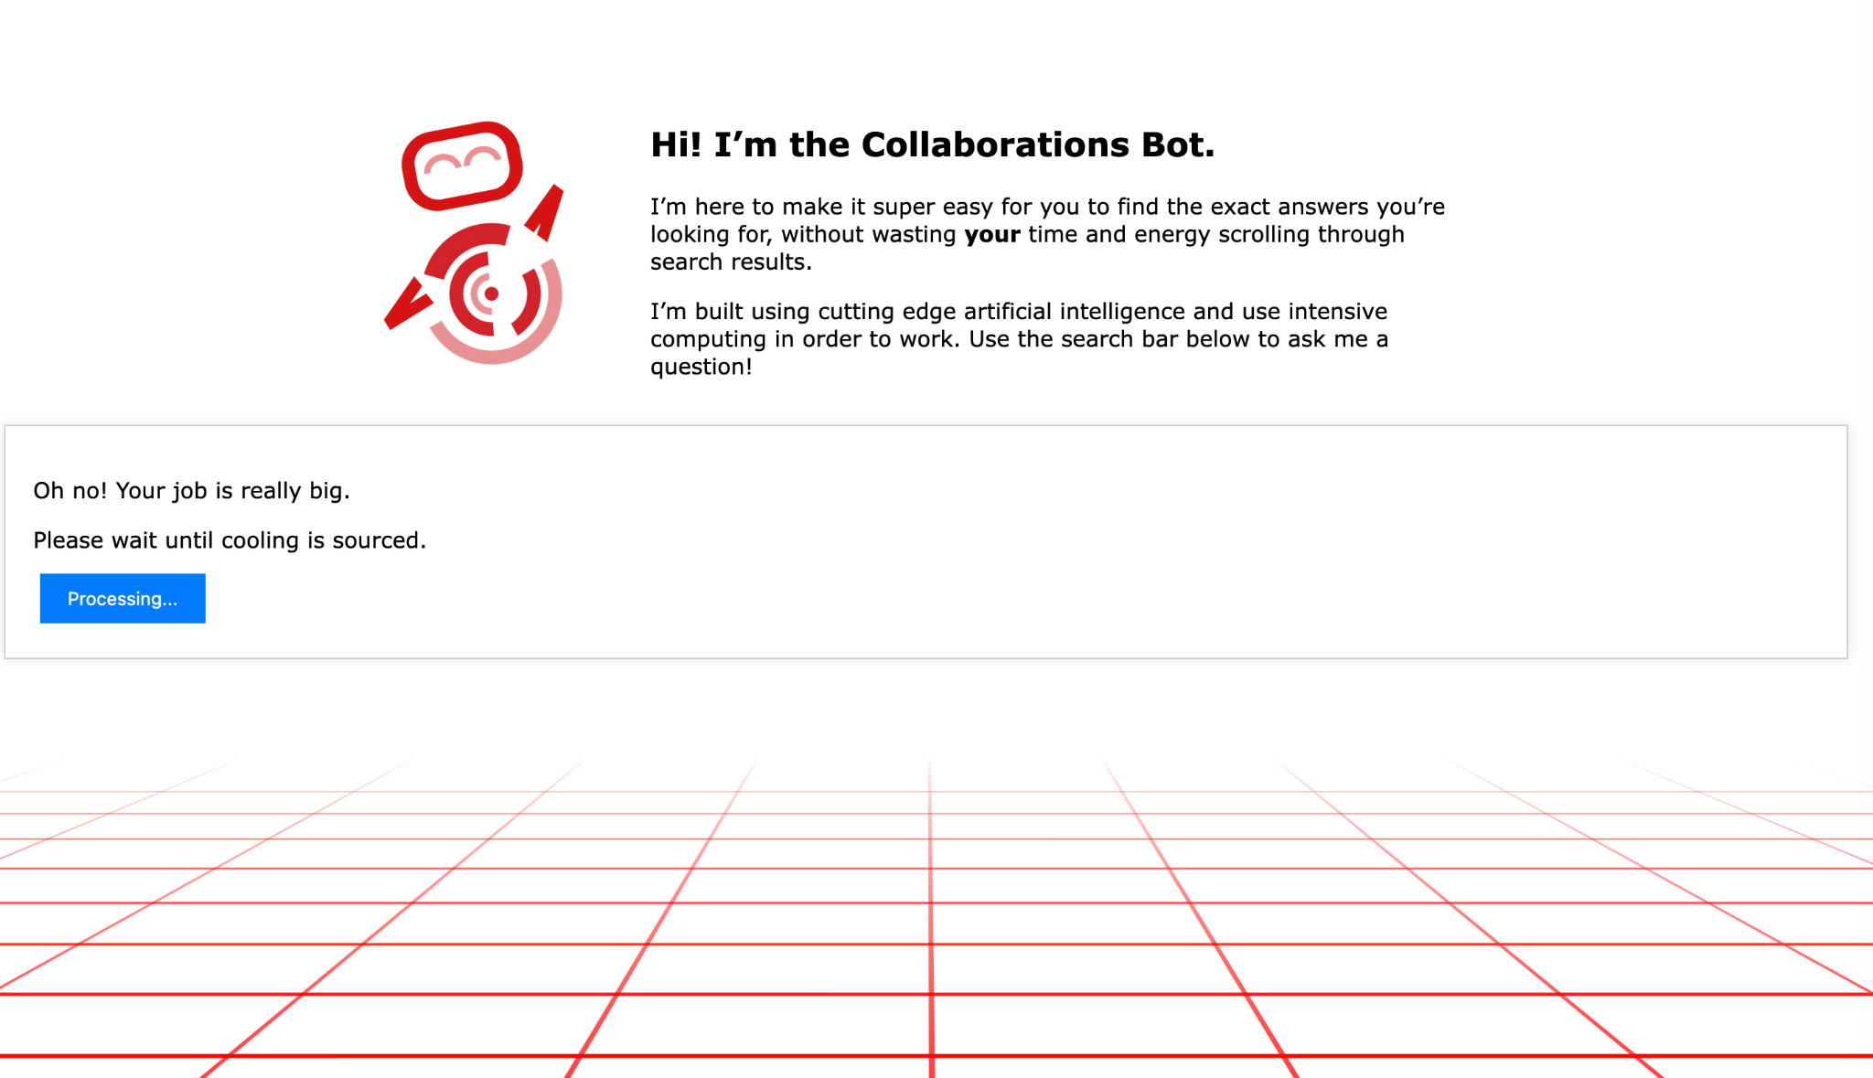

Slide 3

“The researcher is running a big and important job. The data centre is running hot. It needs water for cooling. Bring the researcher ten vessels of water pronto!
Run! For Runtime
(powered by Al Gore-rithm)
https://github.com/quirksahern/Runtime

Slide 4
Run! For Runtime
(powered by Al Gore-rithm)
https://github.com/quirksahern/Runtime

Slide 5
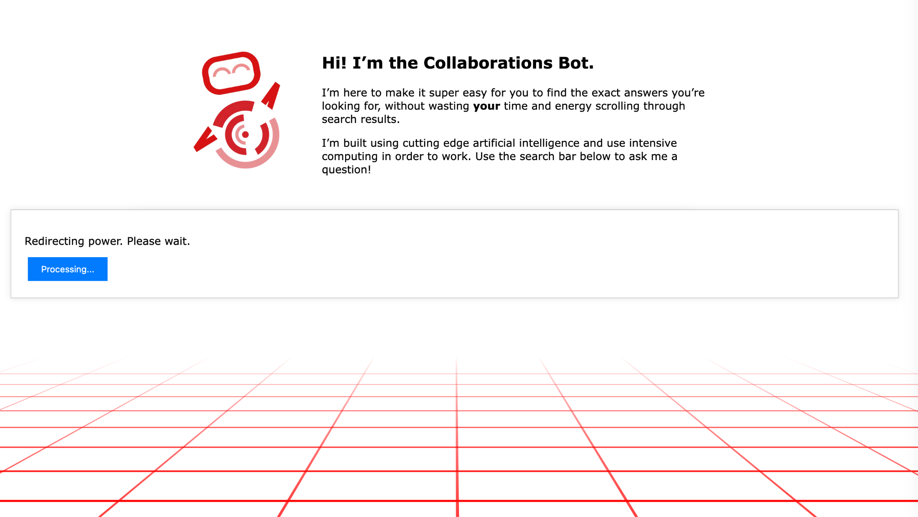

Slide 6

“This job needs lots of power. Given that it is big and important electrical power needs to be redirected. All non-essential power needs to be turned off. Please turn off the lights, close laptops, and stop charging phones. Go!
Run! For Runtime
(powered by Al Gore-rithm)
https://github.com/quirksahern/Runtime

Slide 7
Run! For Runtime
(powered by Al Gore-rithm)
https://github.com/quirksahern/Runtime

Slide 8


Slide 9
Run! For Runtime (powered by Al Gore-rithm)
Why?
"Run! For Runtime" explores the disconnect between people who compute things and the resources (materials, humans, energetics, or water) used to enable that compute.
There are three roles: the Researcher (who runs the job), Gatherers (who enable the job), and the Facilitator (who checks the evidence matches the resources).
The game uses bait-and-switch mechanics, embodied interactions, and snark/sark to educate communities of users.
https://github.com/quirksahern/Runtime
Notes:
Samantha

Slide 10
Run! For Runtime (powered by Al Gore-rithm)
Who is this for?
Educators (for whom this needs a better name!) + RSEs + Anyone who cares about making visible the (largely) invisible impacts of compute.
Full facilitator instructions are ready to go! It is focused on creating dissonance between the researcher and the gatherers to represent the disconnect between the interface presented to users and the things that running computation has an impact on.
https://github.com/quirksahern/Runtime
Notes:
Samantha

Slide 11
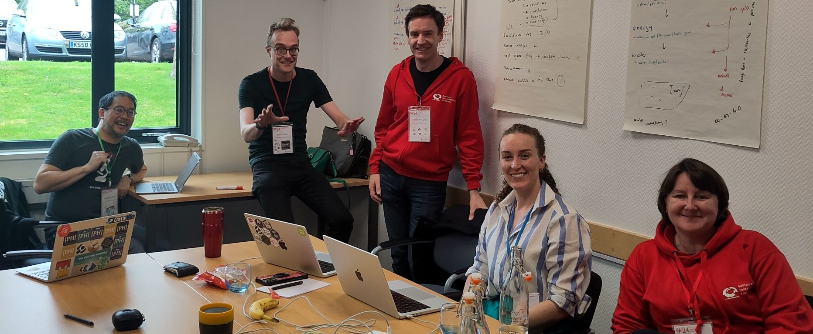
Run! For Runtime (powered by Al Gore-rithm)
How did we do it?
Express JS
HackMD
Github
VS Code
Figma
Us!
“They did what they were told”
https://github.com/quirksahern/Runtime
Notes:
Sophia

Slide 12
Run! For Runtime (powered by Al Gore-rithm)
Next steps!
Fully connecting researcher view with the gatherer view.
Optional pathways, which demonstrate different types of compute job, and/or different forms of energy (dis)proportionality.
Possible development options (e.g. VR/AR, physical card based).
Stronger connection to the literature -- pedagogical connection
Multiplayer options
Wearables integration
https://github.com/quirksahern/Runtime
Notes:
Patrick

Slide 13
“Thanks all! Give them all the prizes!
Run! For Runtime
(powered by Al Gore-rithm)
https://github.com/quirksahern/Runtime

Slide 14
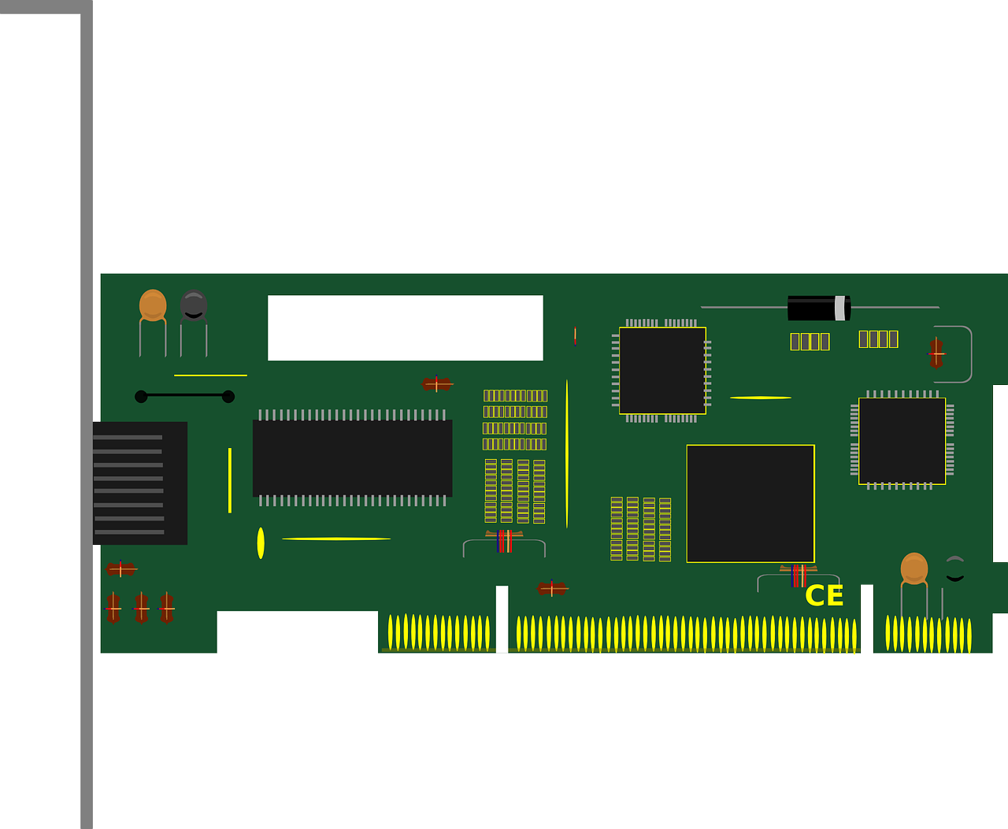
“Right, we need to manufacture a new GPU because this researcher doesn't know how to optimise their code. Gather together items containing the following: electronic circuitry, metal, plastic, and organise them into the shape of a square.
Run! For Runtime
(powered by Al Gore-rithm)

Slide 15
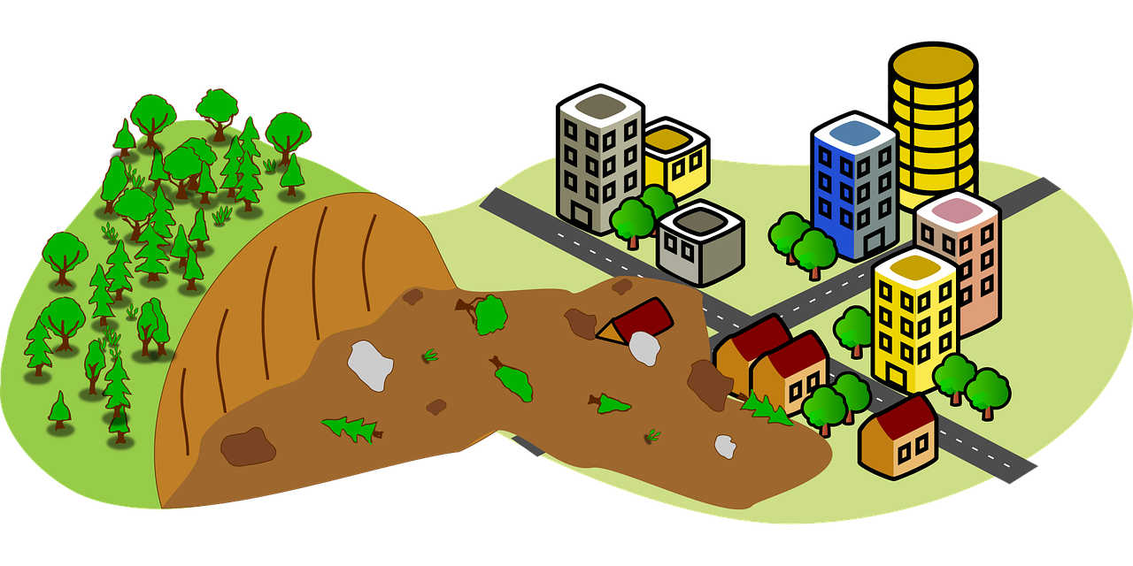
Run! For Runtime
(powered by Al Gore-rithm)
“There are now so many big computational jobs that the dream of a circular economy is impossible to realise. Pristine ecologies far far away from the researcher will need to be destroyed to make room for e-waste pollution. So, all those lovely resources you assembled, now you need to find a space the researcher cannot see (or better still, is just out of their sight but they'd rather not make the effort to notice) and put all of those resources in a disorderly heap.

Slide 16
“The researcher needs more compute. This means that people need to be put to work to do all the mundane things that underpin machine learning. So, those who are able, please begin to jog on the spot.
Run! For Runtime
(powered by Al Gore-rithm)

