Slide 1

SYNCHRONIZATION TOOLS

Slide 2
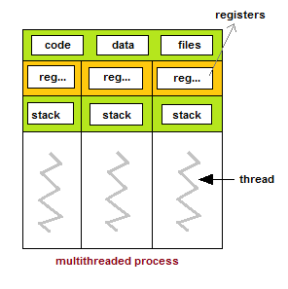
- Thread : Shared memory space

