Slide 1

SYNCHRONIZATION TOOLS

Slide 2



Introduction
Processes are carried out as 2 types:
Independent process
Execution of one process does not affects the execution of other processes
Cooperative process
Execution of one process affects the execution of other processes

Slide 3
Race Condition
Process 1
Process 2
Object
Object: variable, shared memory

Slide 4
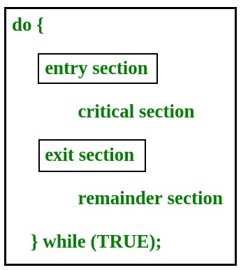
Critical Section
Definition: a code segment that can be accessed by only one process at a time
Problem: Critical section contains shared memory and variables, need to be synchronized
Solution: Any solution to the critical section problem must satisfy three requirements:
Multual Exclusion
Progress
Bounded waiting

Slide 5
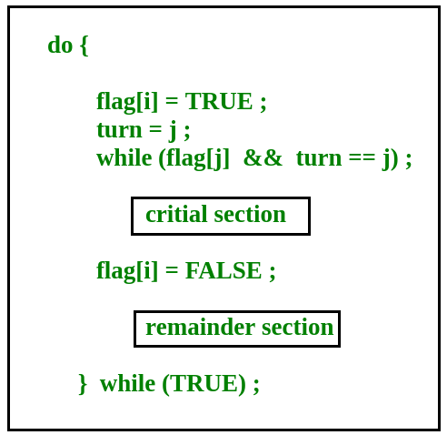
Peterson’s Solution
Peterson’s Solution is a classical software based solution to the critical section problem
In Peterson’s solution, we have two shared variables:
Flat[i]: initialized to False, no one is interesting in entering the critical section
Turn: The process whose is to turn to enter the critical section
Peterson’s Solution preserves all three conditions

Slide 6
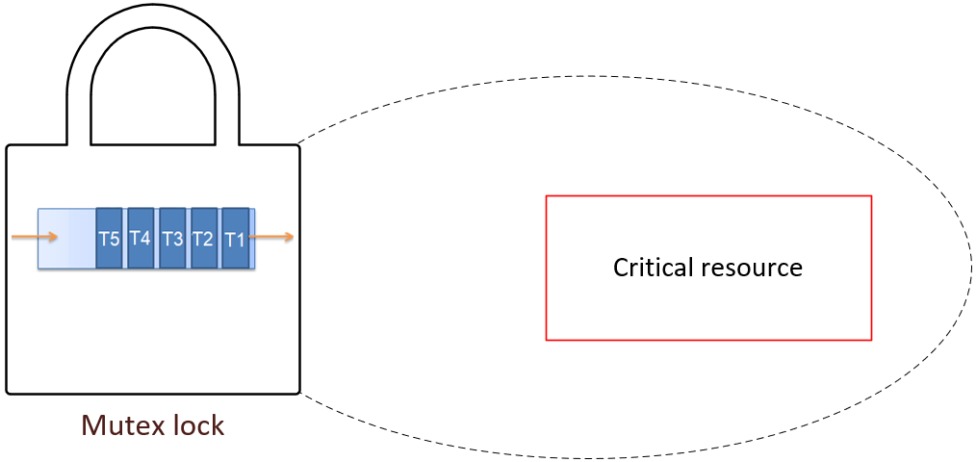
Mutex Locks
A shared lock variable which can take only 2 values, 0 and 1:
0 : Unlock
1 : Lock
The main idea of Mutex Locks:
Lock = 0 : Process can access, lock critical section
Lock = 1 : Access denied
Protect a critical section by first acquire() a lock then release() the lock
lock
Mutual exclusion and progress are preserved but bounded waiting cannot be preserved.

Slide 7
Semaphores
Accessed only through two operations wait() and signal()
Binary semaphore
Counting semaphore
Only be either 0 or 1.
All the processes can share the same mutex semaphore that is initialized to 1
A process has to wait until the lock becomes 0
=> The process can make the mutex semaphore 1 and start its critical section
Any value and are not restricted over a certain domain
Ased to control access to a resource that has a limitation on the number of simultaneous accesses
If values > 1 => available to access, after access, decrease value to 1

Slide 8


