Slide 1

Chapter 7
Wireless and
Mobile Networks
A note on the use of these PowerPoint slides:
We’re making these slides freely available to all (faculty, students, readers). They’re in PowerPoint form so you see the animations; and can add, modify, and delete slides (including this one) and slide content to suit your needs. They obviously represent a lot of work on our part. In return for use, we only ask the following:
If you use these slides (e.g., in a class) that you mention their source (after all, we’d like people to use our book!)
If you post any slides on a www site, that you note that they are adapted from (or perhaps identical to) our slides, and note our copyright of this material.
For a revision history, see the slide note for this page.
Thanks and enjoy! JFK/KWR
All material copyright 1996-2020
J.F Kurose and K.W. Ross, All Rights Reserved
Computer Networking: A Top-Down Approach
8th edition
Jim Kurose, Keith Ross
Pearson, 2020
Notes:
Version History
8.0 (May 2020)
All slides reformatted for 16:9 aspect ratio
All slides updated to 8th edition material
Use of Calibri font, rather that Gill Sans MT
Add LOTS more animation throughout
lighter header font
4G/5G material completely updated; older 2/2.5/3G removed

Slide 2
Wireless and Mobile Networks: context
more wireless (mobile) phone subscribers than fixed (wired) phone subscribers (10-to-1 in 2019)!
more mobile-broadband-connected devices than fixed-broadband-connected devices devices (5-1 in 2019)!
  4G/5G cellular networks now embracing Internet protocol stack, including SDN
two important (but different) challenges
  wireless: communication over wireless link
  mobility: handling the mobile user who changes point of attachment to network

Slide 3

Chapter 7 outline
Introduction
Wireless
Wireless Links and network characteristics
WiFi: 802.11 wireless LANs
Cellular networks: 4G and 5G
Mobility
Mobility management: principles
Mobility management: practice
  4G/5G networks
  Mobile IP
Mobility: impact on higher-layer protocols

Slide 4



















Elements of a wireless network
wired network
infrastructure

Slide 5





Elements of a wireless network
wireless hosts
laptop, smartphone, IoT
run applications
may be stationary (non-mobile) or mobile
  wireless does not always mean mobility!
wired network
infrastructure

Slide 6

Elements of a wireless network
base station
typically connected to wired network
relay - responsible for sending packets between wired network and wireless host(s) in its “area”
  e.g., cell towers, 802.11 access points
wired network
infrastructure

Slide 7
Elements of a wireless network
wireless link
typically used to connect mobile(s) to base station, also used as backbone link
multiple access protocol coordinates link access
various transmission rates and distances, frequency bands
wired network
infrastructure

Slide 8
Characteristics of selected wireless links
14 Gbps
802.11ax
10 Gbps
5G
3.5 Gbps
802.11ac
802.11 af,ah
600 Mbps
802.11n
4G LTE
54 Mbps
802.11g
11 Mbps
802.11b
2 Mbps
Bluetooth
Indoor
Outdoor
Midrange
outdoor
Long range
outdoor
10-30m
50-200m
200m-4Km
4Km-15Km

Slide 9
Elements of a wireless network
infrastructure mode
base station connects mobiles into wired network
handoff: mobile changes base station providing connection into wired network
wired network
infrastructure

Slide 10
Elements of a wireless network
ad hoc mode
no base stations
nodes can only transmit to other nodes within link coverage
nodes organize themselves into a network: route among themselves

Slide 11
Wireless network taxonomy
single hop
multiple hops
host connects to base station (WiFi, cellular) which connects to larger Internet
host may have to relay through several wireless nodes to connect to larger
Internet: mesh net
infrastructure
(e.g., APs)
no base station, no connection to larger Internet (Bluetooth, ad hoc nets)
no base station, no connection to larger Internet. May have to relay to reach other a given wireless node MANET, VANET
no
infrastructure

Slide 12
Chapter 7 outline
Introduction
Wireless
Wireless links and network characteristics
WiFi: 802.11 wireless LANs
Cellular networks: 4G and 5G
Mobility
Mobility management: principles
Mobility management: practice
  4G/5G networks
  Mobile IP
Mobility: impact on higher-layer protocols

Slide 13
Wireless link characteristics (1)
important differences from wired link ….
  decreased signal strength: radio signal attenuates as it propagates through matter (path loss)
  interference from other sources: wireless network frequencies (e.g., 2.4 GHz) shared by many devices (e.g., WiFi, cellular, motors): interference
  multipath propagation: radio signal reflects off objects ground, arriving at destination at slightly different times
…. make communication across (even a point to point) wireless link much more “difficult”

Slide 14
Wireless link characteristics (2)
SNR: signal-to-noise ratio
  larger SNR – easier to extract signal from noise (a “good thing”)
SNR versus BER tradeoffs
  given physical layer: increase power -> increase SNR->decrease BER
  given SNR: choose physical layer that meets BER requirement, giving highest throughput
    SNR may change with mobility: dynamically adapt physical layer (modulation technique, rate)
10⁻¹
10⁻²
10⁻³
BER
10⁻⁴
10⁻⁵
10⁻⁶
10⁻⁷
10
20
30
40
SNR(dB)
QAM256 (8 Mbps)
QAM16 (4 Mbps)
BPSK (1 Mbps)

Slide 15

Wireless link characteristics (3)
Multiple wireless senders, receivers create additional problems (beyond multiple access):
A
B
C
C
A’s signal
strength
C’s signal
strength
B
A
space
Hidden terminal problem
B, A hear each other
B, C hear each other
A, C can not hear each other means A, C unaware of their interference at B
Signal attenuation:
B, A hear each other
B, C hear each other
A, C can not hear each other interfering at B

Slide 16
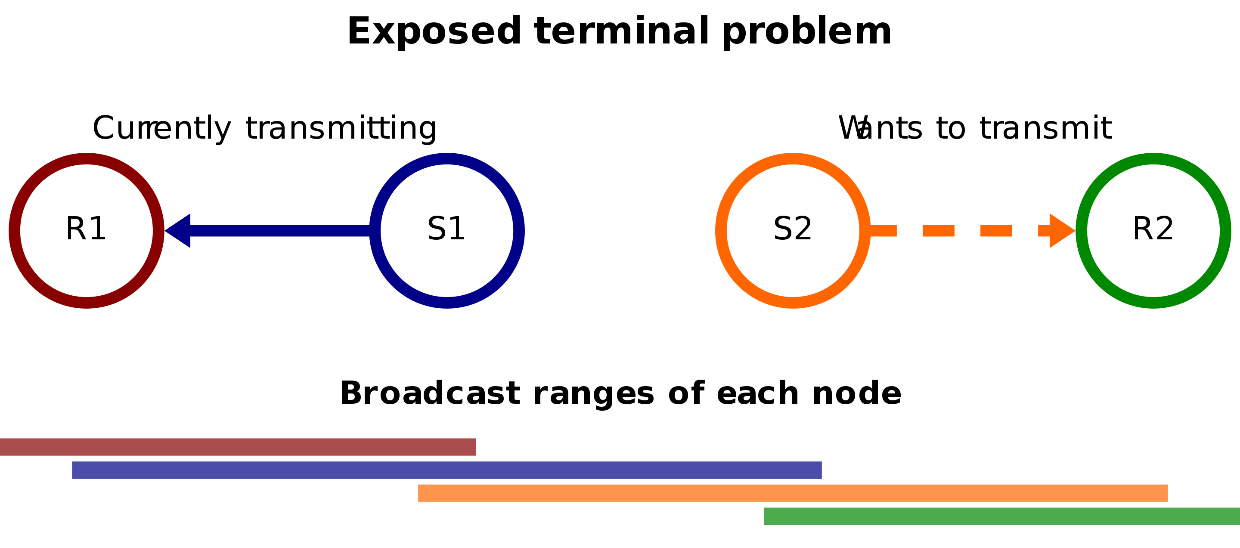
Wireless link characteristics (3)
Multiple wireless senders, receivers create additional problems (beyond multiple access):
Exposed terminal problem
S1, S2 hear each other
S1->R1, S2->R2
S2 cannot transmit due to channel interference

Slide 17
Code Division Multiple Access (CDMA)
unique “code” assigned to each user; i.e., code set partitioning
  all users share same frequency, but each user has own “chipping” sequence (i.e., code) to encode data
  allows multiple users to “coexist” and transmit simultaneously with minimal interference (if codes are “orthogonal”)
encoding: inner product: (original data) X (chipping sequence)
decoding: summed inner-product: (encoded data) X (chipping sequence)

Slide 18
CDMA encode/decode
channel output Z_{i,m}
Z_{i,m}= d_{i}.c_{m}
data
bits
d₀ = 1
1
1
1
1
1
d₁ = -1
1
1
1
-
-
-
-
1
-
-
-
1
-
1
1
1
1
1
sender
1
1
slot 1
channel
output
slot 0
channel
output
1
1
1
1
1
code
1
1
-
-
-
1
-
1
1
1
-
-
-
1
-
1
1
1
slot 1
slot 0
M
D_{i} = Σ Z_{i,m}.c_{m}
m=1
receiver
M
received
input
1
1
1
1
1
1
1
1
d₀ = 1
-
-
-
-
1
-
-
-
1
-
1
1
1
1
1
1
d₁ = -1
1
slot 1
channel
output
slot 0
channel
output
1
1
1
1
1
code
1
1
-
-
-
1
-
1
1
1
-
-
-
1
-
1
1
1
slot 1
slot 0
… but this isn’t really useful yet!

Slide 19
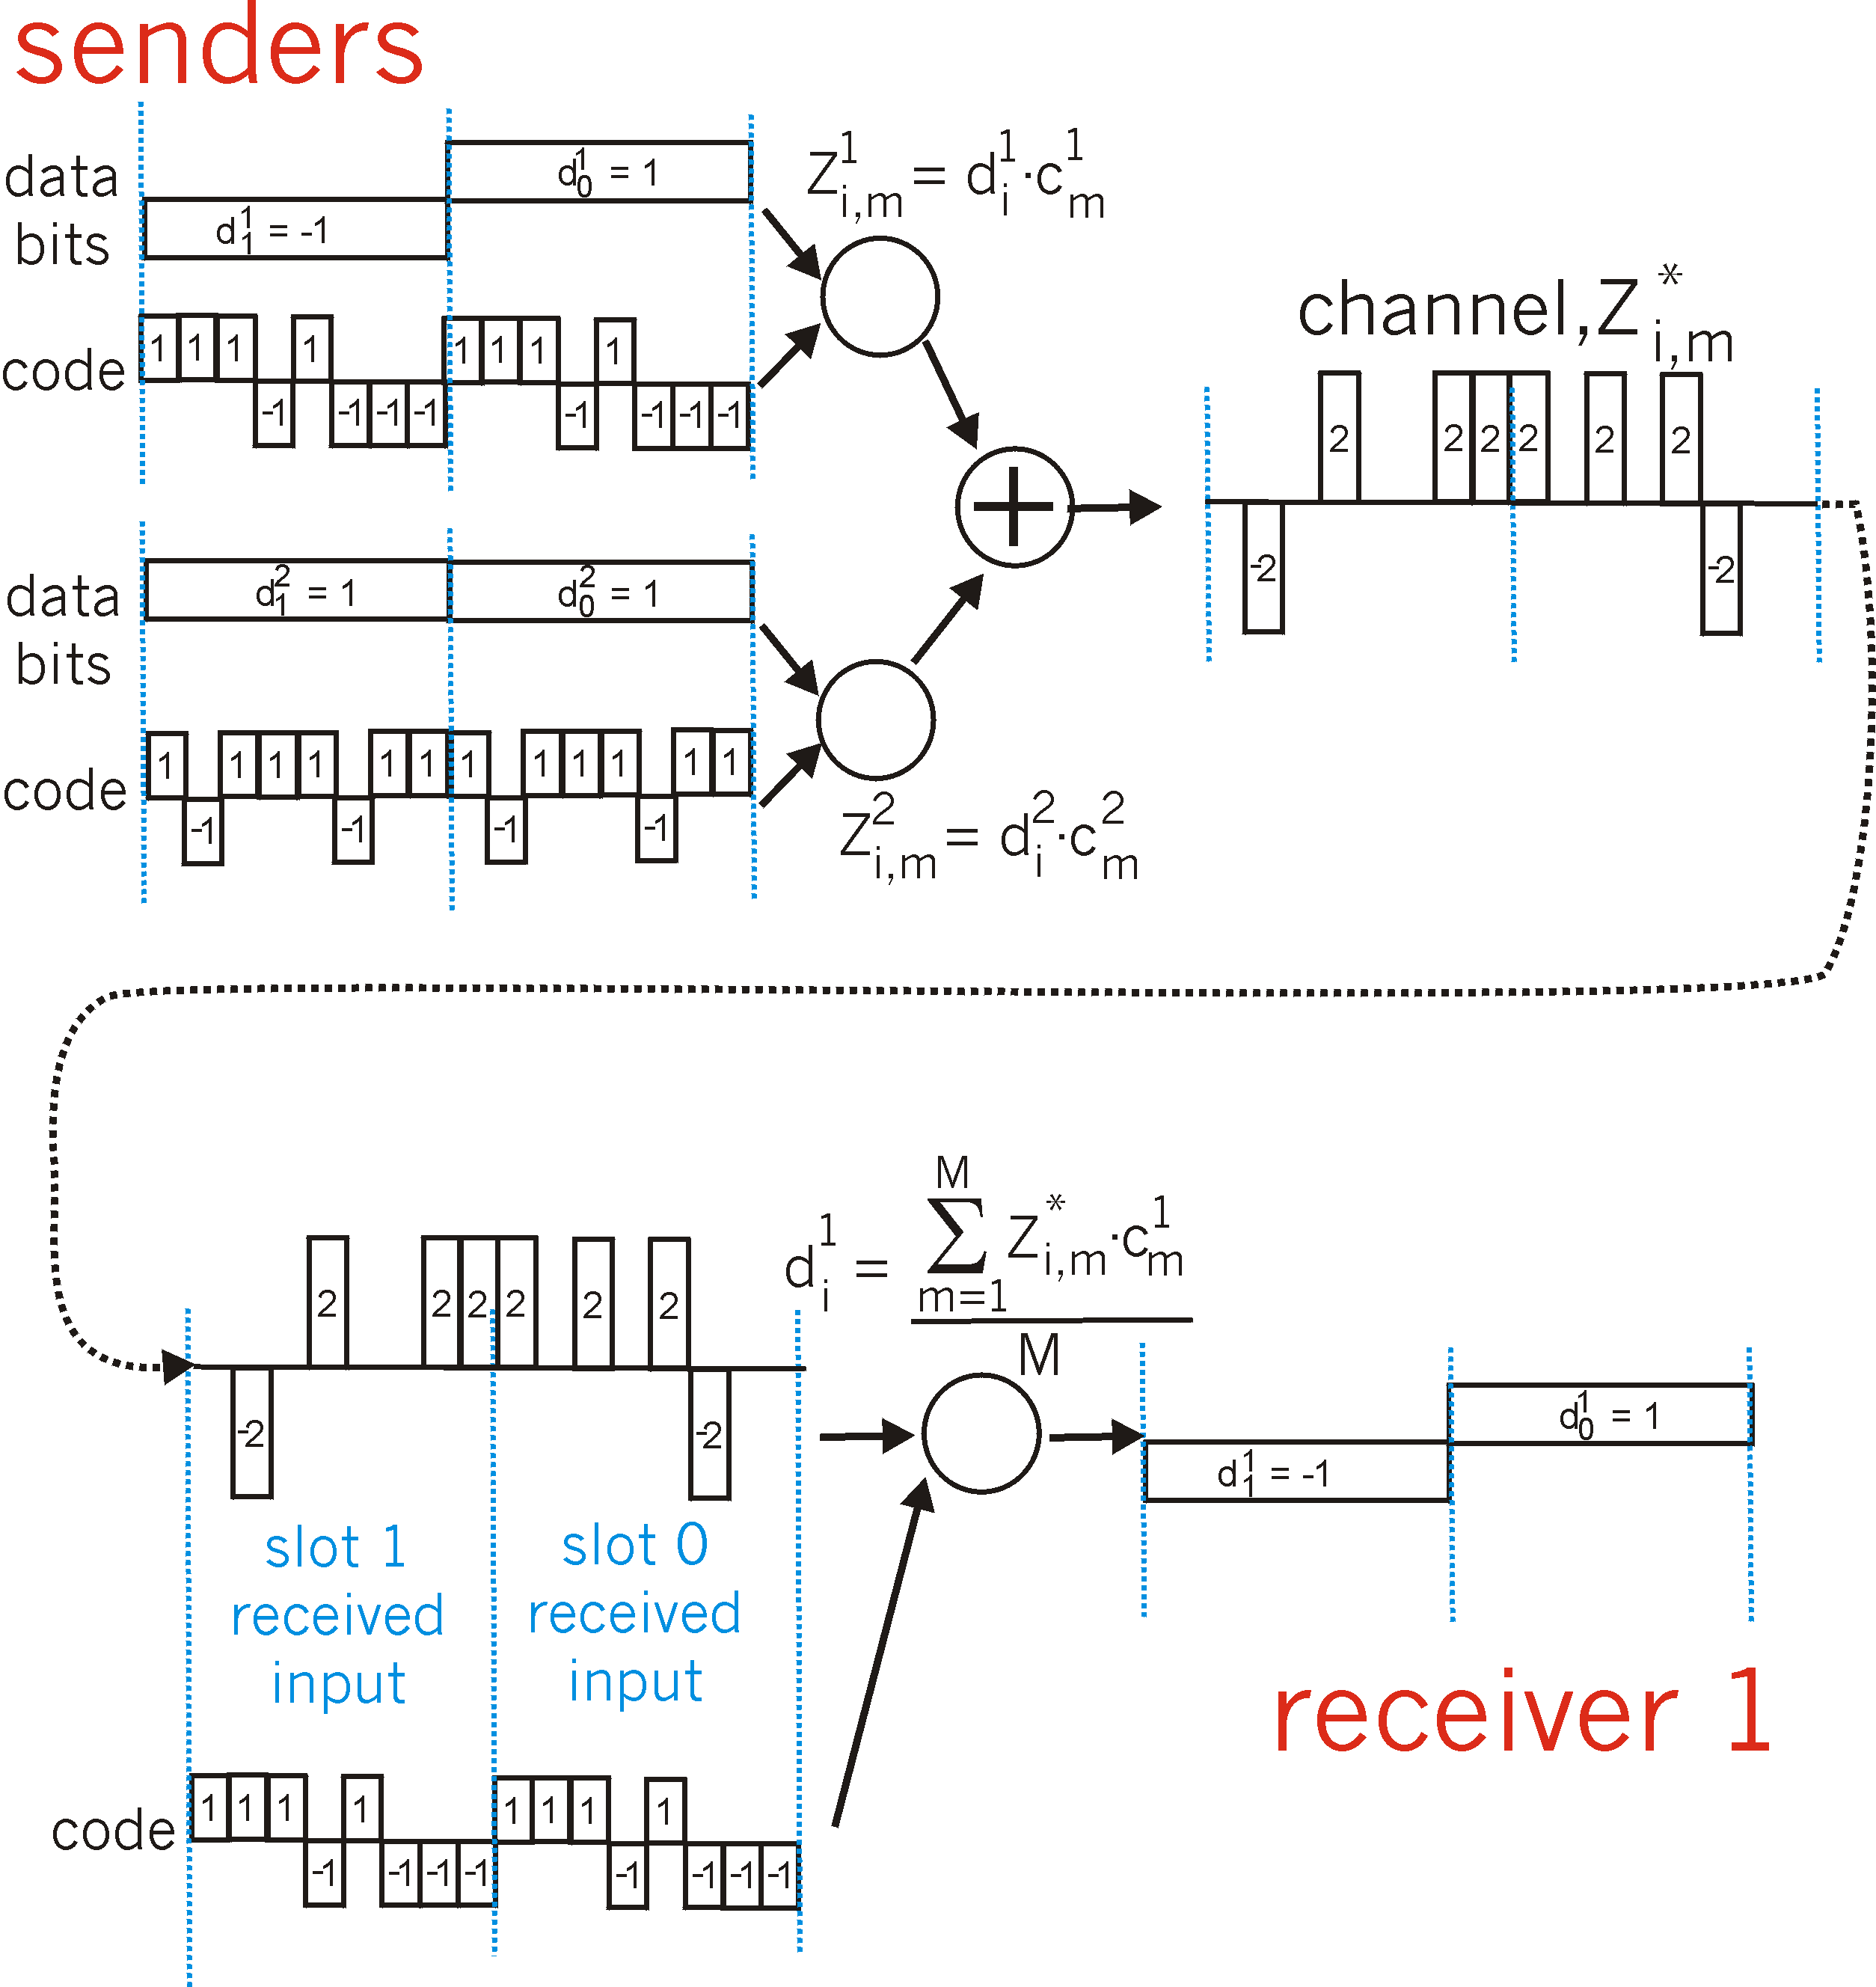
CDMA: two-sender interference
channel sums together transmissions by sender 1 and 2
Sender 1
Sender 2
using same code as sender 1, receiver recovers sender 1’s original data from summed channel data!
… now that’s useful!

Slide 20
Chapter 7 outline
Introduction
Wireless
Wireless links and network characteristics
WiFi: 802.11 wireless LANs
Cellular networks: 4G and 5G
Mobility
Mobility management: principles
Mobility management: practice
  4G/5G networks
  Mobile IP
Mobility: impact on higher-layer protocols

Slide 21
IEEE 802.11 Wireless LAN
IEEE 802.11 standard | Year | Max data rate | Range | Frequency
802.11b | 1999 | 11 Mbps | 30 m | 2.4 Ghz
802.11g | 2003 | 54 Mbps | 30m | 2.4 Ghz
802.11n (WiFi 4) | 2009 | 600Mbps | 70m | 2.4, 5 Ghz
802.11ac (WiFi 5) | 2013 | 3.47Gpbs | 70m | 5 Ghz
802.11ax (WiFi 6) | 2020 (exp.) | 14 Gbps | 70m | 2.4, 5 Ghz
802.11af | 2014 | 35 – 560 Mbps | 1 Km | unused TV bands (54-790 MHz)
802.11ah | 2017 | 347Mbps | 1 Km | 900 Mhz
all use CSMA/CA for multiple access, and have base-station and ad-hoc network versions

Slide 22




802.11 LAN architecture
Internet
wireless host communicates with base station
  base station = access point (AP)
Basic Service Set (BSS) (aka “cell”) in infrastructure mode contains:
  wireless hosts
  access point (AP): base station
  ad hoc mode: hosts only
switch
or router
BSS 1
BSS 2

Slide 23
802.11: Channels, association
spectrum divided into channels at different frequencies
  AP admin chooses frequency for AP
  interference possible: channel can be same as that chosen by neighboring AP!
arriving host: must associate with an AP
  scans channels, listening for beacon frames containing AP’s name (SSID) and MAC address
  selects AP to associate with
  then may perform authentication [Chapter 8]
  then typically run DHCP to get IP address in AP’s subnet
BSS

Slide 24
802.11: passive/active scanning
BBS 1
BBS 2
BBS 1
BBS 2
1
1
AP 2
AP 1
1
AP 2
2
2
2
AP 1
3
3
4
H1
H1
passive scanning:
beacon frames sent from APs
association Request frame sent: H1 to selected AP
association Response frame sent from selected AP to H1
active scanning:
Probe Request frame broadcast from H1
Probe Response frames sent from APs
Association Request frame sent: H1 to selected AP
Association Response frame sent from selected AP to H1

Slide 25




IEEE 802.11: multiple access
avoid collisions: 2⁺ nodes transmitting at same time
802.11: CSMA - sense before transmitting
  don’t collide with detected ongoing transmission by another node
802.11: no collision detection!
  difficult to sense collisions: high transmitting signal, weak received signal due to fading
  can’t sense all collisions in any case: hidden terminal, fading
  goal: avoid collisions: CSMA/CollisionAvoidance
A
B
C
C
B
A’s signal
strength
C’s signal
strength
A
space

Slide 26
IEEE 802.11 MAC Protocol: CSMA/CA
802.11 sender
1 if sense channel idle for DIFS then
  transmit entire frame (no CD)
sender
receiver
DIFS
2 if sense channel busy then
  - start random backoff time
  timer counts down while channel idle
  - Freeze timer if channel busy
  - transmit when timer expires
  if no ACK, increase random backoff interval, repeat 2
data
SIFS
802.11 receiver
if frame received OK
return ACK after SIFS (ACK needed due to hidden terminal problem)
ACK

Slide 27
Avoiding collisions (more)
idea: sender “reserves” channel use for data frames using small reservation packets
sender first transmits small request-to-send (RTS) packet to BS using CSMA
  RTSs may still collide with each other (but they’re short)
BS broadcasts clear-to-send CTS in response to RTS
CTS heard by all nodes
  sender transmits data frame
  other stations defer transmissions

Slide 28

Collision Avoidance: RTS-CTS exchange
A
B
AP
RTS(A)
RTS(B)
reservation collision
RTS(A)
CTS(A)
CTS(A)
time
DATA (A)
defer
ACK(A)
ACK(A)

Slide 29
802.11 frame: addressing
2
2
6
6
6
2
6
0 - 2312
4
frame
control
duration
address
1
address
2
address
3
seq
control
address
4
payload
CRC
Address 1: MAC address of wireless host or AP to receive this frame
Address 4: used only in ad hoc mode
Address 3: MAC address of router interface to which AP is attached
Address 2: MAC address
of wireless host or AP
transmitting this frame

Slide 30
802.11 frame: addressing
Internet
H1
R1
802.3 Ethernet frame
R1 MAC addr
H1 MAC addr
MAC dest addr
MAC source addr
AP MAC addr
H1 MAC addr
R1 MAC addr
address 1
address 2
address 3
802.11 WiFi frame

Slide 31
802.11 frame: addressing
duration of reserved
transmission time (RTS/CTS)
frame sequence # (for reliable data transfer)
2
2
6
6
6
2
6
0 - 2312
4
frame
control
duration
address
1
address
2
address
3
seq
control
address
4
payload
CRC
2
2
4
1
1
1
1
1
1
1
1
protocol
version
type
subtype
to
AP
from
AP
more
frag
retry
power
mgt
more
data
WEP
rsvd
frame type (RTS, CTS, ACK, data)

Slide 32
802.11: mobility within same subnet
H1 remains in same IP subnet: IP address can remain same
switch: which AP is associated with H1?
  self-learning (Ch. 6): switch will see frame from H1 and “remember” which switch port can be used to reach H1
BSS 1
H1
BSS 2

Slide 33
802.11: advanced capabilities
Rate adaptation
base station, mobile dynamically change transmission rate (physical layer modulation technique) as mobile moves, SNR varies
10⁻¹
10⁻²
10⁻³
BER
10⁻⁴
10⁻⁵
10⁻⁶
1. SNR decreases, BER increase as node moves away from base station
10⁻⁷
10
20
30
40
SNR(dB)
2. When BER becomes too high, switch to lower transmission rate but with lower BER
QAM256 (8 Mbps)
QAM16 (4 Mbps)
BPSK (1 Mbps)
operating point

Slide 34
802.11: advanced capabilities
power management
node-to-AP: “I am going to sleep until next beacon frame”
  AP knows not to transmit frames to this node
  node wakes up before next beacon frame
beacon frame: contains list of mobiles with AP-to-mobile frames waiting to be sent
  node will stay awake if AP-to-mobile frames to be sent; otherwise sleep again until next beacon frame

Slide 35
Personal area networks: Bluetooth
less than 10 m diameter
replacement for cables (mouse, keyboard, headphones)
ad hoc: no infrastructure
2.4-2.5 GHz ISM radio band, up to 3 Mbps
master controller / clients devices:
  master polls clients, grants requests for client transmissions
C
P
P
radius of
coverage
M
C
C
P
P
M
master device
client device
parked device (inactive)
C
P

Slide 36
Personal area networks: Bluetooth
TDM, 625 μsec sec. slot
FDM: sender uses 79 frequency channels in known, pseudo-random order slot-to-slot (spread spectrum)
  other devices/equipment not in piconet only interfere in some slots
parked mode: clients can “go to sleep” (park) and later wakeup (to preserve battery)
bootstrapping: nodes self-assemble (plug and play) into piconet
C
P
P
radius of
coverage
M
C
C
P
P
M
master device
client device
parked device (inactive)
C
P

Slide 37
Chapter 7 outline
Introduction
Wireless
Wireless links and network characteristics
WiFi: 802.11 wireless LANs
Cellular networks: 4G and 5G
Mobility
Mobility management: principles
Mobility management: practice
  4G/5G networks
  Mobile IP
Mobility: impact on higher-layer protocols

Slide 38
4G/5G cellular networks
the solution for wide-area mobile Internet
widespread deployment/use:
  more mobile-broadband-connected devices than fixed-broadband-connected devices devices (5-1 in 2019)!
  4G availability: 97% of time in Korea (90% in US)
transmission rates up to 100’s Mbps
technical standards: 3rd Generation Partnership Project (3GPP)
  wwww.3gpp.org
  4G: Long-Term Evolution (LTE)standard

Slide 39
4G/5G cellular networks
similarities to wired Internet
edge/core distinction, but both belong to same carrier
global cellular network: a network of networks
widespread use of protocols we’ve studied: HTTP, DNS, TCP, UDP, IP, NAT, separation of data/control planes, SDN, Ethernet, tunneling
interconnected to wired Internet
differences from wired Internet
different wireless link layer
mobility as a 1st class service
user “identity” (via SIM card)
business model: users subscribe to a cellular provider
  strong notion of “home network” versus roaming on visited nets
  global access, with authentication infrastructure, and inter-carrier settlements

Slide 40

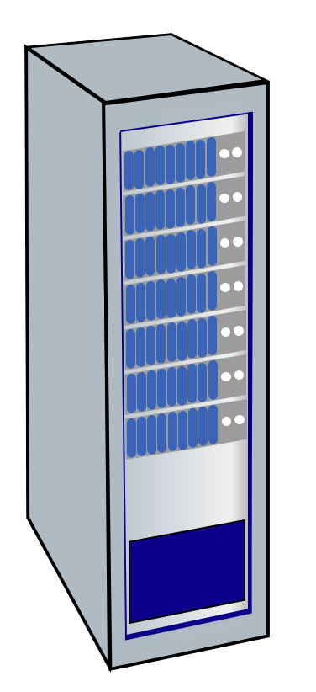




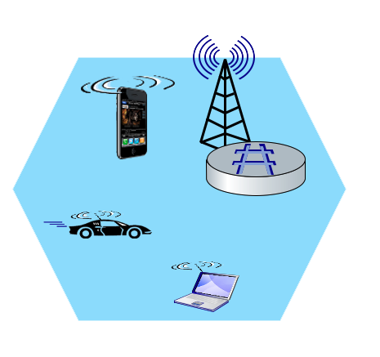
Elements of 4G LTE architecture
Mobile device:
smartphone, tablet, laptop, IoT, ... with 4G LTE radio
64-bit International Mobile Subscriber Identity (IMSI), stored on SIM (Subscriber Identity Module) card
LTE jargon: User Equipment (UE)
Mobility Management Entity (MME)
Home Subscriber Service (HSS)
Mobile device
(UE)
Base station
(eNode-B)
to
Internet
PDN gateway (P-GW)
…
Serving Gateway (S-GW)
radio access
network
all-IP Enhanced Packet Core (EPC)

Slide 41
Elements of 4G LTE architecture
Base station:
at “edge” of carrier’s network
manages wireless radio resources, mobile devices in its coverage area (“cell”)
coordinates device authentication with other elements
similar to WiFi AP but:
  active role in user mobility
  coordinates with nearby base stations to optimize radio use
LTE jargon: eNode-B
Mobility Management Entity (MME)
Home Subscriber Service (HSS)
Mobile device
(UE)
Base station
(eNode-B)
to
Internet
PDN gateway (P-GW)
…
Serving Gateway (S-GW)

Slide 42
Elements of 4G LTE architecture
Home Subscriber Service
a database stores info about mobile devices for which the HSS’s network is their “home network”
works with MME in device authentication
Mobility Management Entity (MME)
Home Subscriber Service (HSS)
Mobile device
(UE)
Base station
(eNode-B)
to
Internet
PDN gateway (P-GW)
…
Serving Gateway (S-GW)

Slide 43
Elements of 4G LTE architecture
Serving Gateway (S-GW), PDN Gateway (P-GW)
lie on data path from mobile to/from Internet
P-GW
  gateway to mobile cellular network
  Looks like any other internet gateway router
  provides NAT services
other routers:
  extensive use of tunneling
Mobility Management Entity (MME)
Home Subscriber Service (HSS)
Mobile device
(UE)
Base station
(eNode-B)
to
Internet
PDN gateway (P-GW)
…
Serving Gateway (S-GW)

Slide 44
Elements of 4G LTE architecture
Mobility Management Entity
device authentication (device-to-network, network-to-device) coordinated with mobile home network HSS
Mobility Management Entity (MME)
Home Subscriber Service (HSS)
Mobile device
(UE)
Base station
(eNode-B)
to
Internet
PDN gateway (P-GW)
mobile device management:
  device handover between cells
  tracking/paging device location
path (tunneling) setup from mobile device to P-GW
…
Serving Gateway (S-GW)

Slide 45
LTE: data plane control plane separation
HSS
control plane
new protocols for mobility management , security, authentication (later)
base station
MME
P-GW
S-GW
data plane
new protocols at link, physical layers
base station
S-GW
P-GW
extensive use of tunneling to facilitate mobility
IP tunnels

Slide 46
LTE data plane protocol stack: first hop
LTE link layer protocols:
Packet Data Convergence: header compression, encryption
Radio Link Control (RLC) Protocol: fragmentation/reassembly, reliable data transfer
Medium Access: requesting, use of radio transmission slots
Application
Transport
IP
IP
Packet Data
Convergence
Packet Data
Convergence
Link
Radio Link
Radio Link
Medium Access
Medium Access
Physical
Physical
data
plane
base station
S-GW
P-GW

Slide 47
LTE data plane protocol stack: first hop
LTE radio access network:
downstream channel: FDM, TDM within frequency channel (OFDM - orthogonal frequency division multiplexing)
  “orthogonal”: minimal interference between channels
  upstream: FDM, TDM similar to OFDM
each active mobile device allocated two or more 0.5 ms time slots over 12 frequencies
  scheduling algorithm not standardized – up to operator
  100’s Mbps per device possible
Application
Transport
IP
IP
Packet Data
Convergence
Packet Data
Convergence
Link
Radio Link
Radio Link
Medium Access
Medium Access
Physical
Physical
base station

Slide 48
LTE data plane protocol stack: packet core
tunneling:
mobile datagram encapsulated using GPRS Tunneling Protocol (GTP), sent inside UDP datagram to S-GW
S-GW re-tunnels datagrams to P-GW
supporting mobility: only tunneling endpoints change when mobile user moves
GTP-U
GTP-U
GTP-U
UDP
UDP
UDP
IP
IP
IP
IP
Packet Data
Convergence
Radio Link
link
link
link
Medium Access
Physical
Physical
Physical
Physical
\
base station
S-GW
P-GW

Slide 49
LTE data plane: associating with a BS
1
2
3
data
plane
base station
S-GW
P-GW
1
BS broadcasts primary synch signal every 5 ms on all frequencies
BSs from multiple carriers may be broadcasting synch signals
2
mobile finds a primary synch signal, then locates 2nd synch signal on this freq.
mobile then finds info broadcast by BS: channel bandwidth, configurations; BS’s cellular carrier info
mobile may get info from multiple base stations, multiple cellular networks
3
mobile selects which BS to associate with (e.g., preference for home carrier)
4
more steps still needed to authenticate, establish state, set up data plane

Slide 50
LTE mobiles: sleep modes
ZZZZ...
data
plane
as in WiFi, Bluetooth: LTE mobile may put radio to “sleep” to conserve battery:
light sleep: after 100’s msec of inactivity
  wake up periodically (100’s msec) to check for downstream transmissions
deep sleep: after 5-10 secs of inactivity
  mobile may change cells while deep sleeping – need to re-establish association

Slide 51
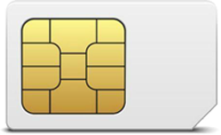
Global cellular network: a network of IP networks
home network HSS:
identify & services info, while in home network and roaming
Home
Subscriber
Server
home mobile
carrier network
P-GW
public Internet
and
inter-carrier IPX
all IP:
carriers interconnect with each other, and public internet at exchange points
legacy 2G, 3G: not all IP, handled otherwise
…
…
in home network
P-GW
SIM card: global identify info in home network
visited mobile
carrier network
…
roaming in visited network

Slide 52
On to 5G!
goal: 10x increase in peak bitrate, 10x decrease in latency, 100x increase in traffic capacity over 4G
5G NR (new radio):
  two frequency bands: FR1 (450 MHz–6 GHz) and FR2 (24 GHz–52 GHz): millimeter wave frequencies
  not backwards-compatible with 4G
  MIMO: multiple directional antennae
millimeter wave frequencies: much higher data rates, but over shorter distances
  pico-cells: cells diameters: 10-100 m
  massive, dense deployment of new base stations required

Slide 53
Chapter 7 outline
Introduction
Wireless
Wireless links and network characteristics
WiFi: 802.11 wireless LANs
Cellular networks: 4G and 5G
Mobility
Mobility management: principles
Mobility management: practice
  4G/5G networks
  Mobile IP
Mobility: impact on higher-layer protocols

Slide 54
What is mobility?
spectrum of mobility, from the network perspective:
no mobility
high mobility
device moves
between networks, but
powers down
while moving
device moves within same AP in
one provider
network
device moves among APs in
one provider
network
device moves
among multiple
provider networks,
while maintaining
ongoing connections
We’re interested in these!

Slide 55
Mobility approaches
let network (routers) handle it:
  routers advertise well-known name, address (e.g., permanent 32-bit IP address), or number (e.g., cell #) of visiting mobile node via usual routing table exchange
  Internet routing could do this already with no changes! Routing tables indicate where each mobile located via longest prefix match!

Slide 56
Mobility approaches
let network (routers) handle it:
  routers advertise well-known name, address (e.g., permanent 32-bit IP address), or number (e.g., cell #) of visiting mobile node via usual routing table exchange
  Internet routing could do this already with no changes! Routing tables indicate where each mobile located via longest prefix match!
not
scalable
to billions of
mobiles
let end-systems handle it: functionality at the “edge”
  indirect routing: communication from correspondent to mobile goes through home network, then forwarded to remote mobile
  direct routing: correspondent gets foreign address of mobile, send directly to mobile

Slide 57

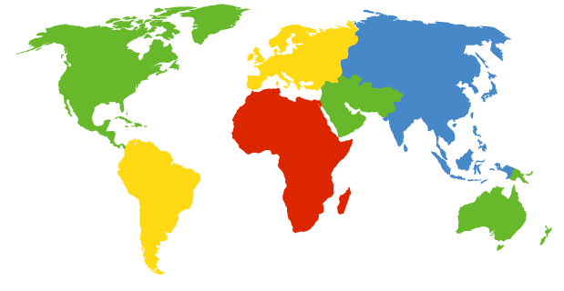

Contacting a mobile friend:
I wonder where Alice moved to?
Consider friend frequently changing locations, how do you find him/her?
search all phone books?
expect her to let you know where he/she is?
call his/her parents?
Facebook!
The importance of having a “home”:
a definitive source of information about you
a place where people can find out where you are

Slide 58
Home network, visited network: 4G/5G
home network:
(paid) service plan with cellular provider, e.g., Verizon, Orange
home network HSS stores identify & services info
Home
Subscriber
Server
home mobile
carrier network
P-GW
public Internet
and
inter-carrier IPX
…
…
in home network
visited network:
any network other than your home network
service agreement with other networks: to provide access to visiting mobile
P-GW
SIM card: global identify info including home network
visited mobile
carrier network
…
roaming in visited network

Slide 59
Home network, visited network: ISP/WiFi
ISP/WiFi: no notion of global “home”
credentials from ISP (e.g., username, password) stored on device or with user
ISPs may have national, international presence
different networks: different credentials
  some exceptions (e.g., eduroam)
  architectures exist (mobile IP) for 4G-like mobility, but not used
authentication
access
server
public Internet
…
…
attach
authentication
access
server
…
attach

Slide 60
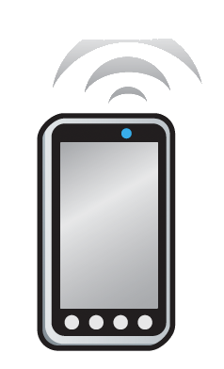

Home network, visited network: generic
Home Network
  e.g.,: 128.119/16
Visited Network
e.g.,: 79.129/16
Permanent IP:
128.119.40.186
IMSI
78:4f:43:98:d9:27
Home
Subscriber
Server
NAT IP:
10.0.0.99
IMSI
78:4f:43:98:d9:27
Mobility manager
Mobility manager
Visited network gateway
Home network gateway
Home gateway
public or private Internet
Correspondent

Slide 61
Registration: home needs to know where you are!
Home Network
  e.g.,: 128.119/16
Visited Network
e.g.,: 79.129/16
1
mobile associates with visited mobility manager
Permanent IP:
128.119.40.186
IMSI
78:4f:43:98:d9:27
Home
Subscriber
Server
NAT IP:
10.0.0.99
IMSI
78:4f:43:98:d9:27
2
Mobility manager
Visited network gateway
visited mobility manager registers mobile’s location with home HSS
Mobility manager
Home network gateway
Home gateway
public or private Internet
end result:
visited mobility manager knows about mobile
home HSS knows location of mobile

Slide 62
Mobility with indirect routing
Home Network
  e.g.,: 128.119/16
Visited Network
e.g.,: 79.129/16
Permanent IP:
128.119.40.186
IMSI
78:4f:43:98:d9:27
Home
Subscriber
Server
NAT IP:
10.0.0.99
IMSI
78:4f:43:98:d9:27
3
Mobility manager
visited gateway router forwards to mobile
2
Mobility manager
4a
Visited network gateway
Home network gateway
Home gateway
home gateway receives datagram, forwards (tunnels) to remote gateway
public or private Internet
1
visited gateway router forwards reply to correspondent via home network (4a) or directly (4b)
4b
correspondent uses home address as datagram destination address
Correspondent

Slide 63
Mobility with indirect routing: comments
triangle routing:
  inefficient when correspondent and mobile are in same network
mobile moves among visited networks: transparent to correspondent!
  registers in new visited network
  new visited network registers with home HSS
  datagrams continue to be forwarded from home network to mobile in new network
  on-going (e.g., TCP) connections between correspondent and mobile can be maintained!

Slide 64
Mobility with direct routing
Home Network
  e.g.,: 128.119/16
Visited Network
e.g.,: 79.129/16
Permanent IP:
128.119.40.186
IMSI
78:4f:43:98:d9:27
Home
Subscriber
Server
NAT IP:
10.0.0.99
IMSI
78:4f:43:98:d9:27
4
Mobility manager
visited gateway router forwards to mobile
Mobility manager
Visited network gateway
Home gateway
2
public or private Internet
3
correspondent contacts home HSS, gets mobile’s visited network
1
Correspondent addresses datagram to visited network address
Correspondent

Slide 65
Mobility with direct routing: comments
overcomes triangle routing inefficiencies
non-transparent to correspondent: correspondent must get care-of-address from home agent
what if mobile changes visited network?
  can be handled, but with additional complexity

Slide 66
Chapter 7 outline
Introduction
Wireless
Wireless links and network characteristics
WiFi: 802.11 wireless LANs
Cellular networks: 4G and 5G
Mobility
Mobility management: principles
Mobility management: practice
  4G/5G networks
  Mobile IP
Mobility: impact on higher-layer protocols

Slide 67
Mobility in 4G networks: major mobility tasks
1
base station association:
covered earlier
mobile provides IMSI – identifying itself, home network
Mobility manager
Home
Subscriber
Server
2
1
MME
Home
network
3
base station
P-GW
S-GW
4
2
control-plane configuration:
MME, home HSS establish control-plane state - mobile is in visited network
Internet
P-GW
Visited network
Streaming server
3
data-plane configuration:
MME configures forwarding tunnels for mobile
visited, home network establish tunnels from home P-GW to mobile
4
mobile handover:
mobile device changes its point of attachment to visited network

Slide 68
Configuring LTE control-plane elements
Mobility manager
Home
Subscriber
Server
2
MME
Home
network
base station
P-GW
P-GW
S-GW
Visited network
Mobile communicates with local MME via BS control-plane channel
MME uses mobile’s IMSI info to contact mobile’s home HSS
  retrieve authentication, encryption, network service information
  home HHS knows mobile now resident in visited network
BS, mobile select parameters for BS-mobile data-plane radio channel

Slide 69
Configuring data-plane tunnels for mobile
Mobility manager
S-GW to BS tunnel: when mobile changes base stations, simply change endpoint IP address of tunnel
S-GW to home P-GW tunnel: implementation of indirect routing
Home
Subscriber
Server
MME
Home
network
base station
P-GW
S-GW
Internet
P-GW
Visited network
Streaming server
tunneling via GTP (GPRS tunneling protocol): mobile’s datagram to streaming server encapsulated using GTP inside UDP, inside datagram

Slide 70
Handover between BSs in same cellular network
data path before handover
source BS
1
current (source) BS selects target BS, sends Handover Request message to target BS
3
S-GW
1
4
2
P-GW
2
target BS pre-allocates radio time slots, responds with HR ACK with info for mobile
data path after
handover
MME
target BS
3
source BS informs mobile of new BS
mobile can now send via new BS - handover looks complete to mobile
4
source BS stops sending datagrams to mobile, instead forwards to new BS (who forwards to mobile over radio channel)

Slide 71
Handover between BSs in same cellular network
source BS
3
S-GW
1
4
5
target BS informs MME that it is new BS for mobile
MME instructs S-GW to change tunnel endpoint to be (new) target BS
2
6
P-GW
5
7
5
MME
target BS
6
target BS ACKs back to source BS: handover complete, source BS can release resources
7
mobile’s datagrams now flow through new tunnel from target BS to S-GW

Slide 72
Mobile IP
mobile IP architecture standardized ~20 years ago [RFC 5944]
  long before ubiquitous smartphones, 4G support for Internet protocols
  did not see wide deployment/use
  perhaps WiFi for Internet, and 2G/3G phones for voice were “good enough” at the time
mobile IP architecture:
  indirect routing to node (via home network) using tunnels
  mobile IP home agent: combined roles of 4G HSS and home P-GW
  mobile IP foreign agent: combined roles of 4G MME and S-GW
  protocols for agent discovery in visited network, registration of visited location in home network via ICMP extensions

Slide 73
Wireless, mobility: impact on higher layer protocols
logically, impact should be minimal …
  best effort service model remains unchanged
  TCP and UDP can (and do) run over wireless, mobile
… but performance-wise:
  packet loss/delay due to bit-errors (discarded packets, delays for link-layer retransmissions), and handover loss
  TCP interprets loss as congestion, will decrease congestion window un-necessarily
  delay impairments for real-time traffic
  bandwidth a scare resource for wireless links

Slide 74
Chapter 7 summary
Wireless
Wireless Links and network characteristics
WiFi: 802.11 wireless LANs
Cellular networks: 4G and 5G
Mobility
Mobility management: principles
Mobility management: practice
  4G/5G networks
  Mobile IP
Mobility: impact on higher-layer protocols

