Slide 1
Dr. Rüdiger Paschotta
RP Photonics Consulting GmbH
Competence Area:
Fiber Devices

Slide 2
Topics in this Area
Fiber lasers, including “exotic” types
Fiber amplifiers, including telecom-type devices and high power devices
Q switching of fiber lasers
Mode locking of fiber lasers
Pulse propagation in fibers
Noise in fiber devices
Note: for more details (with references to publications) on the scientific achievements of R. Paschotta, see
http://www.rp-photonics.com/Science_Paschotta.ppt

Slide 3
Fiber Lasers
WDM
FBG
FBG

Slide 4
Fiber Lasers
Fiber lasers occur in a great variety of forms, serving very different applications, e.g.:
  Lasers generating outputs at special wavelengths, e.g. in the visible or in the infrared spectral region
  (tracking lasers, displays, pumping of solid-state lasers)
  Lasers for very high output power (many watts or even kilowatts) with good beam quality
  (material processing, various industrial processes, military applications)
  Q-switched and mode-locked lasers for short or ultrashort pulses
  (distance measurements, time & frequency metrology, material processing)
Fiber technology creates a huge amount of attractive technical options,
but also comes with a bunch of technical difficulties

Slide 5
Fiber Lasers
Examples for previous activities of R. Paschotta:
Developed numerical computer models for optimizing various kinds of fiber lasers, e.g. blue upconversion lasers with three-step excitation;
this lead to the powerful commercial software package RP Fiber Power.
Discovered unexpected quenching effects in Yb-doped fibers
Worked out design guidelines for various devices
Contributions to the invention of ring-doped fiber designs
Identification and demonstration of a strange situation where spatial hole burning serves to stabilize single-frequency operation

Slide 6
Fiber Lasers
Examples for possible consulting activities:
Develop a numerical model to calculate and optimize the performance of a certain type of fiber laser
Identify performance limitations in terms of output power, wavelength tuning range, linewidth, etc.
Develop fiber laser designs (with optimized fiber parameters, pump source, mirror reflectivities, etc.)
Analyse and optimize Q-switched or mode-locked fiber lasers
Compare fiber laser technology with competing technologies

Slide 7
The RP Fiber Power Software
The commercially available software RP Fiber Power (http://www.rp-photonics.com/fiberpower.html), developed by
Dr. Paschotta, has the following key features:
The integrated mode solver can calculate all guides modes of a fiber from a given refractive index profile. One obtains intensity profiles, propagation constants, group velocities and chromatic dispersion, fraction of power propagating within the fiber core, etc.
One can also numerically simulate beam propagation in fiber devices – not only in simple fibers, but also in multi-core fibers, fiber couplers, etc. A lot of example cases on our website demonstrate the great versatility of the software.

Slide 8
The RP Fiber Power Software
The software can calculate the distribution of optical powers and excitation densities in fiber lasers, amplifiers and ASE sources, taking into account
  longitudinal and transverse spatial dependencies
  arbitrarily complicated level schemes
  influences from spontaneous and stimulated transitions, ASE, excited-state absorption, energy transfers leading to upconversion, etc.
Besides calculating steady-state powers, the software can do dynamic simulations, e.g. for Q switching and pulse amplification.
Ultrashort pulse propagation (for example, in pulse amplifiers and in mode-locked fiber lasers) can also be simulated.

Slide 9
The RP Fiber Power Software
The software has an extremely flexible user interface, with control via simple forms and/or via a powerful script language.
Careful documentation and helpful support is also available.
For a comprehensive description of RP Fiber Power, see the page http://www.rp-photonics.com/fiberpower.html, and download our brochure http://www.rp-photonics.com/RP_Fiber_Power.pdf.

Slide 10
Fiber Amplifiers
Er³⁺
WDM
WDM
980 nm
980 nm

Slide 11
Fiber Amplifiers
Fiber amplifiers are used for very different applications, e.g.:
  Data transmission
  (compensating losses in telecom fibers, providing power for nonlinear data processing devices, etc.)
  Generation of high output powers
  (continuous-wave or pulse amplification for material processing, driving nonlinear devices, etc.)
  Generation of optical noise
  (microscopy, device characterization)
Fiber technology offers large gain and broad amplification bandwidth,
but also comes with a bunch of technical difficulties

Slide 12
Fiber Amplifiers
Examples for previous activities of R. Paschotta:
Developed numerical computer models for various kinds of fiber amplifiers, e.g. with Yb- or Er-doped fibers;
this expertise was used for the software RP Fiber Power.
Worked out design guidelines for various devices
Contributions to the invention of ring-doped fiber designs
Demonstration of high-performance superfluorescence source

Slide 13
Fiber Amplifiers
Examples for possible consulting activities:
Develop a numerical model to calculate and optimize the performance of a certain type of fiber amplifier
Identify performance limitations in terms of output power, nonlinear distortions, etc.
Develop fiber amplifier designs (with optimized fiber parameters, pump source, etc.)
Analyze and optimize noise properties (noise figure, nonlinear distortions)

Slide 14
Q Switching and Mode Locking of Fiber Lasers
WDM
SESAM

Slide 15
Q Switching and Mode Locking
Fiber lasers can be used for pulse generation:
  Q switching for generation of nanosecond pulses
  (distance measurements, material processing)
  Mode locking for generation of picosecond or femtosecond pulses
  (time & frequency metrology, material processing, OPO pumping)
Fiber technology competes with other technologies,
with commercial chances depending on the concrete demands

Slide 16
Q Switching and Mode Locking
Examples for previous activities of R. Paschotta:
Developed numerical computer models for pulse generation and amplification in fibers
Demonstrated very high pulse energies at 1.5 μm
with passive Q switching
Worked out design guidelines for various devices
Various contributions to mode-locked fiber lasers

Slide 17
Q Switching and Mode Locking
Examples for possible consulting activities:
Develop a numerical model to calculate and optimize the performance of a Q-switched or mode-locked fiber laser
Identify performance limitations in terms of output power, wavelength tuning range, linewidth, etc.; optimized device designs
Compare fiber laser technology with competing technologies
(Note: deep and broad experience with various kinds of Q-switched and mode-locked lasers, including bulk lasers and semiconductor lasers)

Slide 18
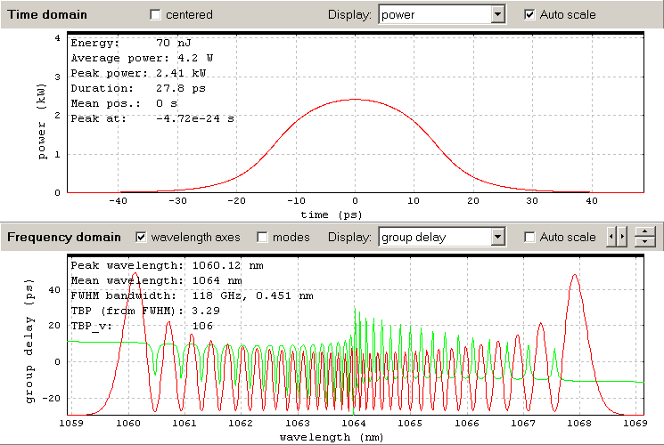
Pulse Propagation in Fibers

Slide 19
Pulse Propagation in Fibers
Fibers can be used transport optical pulses or to manipulate their properties, e.g.
  to broaden their spectrum, e.g. for subsequent pulse compression
  to stretch or compress them temporally
  to generate a “chirp”
  to amplify them with laser gain or Raman gain
  to shift their center wavelength
Apart from dispersion effects, a variety of nonlinearities can influence the pulse propagation

Slide 20
Pulse Propagation in Fibers
Examples for previous activities of R. Paschotta:
Developed numerical computer models for pulse propagation in fibers,
e.g. within fiber lasers or amplifiers, for pulse compressors, or for supercontinuum generation
→ RP Fiber Power software:
see http://www.rp-photonics.com/fiberpower.html
Studied a wide range of fiber nonlinearities, including Kerr effect with self-steepening, Raman effect, Brillouin scattering
Studied in detail soliton propagation effects
Designed mode-locked fiber lasers

Slide 21
Pulse Propagation in Fibers
Examples for possible consulting activities:
Use a numerical model to simulate the propagation of pulses in a laser, amplifier or compressor
Identify performance limitations of fiber devices
Optimize device designs, or identify problems with existing designs
Compare fiber laser technology with competing technologies
(Example: compare picosecond or femtosecond fiber amplifiers with bulk amplifiers)

Slide 22
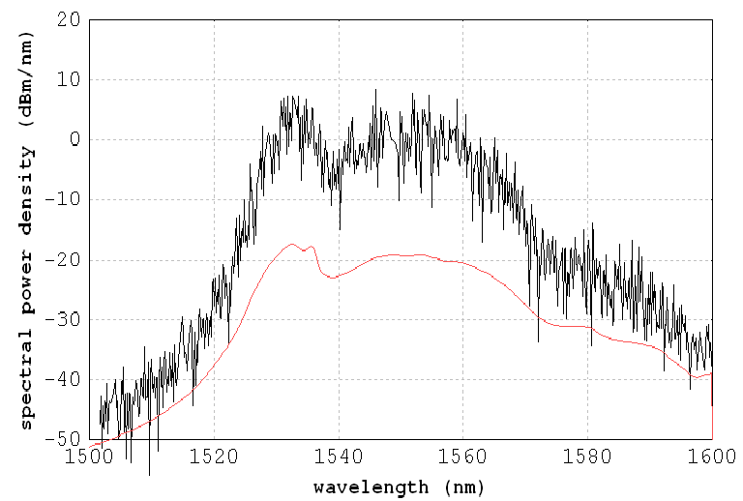
Noise in Fiber Devices

Slide 23
Noise in Fiber Devices
Optical noise can arise in fiber devices through various effects, e.g.
  as amplified spontaneous emission (ASE)
  from quantum noise or input noise,
  amplified through nonlinear effects (e.g. modulational instability)
  quantum effects related to nonlinearities (e.g. Raman interaction)
Noise often limits the performance of fiber devices;
its exact physical and quantitative understanding can be crucial
for optimization of devices.

Slide 24
Noise in Fiber Devices
Examples for previous activities of R. Paschotta:
Developed a numerical computer model for supercontinuum generation in microstructured fibers, and used it to quantitatively study the noise properties of the output (→ spectral coherence)
Developed fiber amplifier models with amplified spontaneous emission (ASE)

Slide 25
Noise in Fiber Devices
Examples for possible consulting activities:
Quantify noise effects in a fiber device, using analytical and/or numerical techniques
Identify performance limitations
Compare fiber laser technology with competing technologies
(Example: compare timing jitter potential of fiber lasers and other lasers)

Slide 26
Publications on Fiber Technology
Books:
R. Paschotta, “Field Guide to Optical Fiber Technology”, SPIE Press, Bellingham (WA) (2010)
R. Paschotta, “Encyclopedia of Laser Physics and Technology”, Wiley-VCH, Weinheim, Germany (2008)
Various scientific articles:
see the CV and publication list of Dr. Paschotta

