Slide 1
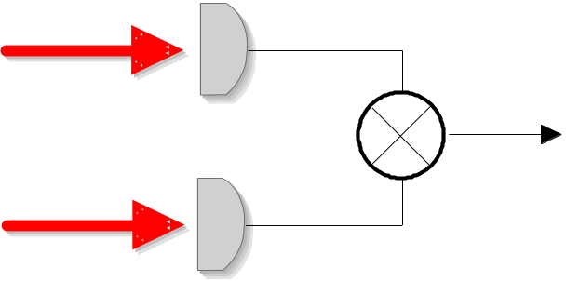
Dr. Rüdiger Paschotta
RP Photonics Consulting GmbH
Competence Area:
Fluctuations & Noise

Slide 2
Overview:
Noise in Optics and Electronics
Why we need to understand noise
Topics in this area.
For various topics, the following is given:
  short description of topic
  previous activities of R. Paschotta in this field
  (See the website for references on scientific results)
  examples for possible consulting activities
Note: for more details (with references to publications) on the scientific achievements of R. Paschotta, see
http://www.rp-photonics.com/Science_Paschotta.ppt

Slide 3
Why we Need to Understand Noise
Noise is often a limiting factor for the performance
of a device or system.
Examples: transmission rate of telecommunication system
limited by the need to keep the bit error rate low enough;
sensitivity of measurements is limited by noise.
Efficient product development often requires
  quantification of noise from components
  calculation of noise effects on system performance
Noise issues can have an important impact on system cost.
Example: by choosing the right measurement scheme, which is less sensitive to noise, one might do the job with a less costly laser system.
Note: incompetent noise specifications can irritate customers!
If that kind of competence is not available in house, have your staff trained!

Slide 4
Topics in this Area
Mathematical description of noise
Origins of noise
Electronic noise measurements
Optical noise measurements
Feedback systems for noise suppression
Noise modeling

Slide 5
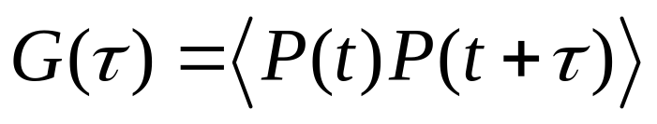
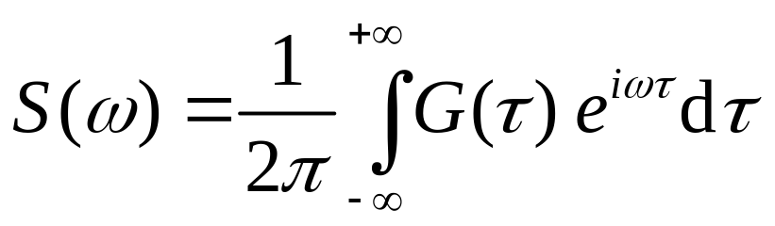
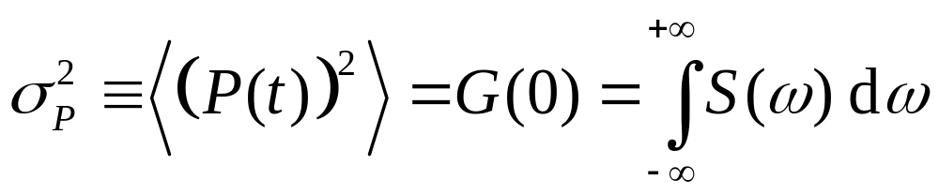
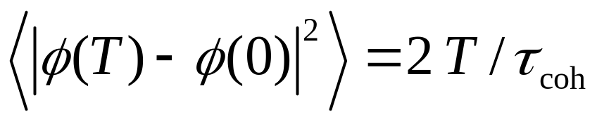
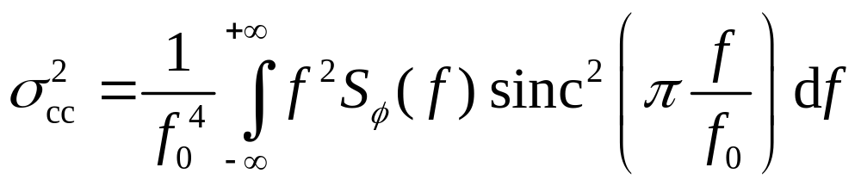
Mathematical Description of Noise

Slide 6
Mathematical Description of Noise
Noise of devices or systems needs to be reliably quantified.
Reason: designs based on properly quantified noise properties
save development time and cost by eliminating trial & error.
This requires correct measurements, but also
correct and helpful specifications.
Specification and comparison of noise properties is not trivial due to
  manifold types of quantities
  (power spectral densities, correlation functions, probability distributions, etc.)
  mathematical difficulties
  (related to divergent quantities, required approximations, statistics, etc.)
  inconsistent notations in the literature
  (different sign conventions, one- or two-sided power spectral densities, f or ω variables, 2π issues, etc.)
  Only a real expert can do reliable and efficient work in this field.

Slide 7
Mathematical Description of Noise
Examples for previous activities of R. Paschotta:
Extensive calculations on quantum noise and thermal fluctuations in optics and electronics
Group-internal teaching on noise specifications

Slide 8
Mathematical Description of Noise
Examples for possible consulting activities:
Checking noise specifications of a product for completeness and soundness, so as to convince your customers.
Investing just half a day of consulting can help to secure sales.
Comparing noise specs of your product to theoretical expectations.
Otherwise you won’t know whether there is room for further improvement.
Checking whether the noise specs of a product will be sufficient for your application, or compare noise specs of different products, or calculate limits to the expected performance.
Don’t loose a lot of money by trying things which can’t work, or by buying the wrong product.
Training your personnel in such areas.
Is there a more cost-efficient way to obtain solid know-how?

Slide 9
Origins of Noise
additional classical noise
pump noise
HR
OC
gain medium
losses introduce
vacuum fluctuations
vacuum fluctuations
spontaneous emission,
dipole fluctuations

Slide 10
Origins of Noise
Thermal fluctuations: often an important source of noise in electronic circuits, e.g. in photodiode preamplifiers
Other electronic noise, e.g. flicker noise:
various sources; may critically depend on parts used
Quantum noise: often important in optical devices,
e.g. shot noise in photodetection or intensity and phase noise in lasers
Mechanical noise: e.g. in the form of vibrations which can couple to optical or electronic parameters

Slide 11
Origins of Noise
Examples for previous activities of R. Paschotta:
Comparison of noise influences in highly nonlinear pulse propagation in photonic crystal fibers
Comprehensive analysis of various noise influences on the timing jitter and the optical phase noise of mode-locked lasers, using a combination of new analytical calculations and numerical techniques

Slide 12
Origins of Noise
Examples for possible consulting activities:
Calculate the expected impact of different noise sources on the performance of your product.
Or would you prefer guess work to guide your development?
Identify the dominating effect
to avoid working on the wrong aspect
Identify the key factors for optimization and quantify the remaining potential
so that your decisions will be well founded

Slide 13

Electronic Noise Measurements
attenuator
mixer
log
envelope detector
VBW
RBW
f
tunable oscillator
peak
S/H
A/D converter
sample
display detector
display

Slide 14
Electronic Noise Measurements
Noise in electrical signals is often measured with RF spectrum analyzers.
Such measurements are prone to an intimidating ensemble of possible errors:
  confusion between 3-dB bandwidth and effective noise bandwidth
  statistical effects from averaging logarithmic (dBm) values
  wrong detector mode: peak detector overestimates noise,
  particularly when combined with wrong video averaging
  saturation of mixer or logarithmic amplifier by signals outside the displayed range
  influence of phase noise from local oscillator
Correct noise measurements with an RF spectrum analyzer require a decent understanding of how such a device works.

Slide 15
Electronic Noise Measurements
Examples for previous activities of R. Paschotta:
Acquired a deep understanding of electronic spectrum analyzers
Optimization of photodetector circuits for noise measurements below the shot noise limit
(→ experiments with nonclassical states of light)
Development of new measurement schemes for low levels of phase noise
Detailed lecturing

Slide 16
Electronic Noise Measurements
Examples for possible consulting activities:
Comparison of different technical approaches for noise measurements
ideally before you heavily invest into some scheme
Development of a measurement setup, or checking an existing setup and proposing improvements
in a process during which your engineers can learn a lot
Checking the data processing to ensure validity of the obtained data

Slide 17
Optical Noise Measurements
laser 1
10 GHz
100 MHz
FFT analyzer
oscillator
10.1 GHz
100 MHz
laser 2
10 GHz

Slide 18
Optical Noise Measurements
Intensity noise: measurements e.g. with photodiodes or photomultiplier tubes
Phase noise: beating with reference laser; heterodyne measurement with unbalanced Mach-Zehnder interferometer
Timing jitter of mode-locked lasers: various measurement schemes exist – high demands for low jitter levels!

Slide 19
Optical Noise Measurements
Examples for previous activities of R. Paschotta:
Detection of nonclassical (“squeezed“) states of light below the shot noise limit
Development of a novel measurement technique, which is very sensitive, very versatile (can be applied to free-running or timing-stabilized mode-locked lasers), and does not require an ultrastable electronic reference oscillator

Slide 20
Optical Noise Measurements
Examples for possible consulting activities:
Compare different measurement techniques
Help to set up measurements of relative intensity noise, phase noise, or timing jitter
Identify limiting factors of existing measurement setups and propose possible improvements

Slide 21
Feedback Systems for Noise Suppression
mode-locked laser
RF analyzer

Slide 22
Feedback Systems for Noise Suppression
Noise can often be suppressed with automatic feedback systems. Examples:
  Stabilization of a laser output power
  Stabilization of the gain or average output power in telecom amplifiers
  Phase locking the pulses of a mode-locked laser to an electronic reference
Effective stabilization and suppression of oscillations requires well-designed feedback loop
Limits for stabilization arise from dead times, electronic noise, quantum effects, etc.

Slide 23
Feedback Systems for Noise Suppression
Examples for previous activities of R. Paschotta:
Designed and operated various electronic feedback systems
Developed advanced schemes for timing stabilization of mode-locked lasers

Slide 24
Feedback Systems for Noise Suppression
Examples for possible consulting activities:
Design or check an electronic feedback system for the stabilization of an optical power
Help to optimize the performance, considering control elements, optimized frequency response of feedback electronics, possible feed-forward schemes, etc.

Slide 25
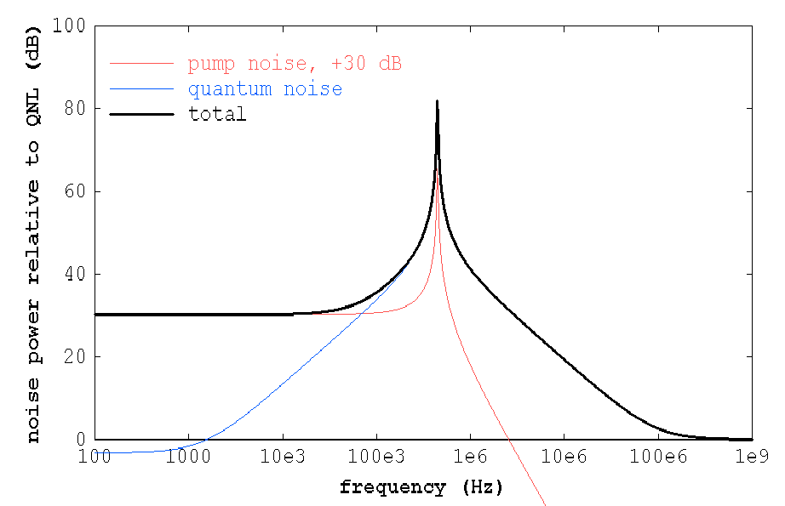
Noise Modeling
dipole fluctuations
& vacuum fluctuations from OC
pump noise
vacuum fluctuations from OC

Slide 26
Noise Modeling
Models can greatly help to
  identify limiting factors
  optimize the design before trying in the lab
  verify by comparison with measurements
  whether the expectable performance is reached
Analytical and/or numerical techniques are required,
depending on the circumstances
Noise modeling requires detailed know-how on mathematical issues, numerical techniques, physical effects, and technical possibilities,
and extensive general experience of working with models.
Note: Setting up a model is one thing –
producing results is another one!

Slide 27
Noise Modeling
Examples for previous activities of R. Paschotta:
Analytical calculation of quantum noise properties of lasers, frequency doublers, parametric oscillators, etc.
Numerical simulation of noise in highly nonlinear pulse propagation in photonic crystal fibers, and studies of its effects on pulse compression
Modeling of timing noise and other noise properties of mode-locked lasers, based on quantum noise and classical noise inputs
Note: R. Paschotta has developed extremely powerful and versatile simulation software, allowing to get quick and reliable results in graphical or text form.

Slide 28
Noise Modeling
Examples for possible consulting activities:
Give advice on what kind of model will be feasible, useful and efficient
Set up a model and use it to answer concrete questions,
e.g. on
  critical parameters
  possibilities for optimization
  effects of noise in components and systems
  (e.g. timing jitter, carrier-envelope offset noise, impact in metrology, e.g. in interferometers)

