Slide 1
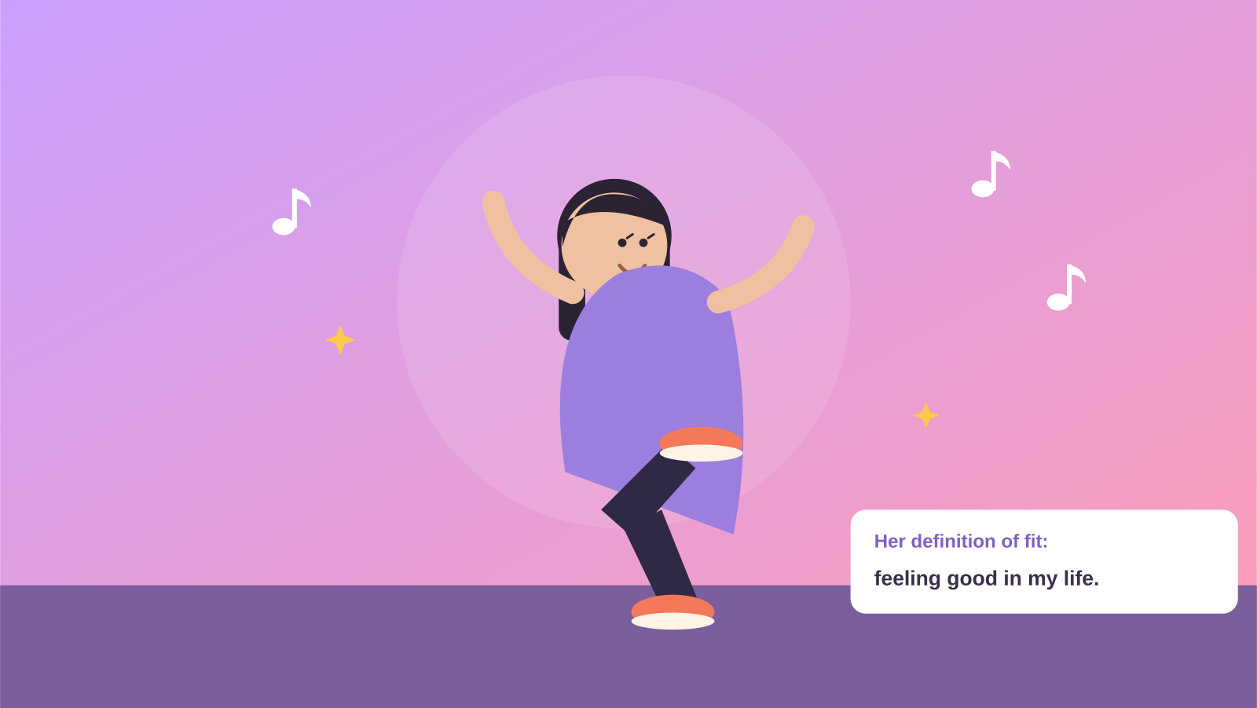
FITNESS APP · STORYBOARD
Feel Good, Your Way
Maya's story — from the comparison trap to a supportive community and fitness on her own terms.
8 panels · a feelings-first, community-driven journey

Slide 2
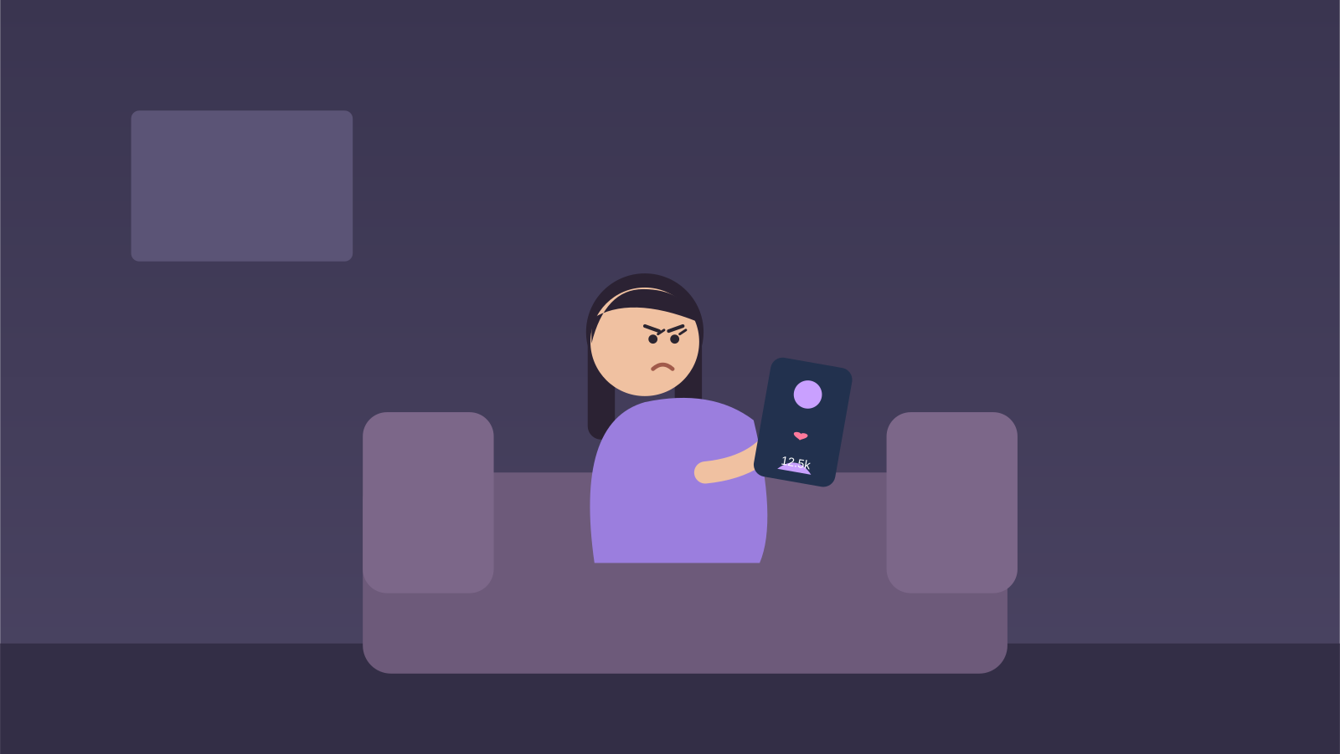
1
Panel 1 · The Comparison Trap
“Everyone's already so fit… why even start?”
PURPOSE Show the real barrier — comparison and intimidation, not laziness.

Slide 3
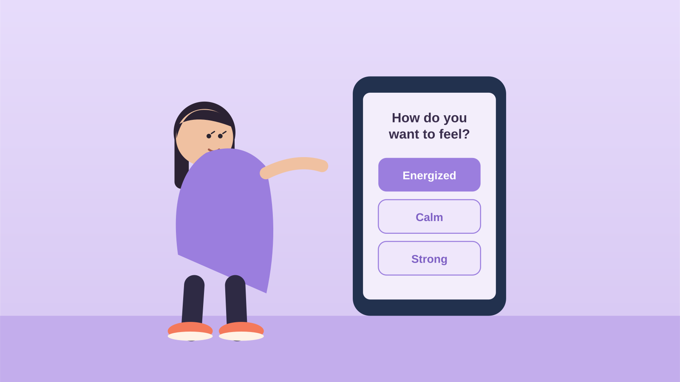
2
Panel 2 · A Different Kind of App
“How do you want to feel today?”
PURPOSE Reframe fitness around feelings, not appearance or weight.

Slide 4
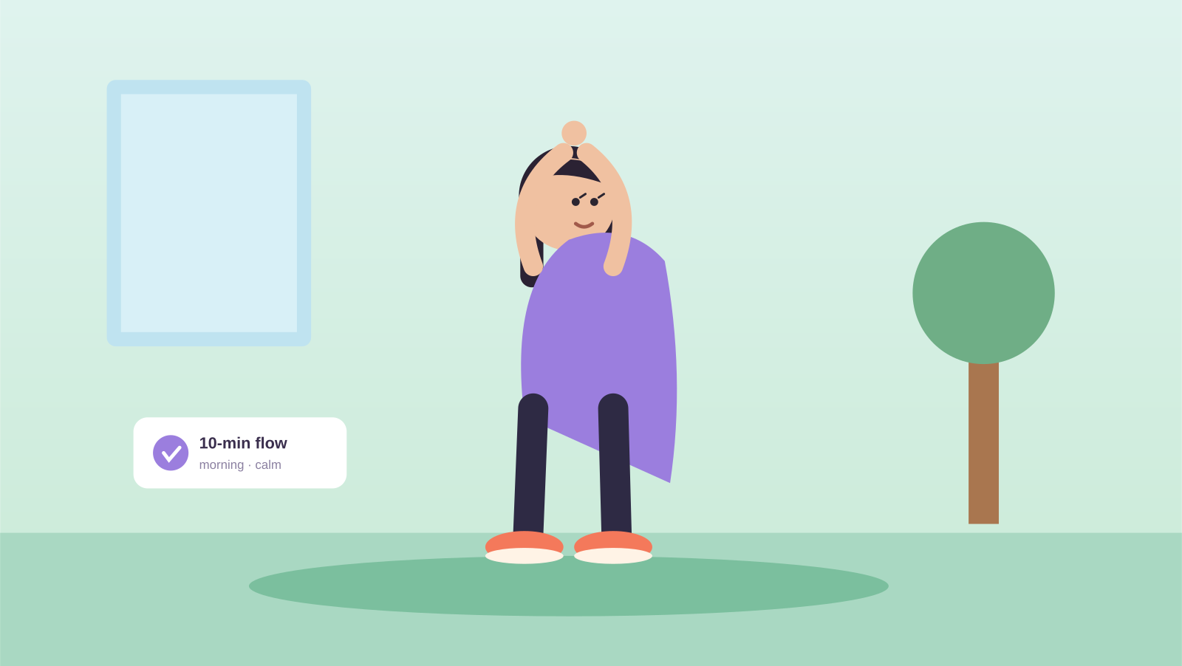
3
Panel 3 · On Her Own Terms
“A 10-minute flow, right in your living room.”
PURPOSE Remove gym intimidation — fitness fits her space and life.

Slide 5
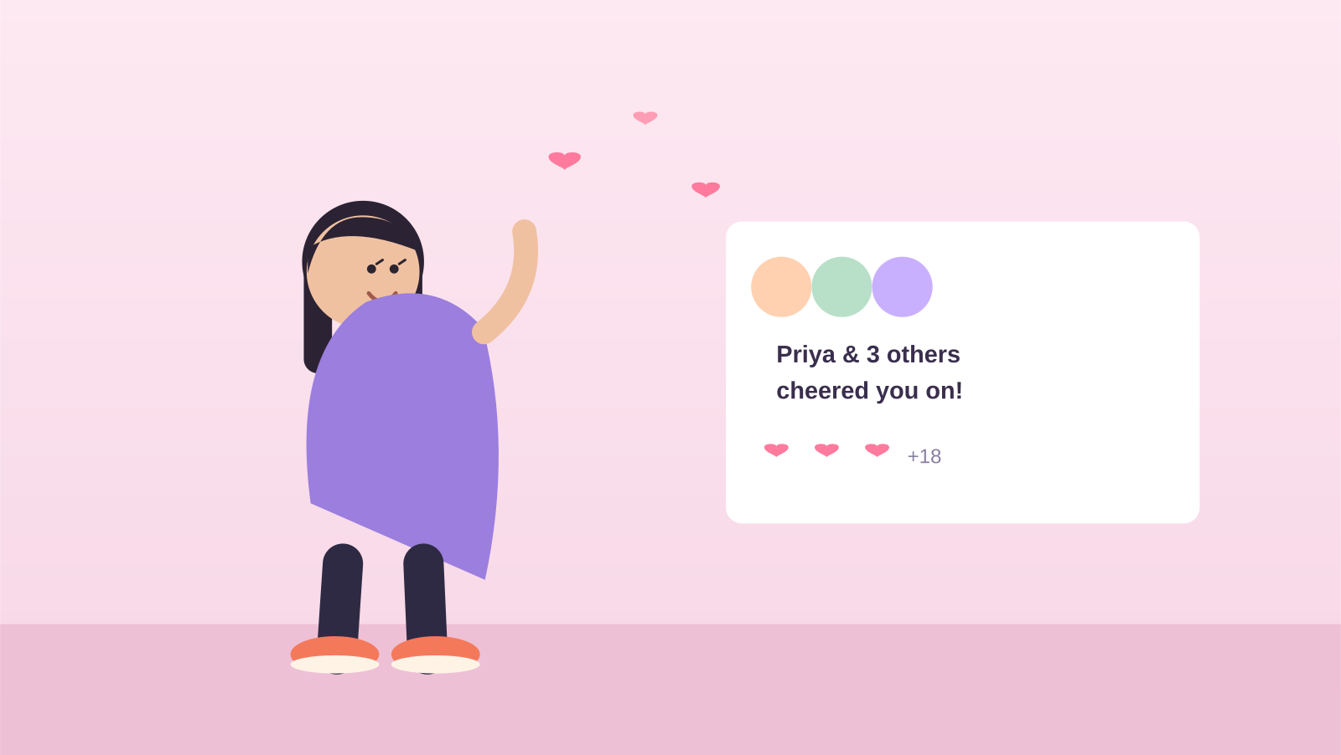
4
Panel 4 · She's Not Alone
“Priya and 3 others cheered you on!”
PURPOSE Belonging and encouragement replace the solo grind.

Slide 6
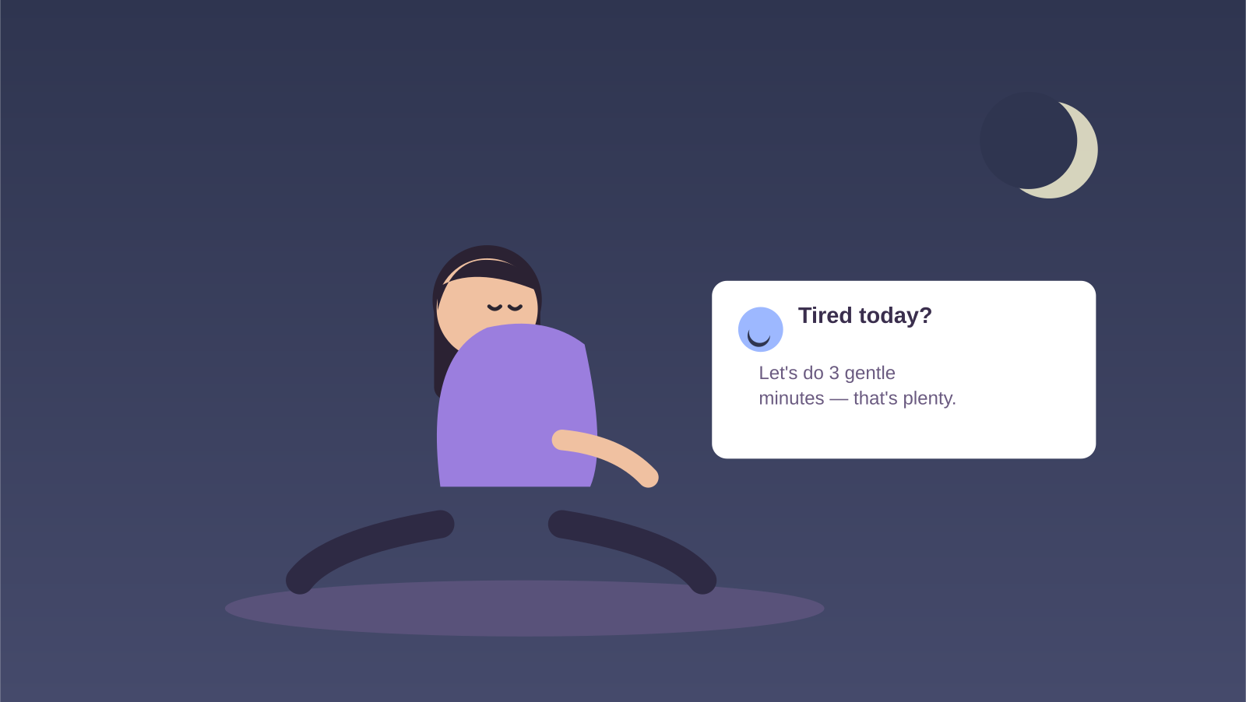
5
Panel 5 · Kindness Over Guilt
“Tired today? Three gentle minutes is plenty.”
PURPOSE The app adapts to her energy instead of shaming her.

Slide 7
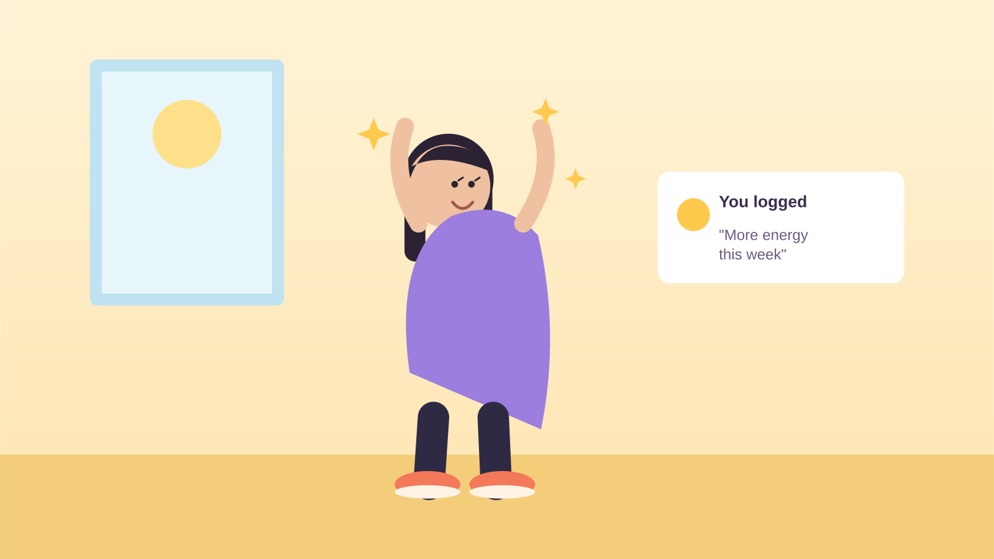
6
Panel 6 · A Win the Scale Can't Show
“You logged: ‘More energy this week.’”
PURPOSE Redefine success beyond weight or appearance.

Slide 8
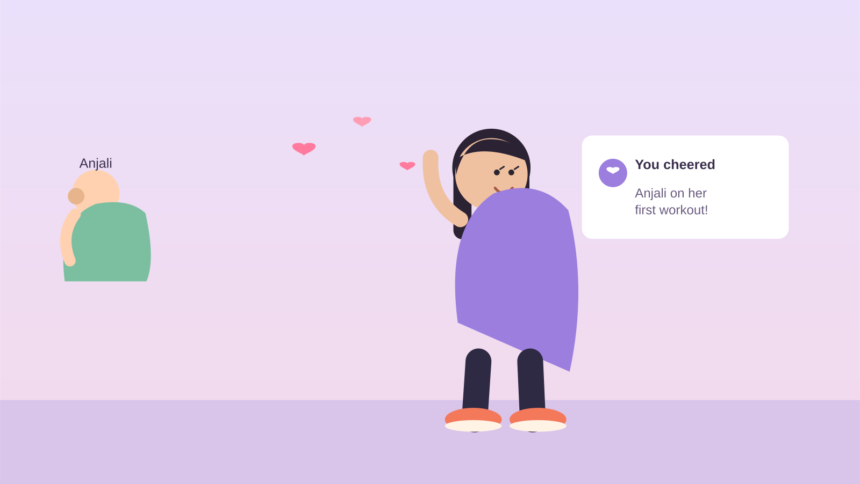
7
Panel 7 · Passing It On
“You cheered Anjali on her first workout!”
PURPOSE Growth becomes generosity — she now lifts others up.

Slide 9
8
Panel 8 · Fit, Redefined
“Fit means feeling good in my own life.”
PURPOSE Close on self-defined, sustainable wellbeing.

