Slide 1
XML Simplified – Session 1
Module 1 - Introduction to XML
Module 2 - Namespaces

Slide 2
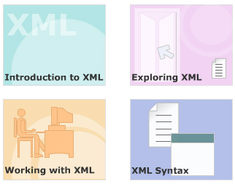
Module 1 - Introduction to XML

Slide 3
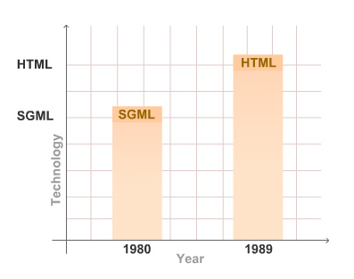
Features of markup languages
GML describes the document in terms of its format, structure and other properties.
SGML ensures that the system can represent the data in its own way.
HTML used ASCII text, which allows the user to use any text editor.
Notes:
Drawbacks
GML and SGML were not suited for data interchange over the web.
HTML possesses instructions on how to display the content rather than the content they encompass.
Features
Early electronic formats like troff and TEX, were more concerned about the presentation of the content rather than with document structure.
Generalized Markup Language (GML), a project by IBM, helped the documents to be edited, formatted, and searched by different programs using its content-based tags.
In 198D, ANSI Committee created Standard Generalized Markup Language (SGML), an all-encompassing coding scheme and flexible toolkit for developing specialized markup languages.
In 1989, Hyper Text Markup Language (HTML), a technology for sharing information by using hyperlinked text documents was developed.

Slide 4
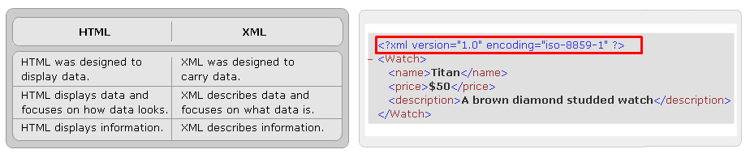
Evolution of XML
In order to address the issues raised by earlier markup languages, the Extensible Markup Language (XML) was created. XML is a W3C recommendation.
XML is a set of rules for defining semantic tags that break a document into parts and identify the different parts of the document.
XML was developed over HTML because of the basic differences between them given in the table below.

Slide 5
Features of XML
XML stands for Extensible Markup Language
XML is a markup language much like HTML
XML was designed to describe data
XML tags are not predefined. You must define your own tags
XML uses a Document Type Definition (DTD) or an XML Schema to describe the data
XML with a DTD or XML Schema is designed to be self-descriptive
Notes:
Features of XML

Slide 6
Benefits of XML
Data Independence
Easier to parse
Reducing Server Load
Easier to create
Web Site content
Remote Procedure Calls
e-Commerce
Notes:
Data Independence
Data independence is the essential characteristic of XML. It separates the content from its presentation. Since an XML document describes data, it can be processed by any application.
Easier to parse
The absence of formatting instructions makes it easy to parse. This makes XML an ideal framework for data exchange.
Reducing Server Load
Because XML's semantic and structural information enables it to be manipulated by any application, much of the processing that was once earlier limited to servers can now be performed by clients. This reduces server load and network traffic, resulting in a faster, more efficient Web.
Easier to create
It is text-based, so it is easy to create an XML document with even the most primitive text processing tools. However, XML also can describe images, vector graphics, animation or any other data type to which it is extended.
Web Site Content
The W3C uses XML to write its specifications and transforms it to a number of other presentation formats. Some web sites also use XML for their content and get it transformed to HTML using XSLT and CSS and display the content directly in browsers.
Remote Procedure Calls
XML is also used as a protocol for Remote Procedure Calls (RPC). RPC is a protocol that allows objects on one computer to call objects on another
computer to do work, allowing distributed computing.
e-Commerce
XML can be used as an exchange format in order to send data from one company to another.

Slide 7
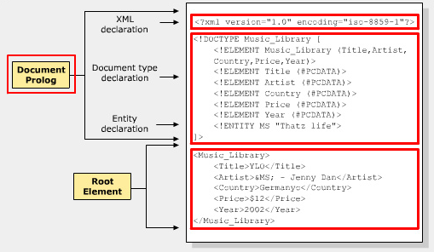
XML Document Structure
XML documents are commonly stored in text files with extension .xml
The two sections of an XML document are:
Document Prolog
Root Element
Notes:
XML Structure
An XML document consists of a set of unambiguously named "entities". Every XML document starts with a "root" or document entity. All other entities are optional. Entities are aliases for more complex functions. A single entity name can represent a large amount of text. The alias name is used each time some text is referenced and the processor expands the contents of the alias.
Document Prolog
XML parser gets information about the content in the document with the help of document prolog. Document prolog contains metadata and consists of two parts - XML Declaration and Document Type Declaration. XML Declaration specifies the version of XML being used. Document Type Declaration defines entities' or attributes' values and checks grammar and vocabulary of markup.

Slide 8
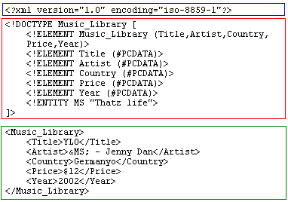
Structure of an XML Document
Logical structure
(Document prolog)
Entity ➔ tag
All tag require
ending tag for
every opening tag.
Empty tag:
<TagName/>
Physical structure
(body)
( Tree data
structure)
Notes:
Example
<?xml version="1.0" encoding="UTF-8"?>
<!DOCTYPE Music_Library [
<!ELEMENT Music_Library (Year, Price, Country, Artist, Title)>
<!ELEMENT Title (#PCDATA)>
<!ELEMENT Artist (#PCDATA)>
<!ELEMENT Country (#PCDATA)>
<!ELEMENT Price (#PCDATA)>
<!ELEMENT Year (#PCDATA)>
<!ENTITY MS "Thatz life">
]>
<Music_Library>
<Title>YLO</Title>
<Artist> &MS;- Jenny Dan</Artist>
<Country>Germany</Country>
<Price>$12</Price>
<Year>2010</Year>
</Music_Library>

Slide 9
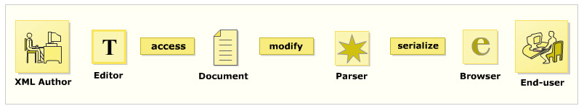
XML Document Life Cycle
An XML editor refers to the DTD and creates an XML document
The document is scanned for elements and attributes in it
The data is then extracted from elements and attributes of the document
The data is then converted into the application program
Notes:
An XML editor refers to the DTD and creates an XML document. After the document is created, the document is scanned for elements and attributes in it. This stage is known as scanning. The XML parser builds a complete data structure after parsing. The data is then extracted from elements and attributes of the document. This stage is known as access. It is then converted into the application program. The document structure can also be modified during the process by inserting or deleting elements or by changing textual content of element or attribute. This stage is known as modification. The data is then serialized to a textual form and is passed to a browser or any other application that can display it. This stage is known as serialization.

Slide 10
Editors for XML
Exchanger XML Lite 3.2
XMLwriter
XML Spy
XML Pro
XMLwind
XMetal
Behind the editing functions, editors can check XML for validity, verify it against a DTD/Schema and perform series of transforms over document...
Notes:
XML documents are most commonly created with an editor. The main functions that editors provide are as follows:
- Add opening and closing tags to the code
- Check for validity of XML
- Verify XML against a DTD/Schema
- Perform series of transforms over a document
- Color the XML syntax
- Display the line numbers
- Present the content and hide the code
- Complete the word

Slide 11
Parsers for XML
XML parser (processor)
Is a software program or set of programs that parses documents for its structure.
The parser reads the document and verifies it for its well-formedness.
None-Validating parser:
It checks the well-formedness of the document.
Reads the document and checks for its conformity with XML.
Validating parser:
It checks the validity of the document using DTD.
Notes:
XML parser (processor)
is a software program or set of programs that parses documents for its structure.
The parser reads the document and verifies it for its well-formedness; it also capable for validating XML files depending on DTD. After this, the parser converts the document into tree of elements or data structure.
Commonly used parsers: Crimson, Xerces, Oracle XML Parser …

Slide 12
Browser for XML
Commonly used Browsers are:
Netscape
Internet Explore
Mozilla Firefox
Opera
Google Chrome
Notes:
After the XML document is read, the parser passes the data structure to the client application. The application can be a web browser. The browser then formats the data and displays it to the user. Other programs like database, MIDI program or a spreadsheet program may also receive the data and present it accordingly.

Slide 13
Working with XML
Create an XML document in an Editor
Save the XML document
Load XML document in a browser
Notes:
Create an XML document in an Editor
To create a simple XML document, you type XML code in any text or XML editor.
For example, you type the following code:
<?xml version="1.0" encoding="iso-8859-1”?>
<Soft_drink>
<Name >Refresh</Name>
<Price>1$</Price>
</Soft_drink>
Save the XML document
After the typing is done, you save the contents of the file. To save the file, you click on the File menu, click on the "Save" option and provide the file name such as, for example, SoftDrink.xml. The extension .xml is compulsory if you are typing the code in Notepad or any kind of word processor such as Microsoft Word.
Load XML document in a browser
After the document is saved, you can open the file directly in a browser that supports XML. A common browser used is Internet Explorer 8.0 or later.

Slide 14
Example
Processing instruction
<?xml version="1.0" encoding="UTF-8"?>
<!DOCTYPE Customers [
<!ELEMENT Customers (Customer)*>
<!ELEMENT Customer (CusTel|CusAddress|CusName|CusCode)*>
<!ELEMENT CusCode (#PCDATA)>
<!ELEMENT CusName (#PCDATA)>
<!ELEMENT CusAddress (#PCDATA)>
<!ELEMENT CusTel (#PCDATA)>
]>
<Customers>
<Customer>
<CusCode>C001</CusCode>
<CusName>James</CusName>
<CusAddress>122 Street 1</CusAddress>
<CusTel>077-123456</CusTel>
</Customer>
<Customer>
<CusCode>C002</CusCode>
<CusName>Nancy</CusName>
<CusAddress>412 Street 3</CusAddress>
<CusTel>075-897666</CusTel>
</Customer>
</Customers>
Declaring DTD
Elements
Notes:
Working with Netbean

Slide 15
Well-formed XML document
Minimum of one element is required.
XML tags are case sensitive.
Every start tag should end with end tag.
XML tags should be nested properly.
XML tags should be valid.
Length of markup names.
XML attributes should be valid.
XML documents should be verified.
Notes:
Well-formed ness refers to the standards that are to be followed by the XML documents. Well-formedness makes XML processors and browsers read XML documents. A document is well formed, if it fulfills the following rules:
Minimum of one element is required: Every well formed XML document should consist of a minimum of the one element
XML tags are case sensitive: All the tags used are case sensitive, that is <URGENT> is diffirent from <urgent>
Every start tag should end with end tag: All the tags in XML should begin with a tag and a matching end tag. The end tags only have an additional forward slash as compared to their start tag.
XML tags should be nested properly: All the XML tags used should be nested property.
XML tags should be valid:
Tags should begin with letter, an underscore (_), or a colon (:).
Tags should contain combination of letters, numbers, periods (.), colons, underscores, or hyphens (-). Tags should not contain white space. Tags should not start with reserved words like "xml".
Length of markup names: The length of the tags depends on the XML processors.
XML attributes should be valid:
• Attributes should not be duplicated.
• Attributes are specified by a name and value pair which is delimited by equal (=) sign. The values are delimited by quotation marks. For example
<DOLL NAME = "BARBIE" COLOR = "PINK">
• Attributes should follow the same rules as followed by tags.
XML documents should be verified: To be read by the XML browsers, the document should be checked against the XML rules.

Slide 16
Well-formed demo
<?xml version="1.0" encoding="UTF-8"?>
<!DOCTYPE Books [
<!ELEMENT Books (Price|Author|Title)*>
<!ELEMENT Title (#PCDATA)>
<!ELEMENT Author (#PCDATA)>
<!ELEMENT Price (#PCDATA)>
]>
<Books>
<Title>Elementary programming with C</title>
<Author>Aptech</Author>
<Price>$23</Price>
</Books>
XML checking started.
Checking file:/D:/ACCP2010/SEM2/XMLExample/src/session01/Example03.xml...
The element type "Title" must be terminated by the matching end-tag "</Title>". [10]
XML checking finished.
Notes:
Using netbean to check

Slide 17
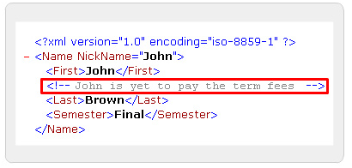
XML Syntax
Comments
Comments start with the string <! -- and end with the string -->. The parser believes that the comment has come to an end when it finds a >.
Notes:
Comments Rules:
Comments should not include "-" or"—" as it might lead to confuse the XML parser.
Comments should not be placed within a tag or entity declaration.
Comments should not be placed before the XML declaration.
Comments can be used to comment the tag sets. For example:
<!-- Highlighc chese
<ChiefGuescl> King </ChiefGuescl>
<Judge>Queen</Judge>
-->
Comment should not be nested.

Slide 18
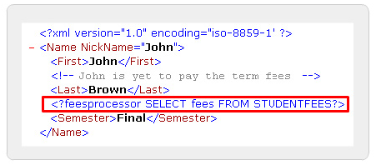
XML Syntax
Processing Instructions
<?PITarget <instruetion>?>
where,
PlTarget is the name of the application that should receive the processing instructions. <instruction> is the instruction for the application.
Notes:
Processing instructions are information which is application specific. These instructions do not follow XML rules or internal syntax. With the help of a parser these instructions are passed to the application.
The main objective of a processing instruction is to present some special instructions to the application.
All the processing instructions should begin with an identifier called target.

Slide 19
XML Syntax
Classification of character data
CDATA: Character data, raw text. Parser need not process these data.
<?xml version="1.0" encoding="UTF-8"?>
<Svg>
<Desc>Three shapes</Desc>
<Para>But the formula was<![CDATA[if (&x1 + &x2)]]> which resulted in 7.
</Svg>
PCDATA: Parsed character data. Parser must process these data.
<?xml version="1.0" encoding="UTF-8"?>
<Name nickname="John">
<First>John</First>
<!--John is yet to pay the term fees-->
<Last>Brown</Last>
<Semester> Final> 10 & <20 </Semester>
</Name>
Notes:
The text inside a CDATA section is not parsed by the XML parser. A text is considered in a CDATA section if it contains '<' or '<&>' characters. The CDATA part begins with a "<![CDATA[" and ends with "]]>". The CDATA sections cannot be nested. It also does not accept line breaks or spaces inside the "]]>" string. Comments are also not recognized.
The data that is parsed by the parser is called as parsed character data (PCDATA). The PCDATA specifies that the element has parsed character data. It is used in the element declaration.
Escape character like "<" when used in the XML document will make the parser interpret it as a new element.

Slide 20
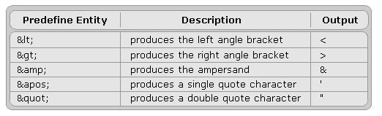
XML Syntax
Entities
<?xml version="1.0" encoding="UTF-8"?>
<!DOCTYPE Letter[
<!ENTITY Address "15 Downing St Floor 1">
<!ENTITY City "New York">
]>
<Letter>
<To>&quot; Tom Smith &quot;</To>
<Address>&Address;</Address>
<City>&City;</City>
<Body>
Hi! How are you?
The sum is &gt; $1000
</Body>
<From>Arnold</From>
</Letter>
Notes:
The XML document is made up of large amount of information called as entities.
Every entity consists a name and a value. The value ranges from a single character to a XML mark up file. As the XML document is parsed, it checks for entity references. For every entity reference, the parser checks the memory to replace the entity reference with a text or markup.
An entity reference consists of an ampersand (a), the entity name, and a semicolon (;).
All the entities must be declared before they are used in the document. An entity can be declared either in a document prolog or in a DTD.

Slide 21
DOCTYPE declarations
Internal DTD
<?xml version="1.0" encoding="UTF-8"?>
<!DOCTYPE Books [
<!ELEMENT Books (Price|Author|Title)*>
<!ELEMENT Title (#PCDATA)>
<!ELEMENT Author (#PCDATA)>
<!ELEMENT Price (#PCDATA)>
]>
<Books>
<Title>Elementary programming with C</title>
<Author>Aptech</Author>
<Price>$23</Price>
</Books>
External DTD
XML file
<?xml version="1.0" encoding="UTF-8"?>
<!DOCTYPE Books SYSTEM "BookDTD.dtd">
<Books>
<Title>
Elementary programming with C
</title>
<Author>Aptech</Author>
<Price>$23</Price>
</Books>
DTD file
<!ELEMENT Books (Price|Author|Title)*>
<!ELEMENT Title (#PCDATA)>
<!ELEMENT Author (#PCDATA)>
<!ELEMENT Price (#PCDATA)>
Notes:
The syntax of document type declaration is as follows:
<! DOCTYPE name_of_root_element SYSTEM “URL of the external DTD subset" [
Internal dtd subset
]>
Where
name_of_root_element is the name of the root element.
SYSTEM is the url where the dtd is located.
[Internal dtd subset] are those declarations that are in the document.

Slide 22
Attributes
Attributes:
Additional information about the attributes can be given in the form of attributes.
Attributes can be used to distinguish between the elements of the same name
<elementName attName1="attValue1" attName2="attValue2">
<?xml version="1.0" encoding="UTF-8"?>
<Player Sex = "Male">
<FirstName>Tom</FirstName>
<LastName>Federer</LastName>
</Player>
Notes:
Additional information about the attributes can be given in the form of attributes. Attributes are created in the DTD along with the elements. Every attribute within an element is associated with a name-value pair.
Attributes can be used to distinguish between the elements of the same name. Attributes occur in the start-tags after the element name. Attribute values are always enclosed in single or double quotes.

Slide 23
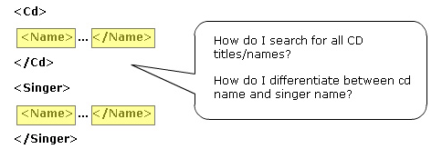
Need for a namespace
XML developer has to ensure the uniqueness of the element names and attributes in a document.
Notes:
Consider an example where there are two occurrences of the <title> element in an XML document, one suggesting the title of a CD whereas another suggesting the title of a book. Imagine that an application is supposed to access this document and search for the <title> element. An XML parser will be lost if it does not get an additional information to search for a specific title.

Slide 24
Define namespaces
A namespace is a collection of names that can be used as element names or attribute names in XML document.
Namespaces allow the browser to:
Combine documents from different sources, and help identify the source of elements or attributes.
Access Document Type Definitions or other description of the elements and attributes against which, the document is validated
Notes:
Define namespaces
A Namespace is identified by the Uniform Resource Identifier (URI).
For example, we can have all three elements named as "batch". The first referring the batch of students in Aptech Education Center, the second a batch of products, and the third, a batch of tourists. The element batch can be identified with a unique URI as given below.
http://www.Aptech_edu.ac.batch
http://www.tea.org.batch
http://www.tourism.org.batch

Slide 25
Syntax
namespacePrefix
elementName
URI
<st:Student xmlns:st="http://www.spectrafocus.com/student/">
<st:First>John</st:First>
<st:Last>Dewey</st:Last>
<st:Title>Student</st:Title>
</st:Student>
Syntax:
<namespacePrefix: elementName xmlns:namespacePrefix = “URI”>
Notes:
namespacePrefix
Each namespace has a prefix that is used as a reference to the namespace. Prefixes must not begin with xmlns or xml. A namespace prefix can be any legal XML name that does not contain a colon. A legal XML name must begin with a letter or an underscore.
elementName: It specifies the name of the element.
xmlns: The xmlns attribute is what notifies an XML processor that a namespace is being declared. xmlns stand for XML Namespace.
URI: A Uniform Resource Identifier (URI) is a string of characters which identifies an Internet Resource. The URI includes Uniform Resource Name (URN) and a Uniform Resource Locator (URL). URLs contain the reference for a document or an HTML page on the Web. The URN is a universally unique number that identifies Internet resources.

Slide 26
Placing attributes in a namespace
Syntax: prefix:attributeName = "value"
<Catalog xmlns:bk="http://www.aptechworldwide.com">
<bk:BookList>
<bk:Title bk:Type = "Fiction">
Evening in Paris
</bk:Title>
<bk:Price>$23</bk:Price>
</bk:BookList>
</Catalog>

Slide 27
Default Namespaces
default namespace have no prefix
<?xml version="1.0" ?>
<DEMO-3 xrnlns="http://Education.com/ns" xrnlns:Tea="http://Tea.com/namespace" >
<BATCHLIST>
<BATCH>Batch 01</BATCH>
<BATCH>Batch 02</BATCH>
<BATCH>Batch 03</BATCH>
<BATCH>TEA BATCH
<Tea:BATCH>Tea Batch 1- 6h</Tea:BATCH>
<Tea:BATCH>Tea Batch 2- 9h</Tea:BATCH>
</BATCH>
<BATCH>TEA BATCH
<Tea:BATCH>Tea Batch 3- 13h</Tea:BATCH>
<Tea:BATCH>Tea Batch 4- 15h</Tea:BATCH>
</BATCH>
</BATCHLIST>
</DEMO-3>
Notes:
A default namespace is used by an element and its child elements if the element does not have a namespace prefix.

Slide 28
Override default namespaces
<Catalog xmlns= "http://www.aptechworldwide.com">
<Book>
<Title type = "Fiction">Evening in Paris</Title>
<Price>$123</Price>
</Book>
<Book>
<Title type = "Non-Fiction">Return to Earth</Title>
<Price xmlns = "http://www.aptech.ac.in">$23</Price>
<Title type = "Non-Fiction">Journey to the center of the Moon</Title>
<Price>$123</Price>
</Book>
</Catalog>
Override default namespace
Notes:
The default namespace applies to the element on which it was defined and all descendants of that element. If one of the descendants has another default namespace defined on it, this new namespace definition overrides the previous one and becomes the default for that element and all its descendants.

Slide 29
Summary
Introduction to XML
Exploring XML
Working with XML
XML Syntax
XML Namespaces.
Working with Namespaces Syntax.
Notes:
Introduction to XML:
XML was developed to overcome the drawbacks of earlier mark up languages. XML consists of set of rules that describe the content to be displayed in the document. XML markup contains the content in the information containers called as elements.
Exploring XML:
XML document is divided into two parts namely document prolog and root element. An XML editor creates the XML document and a parser validates the document.
Working with XML:
XML document is divided into XML Version Declaration, DTD and the document instance in which the mark up defines the content. The XML mark up is again categorized into structural, semantic and stylistic. The output of the XML document is displayed in the browser if it is well formed.
XML Syntax:
Comments are used in the document to give information about the line or block of code. The content in XML document is divided into mark up and character data. The entities in XML are divided into general entities and parameter entities. A DTD can be declared either internally or externally.
XML Namespaces:
Namespaces distinguish between elements and attributes with the same name from different XML applications. It is a collection of names that can be used as element names or attribute names in XML document. XML Namespaces provide a globally unique name for an element or attribute to avoid name collisions.
Working with Namespaces Syntax:
Namespaces are declared by an xmlns attribute whose value is the URI of the namespace. If an attribute name has no prefix, it has no namespace. A default namespace is used by an element and its child elements if the element does not have a namespace prefix.

Slide 30
Introduction to XML Namespaces
Q&A
XML Simplified

Slide 31
Next …
In the next session, we will discuss about DTDs and XML Schema

