Slide 1
XML Simplified – Session 2
Module 3 - DTDs
Module 4 - XML Schema
Notes:
Welcome to the module, Document Type Definitions (DTDs). This module focuses on how to create DTDs for XML files. In this module, topics such as DOCTYPE declarations, types of DTDs, wellformedness and validity of XML files, declaration of elements, attributes, and entities in a DTD are also covered.
Welcome to the module, XML Schema. This module focuses on exploring XML schema and its features. The structure of an XML document with the help of schema is also discussed. This module aims at providing a clear understanding of the different elements and data types supported by an XML schema.

Slide 2
Module 1, 2– Review
Introduction to XML
Exploring XML
Working with XML
XML Syntax
XML Namespaces.
Working with Namespaces Syntax.

Slide 3
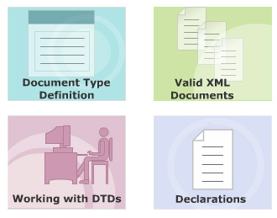
Module 3 - DTDs
Notes:
Objectives

Slide 4
Definition of a DTD
A Document Type Definition is a non XML document made up of element, attribute and entity declarations
The DTD
Helps XML parsers to validate the XML document
Helps authors to set default values for element attributes
The document's tree structure can be determined based on the DTD
Notes:
MORE:
Tree Structure
Hierarchical representation of an XML document, its root element, other elements, entities and so on. This structure is conceptually interpreted as the document's tree structure.
XML Parsers
An XML parser is a software program or set of programs that parses XML documents for its structure. XML parsers are also capable of validating XML files depending on DTDs.

Slide 5
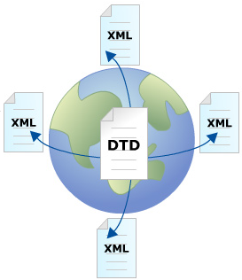
Need for a DTD
People working on parts of the same XML document sometimes used similar tags for different purposes and at other times used different tags for the same purpose.
At times, same elements possessed or exhibited different attributes. Some sort of standardization of elements and attributes was needed.
Notes:
The fact that XML allowed its user to define his/her own tag was one of its biggest advantages. But it also led to a genuine problem. People working on parts of the same XML document sometimes used similar tags for different purposes and at other times used different tags for the same purpose. At times, same elements possessed or exhibited different attributes. Some sort of standardization of elements and attributes was needed.
That is how DTDs came into picture. A DTD can define all the possible combinations and sequences for elements to be used in an XML document along with their attributes and their acceptable values.

Slide 6
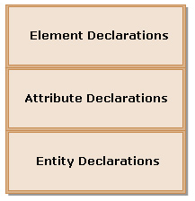
Structure of DTD
<!ELEMENT Mobile (Company, Model, Price)>
<!ELEMENT Company (#PCDATA)>
<!ELEMENT Model (#PCDATA)>
<!ELEMENT Price (#PCDATA)>
<!ATTLIST Model Type CDATA "Camera">
<!ENTITY HP "Head Phones">
Notes:
A typical DTD structure is composed of the following three blocks:
- Element Declarations
- Attribute Declarations
Entity Declarations
Each element declaration specifies the name of the element, and the content which that element can contain. Each attribute declaration specifies the element that owns the attribute, the attribute name, its type and its default value (if any). Each entity declaration specifies the name of the entity and either its value or location of its value.
These groups of element, attribute and entity declarations that form the three blocks of a DTD respectively can be declared in any sequence.

Slide 7
Creating Internal DTDs
1. Declare all the possible elements.
2. Specify the permissible element children, if any.
3. Set the order in which elements must appear.
4. Declare all the possible element attributes.
5. Set the attribute data types and values.
6. Declare all the possible entities.
Notes:
Steps 1 to 3 deal with element declaration, steps 4 and 5 with attribute declarations and step 6 with entity declarations. This is in clear accordance with the structure of a DTD.

Slide 8
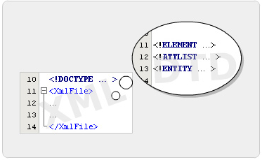
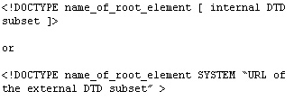
DOCTYPE Declarations
A Document Type Declaration declares that the XML file in which it is present adheres to a certain DTD.
The declaration also specifies the name of that DTD and either its content or location.
Notes:
A Document Type Declaration declares that the XML file in which it is present adheres to a certain DTD. The declaration also specifies the name of that DTD and either its content or location.
Placed in the XML document's prolog, a DOCTYPE declaration begins with <!DOCTYPE and ends with a >. In between is the name of the root element, followed either by a pair of square brackets containing the DTD itself or by the SYSTEM keyword and a URL specifying where the DTD can be found.
Without the document type declaration, a DTD is nothing but plain text.

Slide 9
Types of DTDs
Internal DTDs
<?xml version="1.0" encoding="UTF-8"?>
<!DOCTYPE Books [
<!ELEMENT Books (Price|Author|Title)*>
<!ELEMENT Title (#PCDATA)>
<!ELEMENT Author (#PCDATA)>
<!ELEMENT Price (#PCDATA)>
]>
<Books>
<Title>Elementary programming with C</title>
<Author>Aptech</Author>
<Price>$23</Price>
</Books>
Notes:
DOCTYPE declarations have two basic forms of syntax. Depending on the document type declaration syntax used, DTDs can be classified as Internal or External DTDs.

Slide 10
Types of DTDs
BookDTD.dtd
External DTDs
<!ELEMENT Books (Price|Author|Title)*>
<!ELEMENT Title (#PCDATA)>
<!ELEMENT Author (#PCDATA)>
<!ELEMENT Price (#PCDATA)>
<?xml version="1.0" encoding="UTF-8"?>
<!DOCTYPE SYSTEM "BookDTD.dtd">
<Books>
<title>Elementary programming with C</title>
<Author>Aptech</Author>
<Price>$23</Price>
</Books>
Notes:
DOCTYPE declarations have two basic forms of syntax. Depending on the document type declaration syntax used, DTDs can be classified as Internal or External DTDs.

Slide 11
Well-formed XML documents
All elements must be enclosed by the root element
All elements must have closing tags
All tags should be case sensitive
All elements must be properly nested
All attribute values must always be quoted
Notes:
For an XML document to execute properly, it should be well-formed. A well-formed XML document adheres to the basic XML syntax rules. The World Wide Web Consortium in its specifications, states that XML documents with errors should not be processed by any program.

Slide 12
Valid XML documents
Valid XML document = Well-formed document +
The document adheres to its DTD
Validity of XML documents plays an important role in all XML applications.
Be it creating modular parts of the code, or data interchange, or processing of transferred data, or database access and so on
Validity of the XML document is a recommended feature.
Notes:
Valid XML documents

Slide 13
Testing XML for Validity
using netbean
<?xml version="1.0" encoding="UTF-8"?>
<!DOCTYPE Books [
<!ELEMENT Books (Price|Author|Title)*>
<!ELEMENT Title (#PCDATA)>
<!ELEMENT Author (#PCDATA)>
<!ELEMENT Price (#PCDATA)>
]>
<Books>
<Title>Elementary programming with C</title>
<Author>Aptech</Author>
<Price>$23</Price>
</Books>
XML checking started.
Checking file:/D:/ACCP2010/SEM2/XMLExample/src/session01/Example03.xml...
The element type "Title" must be terminated by the matching end-tag "</Title>". [10]
XML checking finished.
Notes:
Using IE to check the validation of XML documents.

Slide 14
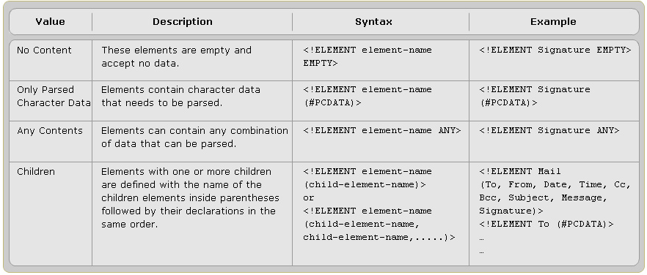
Declaring Elements
Notes:
Declaring Elements

Slide 15
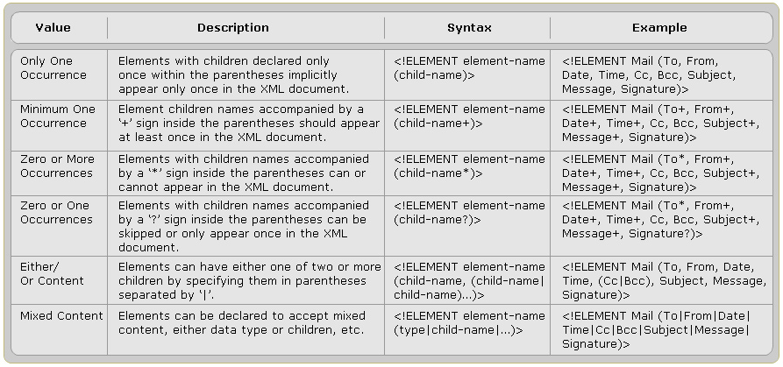
more …
Notes:
more …

Slide 16
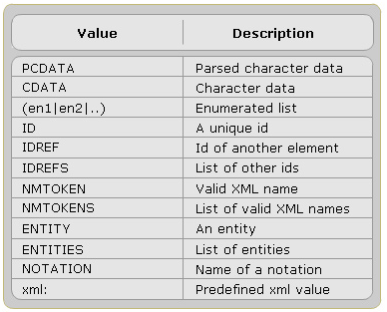
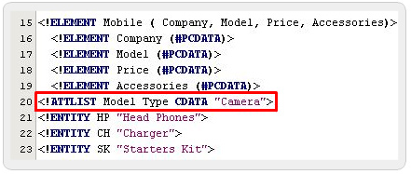
Declaring Attributes
Syntax:
<!ATTLIST element-name attribute-name attribute-type default-value>
Notes:
Declaring Attributes

Slide 17
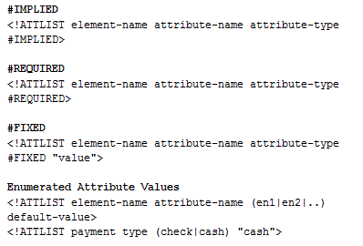
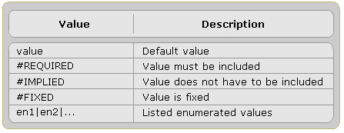
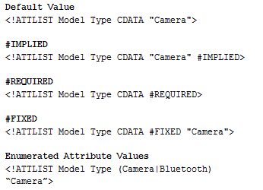
Specifying Attribute Values

Slide 18

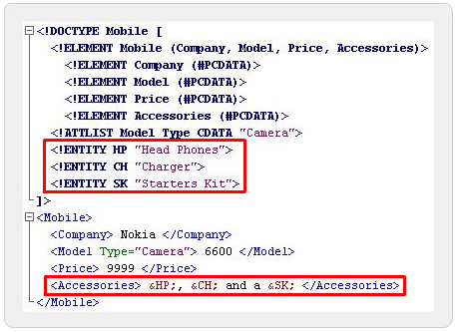
Entities in DTD
An entity, in XML, is a placeholder that consists of a name and a value.
It is declared once and then repeatedly used through out the document in place of its value.
Notes:
At the time of processing, the XML parser goes through the document declarations. The parser then scans the document for all entity references. When the parser encounters an entity reference, it replaces the entity reference with the entity value associated with that entity. The parser then resumes parsing from the replaced text. Entity references within the replaced text are also replaced by doing so.

Slide 19
Kinds of Entity Declarations
Internal Entity Declaration
<?xml version="1.0" encoding="UTF-8"?>
<!DOCTYPE Books [
<!ELEMENT Books (Price|Author|Title)*>
<!ELEMENT Title (#PCDATA)>
<!ELEMENT Author (#PCDATA)>
<!ELEMENT Price (#PCDATA)>
<!ENTITY Ap "Aptech Computer Education">
]>
<Books>
<Title>Elementary programming with C</title>
<Author>&Ap;</Author>
<Price>$23</Price>
</Books>
Notes:
Entity references are used extensively in XML. That leads to, Internal and External entity declarations, the two basic kinds of entity declarations used in XML.

Slide 20
Kinds of Entity Declarations
External Entity Declaration
Hp Company
<!DOCTYPE Mobile [
<!ELEMENT Mobile (Company, Model, Price, Accessories)>
<!ELEMENT Company (#PCDATA)>
<!ELEMENT Model (#PCDATA)>
<!ELEMENT Price (#PCDATA)>
<!ELEMENT Accessories (#PCDATA)>
<!ATTLIST Model Type CDATA "Camera">
<!ENTITY HP SYSTEM "hp.txt">
]>
<Mobile>
<Company> Nokia </Company>
<Model Type="Camera"> 6600 </Model>
<Price> 9999 </Price>
<Accessories> &HP;</Accessories>
</Mobile>
Notes:
Entity references are used extensively in XML. That leads to, Internal and External entity declarations, the two basic kinds of entity declarations used in XML.

Slide 21
XML Schema
Notes:
Instroduction to XML

Slide 22
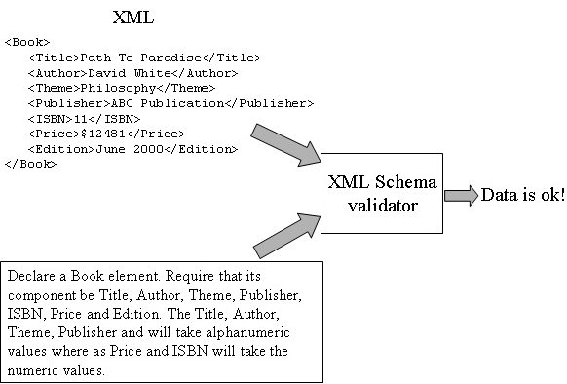
Validating XML data
Notes:
Review: Validating XML data.

Slide 23
Schema
DTDs though they define document structure and validate XML documents, but have some limitations.
An XML Schema defines the valid building blocks of XML document. It can be considered as a common vocabulary that different organizations can share to exchange documents.
The XML Schema Language is referred as XML Schema Definition (XSD).
Notes:
DTDs though they define document structure and validate XML documents, but have some limitations. Hence an XML-based alternative to DTDs, known as XML schema has been introduced, with an objective to overcome the drawbacks of DTDs:
- Does not use XML syntax
- Not extensible
- Does not support namespace
- Supports very few data type

Slide 24
What is an XML Schema
An XML Schema defines:
Elements and attributes that can appear in a document
Which elements are child elements
The order and number of child elements
Whether an element is empty or can include text
Data types for elements and attributes
Default and fixed values for elements and attributes
Notes:
The objective of an XML Schema is to define the valid structure of an XML document, similar to a DTD.

Slide 25
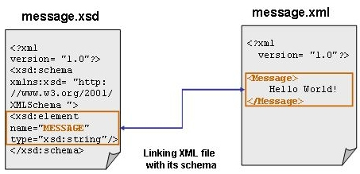
How to write an XML Schema
Notes:
XML file:
Given XML document contains a single element, <Message>. A schema for this document has to declare the <Message> element.
XSD file:
For storing schema documents, the file is saved with “.xsd” as the extension. Schema documents are XML documents and can have DTDs, DOCTYPE declarations.

Slide 26
Features of XML Schema
Schemas support data types
Schemas are portable and efficient
Schemas secure data communication
Schemas are extensible
Schemas catch higher-level mistakes
Schemas support Namespace
Notes:
Schemas support data types:
The support of XML schema for the data types and the ability to create the required datatypes has overcome the drawbacks of DTDs. It means it is easy to define and validate valid document content and data formats. A developer can find it simple to work with data from a database. It can also be easy to implement the restrictions on data.
Schemas are portable and efficient:
Schemas are portable and efficient as they use the same XML syntax. Hence, there is no need to learn any new language or any editor to edit the schema files. A similar XML parser can be used to parse the Schema files.
Schemas secure data communication:
During data transfer, it is essential that both sender and receiver should have the same "vocabulary". With XML Schemas, the sender can specify the data in a way that the receiver will understand.
Schemas are extensible:
A schema definition can be extended; hence it is possible to reuse an existing schema to create another schema. A developer can create his own data types derived from the standard types. Schemas also support reference of multiple schemas in the same document.
Schemas catch higher-level mistakes:
XML checks for well-formedness of an XML document to validate the basic syntax. A document is said to be well-formed if it has an XML declaration, unique root element, matching start and end tag, properly nested elements and so on. A well-formed document can still have errors. XML Schemas can catch higher-level mistakes that arise, such as a required field of information is missing or in a wrong format, or an element name is mis-spelled.
Schemas support Namespace:
The support for XML Namespaces allows the programmer to validate documents that use markup from multiple namespaces. It means that constructs can be re-used from schemas already defined in a different namespace.

Slide 27
Comparing DTDs with Schemas
DTD | XML Schema
DTDs are written in non-XML syntax DTDs are not extensible DTDs do not support namespaces DTDs offer limited data typing | Richer data type Archetypes Attribute grouping Refinable archetypes
Notes:
DTDs are written in non-XML syntax:
DTDs do not use XML notation and therefore they are difficult to write and use.
DTDs are not extensible:
DTDs are not extensible. For example, if there is an Address DTD to catalog friends, and one wants to add a new section to the code for official contacts, then the entire DTD has to be rewritten.
DTDs do not support namespaces:
Namespaces can be used to introduce an element type into an XML document. However, a Namespace cannot be used to refer to an element or an entity declaration in the DTD. If a Namespace is used, then the DTD has to be modified to include any elements taken from the Namespace.
DTDs offer limited data typing:
DTDs can only express the data type of attributes in terms of explicit enumerations and a few coarse string formats. DTDs do not have a facility to describe numbers, dates, currency values, and so forth. Furthermore, DTDs do not have the ability to express the data type of character data in elements. For example, a <Zip> element can be defined to contain CDATA However, the element cannot be constrained to just numerals when it uses a DTD.
-------------------------------------------------------------
Richer data type:
The Schema draft defines booleans, numbers, dates and times, URIs, integers, decimal numbers, real numbers, and also time intervals.
Archetypes:
An archetype allows to define own named datatype from prexisting data types. For example, one can define a 'ContactList' datatype, and then define two elements, "FriendsList" and 'OfficialList' under that type.
Attribute grouping:
There can be common attributes that apply to all elements, or several attributes that include graphic or table elements. Attribute grouping allows the schema author to make this relationship explicit.
Refinable archetypes:
A DTD follows a 'closed' type of model. It describes all, and only those elements and attributes that may appear in the content of the element. XML Schema allows two more possibilities: 'open' and 'refinable'. In an 'open' content model, elements other than the required elements can also be present. Additional elements may be present in a refinable content model, but the schema should define those additional elements.

Slide 28
Sample schema File: mail.xsd
<?xml version="1.0" encoding="UTF-8"?>
<xs:schema targetNamespace="http://www.abc.com.vn"
xmlns:xs="http://www.w3.org/2001/XMLSchema"
xmlns="http://www.abc.com.vn"
elementFormDefault="qualified"
attributeFormDefault="unqualified">
<xs:element name="mail">
<xs:complexType>
<xs:sequence>
<xs:element name="to" type="xs:string"/>
<xs:element name="from" type="xs:string"/>
<xs:element name="header" type="xs:string"/>
<xs:element name="body" type="xs:string"/>
</xs:sequence>
</xs:complexType>
</xs:element>
</xs:schema>

Slide 29
Sample XML File with a reference to schema: mail.xml
<?xml version="1.0"?>
<mail xmlns=http://www.abc.com.vn
xmlns:xs="http://www.w3.org/2001/XMLSchema-instance"
xs:schemaLocation="http://www.abc.com.vn mail.xsd">
<to>Nguyen</to>
<from>3</from>
<header>gui mail</header>
<body>^_^ ... ^_^</body>
</mail>

Slide 30
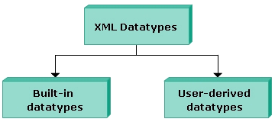
Data Types Supported by Schema
The built-in data types specified by XML working group are: string, boolean, numeric, dateTime, binary, anyURI.
Derived data types: integer, decimal, time.

Slide 31
Build-in Datatypes
DataType | Examples
string | <xs:element name="customer" type="xs:string"/> <customer>John Smith</customer>
date | <xs:element name="start" type="xs:date"/> <start>2002-09-24</start>
decimal | <xs:element name="prize" type="xs:decimal"/> <prize>999.50</prize>
integer | <xs:element name="prize" type="xs:integer"/> <prize>999</prize>
boolean | <xs:attribute name="disabled" type="xs:boolean"/> <prize disabled="true">999</prize>
binary | <xs:element name="blobsrc" type="xs:hexBinary"/>
anyURI | <xs:attribute name="src" type="xs:anyURI"/> <pic src="http://www.w3schools.com/images/smiley.gif" />

Slide 32
Complex Element
A complex element is an XML element that contains other elements and/or attributes.
There are four kinds of complex elements:
empty elements
elements that contain only other elements
elements that contain only text
elements that contain both other elements and text

Slide 33
Complex Empty Elements
An empty complex element cannot have contents, only attributes
Example: <product prodid="1345" />
<xs:element name="product"> <xs:complexType> <xs:complexContent> <xs:restriction base="xs:integer"> <xs:attribute name="prodid" type="xs:positiveInteger"/> </xs:restriction> </xs:complexContent> </xs:complexType> </xs:element>

Slide 34
Elements Only
An "elements-only" complex type contains an element that contains only other elements
Example
<person> <firstname>John</firstname> <lastname>Smith</lastname> </person>
<xs:element name="person"> <xs:complexType> <xs:sequence> <xs:element name="firstname" type="xs:string"/> <xs:element name="lastname" type="xs:string"/> </xs:sequence> </xs:complexType> </xs:element>

Slide 35
Complex Text-Only Elements
Complex text-only element can contain text and attributes.
Example: <shoesize country="france">35</shoesize>
<xs:element name="shoesize"> <xs:complexType> <xs:simpleContent> <xs:extension base="xs:integer"> <xs:attribute name="country" type="xs:string" /> </xs:extension> </xs:simpleContent> </xs:complexType> </xs:element>

Slide 36
Complex Types with Mixed Content
A mixed complex type element can contain attributes, elements, and text
<letter> Dear Mr.<name>John Smith</name>. Your order <orderid>1032</orderid> will be shipped on <shipdate>2001-07-13</shipdate>. </letter>
<xs:element name="letter"> <xs:complexType mixed="true"> <xs:sequence> <xs:element name="name" type="xs:string"/> <xs:element name="orderid" type="xs:positiveInteger"/> <xs:element name="shipdate" type="xs:date"/> </xs:sequence> </xs:complexType> </xs:element>

Slide 37
Define Complex Types
<employee> <firstname>John</firstname> <lastname>Smith</lastname> </employee>
Type attribute that refers to the name of the complex type
Declared directly by naming the element
<xs:element name="employee"> <xs:complexType> <xs:sequence> <xs:element name="firstname" type="xs:string"/> <xs:element name="lastname" type="xs:string"/> </xs:sequence> </xs:complexType> </xs:element>
<xs:element name="employee" type="personinfo"/> <xs:complexType name="personinfo"> <xs:sequence> <xs:element name="firstname" type="xs:string"/> <xs:element name="lastname" type="xs:string"/> </xs:sequence> </xs:complexType>
Notes:
Define Complex Types

Slide 38
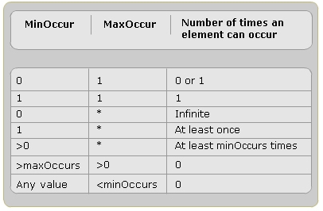
minOccurs and maxOccurs
minOccurs:
specify the minimum number of occurrences of the element in an XML document.
The default value for the minOccurs attribute is 1.
maxOccurs:
specify the maximum number of occurrences of the element in an XML document.
The default value for the maxOccurs attribute is 1.
Notes:
minOccurs: If an element has a minOccurs value of 0, it is optional. An attribute is optional, if the minOccurs is 0. If minOccurs is set to 1, the arrtribute is required.
maxOccurs: If its value is kept unbounded, it means that the element can appear unlimited nunmber of times. The maxOccurs attribute default to 1 unless it is specified.

Slide 39
Example
<xs:element name="person"> <xs:complexType> <xs:sequence> <xs:element name="full_name" type="xs:string"/> <xs:element name="child_name" type="xs:string" maxOccurs="10" minOccurs="0"/> </xs:sequence> </xs:complexType> </xs:element>
<person> <full_name>Tove Refsnes</full_name> <child_name>Hege</child_name> <child_name>Stale</child_name> <child_name>Jim</child_name> <child_name>Borge</child_name> </person>

Slide 40
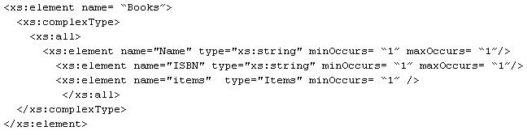
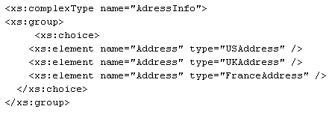
Grouping Constructs
xs:all
xs:choice
Notes:
The XML Schema Language provides three grouping constructs that specify whether and how ordering of individual elements is important.

Slide 41
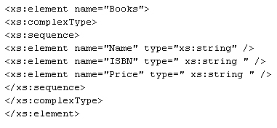
Grouping Constructs
xs:sequence
Notes:
The XML Schema Language provides three grouping constructs that specify whether and how ordering of individual elements is important.

Slide 42
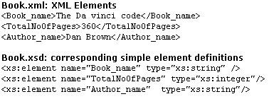
Defining a Simple Type Element
A Simple type is an XML element or attribute, which contains only text and no other elements or attributes.
Notes:
The simple type declarations are used to form the textual data and specify the type of data allowed within attributes and elements. For example, it can be specified that the element TotalNoOfPages is an integer type, which is again a positive integer with three digits.

Slide 43
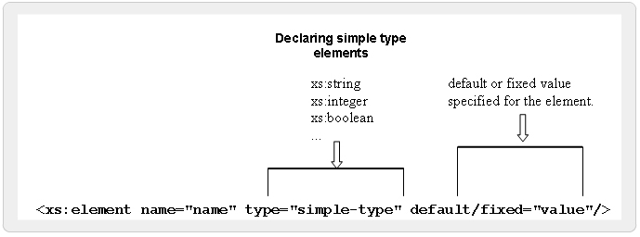
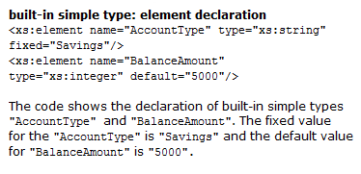
Built-in simple types
Notes:
There are several built-in simple types, such as integer, date, float and string that one can use without further modifications.
A built-in simple element can contain a default value or a fixed value. A 'default' value is the value that is assigned automatically to the element when no other value has been specified. A 'fixed' value is assigned to an element, when there is no need to change the value for that element.

Slide 44
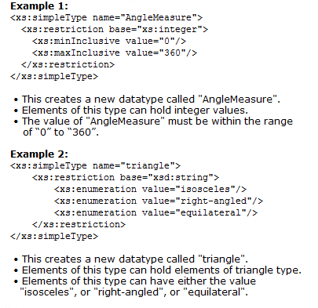
User-defined simple types
<xs:simpleType name="name of the simpleType"> <xs:restriction base="built-in data type">
<xs:constraint="set constraint to limit the content"/> </xsd:restriction>
</xsd:simpleType>
Notes:
XML-schema supports a library of built-in datatypes. However, during the course of writing complex schema documents, a developer may need a type of data that is not defined in the schema recommendation. For instance, consider the declaration of an element <AngleMeasure>. It implements the available restrictions to its content to accept non-negative numeric values, but still it accepts unwanted values like:
<AngleMeasure>49D</AngleMeasure>
As per schema declaration, "490" is a valid non-negative numeric value, but still it needs numeric type that allows the values with a range from D to 360. Hence, a custom user defined datatype can be created using the <simpleType> definition.

Slide 45
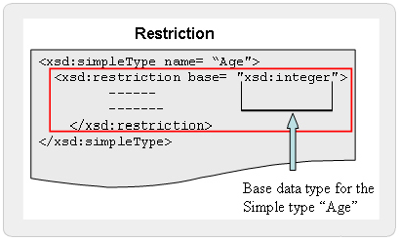
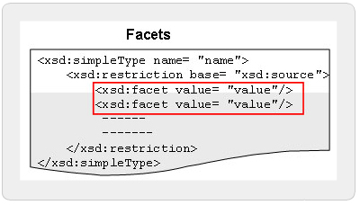
Restriction & Facets
Restrictions are used to define acceptable values for XML elements or attributes. Restrictions on XML elements are called facets.
Common syntax of facet elements:
<FacetName value=‘string’ fixed=‘boolean’ id=‘ID’ />
There are 12 facet elements.
Notes:
Declaration of a data type puts certain limitations on the content of an XML element or attribute. If an XML element is of type "xs:integer" and contains a string like "Welcome", the element will not be validated. These limitations are called restrictions, which defines allowable values for XML elements and attributes.
Restrictions can be specified for the simpleType elements and restriction types are declared using the <restriction> declaration. Basically, the lt;restriction> declaration is used to declare a derived simpleType, which is a subset of its base simpleType. The value of the base attribute can be any existing simpleType, or built-in XML Schema datatype.

Slide 46
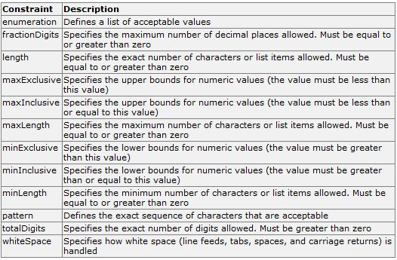
Restriction & Facets
Notes:
With XML Schemas, custom restrictions can be specified on XML elements and attributes. These restrictions are called facets.
Facets are used to restrict the set or range of values a datatype can contain. The value range defined by the facet must be equal to or narrower than the value range of the base type.
There are 12 facet elements, declared using a common syntax. They each have a compulsory value attribute that indicates the value for the facet. One restriction can contain more than one facet. Any values appearing in the instance and value spaces must conform to all the listed facets.

Slide 47
Summary
Document Type Definition
Working with DTDs
Valid XML Documents
Declarations
XML Schema
Exploring XML Schema
Working with Complex types
Working with simple types
Notes:
Document Type Definition:
This lesson defines DTDs and identifies the need for DTDs.
Working with DTDs:
This lesson talks about the structure of DTDs, step to create DTDs, DOCTYPE declarations and the type o
Valid XML Documents:
This lesson talks about the well-formed valid documents and the steps to determine the validity of XML documents.
Declarations:
This lesson deals with declarations of elements, attributes, and entities in DTDs.
---
XML Schema:
An XML Schema is an XML-based alternative to DTDs, which describes the structure of an XML document. The XML Schema language is also referred to as XML Schema Definition (XSD). An XML Schema can define elements, attributes, child elements and the possible values that can appear in a document. Schemas overcome the limitations of DTDs and allow Web applications to exchange XML data robustly, without relying on ad hoc validation tools.
Exploring XML Schema:
XML schema offers a range of data types. It supports built-in data types like string, boolean, number, dateTime, binary and uri. Additional data types like integer, decimal, real, time, timeperiod and user defined data types.
Working with Complex types:
Elements with complex type may contain nested elements and have attributes. A complex element can be defined by directly naming the element and by using the name and the type attribute of the complex type. minOccurs specifies the minimum number of occurrences of the element in an XML document. maxOccurs specifies the maximum number of occurrences of the element in an XML document. Element content in an XML document contains only XML elements and mixed content contains text mixed with elements. The grouping constructs in XML schema specify the order of XML elements.
Working with simple types:
The elements of simple type describe the content and data type of the element rather than its structure. The simple type can have built-in and user defined data types. Simple type definition takes one of the two values, default or fixed as per the requirement. The user-defined data type can be derived from a built in type or an existing simple type. Use of restrictions and facets restricts its content to user prescribed values. Schema supports usage of attributes in elements, which is declared with a simple type definition.

Slide 48
DTDs XML Schema
Q&A
XML Simplified
Notes:
Questions & Answers

Slide 49
Next …
In the next session, we will discuss about Stylesheets
Notes:
Next…

