Slide 1
XML Simplified – Session 3
Module 5 – Stylesheets
Notes:
Welcome to the module, Document Type Definitions (DTDs). This module focuses on how to create DTDs for XML files. In this module, topics such as DOCTYPE declarations, types of DTDs, wellformedness and validity of XML files, declaration of elements, attributes, and entities in a DTD are also covered.
Welcome to the module, XML Schema. This module focuses on exploring XML schema and its features. The structure of an XML document with the help of schema is also discussed. This module aims at providing a clear understanding of the different elements and data types supported by an XML schema.

Slide 2
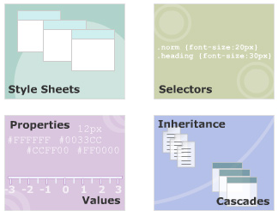
Module 5 - Stylesheets
Notes:
Objectives

Slide 3
Style Sheets
Notes:
Style Sheets

Slide 4
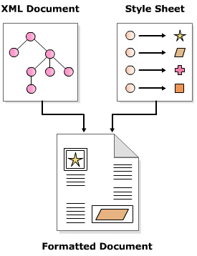
Need of Style Sheets
Style sheets are a set of rules that describe the appearance of data in a XML document.
Two most popular types of Style Sheets:
Cascading Style Sheets (CSS)
Extensible Style Sheets (XSL)
Notes:
XML was inspired by the problems posed by presentational markup. Presentational markup does not describe data; it defines the appearance of data. In a document, if you had to change all proper nouns from bold to italics, you would have to do it manually for each proper noun. Presentation markup failed to provide same look and feel across multiple devices such as computers, Personal Digital Assistant (PDA) devices, and cell phones.
Style sheets and XML solve these problems. XML describes data. Style sheets define the appearance of data. However, both XML and style sheets are defined in separate files.

Slide 5
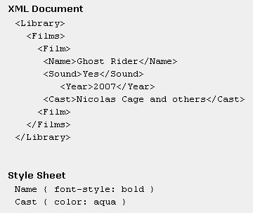
Cascading Style Sheet (CSS)
CSS allows you to control the appearance of data in HTML and XML documents by providing various properties to define:
• Position and size of data to be displayed
• Foreground and background color of data
• Font to be used to display data
• Spacing between data
Benefits of CSS
- Code reusability
- Device independence
- Change in one place
Notes:
Cascading style sheets is a rule-based language invented in 1996 to write formatting instructions for data contained in HTML documents.
A CSS style sheet comprises a set of rules for various elements in a document. Each rule defines how the data enclosed in the element should be displayed.
Style sheet rules can be combined from different sources, or subsets can be created or the rules can be overridden. The term cascading is derived from this ability to mix and match rules.

Slide 6

Style rules
selector:
Selector is an element name of an XML document. A typical element name could be CD, Name, or Title.
property:
Property is a CSS style property that defines how the element will be rendered. Some of the CSS properties are border, font, and color.
value:
Value is the value associated with a CSS property. One CSS property can have several values. The various values for property font-family are the various font family names such as "times", "arial", and "courier" to name a few.
Notes:
A style sheet in CSS comprises a set of style rules. These rules define how the content enclosed in an element will be displayed. These rules are applicable to all child elements within an element. A style rule comprises a selector, a property and a value. A property and a value separated with a colon are referred as property declaration.

Slide 7
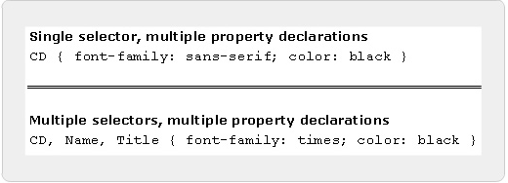
Ways of writing Style rules
A single selector can have more than one property-value pairs associated with it.
For example, the figure shows a CD element having two property declarations - one to set the font family to sans-serif, and other to set the color of text to black. Notice the property -value pairs are separated by a semi-colon.
Notes:
Similarly, a collection of one or more property-value pairs can be associated with more than one selector. For example, the figure shows two property declarations assigned to three elements namely CD, Title and Name.

Slide 8
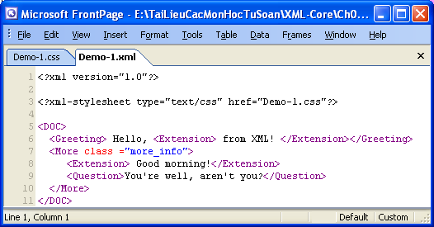
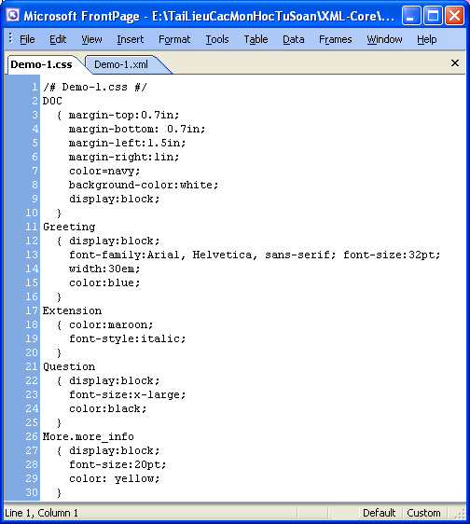
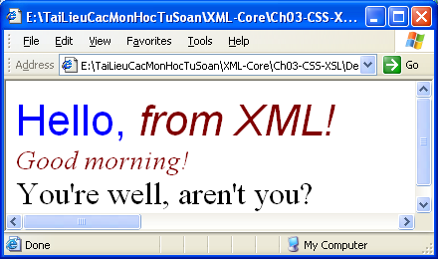
External style sheets
Notes:
In CSS, the style rules are written in a file with the extension .css. This file is associated with an XML document using a style sheet processing instruction. A few points to note about style sheet processing instruction are:
It should appear in the prolog section of an XML document, that is, it should appear before any tag of an element.
One XML document can have more than one style sheet processing instructions, each linked to one .css file.

Slide 9
Selectors in CSS
Notes:
Style Sheets

Slide 10
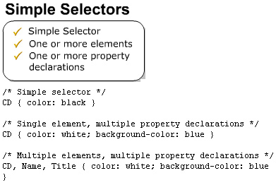
Simple Selectors
Notes:
Simple selector comprises an element name followed by one or more property declarations. Same property declarations can be assigned to multiple elements by separating element names with a comma. Simple selectors match every occurrence of the element in a document.

Slide 11
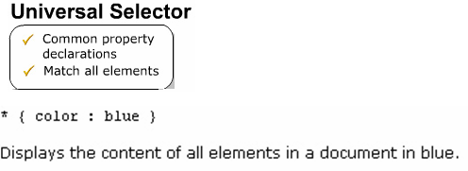
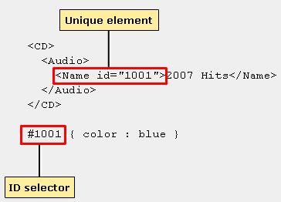
Universal & ID Selector
Notes:
A universal selector comprises an asterisk followed by property declarations. It is used when you want to assign the same style rules to all the elements in a document. A universal selector matches all the elements in a document.
An ID selector comprises a hash (#) symbol, immediately followed by an attribute's value followed by property declarations. It is used to define styles for unique elements in a document. For example, if you want the data of a unique element to be in a different style, you would define an ID selector for it. Unique element is one which has one of its attributes named as id.

Slide 12
Properties and Values
Notes:
Style Sheets

Slide 13
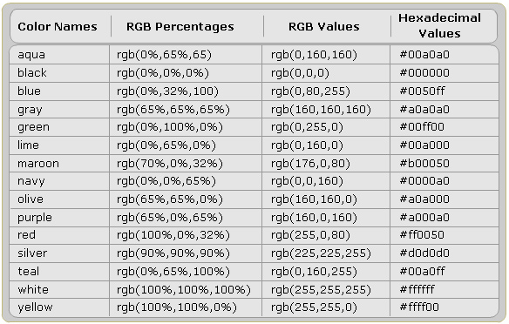
Color Properties
Notes:
The CSS provides properties to set the foreground and background color of text. CSS uses color name, red-green-blue (RGB) values, RGB percentages and hexadecimal values to specify color values. The various ways in which color values are specified is shown in the following table.

Slide 14
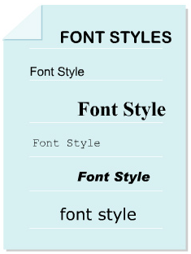
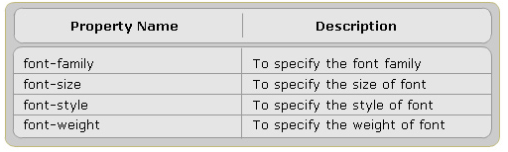
Font Properties
The CSS specification defines several font properties to set the font family, font size, font style such as bold, italics and so on.
Some of these properties are listed in the following table:
Notes:
Demo :
Font-family
Font-size
Font Style and weight

Slide 15
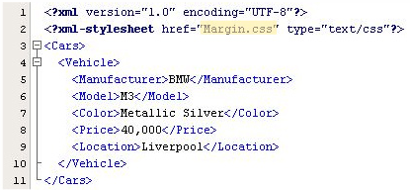
Margins in CSS
Syntax
Code
Notes:
Every element in an XML document is displayed in its own box. CSS provides four properties namely margin-left, margin-right, margin-top and margin-bottom to insert space around the element's box.

Slide 16

Margins in CSS
Style Sheet
Output
Notes:
Every element in an XML document is displayed in its own box. CSS provides four properties namely margin-left, margin-right, margin-top and margin-bottom to insert space around the element's box.

Slide 17
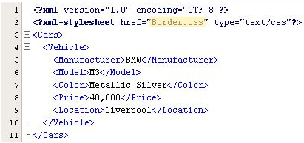
Border Properties in CSS
Syntax
Code
Notes:
Borders are rectangular outlines surrounding an element's box. CSS provides properties to create dotted, solid and groove borders to name a few.

Slide 18


Border Properties in CSS
Style Sheet
Output
Notes:
Borders are rectangular outlines surrounding an element's box. CSS provides properties to create dotted, solid and groove borders to name a few.

Slide 19
Inheritance and Cascades in CSS
Notes:
Style Sheets

Slide 20
Cascading in CSS
All declarations that apply to an element and property are grouped.
Declarations are sorted by weight and origin.
Declarations are sorted by specificity of selector.
Declarations are sorted by the order specified.
Notes:
There are several ways in which style sheets can be defined. For example, one document can have more than one style sheet defined for it. A browser has its own style sheet. In such cases, it is possible that more than one style rule may exist for an element.

Slide 21
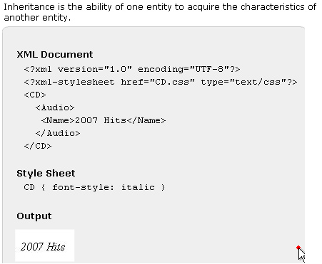
Inheritance in CSS
Notes:
Inheritance is the ability of one entity to acquire the characteristics of another entity.
In CSS, the child elements inherit the styles rules defined for parent element. However, this is applicable only if the child has no explicit style rule defined for it. Otherwise, the style rule defined for child element overrides the style rule defined for parent element.
The figure shows that the text in element Name is displayed in italics. This is because there are no style rules defined for elements Audio and Name. Hence, the style rule defined for CD is inherited by child element Name.

Slide 22
Summary
Style Sheets
Selectors in CSS
Properties and Values
Inheritance and Cascades in CSS
Notes:
Style Sheets:
Style Sheets are a set of rules that define the appearance of data. These rules are written in a file with the extension .ess. The .ess file is associated with an XML document using the xml-processing instruction.
Selectors in CSS:
Selectors define the elements to which the styles will be applied. The various types of selectors are simple, universal and ID selectors.
Properties and Values:
CSS provides several properties to define the appearance of data. Some of these properties are color, background-color, position, padding, font, text-align to name a few.
Inheritance and Cascades in CSS:
In CSS, a child element inherits the styles rules applied to its ancestor element. Also there are several sources of style sheets, hence CSS follows W3C defined cascading order when applying style rules to elements.

Slide 23
Stylesheets
XML Simplified
Q&A
Notes:
Questions & Answers

Slide 24
Next …
In the next session, we will discuss about XSL XSLT
Notes:
Next…

