Slide 1
XML Simplified – Session 4
Module 6 – XSL and XSLT
Module 7 – More on XSLT
Notes:
Welcome to the module, Document Type Definitions (DTDs). This module focuses on how to create DTDs for XML files. In this module, topics such as DOCTYPE declarations, types of DTDs, wellformedness and validity of XML files, declaration of elements, attributes, and entities in a DTD are also covered.
Welcome to the module, XML Schema. This module focuses on exploring XML schema and its features. The structure of an XML document with the help of schema is also discussed. This module aims at providing a clear understanding of the different elements and data types supported by an XML schema.

Slide 2
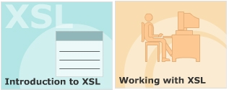
Module 6 – XSL and XSLT
Notes:
Objectives

Slide 3
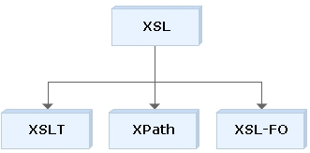
Extensible Stylesheet Language (XSL)
XSL
Transformation
XML Path
XML
Formatting Objects
Notes:
XSL is an XML-based language used to create stylesheets. XSL is designed to format XML content for display purposes and also has the ability to completely transform XML documents.
XSL consists of three languages:
-XSL Transformations (XSLT) - an XML language for transforming XML documents.
-XML Path Language (XPath) - a language for navigating the XML document.
-XSL Formatting Objects (XSL-FO) - an XML language for formatting XML documents.

Slide 4
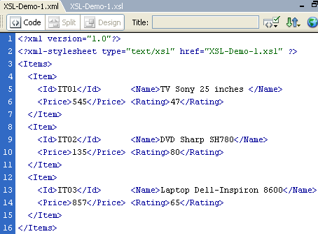
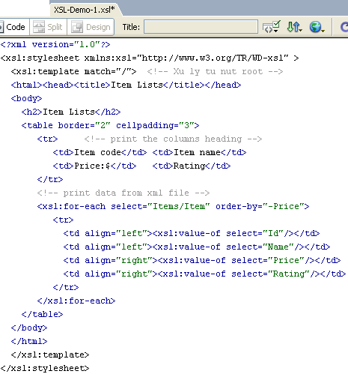
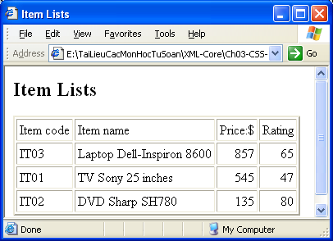
XSL Transformations
namespace
Loop
Notes:
The transformation component of the XSL stylesheet technology is XSLT. Its purpose is to transform XML documents.
It describes the process of transforming an XML document, using a transformation engine and XSL. The XML document and XSL stylesheet are provided as input to the XML transformation engine, also known as the XSLT processor. The output of the processor is in the form of a result tree in which the elements of the XML document are converted into nodes having specific text values and attributes.

Slide 5
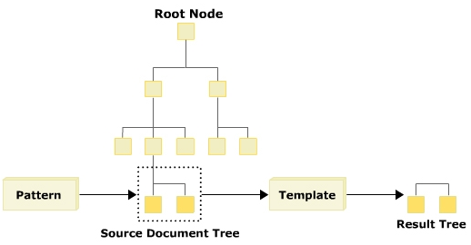
XSL Processing Model
Notes:
The XML processor reads an XML document and processes it into a hierarchical tree containing nodes for each piece of information in a document. After a document has been processed into a tree, the XSL processor begins applying the rules of an XSL stylesheet to the document tree.

Slide 6
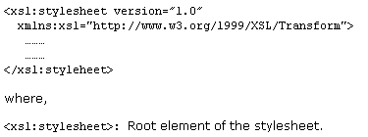
XSLT Structure and Syntax
File.XSL
Notes:
XSLT follows normal rules of XML syntax. It uses a standard document introduction, matching closing tags for any opening tags that contain content, and a proper syntax for empty elements.
In XSL, the style rules are written in a file with the extension .xsl. This file is associated with an XML document by using the statement <?xml-stylesheet href="xsl file" type="text/xsl"?>. Here, the xml-stylesheet is the processing instruction.

Slide 7
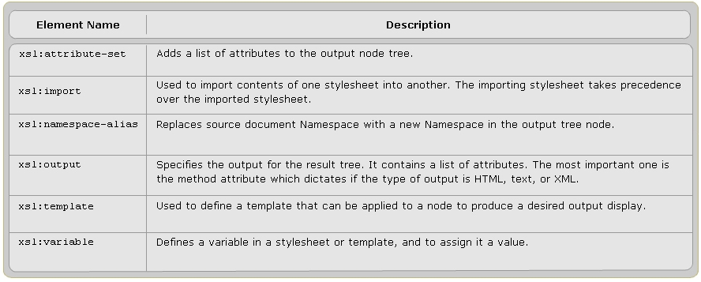
Top Level XSLT Elements
Notes:
The top level XSLT elements can occur directly inside the xsl: stylesheet element. An element occurring as a child of an xsl: stylesheet element is called a top-level element. These elements provide the building blocks for creating XSLT documents.

Slide 8
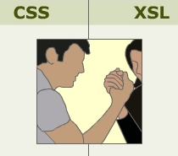
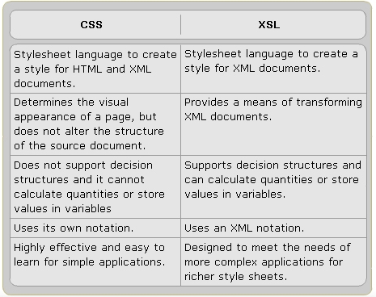
CSS and XSL
Notes:
XSL and CSS are two different style languages recommended by the World Wide Web Consortium (W3C). XSL is more powerful and complex than CSS.

Slide 9
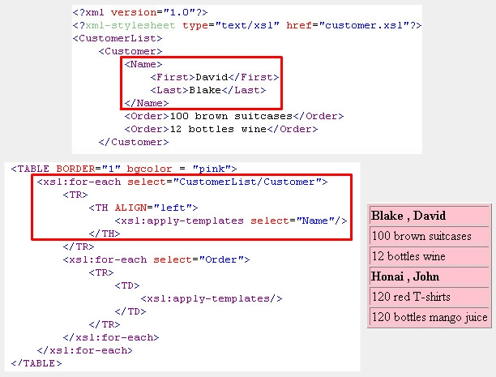
XSL Templates
Notes:
Each template rule is represented by the xsl:template element. The xsl:template is an element that defines an action for producing output from a source document.

Slide 10
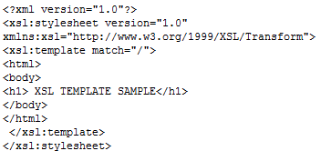
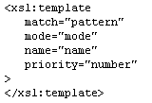
The xsl:template element
Syntax
match=“/” : root of the document
match=“*” : all nodes of the document
Notes:
The xsktemplate element is used to define a template that can be applied to a node to produce desired output.
The match attribute in xsltemplate is used to associate the template with an XML element. You can also define a template for a whole branch of the XML document by using the match attribute (for example, match="/" defines the whole XML document).

Slide 11
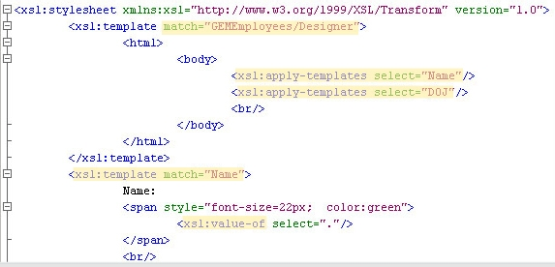
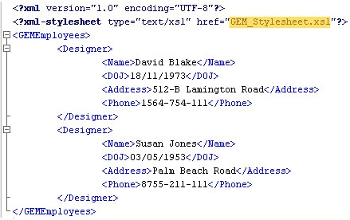
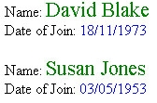
xsl:template demo
The select attribute can
be used to process
nodes selected by an
expression instead of
processing all children
The attribute select=“.”
is used to specify the
current node.
<xsl:apply-templates>
is used to declare
an application
a template
to a set of nodes
<xsl:value-of>
will get the
string data
of a node
Notes:
Demo

Slide 12
Procedural Syntax
Loop statement
<xsl:for-each select=“expression”>
<body>
</xsl:for-each>
Add text to output
<xsl:text disable-output-escaping=“yes”|”no”>
added-text
</xsl:text>
Add number to output
<xsl:number>
count=“pattern” /* nodes will be counted*/
format=“{ string }” /* format of number in ouitput */
value=“expression” /* content must be output */
</xsl:text>
Notes:
Procedural Syntax

Slide 13
Procedural Syntax
Select 1/2 statement
Select 1/n statement
<xsl:if test=“exprsession”>
<body>
</xsl:for-each>
<xsl:choose>
<xsl:when test=“exprsession1”>
<body>
</xsl:when>
<xsl:when test=“exprsession2”>
<body>
</xsl:when>
………..
<xsl:otherwise>
<body>
</xsl:otherwise>
</xsl:choose>
Notes:
Procedural Syntax

Slide 14
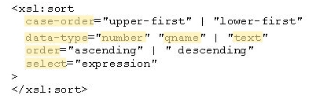
Sorting in XSLT
The xsl:sort element in XSLT can be used to sort a group of similar elements. The sorting can be done in various ways by using the attributes of this element.
Notes:
Sorting in XSLT

Slide 15
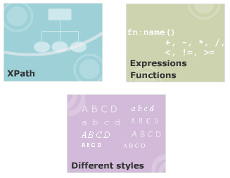
Module 7 – More on XSLT
Notes:
Objectives

Slide 16
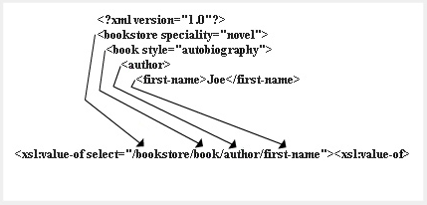
XPath
XSLT
XSLT is a language for transforming XML documents into XML, HTML, or text .
XQuery
XQuery builds on XPath and is a language for extracting information from XML documents.
Notes:
XPath can be thought of as a query language like SQL. However, rather than extracting information from a database, it extracts information from an XML document. XPath is a language for retrieving information from a XML document. XPath is used to navigate through elements and attributes in an XML document. Thus XPath allows identifying parts of an XML document.
XPath provides a common syntax for features shared by Extensible Stylesheet Language Transformations (XSLT) and XQuery.

Slide 17

Benefits of XPath
XPath is designed for XML documents. It provides a single syntax that you can use for queries, addressing, and patterns. XPath is concise, simple, and powerful.

Slide 18
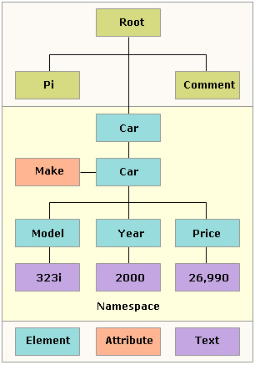
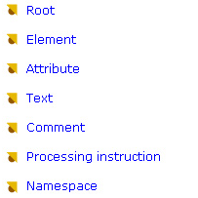
XML Document in XPath
Notes:
Root: The XPath tree has a single root node, which contains all other nodes in the tree
Element: Every element in a document has a corresponding element node that appears in the tree under the root node. Within an element node appear all of the other types of nodes that correspond to the element's content. Element nodes may have a unique identifier associated with them that is used to reference the node with XPath.
Attribute: Each element node has an associated set of attribute nodes; the element is the parent of each of these attribute nodes; however, an attribute node is not a child of its parent element.
Text: Character data is grouped into text nodes. Characters inside comments, processing instructions and attribute values do not produce text nodes. The text node has a parent node and it may be the child node too.
Comment: There is a comment node for every comment, except for any comment that occurs within the document type declaration (DTD). The comment node has a parent node and it may be the child node too.
Processing instruction: There is a processing instruction node for every processing instruction, except for any processing instruction that occurs within the document type declaration. The processing instruction node has a parent node and it may be the child node too.
Namespace: Each element has an associated set of namespace nodes. Although the namespace node has a parent node, the namespace node is not considered a child of its parent node because they are not contained in a parent node, but are used to provide descriptive information about their parent node.

Slide 19
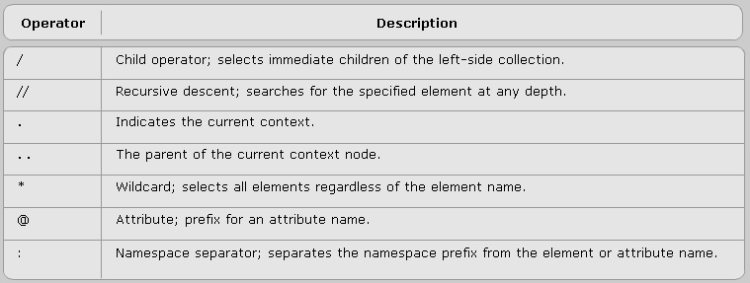
Operators in XPath
An XPath expression returns a node set, a boolean, a string, or a number. XPath provides basic floating point arithmetic operators and some comparison and boolean operators.

Slide 20
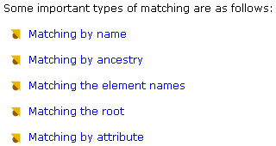
Types of Matching
Notes:
Matching by name: <xsl:template match = "Greeting”>
Matching by ancestry: <xsl:template match = “P//EM”>
Matching the element names:
<xsl:template match="Product">
<xsl:value-of select="Product_ID"/>
</xsl:template>
Matching the root: <xsl:template match = “/”>
Matching by attribute:
<xsl:template match="Product">
<xsl:apply-templates select="@Units"/>
</xsl:template>

Slide 21
XPath Expressions and Functions
XPath Expressions are statements that can extract useful information from the XPath tree.
There are four types of expressions in XPath: -Node set
-Boolean
-Number
-String
Notes:
Instead of just finding nodes, one can count them, add up numeric values, compare strings, and more. They are much like statements in a functional programming language. Every XPath expression evaluates to a single value.
Node set: A node set is an unordered group of nodes from the input document that match an expression’s criteria
Boolean: A boolean has one of two values: true or false. XSLT allows any kind of data to be transformed into a boolean. This is often done implicitly when a string or a number or a node set is used where a boolean is expected.
Number: XPath numbers are numeric values useful for counting nodes and performing simple arithmetic. The numbers like 43 or -7DDD that look like integers are stored as doubles. Non-number values, such as strings and booleans, are converted to numbers automatically as necessary.
String: A String is a sequence of zero or more Unicode characters. Other data types can be converted to strings using the string() function.

Slide 22
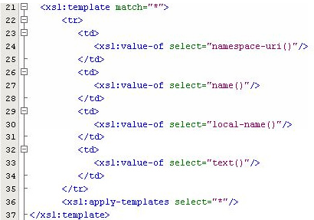
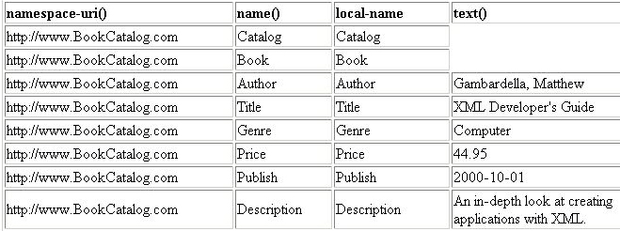
Node set Functions
name()
name(nodeset)
local-name()
namespace-uri()
root()
text()
Notes:
Node set functions take a node set argument. They return a node set, or information about a particular node within a node set. The different Node set functions are name(), local-name(), namespace-uri() and root().

Slide 23
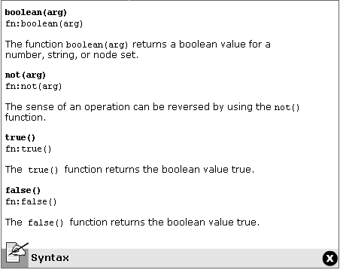
Boolean Functions
Notes:
The XML Path Language (XPath) syntax supports boolean functions that return true or false, and can be used with comparison operators in filter patterns. Some of these functions are boolean, not, true and false.

Slide 24
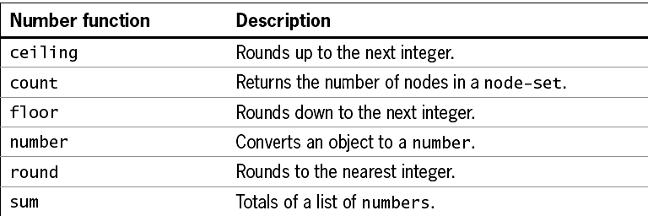
Numeric Functions
Notes:
XPath syntax supports number functions that return strings or numbers and can be used with comparison operators in filter patterns. The different numeric functions are number(arg), ceiling(num), floor(num) and round(num).

Slide 25
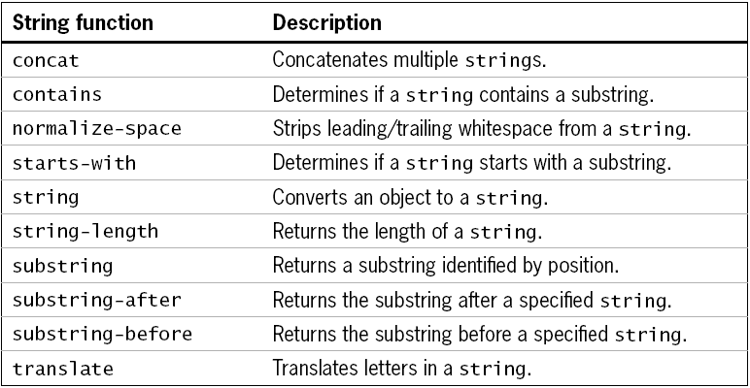
String Functions
Notes:
String functions are used to evaluate, format, and manipulate string arguments, or to convert an object to a string. The different string functions are string(arg), compare(), concat() and substring().

Slide 26

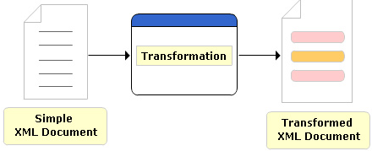
Transformation of XML document
Notes:
Transformation is one of the most important and useful techniques for working with XML. XML can be transformed by changing its structure, its markup, and perhaps its content into another form.
The most common reason to transform XML is to extend the reach of a document into new areas by converting it into a presentational format.

Slide 27
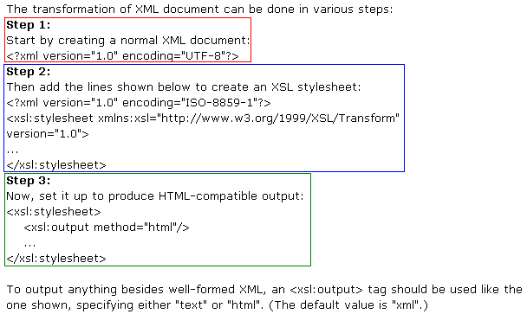
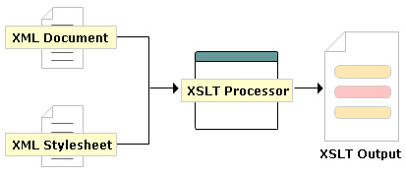
Transformation using an XSLT processor
Notes:
Demo

Slide 28
Transformation using an XSLT processor
Step 1
XSL
Notes:
Demo

Slide 29

Transformation using an XSLT processor
Step 2
Notes:
Demo

Slide 30
Summary
Introduction to XSL
Working with XSL
XPath
XPath Expression and Function
Working with different styles
Notes:
Style Sheets:
Style Sheets are a set of rules that define the appearance of data. These rules are written in a file with the extension .ess. The .ess file is associated with an XML document using the xml-processing instruction.
Selectors in CSS:
Selectors define the elements to which the styles will be applied. The various types of selectors are simple, universal and ID selectors.
Properties and Values:
CSS provides several properties to define the appearance of data. Some of these properties are color, background-color, position, padding, font, text-align to name a few.
Inheritance and Cascades in CSS:
In CSS, a child element inherits the styles rules applied to its ancestor element. Also there are several sources of style sheets, hence CSS follows W3C defined cascading order when applying style rules to elements.

Slide 31
XSL and XSLT, More on XSLT
XML Simplified
Q&A
Notes:
Questions & Answers

