Slide 1
Asynchronous C#

Slide 2
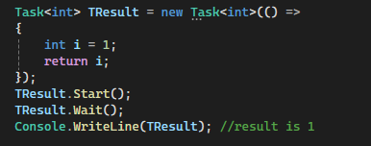
Task
An abstraction of “ Where to run some code”
The promise of a result in the future
CancellationTokenSource() to destroy a Task

Slide 3
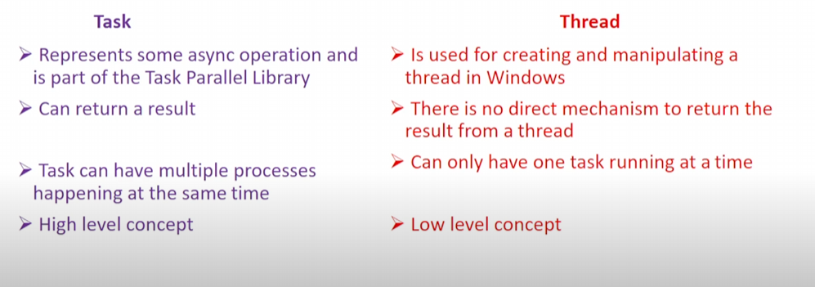
Different between Task and Thread

Slide 4
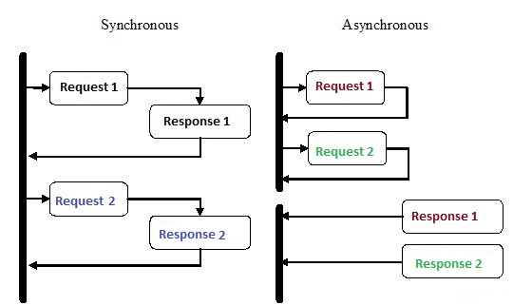
Synchronous and Asynchronous programming

Slide 5
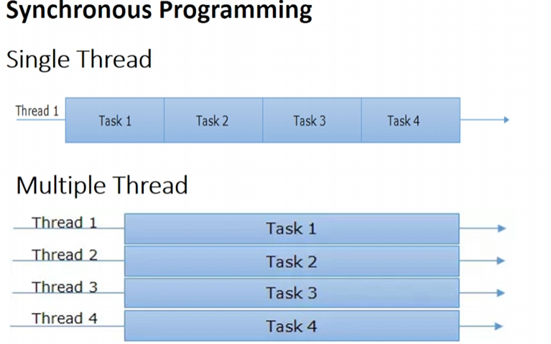
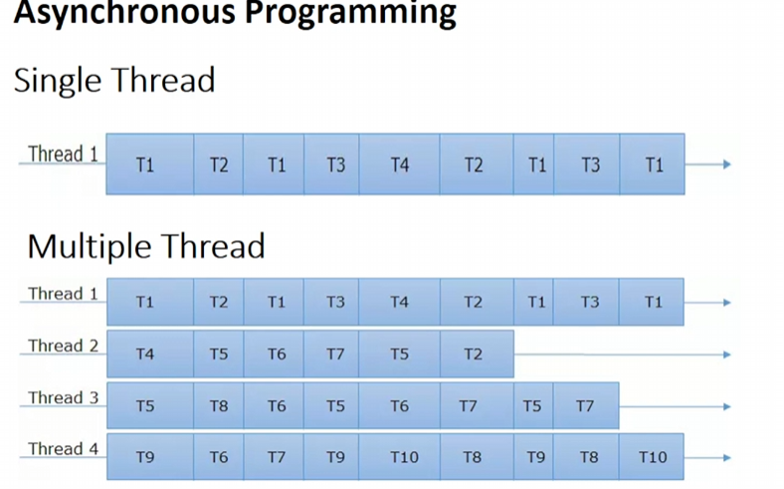

Slide 6
