Slide 1
Introduction to Coarse-Grained Molecular Dynamics on GROMACS
In silico Methodologies for biochemist
2024
quoc.ngo@oulu.fi

Slide 2
Outline
Martini philosophy
Protein model in Martini
Limitations
Exercises
- 01 Martini + elastic network
- 02 Martini without structural models
- 03 Analyzing the trajectory

Slide 3
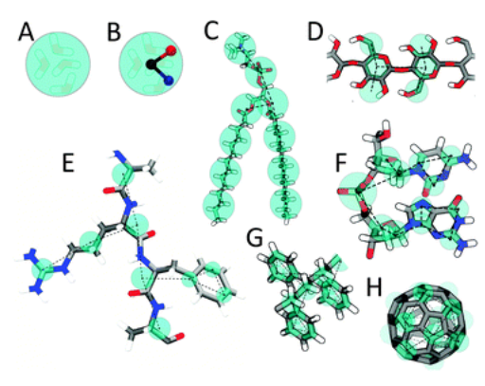
1. Martini philosophy
Martini model uses four-to-one mapping scheme.
On average, four heavy atoms and their associated hydrogens are mapped to one coarse-grained bead.
http://cgmartini.nl/

Slide 4
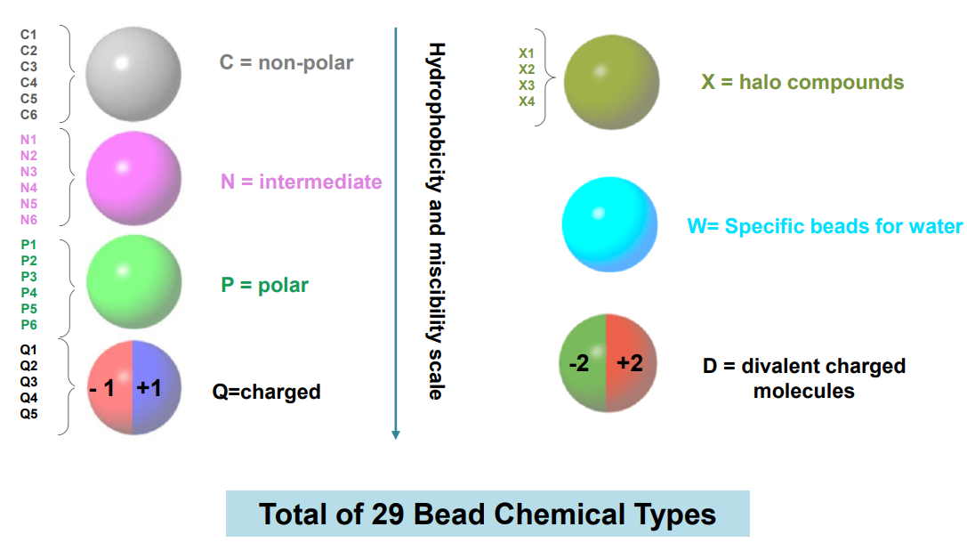
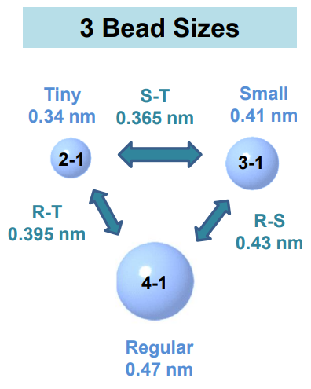
1. Martini philosophy
http://cgmartini.nl/images/stories/workshop2021/lectures/first/Introduction_to_Martini3.pdf

Slide 5
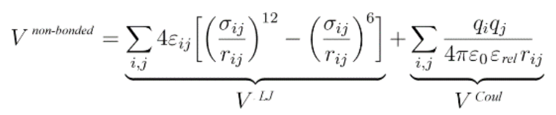
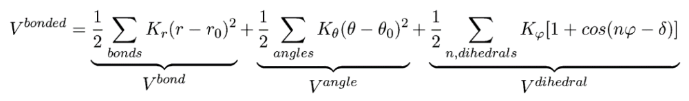
2. Protein model in Martini
Non-bonded interactions
Bonded interactions
http://cgmartini.nl/images/stories/workshop2021/lectures/first/Introduction_to_Martini3.pdf

Slide 6
2. Protein model in Martini
Additional structural model required to stabilize protein tertiary structure
- Elastic networks (EN) (Periole et al., 2009)
- Gō-like model (Poma et al., 2017)

Slide 7
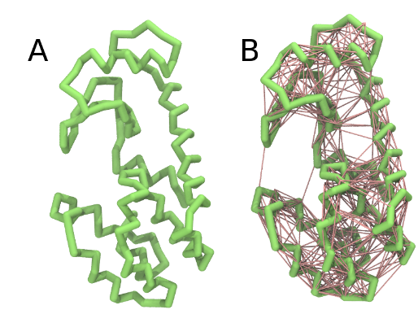

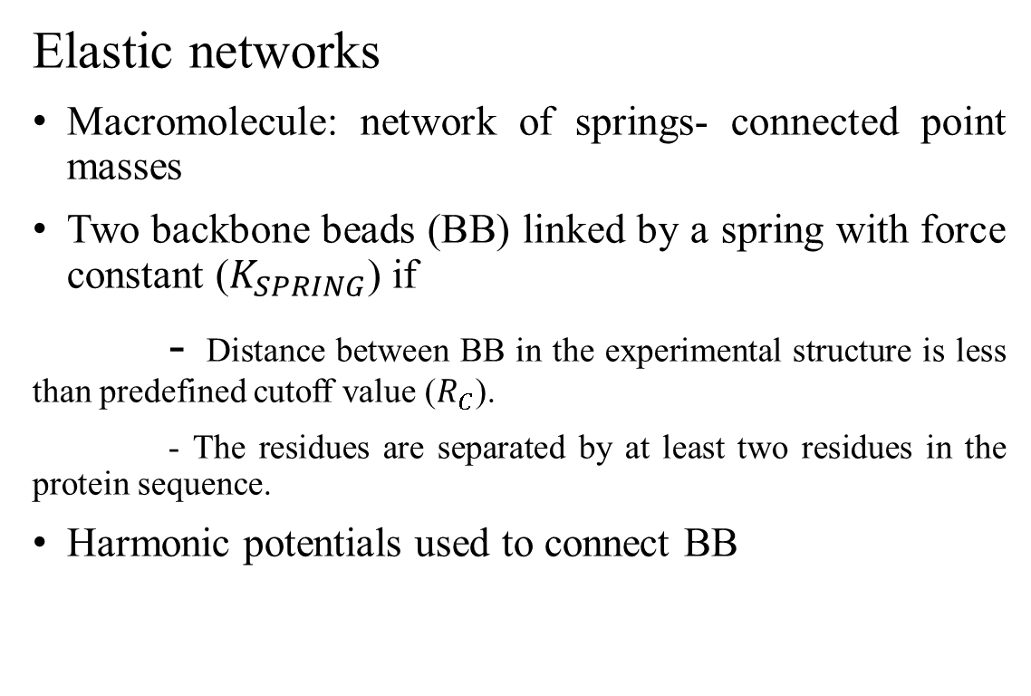
2. Protein model in Martini
Elastic networks
Macromolecule: network of springs- connected point masses
Two backbone beads (BB) linked by a spring with force constant ($K_{SPRING}$) if
- Distance between BB in the experimental structure is less than predefined cutoff value ($R_{C}$).
- The residues are separated by at least two residues in the protein sequence.
Harmonic potentials used to connect BB
Licorice representation of T4 lysozyme backbone in Martini 3 models: (A) no bias; (B) elastic network (harmonic bonds in red) (http://cgmartini.nl/index.php/2021-martini-online-workshop/tutorials/564-2-proteins-basic-and-martinize-2).
http://www.cgmartini.nl/images/stories/workshop2021/lectures/second/M3workshop-01.pdf

Slide 8
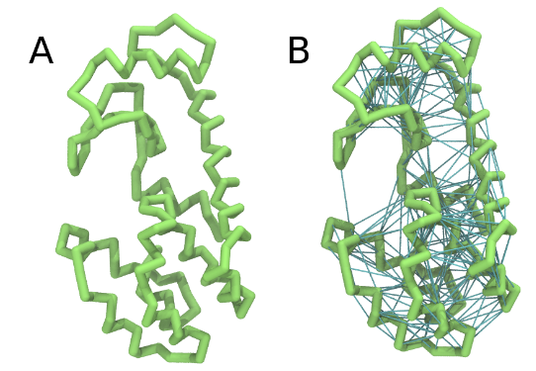

2. Protein model in Martini
Gō-like model
Set of Lennard-Jones (LJ) potentials included based on the native structure of the protein
LJ potential used to connect BB
LJ bonds used in Gō-like model behave like harmonic bonds used in EN except LJ bonds are breakable → Higher degree of flexibility
Licorice representation of T4 lysozyme backbone in Martini 3 models: (A) no bias; (B) GōMartini model (pair interactions represented in cyan) (http://cgmartini.nl/index.php/2021-martini-online-workshop/tutorials/564-2-proteins-basic-and-martinize-2)
http://www.cgmartini.nl/images/stories/workshop2021/lectures/second/M3workshop-01.pdf

Slide 9
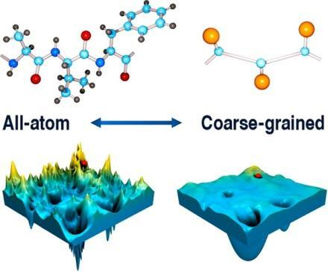
3. Limitations
Missing entropy due to the reduced degree of freedom
Wrong driving forces in some cases
Faster time scales
Kmiecik et al., 2016

Slide 10
References
http://cgmartini.nl/index.php
Kmiecik, S., Gront, D., Kolinski, M., Wieteska, L., Dawid, A., & Kolinski, A. (2016). Coarse-Grained Protein Models and Their Applications. Chemical Reviews, 116(14), 7898-7936. doi: 10.1021/acs.chemrev.6b00163
Marrink, S., Risselada, H., Yefimov, S., Tieleman, D., & de Vries, A. (2007). The MARTINI Force Field: Coarse Grained Model for Biomolecular Simulations. The Journal Of Physical Chemistry B, 111(27), 7812-7824. doi: 10.1021/jp071097f
Periole, X., Cavalli, M., Marrink, S., & Ceruso, M. (2009). Combining an Elastic Network With a Coarse-Grained Molecular Force Field: Structure, Dynamics, and Intermolecular Recognition. Journal Of Chemical Theory And Computation, 5(9), 2531-2543. doi: 10.1021/ct9002114
Poma, A., Cieplak, M., & Theodorakis, P. (2017). Combining the MARTINI and Structure-Based Coarse-Grained Approaches for the Molecular Dynamics Studies of Conformational Transitions in Proteins. Journal Of Chemical Theory And Computation, 13(3), 1366-1374. doi: 10.1021/acs.jctc.6b00986
Souza, P., Alessandri, R., Barnoud, J., Thallmair, S., Faustino, I., & Grünewald, F. et al. (2021). Martini 3: a general purpose force field for coarse-grained molecular dynamics. Nature Methods, 18(4), 382-388. doi: 10.1038/s41592-021-01098-3

Slide 11
4. Exercises
01- Martini + elastic network
Download files and activate environment
cd /study/2023/747613S/personal/ /username
git clone https://github.com/quocbao310/GromacsMartiniTutorial.git
cd GromacsMartiniTutorial
mkdir ENWork
cd ENWork
cp ../Leptin_complex.pdb .

Slide 12
4. Exercises
01- Martini + elastic network
Use martinize2 to generate the coarse-grained structure and topology with elastic network
martinize2 -f Leptin_complex.pdb -o system.top -x Leptin_complex_cg.pdb -dssp mkdssp -p backbone -ff martini3001 -elastic -ef 700.0 -el 0.5 -eu 0.9 -ea 0 -ep 0 -scfix -cys auto
Update system topology by the following commands
sed -i 's|martini.itp|../mdp/martini_v3.0.0.itp|g' system.top
sed -i '/#include "molecule_0.itp"/i\#include "../mdp/martini_v3.0.0_solvents_v1.itp"' system.top sed -i '/#include "molecule_0.itp"/i\#include "../mdp/martini_v3.0.0_ions_v1.itp"' system.top

Slide 13
4. Exercises
01- Martini + elastic network
Define the box dimensions using the editconf module
gmx_mpi editconf -f Leptin_complex_cg.pdb -d 1.5 -bt dodecahedron -o Leptin_complex_box.gro
Running a short minimization under vaccum
gmx_mpi grompp -p system.top -f ../mdp/minimization.mdp -c Leptin_complex_box.gro -o minimization-vac.tpr -r Leptin_complex_box.gro
gmx_mpi mdrun -s minimization-vac.tpr -deffnm minimization-vac -ntomp 2 -v

Slide 14
4. Exercises
01- Martini + elastic network
Fill the box with water using the solvate module
cp ../mdp/water.gro . # moving water model to working directory
gmx_mpi solvate -cp minimization-vac.gro -cs water.gro -radius 0.21 -o solvated.gro -p system.top
Neutralize the system
gmx_mpi grompp -f ../mdp/ions.mdp -c solvated.gro -r solvated.gro -p system.top -o ions.tpr
gmx_mpi genion -s ions.tpr -o Leptin_complex_solv_ions.gro -p system.top -pname NA -nname CL -neutral # When prompted, choose group 13 ‘W’ for embedding ions

Slide 15
4. Exercises
01- Martini + elastic network
Running energy minimization with solvent
gmx_mpi grompp -p system.top -c Leptin_complex_solv_ions.gro -f ../mdp/minimization_W.mdp -o
minimization.tpr -r Leptin_complex_solv_ions.gro
gmx_mpi mdrun -s minimization.tpr -deffnm minimization -ntomp 2 -v
Position-restrained equilibration of the solvated system with different time step
gmx_mpi grompp -f ../mdp/npt_2fs.mdp -c minimization.gro -p system.top -o npt_2fs.tpr -r minimization.gro –maxwarn 2
gmx_mpi mdrun -s npt_2fs.tpr -deffnm npt_2fs -ntomp 8 -v # NPT with time step of 2fs

Slide 16
4. Exercises
01- Martini + elastic network
Position-restrained equilibration of the solvated system with different time step (continued)
gmx_mpi grompp -f ../mdp/npt_10fs.mdp -c npt_2fs.gro -r npt_2fs.gro -p system.top -o npt_10fs.tpr –maxwarn 2
gmx_mpi mdrun -s npt_10fs.tpr -deffnm npt_10fs -ntomp 8 -v # NPT with time step of 10fs
gmx_mpi grompp -f ../mdp/npt_20fs.mdp -c npt_10fs.gro -r npt_10fs.gro -p system.top -o npt_20fs.tpr –maxwarn 2
gmx_mpi mdrun -s npt_20fs.tpr -deffnm npt_20fs -ntomp 8 -v # NPT with time step of 10fs

Slide 17
4. Exercises
01- Martini + elastic network
Production run (without position restraints) for 100ns
gmx_mpi grompp -f ../mdp/prod.mdp -c npt_20fs.gro -r npt_20fs.gro -p system.top -o prod.tpr
gmx_mpi mdrun -s prod.tpr -deffnm prod -ntomp 8 -v
Correcting for periodicity
gmx_mpi trjconv -s prod.tpr -f prod.xtc -o prod_noPBC.xtc -pbc nojump -center -ur compact # When prompted, choose group 1 ‘Protein’ for centering and group 1 ‘Protein’ for output
gmx_mpi trjconv -s prod.tpr -f prod_noPBC.xtc -o prod_noPBC_fit.xtc -fit rot+trans # When prompted, choose group 1 ‘Protein’ for least squares fit and group 1 ‘Protein’ for output
gmx_mpi trjconv -f prod_noPBC_fit.xtc -s prod.tpr -dump 0 -o frame0.pdb # When prompted, choose group 1 ‘Protein’ for output

Slide 18
4. Exercises
02 Martini without structural models
Again, use martinize2 to generate the coarse-grained structure and topology. However, this time, we will not use any extra structural model to preserve protein native structure.
martinize2 -f Leptin_complex.pdb -o system.top -x Leptin_complex_cg.pdb -dssp mkdssp -p backbone -ff martini3001
Proceed as before (from the step of updating system topology file) and start a production run for 100ns.

Slide 19
4. Exercises
03 Analyzing the trajectory
Most of the tools used to analyze the MD trajectory in ATMD can be used to analyze the trajectory in CGMD.
There are a lot of tools for analyzing the trajectory, which will not be covered in this course (https://manual.gromacs.org/documentation/2020/user-guide/cmdline.html#tools).
However, there are still some exception (for ex. analyzing the secondary structure).

Slide 20
4. Exercises
03 Analyzing the trajectory
Python is also really useful for analyzing the trajectory. A few example can be found in MDAnalysis directory
python3 file-name --help # the command provides the description of the program and instruction, how to use the program

Slide 21
4. Exercises
03 Analyzing the trajectory
Principal components analysis
Building a covariance matrix:
gmx_mpi covar -s frame0.pdb -f prod_noPBC_fit.xtc # When prompted, choose group 1 ‘Protein’ for the least squares fit and covariance analysis
Visualizing the sampled conformations in the subspace spanned by the first two eigenvectors:
gmx_mpi anaeig -s frame0.pdb -f prod_noPBC_fit.xtc -2d -first 1 -last 2 # When prompted, choose group 1 ‘Protein’ for the index group that was used for the least squares fit in g_covar and the index group that corresponds to the eigenvectors

Slide 22
4. Exercises
03 Analyzing the trajectory
Back-mapping coarse-grained to all-atom representations
Generating atomistic topology of the studied system
gmx_mpi pdb2gmx -f Leptin_complex.pdb -o Leptin_complex_processed.pdb –ignh # When prompted, choose CHARMM36 all-atom force field and TIP3P_CHARMM water model
Conducting coarse-grained to all-atom representations conversion
bash initram.sh -f frame_0.pdb -o aa_charmm36_frame0.gro -to charmm36 -p topol.top

